Slide 1
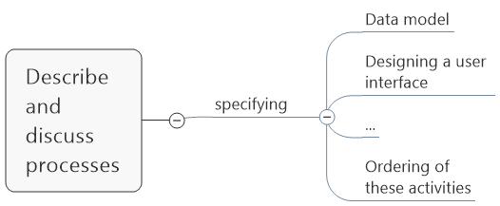
Software Process
Waterfall model
Incremental development
Process
descriptions
Include
Plan driven
and
Agile processes
Process models

Slide 2
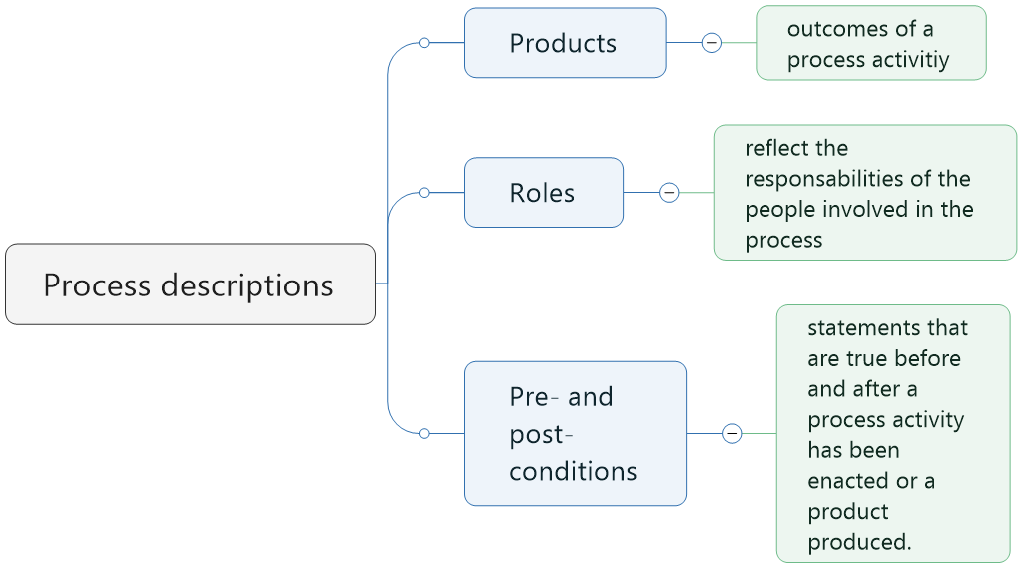
Software Process
Waterfall model
Incremental development
Process
descriptions
Include
Plan driven
and
Agile processes
Process models

Slide 3
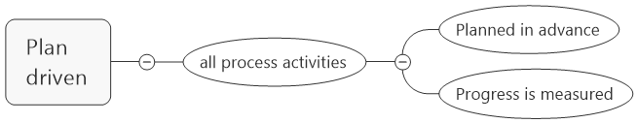
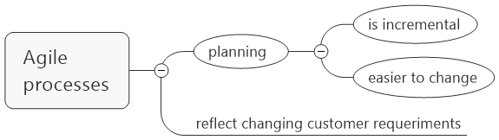
Software Process
Waterfall model
Incremental development
Process
descriptions
In practices, most practical processes include elements of:
Include
Plan driven
and
Agile processes
Process models

Slide 4
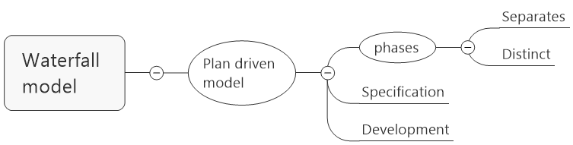
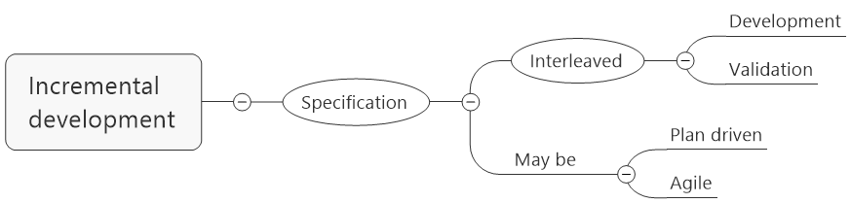
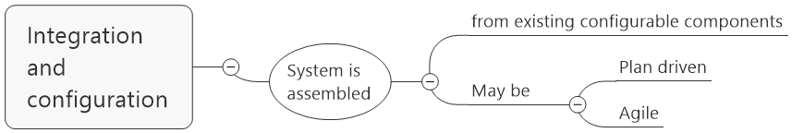
Software Process
Waterfall model
Incremental development
Process
descriptions
Include
Plan driven
and
Agile processes
Process models

Slide 5
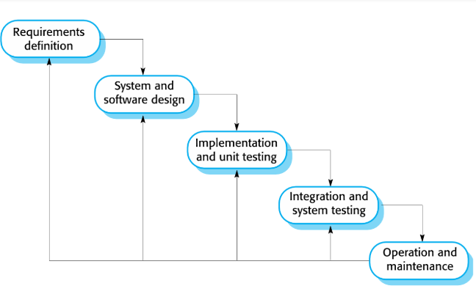
Software Process
Waterfall model
Incremental development
Model
Phases
Problems

Slide 6
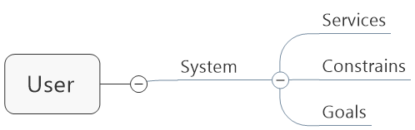
Software Process
Waterfall model
Incremental development
Requirements
Design
Implementation
Testing
Maintenance
Model
Phases
Problems

Slide 7
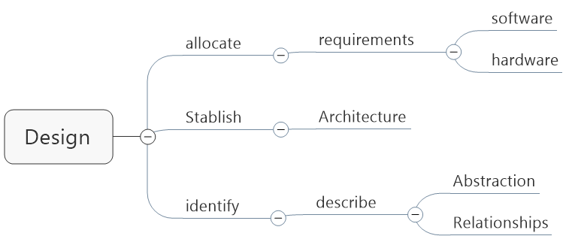
Software Process
Waterfall model
Incremental development
Requirements
Design
Implementation
Testing
Maintenance
Model
Phases
Problems

Slide 8
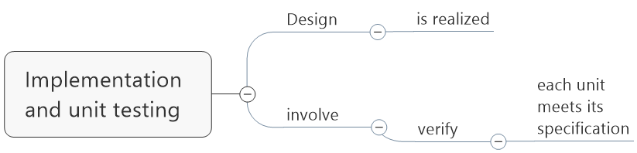
Software Process
Waterfall model
Incremental development
Requirements
Design
Implementation
Testing
Maintenance
Model
Phases
Problems

Slide 9
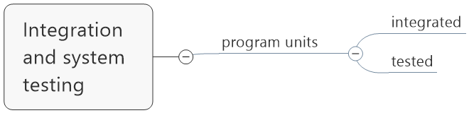
Software Process
Waterfall model
Incremental development
Requirements
Design
Implementation
Testing
Maintenance
Model
Phases
Problems

Slide 10
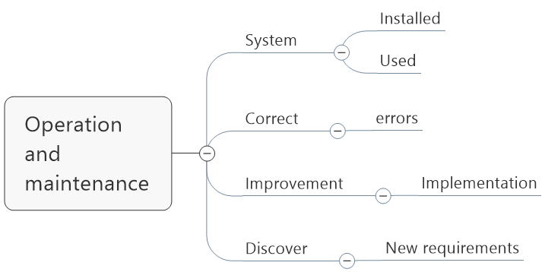
Software Process
Waterfall model
Incremental development
Requirements
Design
Implementation
Testing
Maintenance
Model
Phases
Problems

Slide 11
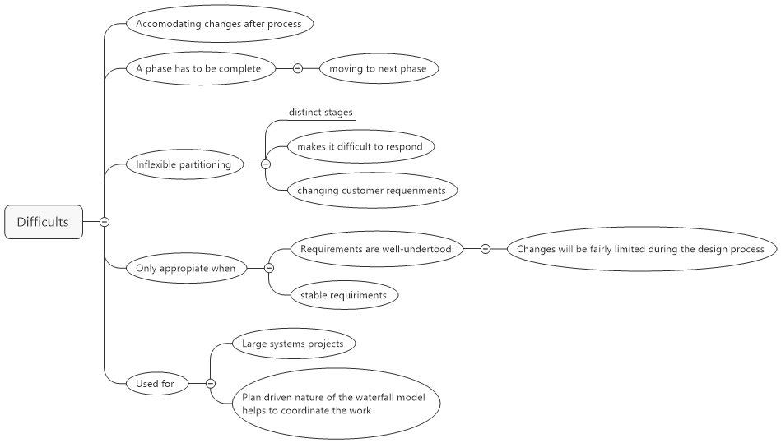
Software Process
Waterfall model
Incremental development
Model
Phases
Problems

Slide 12
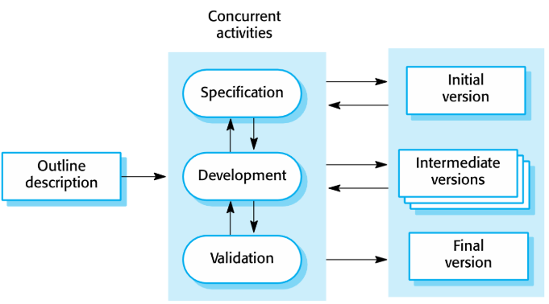
Software Process
Waterfall model
Incremental development
Model
Phases
Problems

Slide 13
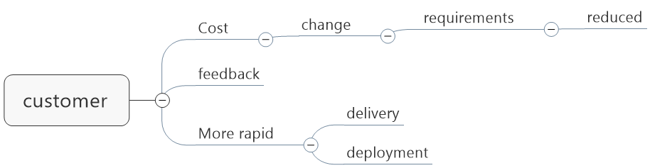
Software Process
Waterfall model
Incremental development
Model
Benefits
Problems

Slide 14
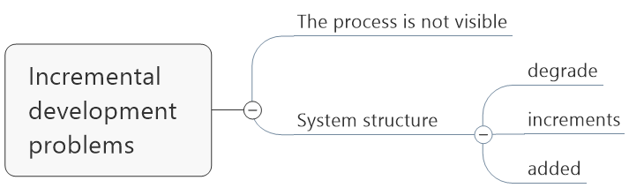
Software Process
Waterfall model
Incremental development
Model
Benefits
Problems

