Slide 1
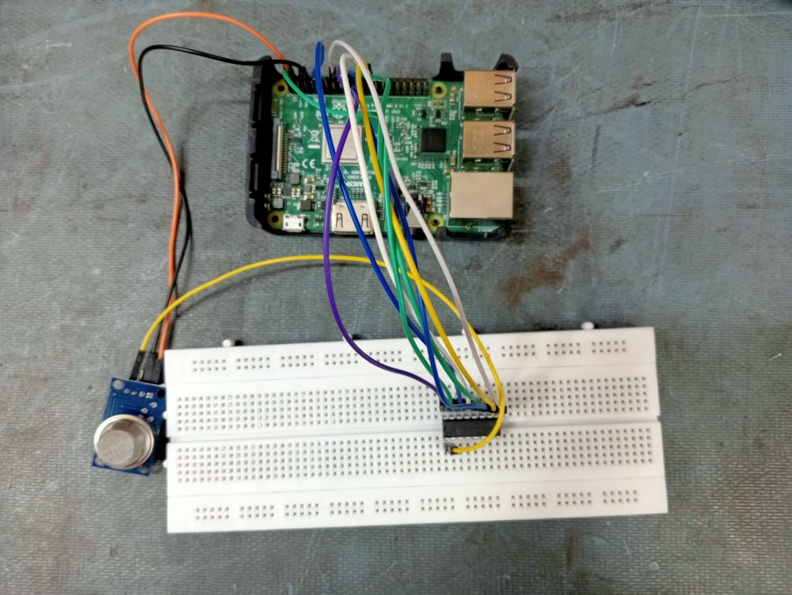
Air Pollution Monitoring System using Raspberry Pi
Presented By: Apurva M. Gangarde
Date: 25/10/2024

Slide 2
Components of the System
Hardware Components:
1. MQ-135 Gas Sensor
2. MCP3008 Analog-to-Digital Converter (ADC)
3. Raspberry Pi
4. Wiring and Resistors
5. Power Supply
Software and Platform:
Python Script
ThingsBoard IoT Platform

Slide 3
Hardware Connection Diagram
Vcc
RPi 3
MQ135 Gas Sensor
5V
GND
GND
Aout
3.3V
SPICLK
3.3V
MISO
MCP3008 ADC
CH0
VDD
GND
MOSI
Vref
GND
CE0 (GPIO8)
AGND
DGND
CLK
Dout
Din
CS

Slide 4
Hardware Connection Diagram
Hardware Setup
MQ-135 Sensor: Connected to the MCP3008 ADC.
MCP3008 ADC: Connected to Raspberry Pi via SPI protocol.
Power Supply: Provides 3.3V/5V to MQ-135 and MCP3008.
Connection Details:
SPI Pins (MISO, MOSI, SCLK, CE)
Analog Pin (MQ135) connected to CH0 of MCP3008.

Slide 5
Code Breakdown
Key Components of the Code:
1. SPI Initialization
2. Reading Sensor Data
3. PPM Calculation
4. AQI Calculation
5. Sending Data to ThingsBoard

Slide 6
Air Quality Index (AQI):
Range: Typically, between 0 and 500.
Interpretation:
0-50: Good
51-100: Moderate
101-150: Unhealthy for sensitive groups
151-200: Unhealthy
201-300: Very unhealthy
301-500: Hazardous

Slide 7
ThingsBoard Integration
1. Real-time data monitoring: AQI, sensor voltage, and PPM values are visualized.
2. ThingsBoard Cloud: Data sent via HTTP API to the ThingsBoard cloud server.
3. Visualization Widgets: Real-time graphs, gauges, and widgets.
4. Data History: Storing and visualizing historical air quality data.

Slide 8
Conclusion
Key Takeaways:
Real-time air quality monitoring using the MQ-135 sensor.
PPM and AQI calculations are essential for understanding gas concentration.
Integration with ThingsBoard allows remote monitoring and data visualization.
Future Improvements:
Adding more sensors for enhanced environmental monitoring.
Implementing alerts for hazardous AQI levels via ThingsBoard.

Slide 9
Future Scope
IoT Expansion:
Extend the project into a smart city context by integrating your AQI system with other IoT-enabled environmental sensors (e.g., temperature sensors).
Mobile Application:
Develop a mobile app that syncs with the AQI monitoring system, allowing users to monitor air quality on-the-go and receive notifications about poor air quality.
Smart Alerts:
Set up automatic notifications or alerts for users when AQI exceeds safe levels, promoting proactive action.

Slide 10


