Slide 1

Microsoft Teams
To Build and Run a Microsoft Teams App with React

Slide 2
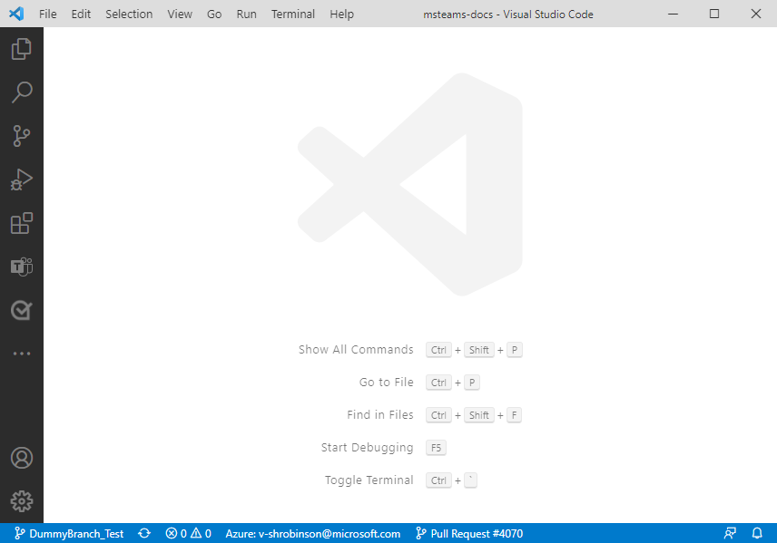
1. Select the Teams icon.

Slide 3
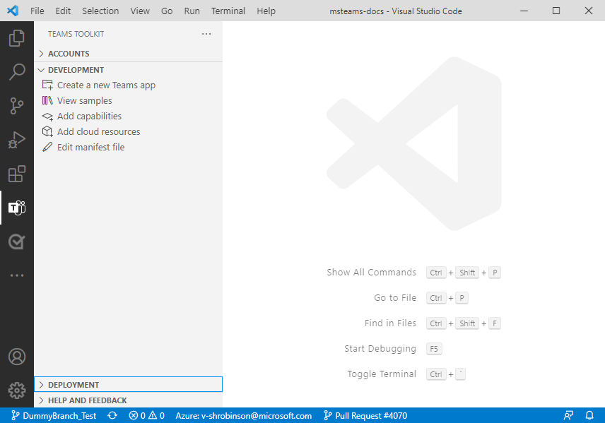
2. Select Create a new Teams app.

Slide 4
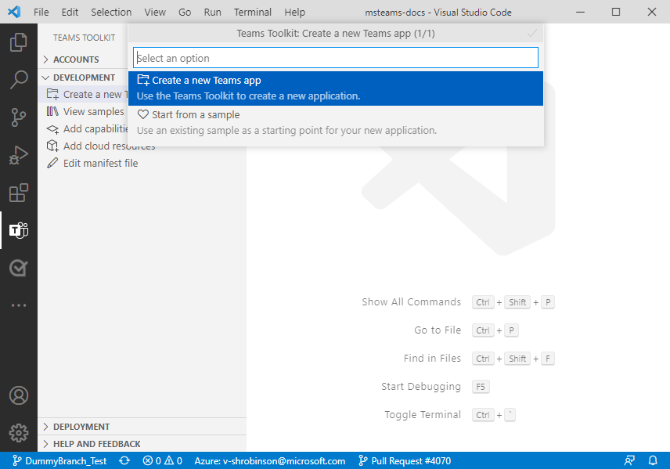
3. Select Create a new Teams app.

Slide 5
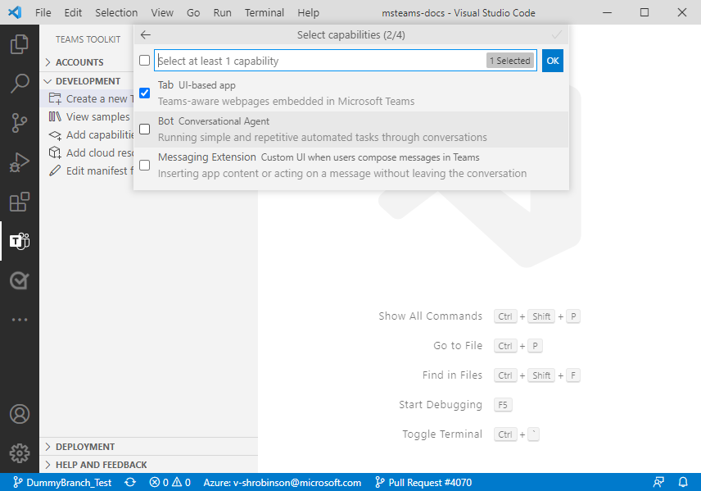
4. Select Tab UI-based app a the app capability and select OK.

Slide 6
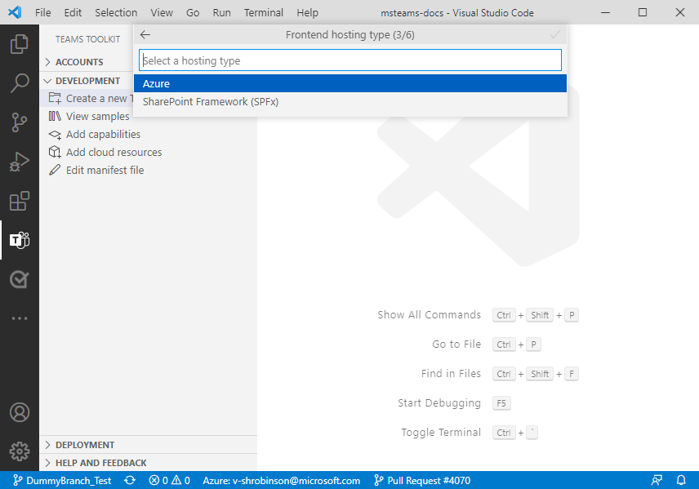
5. Select Azure as Frontend hosting type.

Slide 7
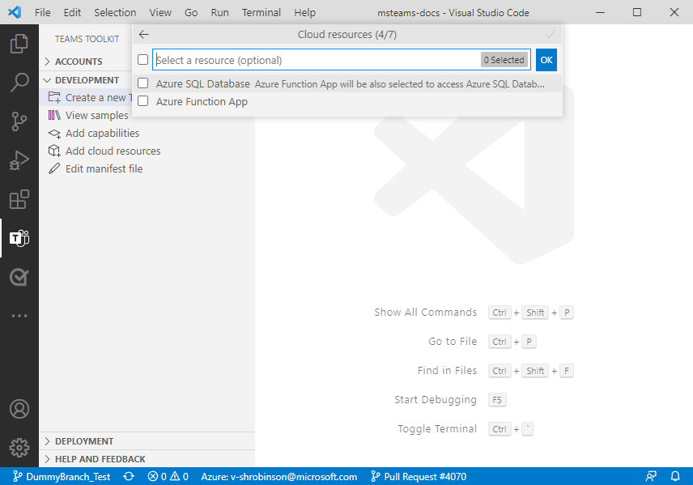
6. You do not need any could resources for this tutorial. Select OK.

Slide 8
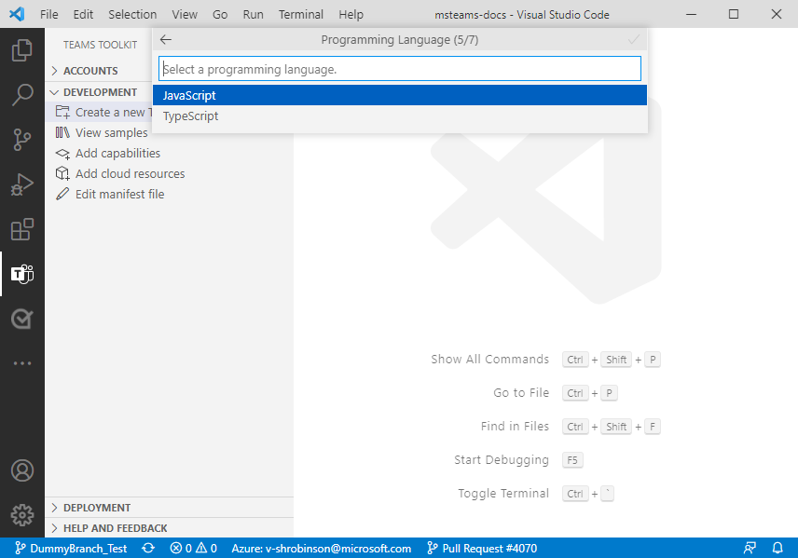
7. Select JavaScript as the Programming Language.

Slide 9
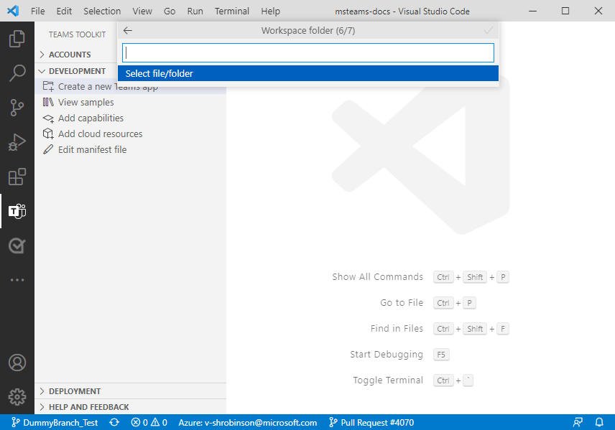
8. Select Select file/folder to create a workspace for the app.

Slide 10
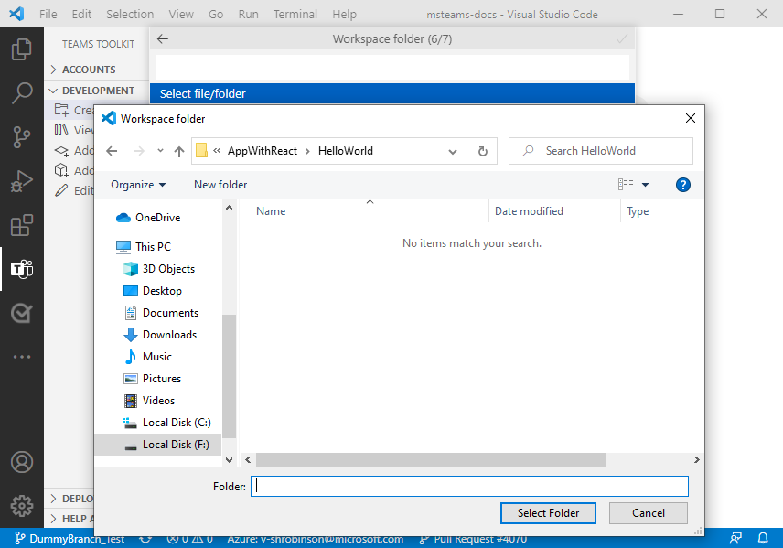
9. Select the workspace and select Select Folder.

Slide 11
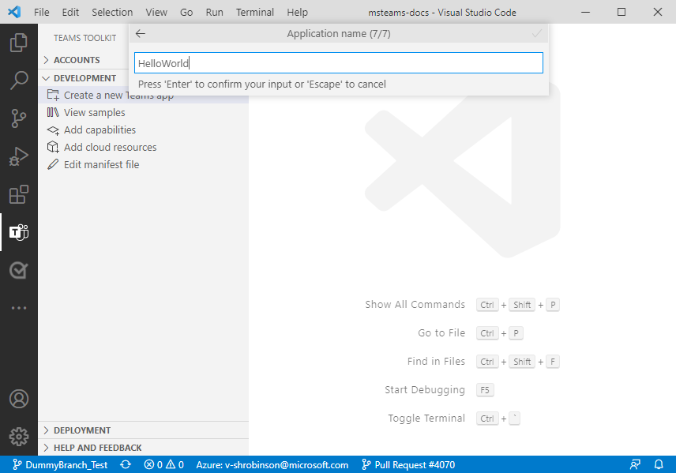
10. Enter the name of the application and select Enter.

Slide 12
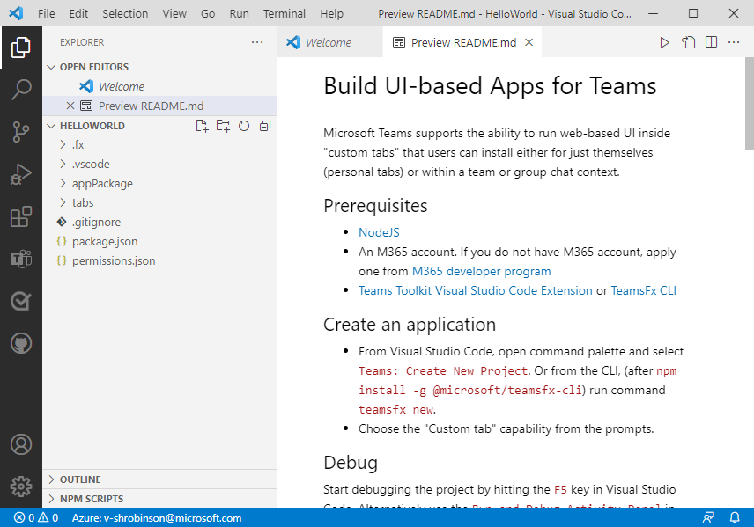
A Microsoft Teams app is created in a few seconds.

