Slide 1

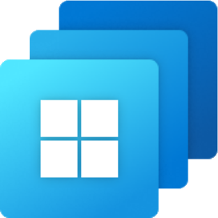






Geography A
Geography B
Geography B
Azure region A
Azure region B
Virtual network
Azure backbone
Virtual Desktop gateway
Internet
VPN/ExpressRoute
User network
LOB apps
User network

Slide 2
Geography A
Geography B
Geography B
Azure region A
Azure region B
Azure backbone
Virtual network
Virtual Desktop gateway
VPN/ExpressRoute
VPN/ExpressRoute
User network
LOB apps
User network

Slide 3
Windows 365 Azure network connection architecture: Responsibility matrix
Microsoft responsibility
Customer responsibility
Microsoft and customer subscription ownership
 | MEM portal | Windows 365 service | Virtual Machines | Virtual Desktop resources for Windows 365 | Virtual NICs for Windows 365 VMs | Resource group for Windows 365 resources | Virtual Network | Guest OS | Applications | User identity
Deployment
Life cycle
Configuration |  |  |  |  |  |  | *
* Windows 365 ability to attach NICs
requires configuration of
the subnet on the virtual network.

Slide 4
Windows 365 Azure network connection architecture pattern: Responsibility matrix
Microsoft-owned infrastructure
Customer-owned infrastructure
 | Azure Virtual Desktop service | Windows 365 service | Cloud PC infrastructure | Cloud PC VMs | Intune | Cloud PC virtual NICs | Azure subscription | Resource group | #Azure Storage | Virtual Network | Routing configuration | VPN or ExpressRoute | Entra Hybrid join & Azure DNS | Guest OS | Applications | Cloud PC security
Deployment
Life cycle
Configuration
- Microsoft responsibility
- Customer responsibility
# - Optional

Slide 5
Windows 365 Microsoft-hosted network architecture pattern: Responsibility matrix
Microsoft-owned infrastructure
Customer-owned infrastructure
 | Virtual Desktop service | Windows 365 service | Cloud PC infrastructure | Cloud PC VMs | Intune | Cloud PC virtual NICs | Azure subscription | Resource group | #Azure Storage | Virtual Network | Routing configuration | Microsoft Entra ID & Azure DNS | Guest OS | Applications | Cloud PC security
Deployment
Life cycle
Configuration
- Microsoft responsibility
- Customer responsibility
# - Optional

Slide 6


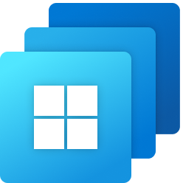



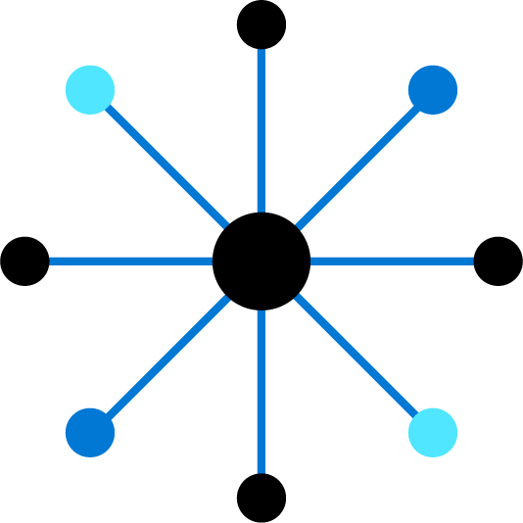
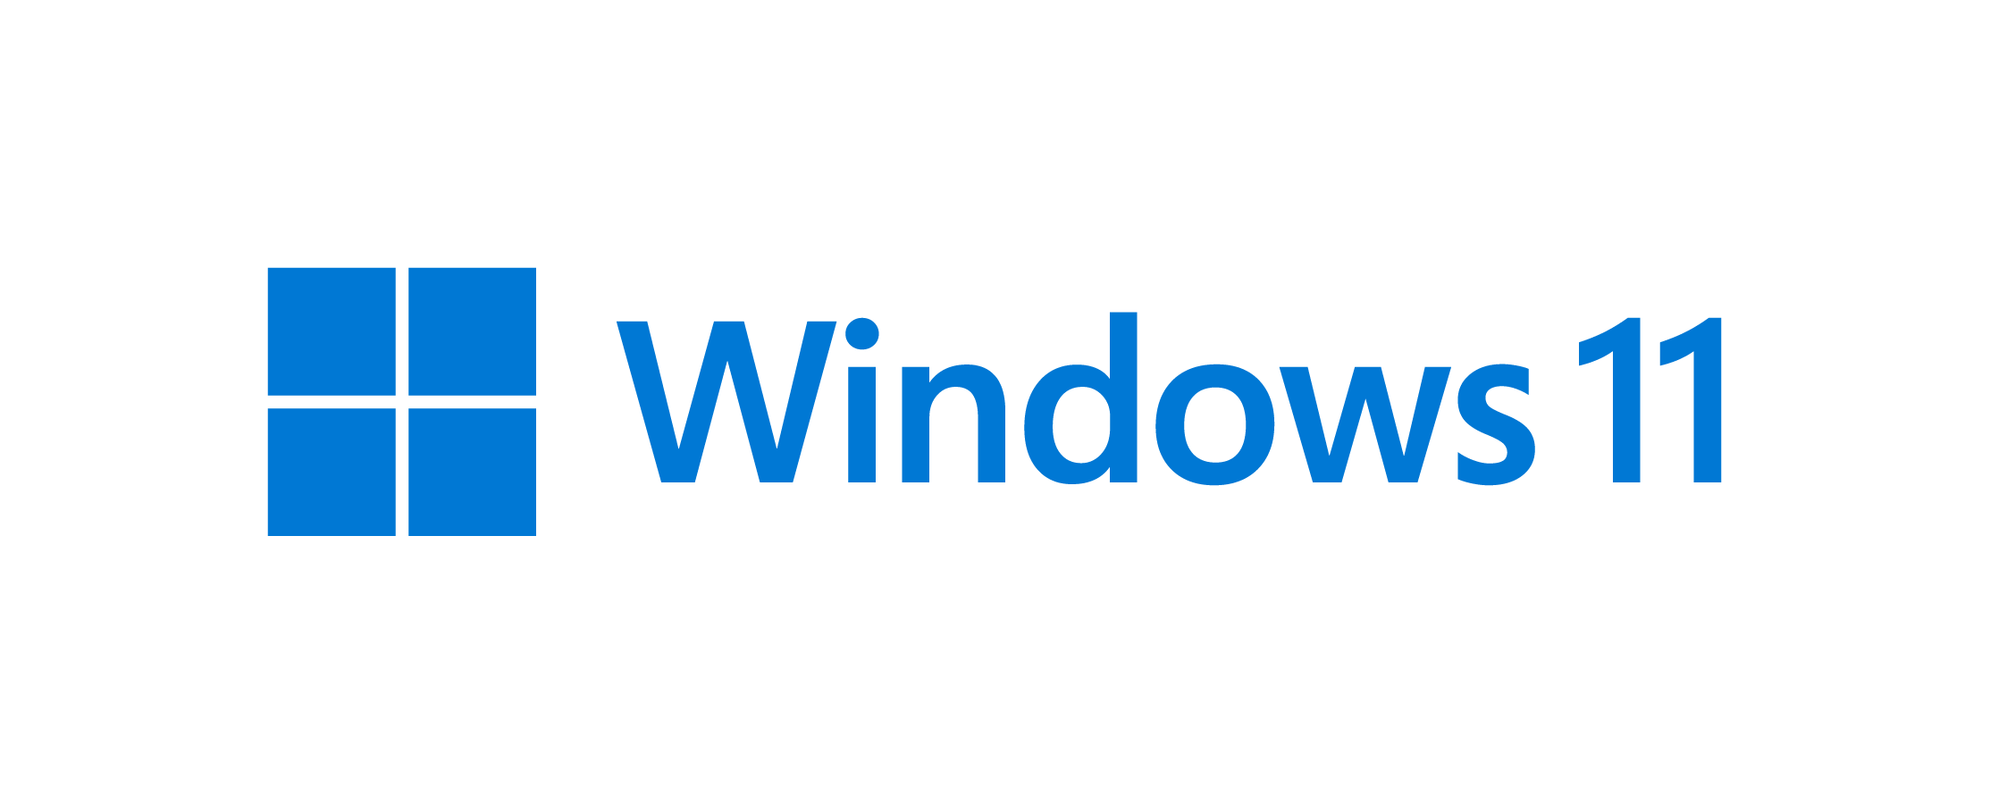
Microsoft-hosted network - Cloud PC’s Azure virtual network that’s fully managed by Microsoft
Microsoft Entra join
Microsoft Intune
Microsoft Entra ID
Customer subscriptions
VPN or private access
(Optional)
Customer corporate network
Virtual network
Windows 365 app
Azure subscriptions
Direct internet traffic
(Optional routing path)
Windows 365 gallery images

Slide 7
Azure network connection - Cloud PC’s Azure virtual network in a customer-managed subscription
Microsoft Entra join
Internet traffic
(Optional routing path)
Microsoft Intune
Microsoft Entra ID
Virtual network
Customer subscriptions
Contoso corporate network
ExpressRoute, site-to-site VPN, traditional VPN
(Optional)
Azure subscriptions

Slide 8

Azure network connection - Cloud PC’s Azure virtual network in a customer-managed subscription
Microsoft Entra hybrid join
Direct internet traffic
(Optional routing path)
Microsoft Intune
Microsoft Entra ID
Virtual network
Customer subscriptions
Contoso corporate network
ExpressRoute, site-to-site VPN for connectivity to a Windows Server Entra ID domain (Required)
Domain controller
Azure subscriptions

