Slide 1





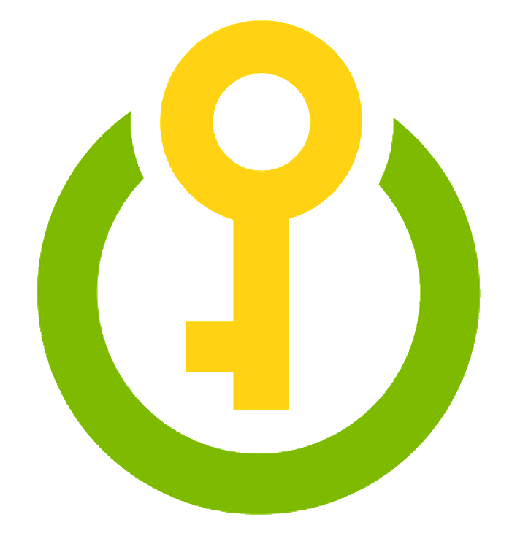



Azure Data Lake Gen 2
Azure Synapse Analytics
Power BI
Logs, files, and media
(unstructured)
Ingest and Store
Analyze
Visualize
1
2
8
Business/custom apps
(structured)
Build
and
Train
3
Azure ML
Azure Machine Learning
Azure Synapse Analytics
Azure Data Lake Gen 2
Azure Container Registry
Azure Kubernetes Service
Azure Monitor
Azure Key Vault
Azure Load Balancer
Power BI
Authenticate
Retrain
7
Azure
Active
Directory
Azure
Key Vault
Register
Deploy
4
Azure
Monitor
5
Monitor & Log
Azure
Kubernetes
Service
6
Azure
Container
Registry
Azure
vNet
Azure
Load
Balancer

