Slide 1


Department of Information Technology Chandubhai S. Patel Institute of Technology
IOT based
Smoke Detection System using Arduino
Prepared by:
Daksh Mangukiya (16IT051)
Jeet Patel (16IT075)
Guided by:
Prof. Miral Desai

Slide 2
INTRODUCTION
A smoke detector is a device that senses smoke, typically as an indicator of fire. Commercial security devices issue a signal to a fire alarm control panel as part of a fire alarm system, while household smoke detectors, also known as smoke alarms, generally issue a local audible or visual alarm from the detector itself.

Slide 3
SOFTWARE & HARDWARE REQUIREMENTS
Software : Arduino IDE.
Hardware : MQ2 Gas sensor, Arduino Uno, GSM module,
Breadboard , 1K ohm resistors, LED Light, Buzzer.

Slide 4
Our !dea
In this project, first the MQ2 sensor will detect the smoke then the reading which is voltage will go in the arduino board.
After the smoke is detect then the buzzer will start.
After the buzzer goes on then the it will go to the GSM module.
when in GSM module there will be a sim card using which it will send a message on to the mobile phone .

Slide 5
MAJOR FUNCTIONALITY
The MQ2 sensor can sense NH3, NOx, Alcohol, Benzene, smoke,
CO2 and some other gases, so it is perfect gas sensor for our
Smoke detection Project. When we will connect it to Arduino thenit will sense the gases, and we will get the smoke level in
PPM (parts per million). MQ2 gas sensor gives the output in form
of voltage levels and we need to convert it into PPM.

Slide 6
Flow Chart
MQ-2 Sensor
Arduino uno board
GSM module
Mobile Phone
Led Red
Buzzer
Led Green

Slide 7
OUTCOME
Sensor should be giving us a value around 25 PPM when there is no gas near it and the safe level of air quality is 30PPM and it should not exceed 50PPM.
Whenever the value will increase to 50 PPM, then the buzzer will start beeping

Slide 8
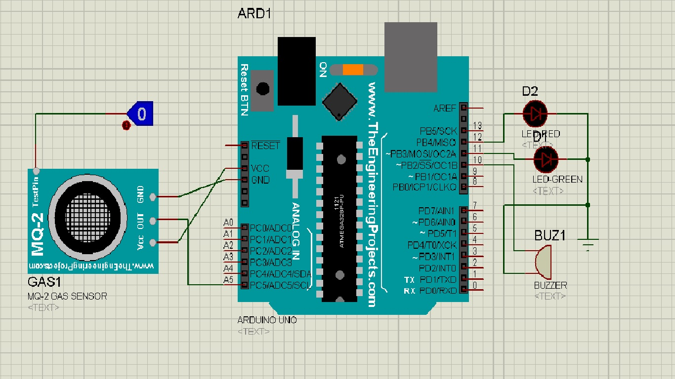
SCHEMATIC DIAGRAM

Slide 9
LIMITATIONS OF PROJECT
It would not detect other harmful gases like Sulphur Dioxide, Greenhouse gases and many more such gases
Even in case of non-harmful gases the sensor would activate the buzzer
Will not work in humid condition
No provision to detect the type of gas in air

Slide 10
FUTURE ENHANCEMENT
- We can add a Humidity Sensor in future so that the system would shut itself down in extreme humid conditions.
- Other features can be included like automatic opening of windows and start off water sprinklers during high smoke levels or automatic switching on the Exhaust fan.

Slide 11
REFERENCES
http://safeair.ca/blog/common-gases-in-the-air-that-could-be-harmful/
https://en.wikipedia.org/wiki/Air_quality_index
https://github.com/GeorgK/MQ2

Slide 12
Thank You

