Slide 1
Parking Management System
Team:
Askarbekov Bayel
Sultanova Nurjanat
Parking Management System
1/10

Slide 2
Introduction
Purpose: automate parking operations in a desktop application.
Significance: reduces manual errors, speeds up entry/exit, and keeps data consistent.
Architecture choice: MVC + DAO for clean separation of responsibilities.
Team roles: Sultanova Nurjanat - database; Askarbekov Bayel - application logic and GUI.
Parking Management System
2/10

Slide 3
Project Requirements (1/2)
1. Register vehicle entry with plate, type, and parking hours.
2. Auto-assign a suitable free parking spot by vehicle type.
3. Generate and store parking tickets in SQLite.
4. Register vehicle exit by ticket ID.
5. Calculate payment with base price and overtime fine.
6. Display active tickets in a GUI table.
Parking Management System
3/10

Slide 4
Project Requirements (2/2)
7. Show live dashboard: total, free, occupied spots, active tickets.
8. Validate invalid user input and display error notifications.
9. Persist all data in SQLite database.
10. Use DAO classes for CRUD operations.
11. Provide multiple database reports (5+).
12. Cover model logic with unit tests.
Parking Management System
4/10

Slide 5
Code Overview
Main file: parking_management_system.py
Model: ParkingModel handles validation, pricing, and parking workflows.
DAO layer: VehicleDAO, SpotDAO, TicketDAO, ReportDAO encapsulate SQL.
View: ParkingView (Tkinter UI: forms, dashboard, active tickets, reports).
Controller: ParkingController binds UI actions to model methods.
Tests: test_parking_model.py validates core model scenarios.
Parking Management System
5/10

Slide 6
Code Flow
Entry flow: UI button -> Controller.on_park -> Model.park_vehicle -> DAOs -> DB.
Exit flow: UI button -> Controller.on_exit -> Model.exit_vehicle -> payment + close ticket.
Refresh flow: Controller.refresh_all updates dashboard, ticket table, and reports.
Data model: vehicles, parking_spots, tickets tables with relations.
Parking Management System
6/10

Slide 7
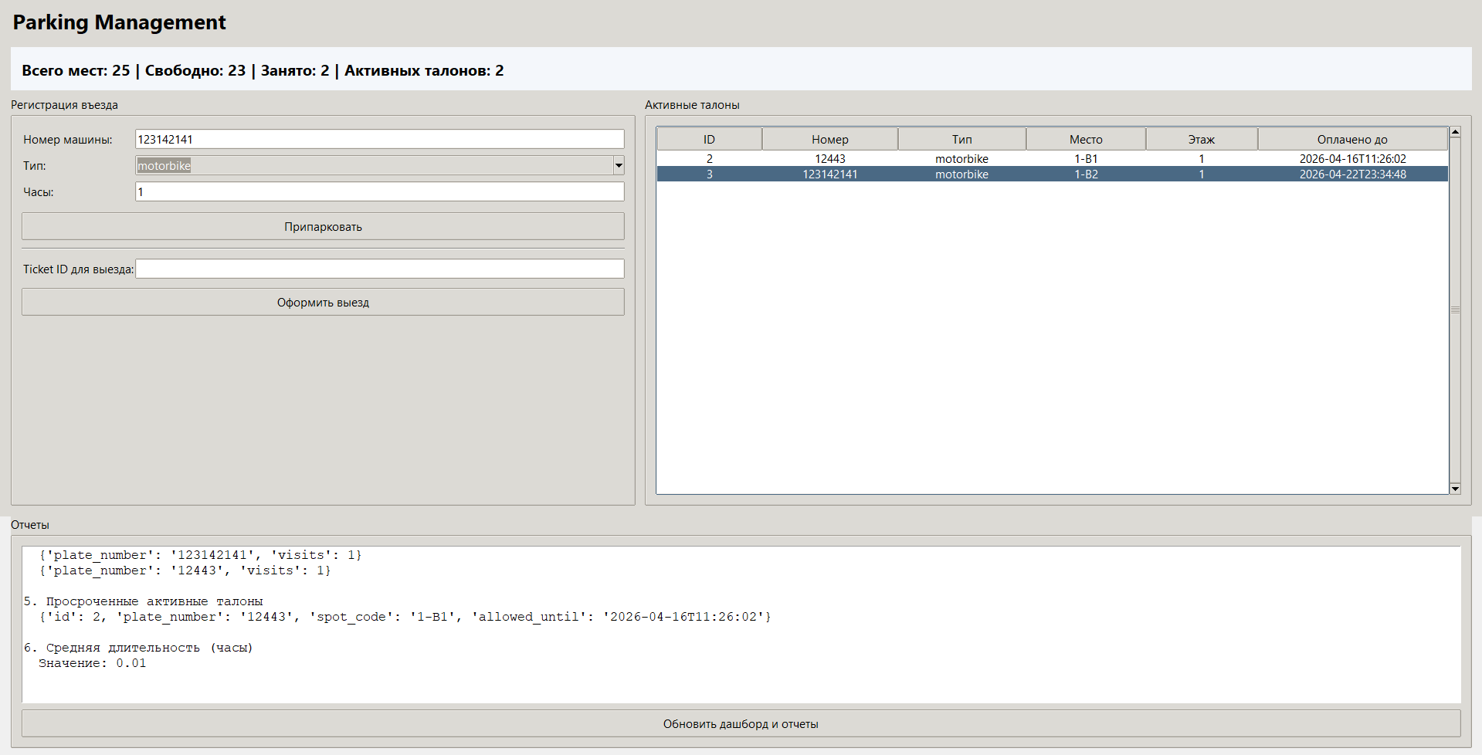
Demonstration
Live demo flow:
1. Register vehicle entry and auto-assign spot
2. Observe active ticket table and dashboard updates
3. Register vehicle exit using ticket ID
4. Verify payment calculation and spot release
5. Refresh reports (occupancy, revenue, overdue tickets)
Application screenshot
Parking Management System
7/10

Slide 8
Feedback and Actions
Feedback: improve input validation and exception handling in UI actions.
Action: added clear validation errors for vehicle type, plate, and parking hours.
Feedback: add analytics visibility for operations.
Action: implemented 6 reports (occupancy, revenue, overdue tickets, average duration).
Feedback: strengthen reliability with tests.
Action: added unit tests for park, exit, validation, and report availability.
Parking Management System
8/10

Slide 9
Project Improvement
Add authentication and role-based access (admin/operator).
Introduce reservation support and dynamic pricing policies.
Add payment integration (QR/card) and receipt export.
Migrate to layered package structure and add service abstractions.
Expand test coverage with integration and UI tests.
Provide cloud sync and web/mobile dashboard.
Parking Management System
9/10

Slide 10
Conclusion
The project demonstrates OOP principles with MVC + DAO architecture.
Core parking workflows are implemented end-to-end with persistent storage.
GUI and reports make operations visible and manageable.
Automated tests confirm stability of key model logic.
The system is ready for iterative improvements and feature expansion.
Parking Management System
10/10

