Slide 1


USED CARS PRICE
PREDICTION
Course Number: DSA 5103
Course Name: Intelligent Data Analytics
Semester: Fall
Year: 2019
Names: Meghana Nagendra
Sai Kiran Reddy Mamidi
Ram Charan Reddy Kankanala
GROUP-20

Slide 2


Outline
Introduction
Proposed Work
Proposed Methods
Results
Conclusion and Future Work
GROUP-20

Slide 3
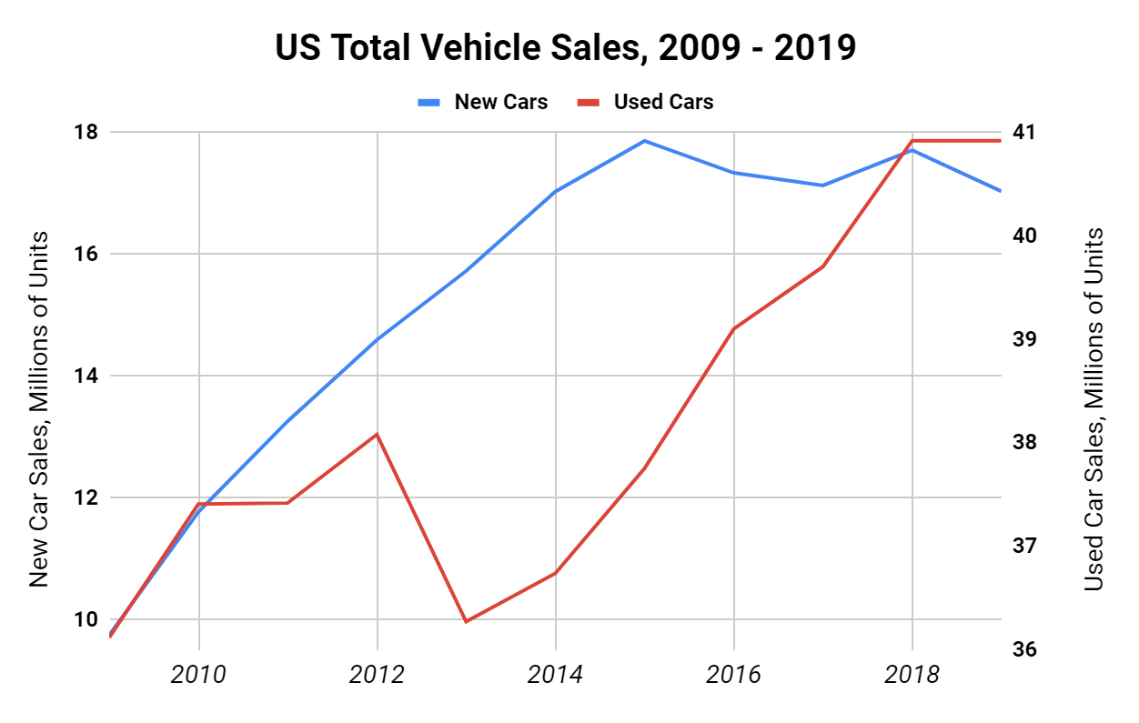
Introduction
In most developing countries, it is a common practice to buy used cars. The high pricing fixed by the manufacturers often influence the customers towards buying more affordable used cars.
In general, the prices of the used cars in the market are not constant and various factors (such as fuel, condition and odometer reading) influence the trends in used car pricing.
So there, arises a question, “How can the used car prices be predicted and what are the factors influencing the pricing?”

Slide 4
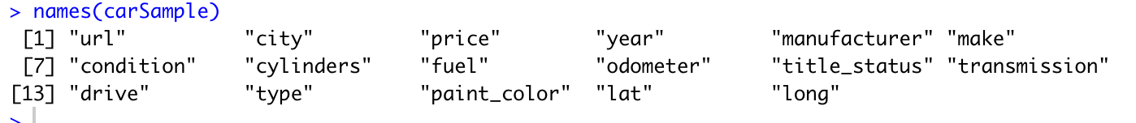
Data Preprocessing
The dataset consists of 70000 rows and 22 columns.
Initial features from the dataset are:
Some of the data preprocessing operations performed are dimensionality reduction, outlier removal, imputing missing values and handling categorical values.
Dimensionality Reduction:
Removed irrelevant features like city_url, VIN, desc and image_url.
Removing Missing values:
Removed rows that have more than 50% missingness.
Removed rows which had price = 0.

Slide 5
Data Preprocessing (Cont.)
Outlier Removal:
Removed outliers in ‘price’. Like cars that are having price more than 100 thousand that generally people will not prefer.
Imputing Missing values, Handling Categorical Values and Log Transformation:
Using fct_lump() missing values imputation, reduction of factor levels and log transformations are applied respectively depending on features.

Slide 6
Proposed Work
The proposed model provides solution to predicting the price of used cars based on the different features of a car such as Fuel type, manufacturer, manufacture year, size, condition, etc.
The regression algorithms proposed to be considered for price prediction are:
Linear Regression
Lasso Regression
MARS

Slide 7
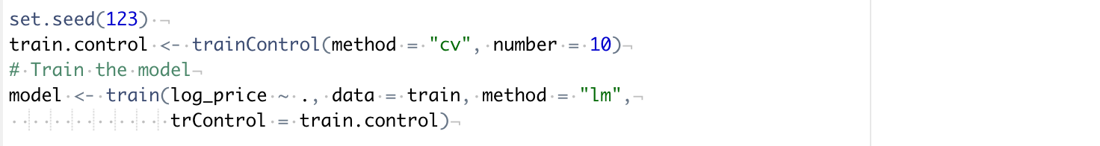

Proposed Work (Cont.)
Multiple Linear Regression:
The model with k predictor variables $X_{1},X_{2},X_{3},…,X_{k}$ and $β_{0}$, $β_{1}$, …, $β_{k}$ being the coefficients, the target variable $y$ is represented as follows:
$$y=β_{0}+β_{1}X_{1}+β_{2}X_{2}+…+β_{k}X_{k}+ε$$
Gradient Descent algorithm for linear regression which is used to minimize the errors.
Model building for Used cars.

Slide 8
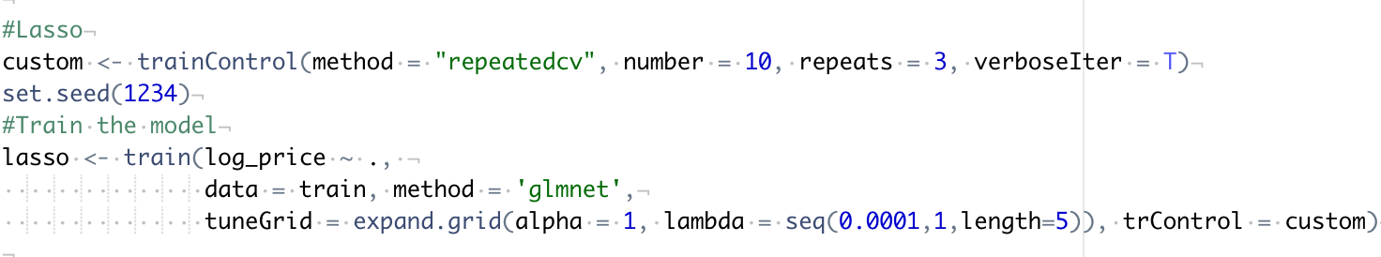
Proposed Work (Cont.)
LASSO(Least Absolute Shrinkage Selector Operator) Regression:
The main reason for choosing Lasso Regression is because it is also a type of linear regression and also handles large number of features.
Lasso work by penalizing the magnitude of coefficients of features along with minimizing the error between predicted and actual observations. This is called ‘regularization’ technique.
It as two hyper parameters names (alpha and lambda).
Model building for Used cars.

Slide 9
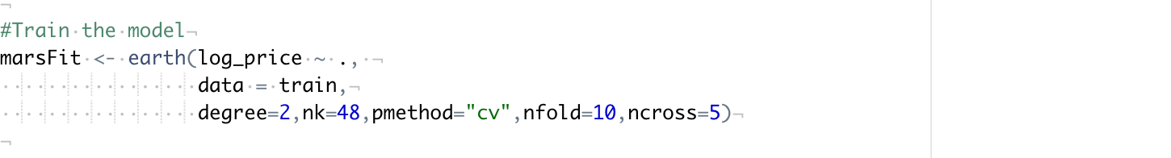
Proposed Work (Cont.)
MARS(Multivariate Adaptive Regression Splines):
MARS is also similar to linear regression and also handles large number of features.
MARS provide a convenient approach to capture the nonlinearity aspect of polynomial regression by assessing cut points (knots) similar to step functions.
In MARS we can fix number of degrees and knots to get a better model.
Model building for Used cars.

Slide 10
Results
We performed K-fold cross validation with number of folds = 10, to get the results of the model and check the accuracy of the predictions.
The metrics used for calculating the performance of the model are Root mean squared error and R^2 Score. The results are as follows:
Multiple Linear Regression:
LASSO Regressor:

Slide 11
Results (Cont.)
MARS:
Model | RMSE | R^2 Score
Multiple Linear Regression | 2.3369448569917393 | 0.0000106348553879
LASSO Regressor | 1.0080987311299152 | -0.000043219378910
MARS | 0.2778974988554263 | 0.3792270800303933

Slide 12
Conclusion and Future Work
Conclusion:
It is a challenging task to predict car prices since the number of features is high. So, we cleaned the data appropriately to improve the efficiency of the prediction model.
We intend to develop a application with front end that enables users to know not only about price of cars car, but also features that decides price.
Future work:
We can extend our work in future to scrape data from sites like eBay and craigslist to predict the prices of cars for these datasets. This is a really useful idea and making it available online would help many customers.

Slide 13
Thank You
Buy your car now!!!

