Slide 1

Welcome, Builders of Tomorrow!

Slide 2

Hello and welcome to Hobbit’s Den
It is a Java-based application designed to serve as your personal book journal. This program allows you to log and organize your reading experiences in a simple, user-friendly way.

Slide 3


Key Features
Custom User Experience: Your book data is tied to your username, ensuring a personalized journal for every user.
Add Books: Document each book you've read with details such as title, author, genre, completion date, rating, and personal notes.
View Your Library: Browse through the list of books you've added, review their details, and even edit or delete entries.
Search Books: Quickly locate a book by its title to access its information instantly.

Slide 4

Using the Application
Upon launching the application, you'll be prompted to enter your username. This ensures your book records are saved and accessible under your profile. If you’re new, simply type a desired username to get started.
The main interface will welcome you with the title "Hobbit's Den“, and buttons for easy navigation:
Add Book
View My Books
Search Books
Exit

Slide 5
Viewing Your Library
Adding a Book
Click the View My Books button to see all the books you’ve logged. Each entry will display the book’s title and author, along with three action buttons:
View Details: Shows all saved details about the book.
Edit: Opens a form to modify book details.
Delete: Permanently removes the book from your journal after confirmation.
Click the Add Book button. A form will appear to input the following details:
Title
Author
Genre
Date Finished
Rating (1-5 stars)
Personal Notes
Viewing Your Library
Click the View My Books button to see all the books you’ve logged. Each entry will display the book’s title and author, along with three action buttons:
View Details: Shows all saved details about the book.
Edit: Opens a form to modify book details.
Delete: Permanently removes the book from your journal after confirmation.
Once you’ve filled out the fields, click Add Book to save your entry. An alert will confirm successful addition.
Searching for a Book
Click Search Books to locate a specific book by its title.
Enter a keyword or phrase in the search bar and hit Search. Matching results will display with options to view details for each book.

Slide 6

Exiting the Application
Click the Exit button to close the application. Your book journal is automatically saved to ensure no data is lost.
Important Notes
All your book data is saved locally in a file named book_journal.dat. This ensures your journal is available every time you reopen the app.
Keyboard Shortcuts
While the application primarily uses mouse interactions, a helpful tip is to press Enter to confirm text inputs in dialogs.

Slide 7

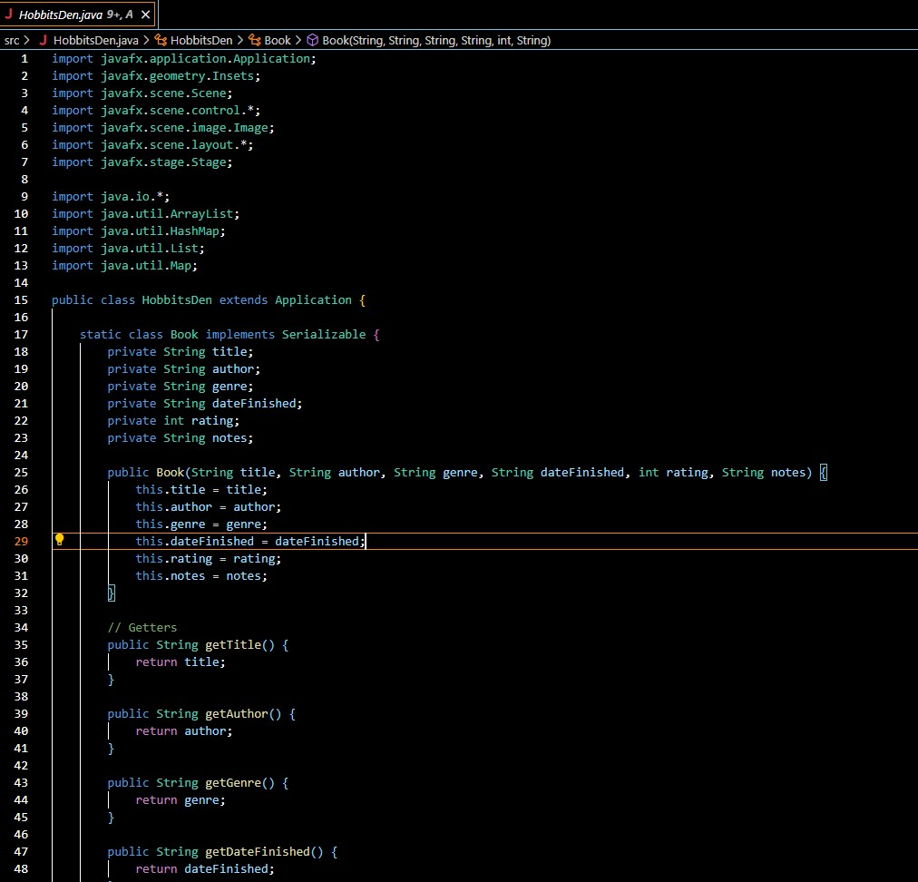
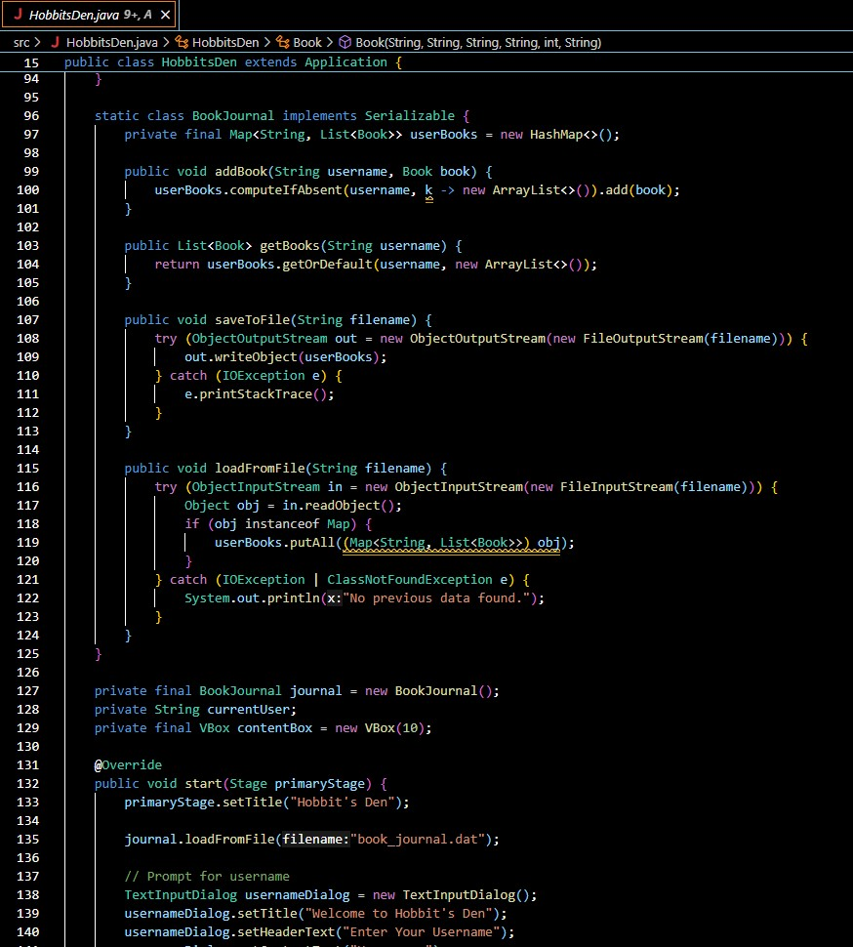

Slide 8
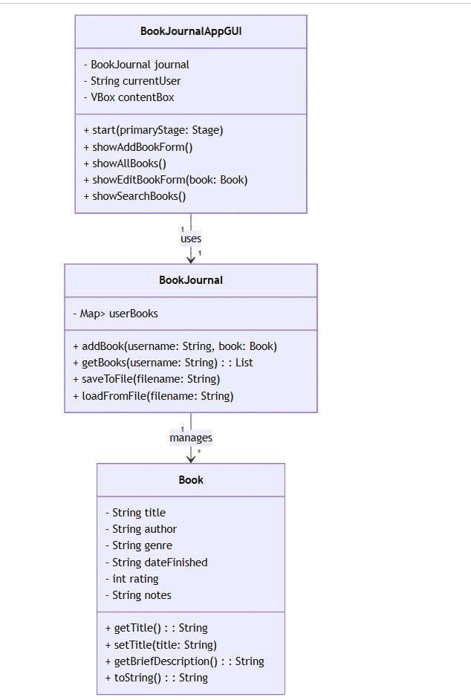

Slide 9


This brings the end of my presentation. I truly appreciate your time and hope you enjoyed it!

