Slide 1
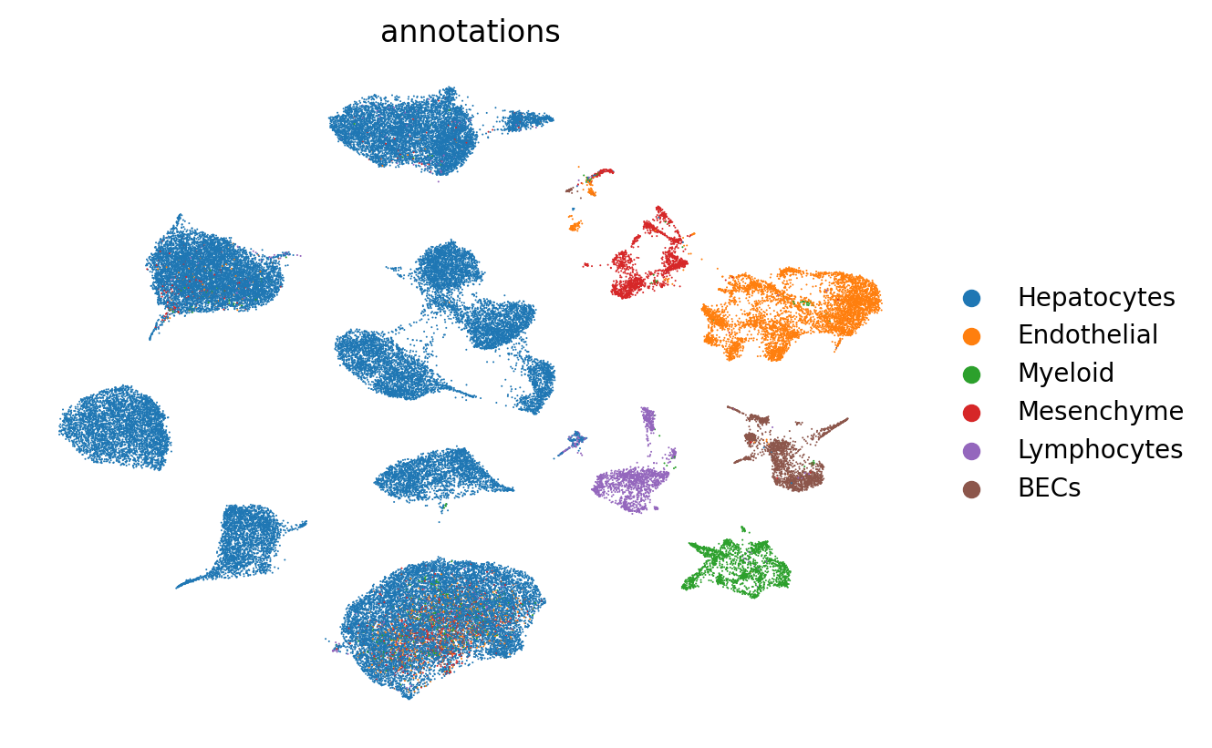
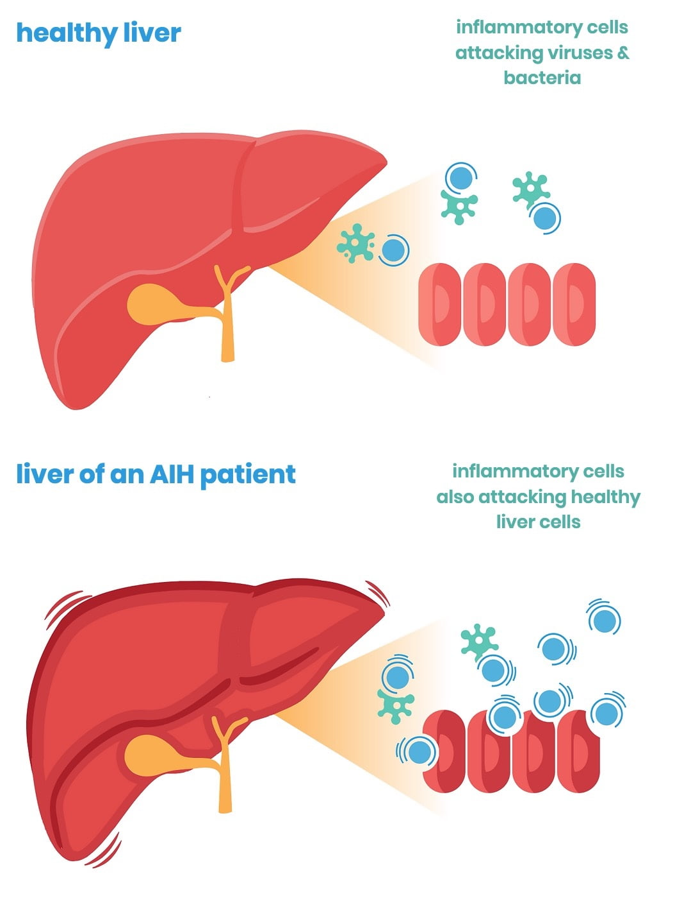
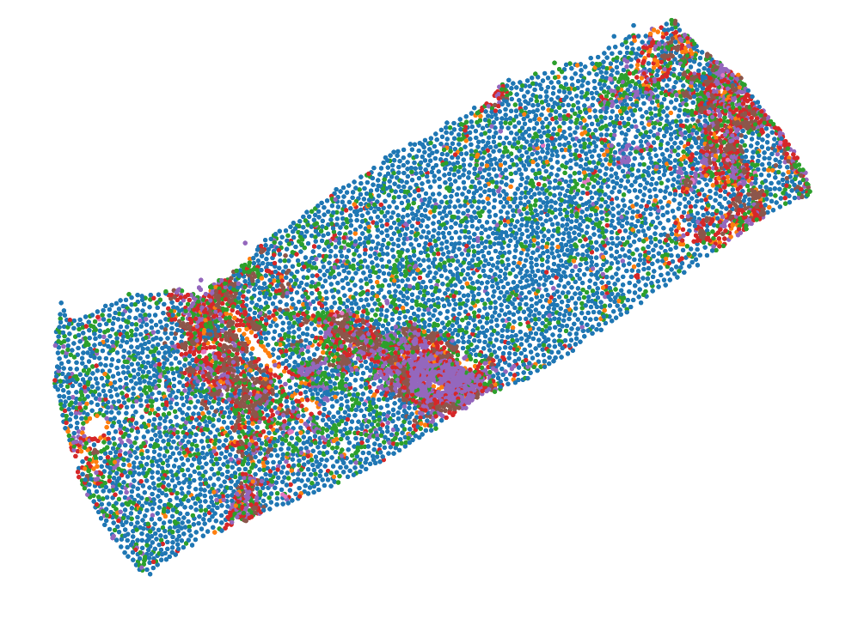
Characterizing Autoimmune hepatitis (AIH) using complementary single-nuclei and spatial transcriptomics techniques
Nikita Sajai
Data Scientist in Bruce Wang Lab and UCSF Liver Center
AIH Liver
sn-RNA seq
Spatial transcriptomics

Slide 2
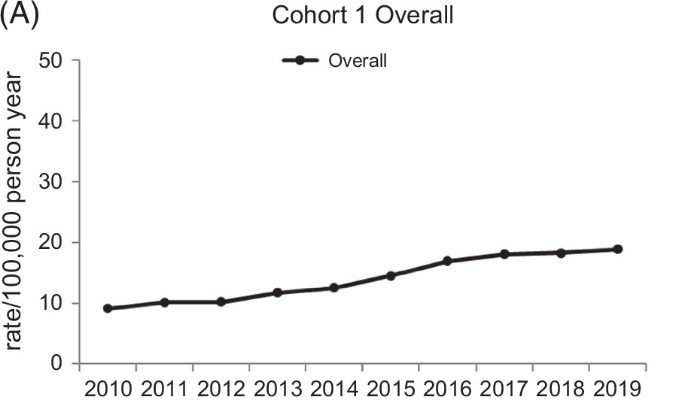
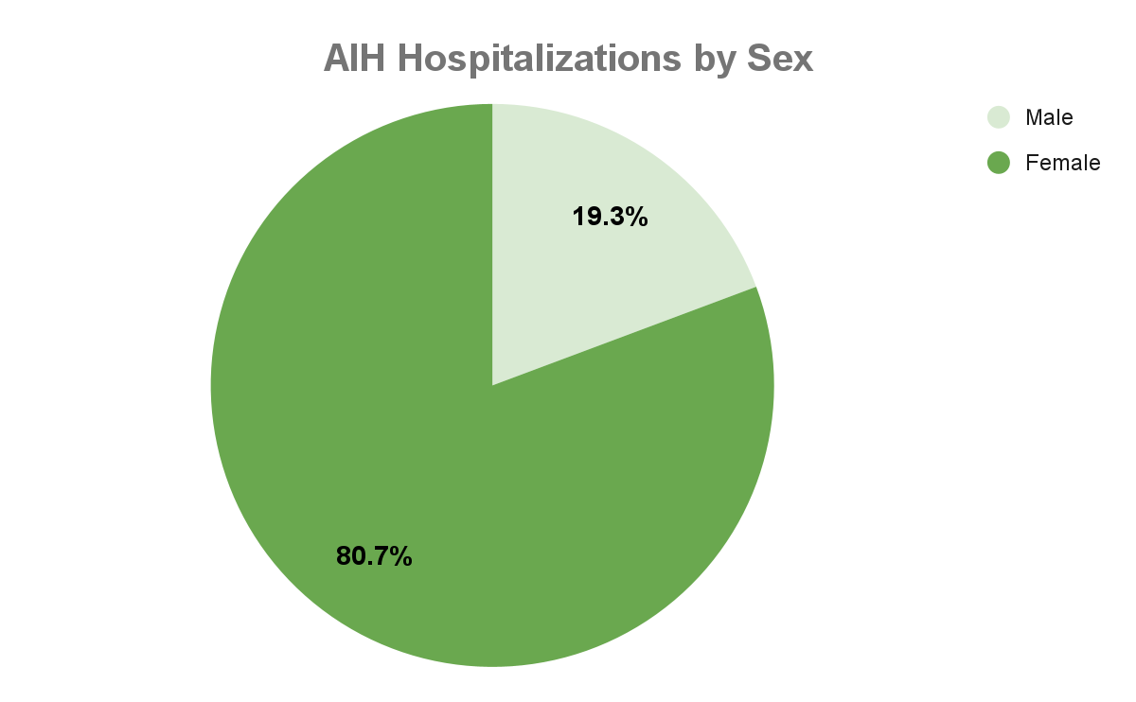
Auto-Immune Hepatitis (AIH)
Rising incidence and prevalence
Disproportionately affecting women and people of color
Autoimmune Hepatitis Association
[1] Yao et al., Hep Communications 2025
[2] J. Wen et al. AJG 2018
Immune-mediated liver disease caused by immune cells attacking hepatocytes
Better understanding of AIH = Better diagnostic methods
Notes:
AIH is an immune-mediated liver disease characterized by immune cells attacking hepatocytes. This disease leads to chronic liver inflammation, cirrhosis, and death if left untreated.
AIH incidence and prevalence is rising, and multiple research groups have observed AIH hospitalizations occurring at disproportionately higher rates among women and people of color.
However, current diagnostic methods are invasive, requiring liver biopsies, and treatment options are limited, requiring lifelong immunosuppression. [click] A lot remains unknown about the pathology of AIH, so if we have a better understanding of AIH, we can develop better diagnostic methods. To do this, we used a combination of single-nuclei and spatial techniques to characterize AIH.
https//aihep.org/what-is-autoimmune-hepatitis/
https://journals.lww.com/hepcomm/fulltext/2025/11010/the_prevalence_of_autoimmune_hepatitis_is_rising_.3.aspx
https://journals.lww.com/ajg/fulltext/2018/02000/hospitalizations_for_autoimmune_hepatitis.18.aspx

Slide 3
Part 1: Single-nuclei RNA sequencing (snRNA-seq) of AIH patient liver tissue
10 patients total:
3 healthy controls
7 AIH patients from POSULD cohort
All Female
~58k nuclei:
Major cell types identified
Notes:
We first performed single-nuclei on liver tissues from 7 patients with AIH, merged with publicly available data from 3 healthy controls. The 7 patients are from the POSULD cohort, a well-characterized, diverse group of patients with integrated clinical and molecular data.
[CLICK] From these patients, we collected roughly ~58k nuclei representing a broad array of cell types, as shown in this UMAP. Each dot represents a nuclei and nuclei with similar gene expression profiles form clusters.

Slide 4
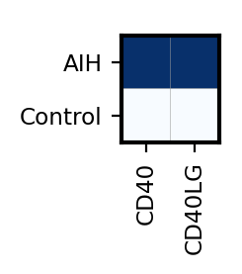
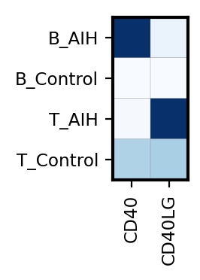
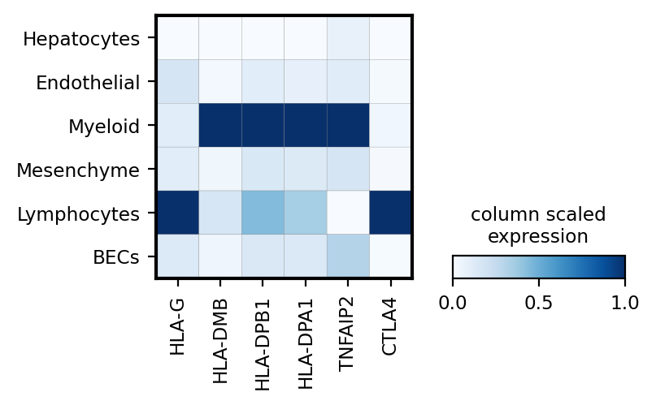
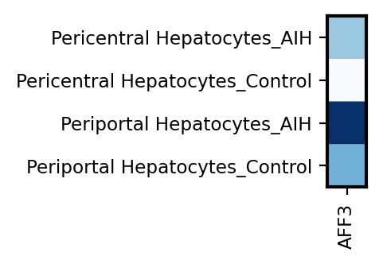
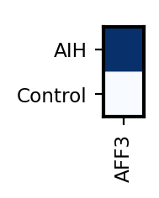
Part 1: snRNA-seq identified the key cell types, signaling pathways, and a potential autoantigen involved in AIH
Upregulation of CD40/CD40LG in B/T cells in AIH livers
Upregulation of key markers in AIH livers, specifically in myeloid and lymphocytes
Upregulation of AFF3 in Periportal Hepatocytes in AIH livers
Notes:
Previous bulk-RNA seq studies identified these key markers upregulated in AIH patients, but our single-nuclei data helped us further identify that their expression is localized to myeloid cells and lymphocytes, linking these cell types to AIH pathology.
Pathway analysis showed an upregulation of two key CD40 signaling pathway genes in our AIH livers, and seen in this expression plot.
The CD40 receptor is expressed by B cells and binds the CD40-ligand expressed by activated CD4+ T cells. This second expression plot shows an upregulation of the CD40/CD40LG signal-receptor pair in AIH livers by their respective cell types.
Secondly, our collaborators used Phip-seq to identify AFF3 as a novel auto-antigen associated with AIH. We confirmed AFF3 expression is upregulated in AIH livers and further localized to Periportal Hepatocytes. This suggests that the periportal region may be the site of damage.

Slide 5
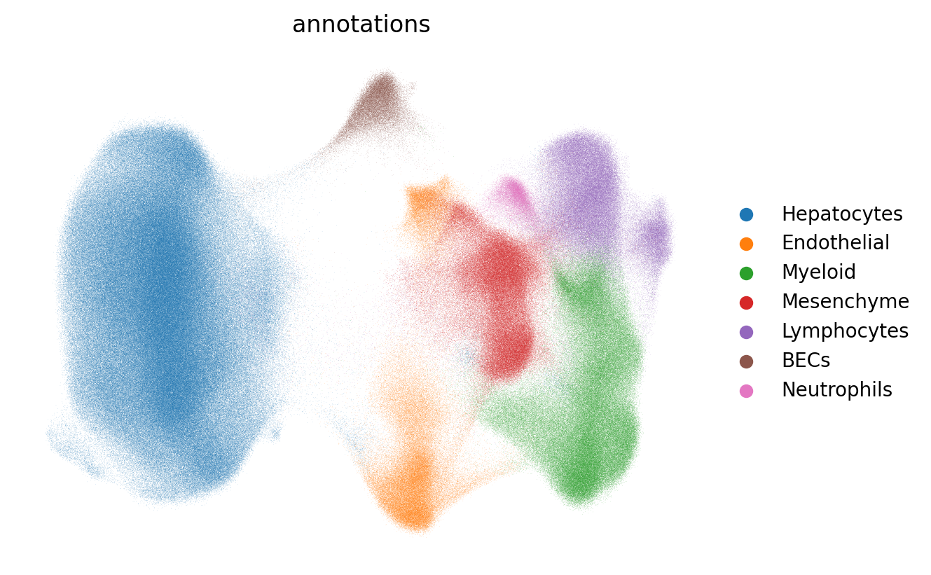
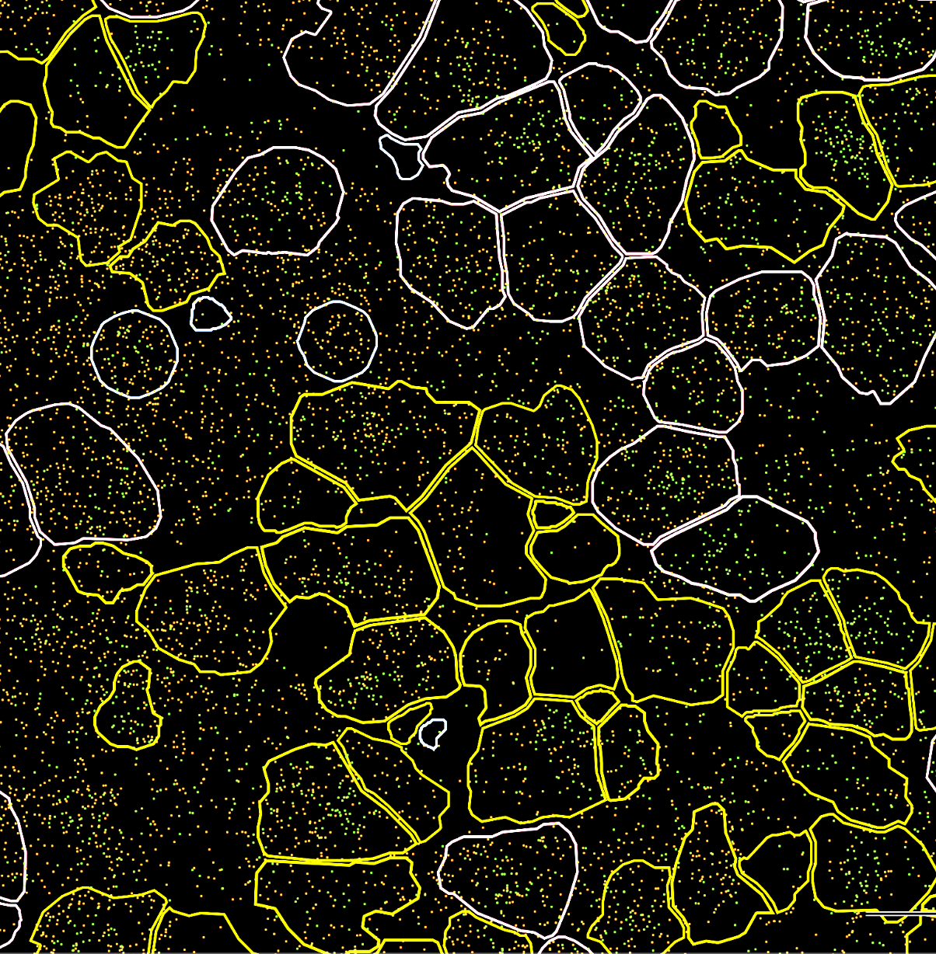
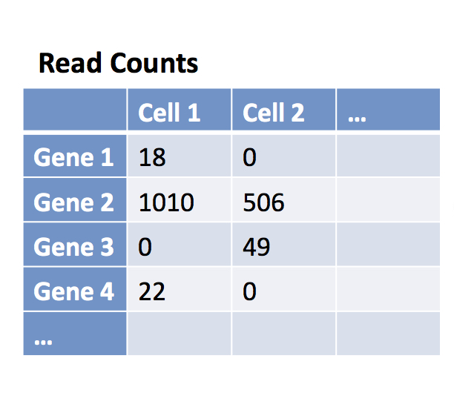
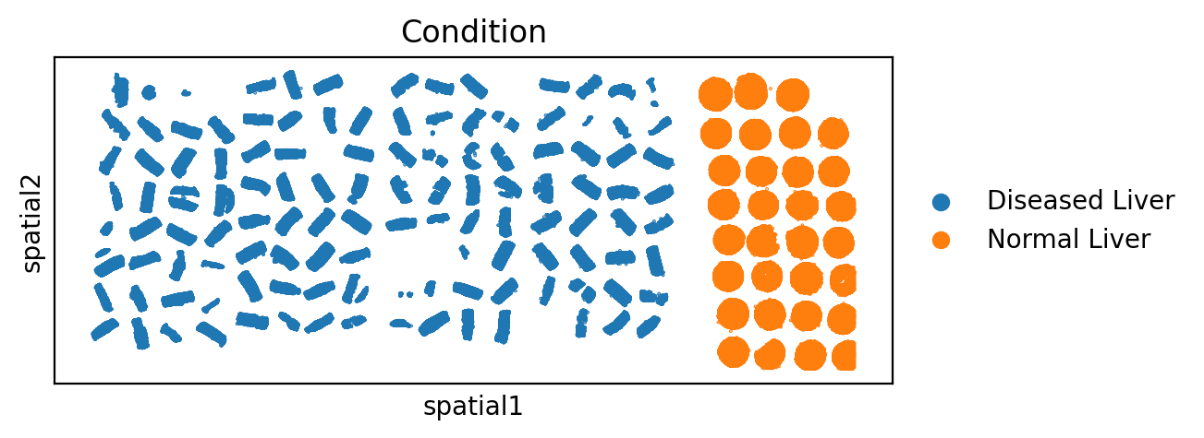
Part 2: Spatial Transcriptomics analysis of patient livers
48 patients: 42 patients from POSULD cohort, 6 healthy control patients
Generate liver tissue microarrays
Apply probes from human liver gene panel to generate counts matrix of spatial data
Identify cell types from spatial data
Notes:
To characterize AIH-related changes in situ, we applied spatial transcriptomics using the 10x Xenium platform
We generated liver tissue microarrays using liver biopsy samples from 48 patients: 42 patients from the POSULD cohort, some with AIH and others with MASLD, and 6 healthy human controls. I just showed you single-nuclei data from 7 of the 42 POSULD patients.
We then applied probes from our custom 480-gene human liver panel, which allow us to generate a counts matrix of our spatial data. This counts matrix can then be translated through downstream analysis to a UMAP where liver cell types are identified.

Slide 6
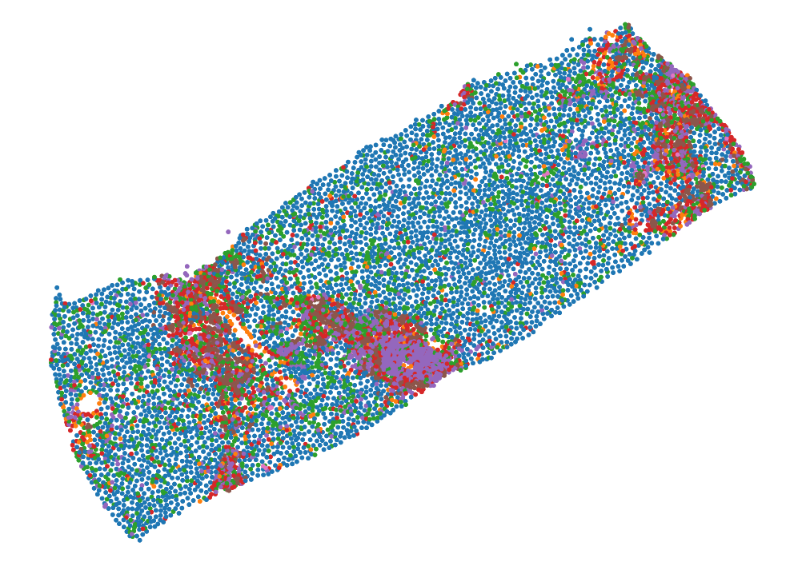
Identify the major cell types and map them back to their spatial context
~1.3 mil cells total
570k Normal cells
772k Diseased cells
Notes:
From these patients, we spatially identified 1.3 million cells in total and parsed apart major cell types. We can map these cell types back to their respective cores and view them in their native liver context, as seen in the example liver core on the right.

Slide 7
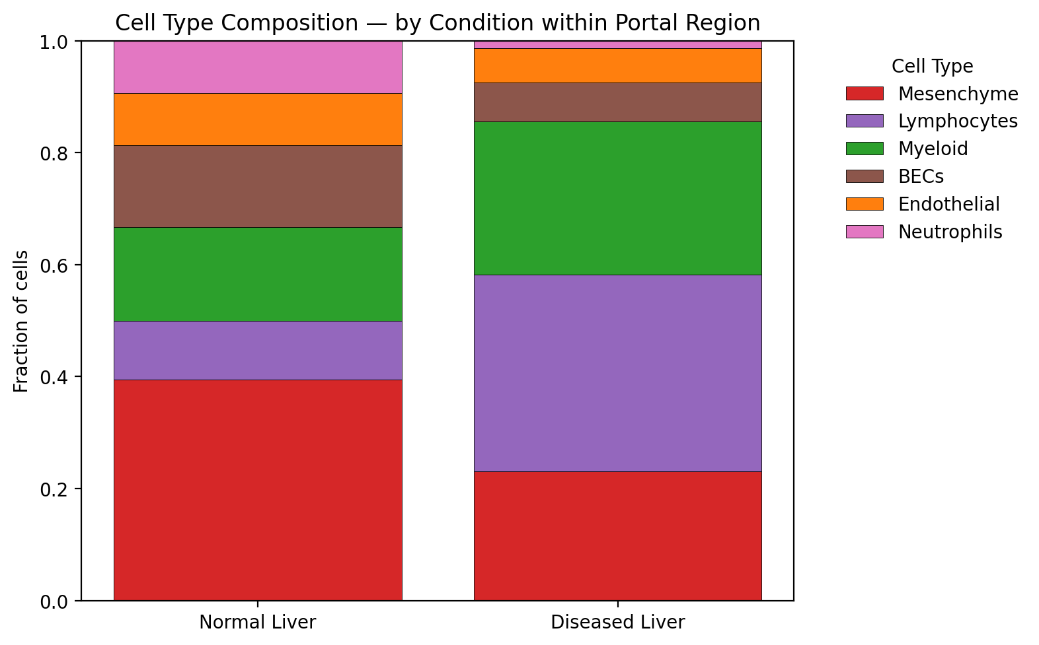
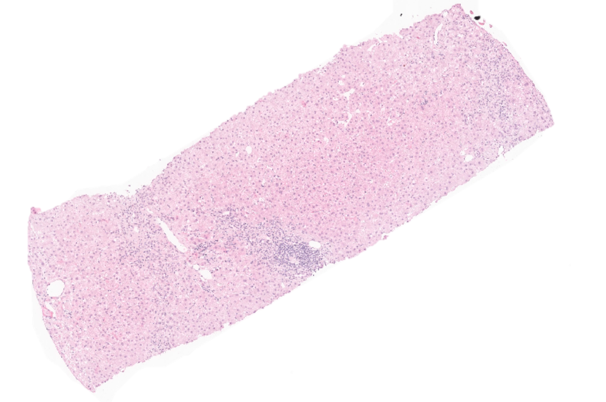
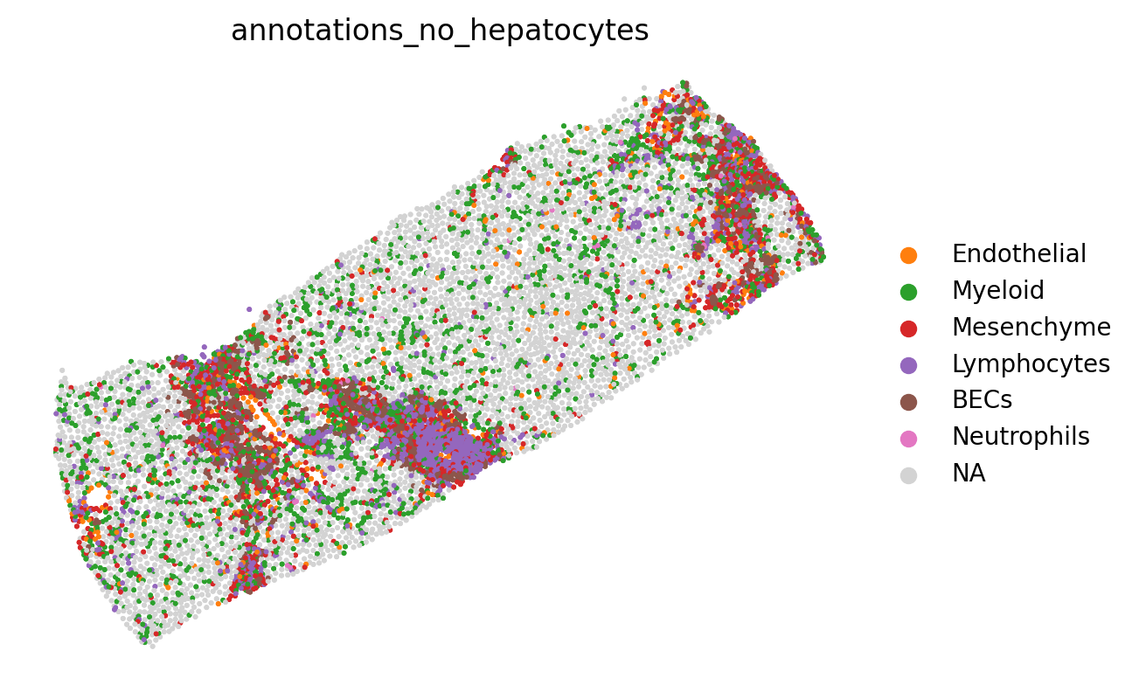
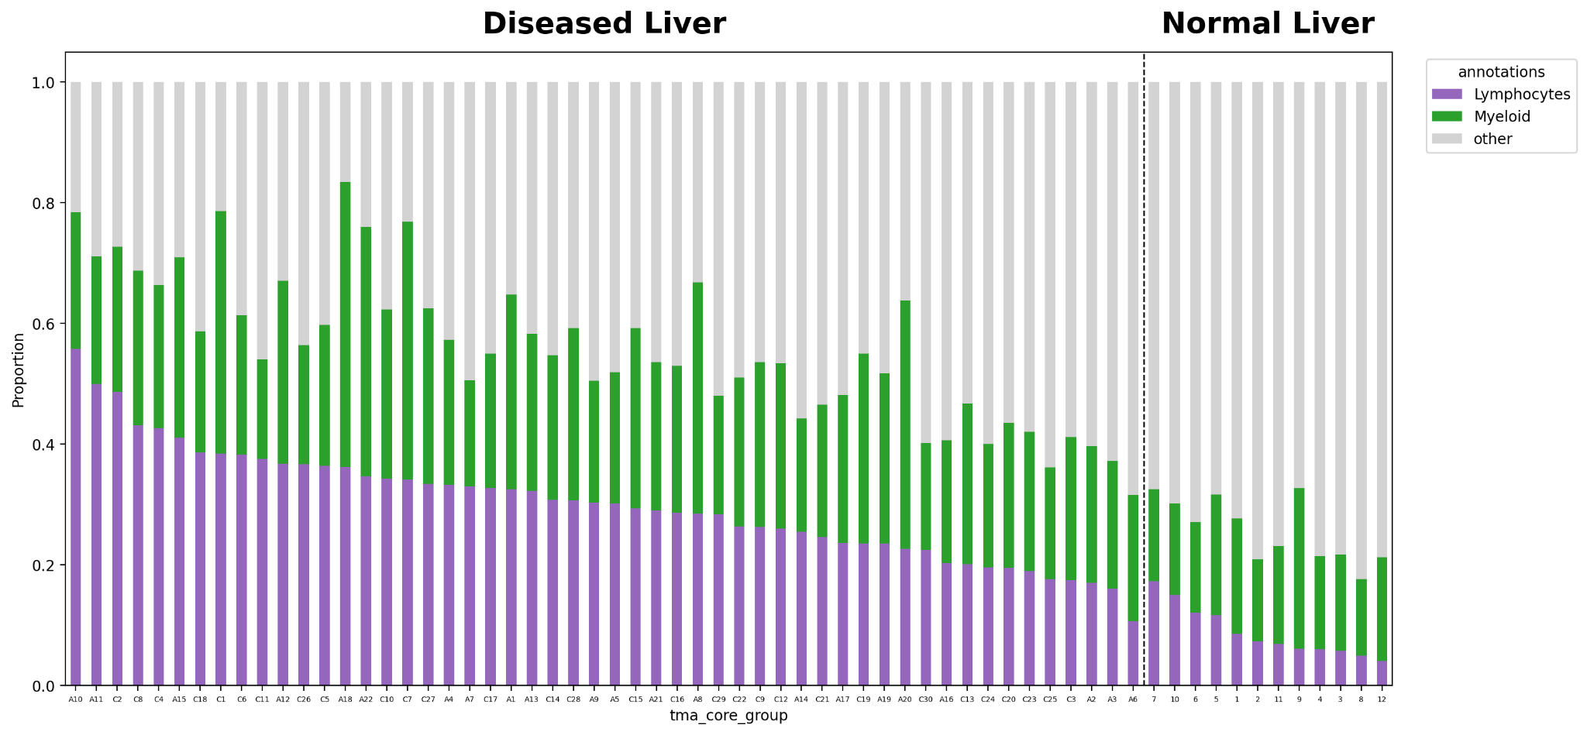
Lymphocytes and Myeloid cell proportions are increased in the Portal Region of diseased livers
Lymphocytes and Myeloid cell proportions vary across patients
Notes:
The H&E images showed inflammation in the portal region[point then click]. Using our spatial data, we are able to quantify the proportions of cell types in the portal region of each liver core.
In this barplot, we see that the Lymphocyte and Myeloid proportion increases in the portal region of diseased livers, corroborating our single-nuclei findings that these cell types are implicated in AIH pathology.
However, when we split this proportion barplot by patient, we can see the distribution is not equal with diseased patients ranging from having very large to smaller proportions of immune cells. So, we sought to figure out what other spatial features differentiate these patients, and can we correlate those spatial differences to patient condition to identify clinically relevant patient groups?

Slide 8
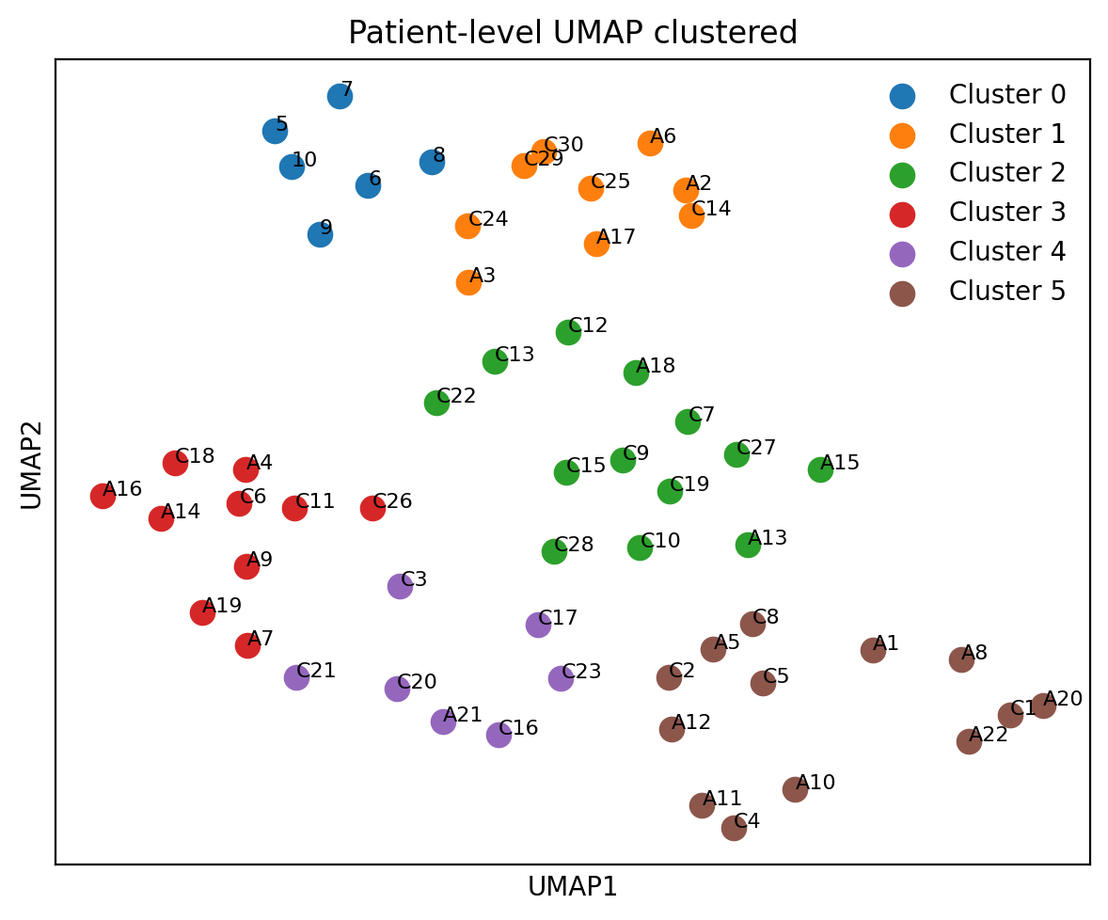
Can we correlate spatial differences to patient condition and identify clinically relevant patient groups?
Proportions Data: Proportions of cell types per patient
Patient-Feature Matrix
Patient-Feature UMAP
Patient ID | Proportion Lymphocytes PP region | Proportion Lymphocytes PC region | Proportion Lymphocytes Portal region | …
A1
A2
…
Expression Data: Gene module scores of cell types, signaling pathways, AIH genes per patient
Total features: 208
Notes:
To answer this question, first we created a patient feature matrix of all spatial features we could think of, including the proportions of all cell types across the lobule and within each lobular region, as well as gene expression scores of major cell types, signaling pathways, and AIH-associated genes from previous literature.
We could then use unbiased clustering methods to cluster patients based purely on their spatial features.

Slide 9
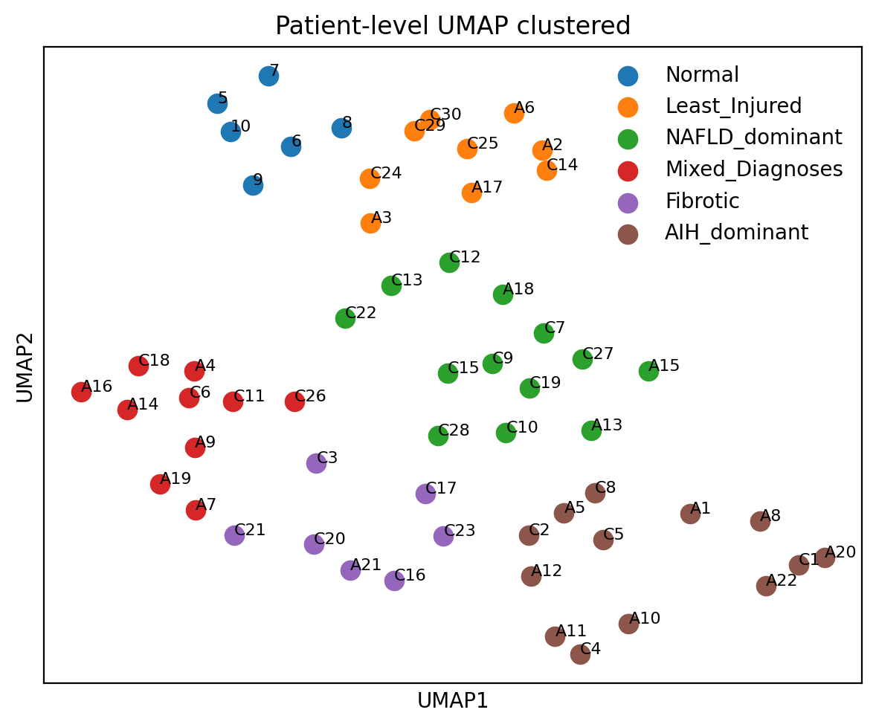
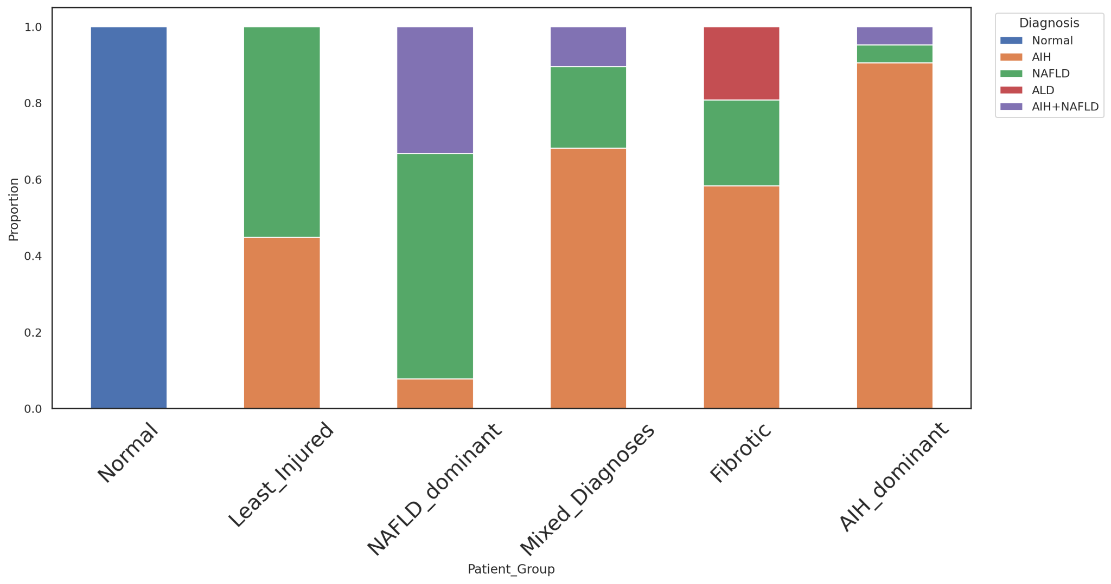
Patient Groups roughly correspond with clinical diagnosis
Notes:
Turns out, we are able to identify 6 patient groups using ONLY spatial features: a normal, least injured, nafld dominant, mixed diagnoses, fibrotic, and AIH dominant patient group.
Looking at this barplot, we see these groups roughly correspond with clinical diagnosis, as our normal patients group together and the AIH-dominant patient group has mostly AIH-diagnosed patients.

Slide 10
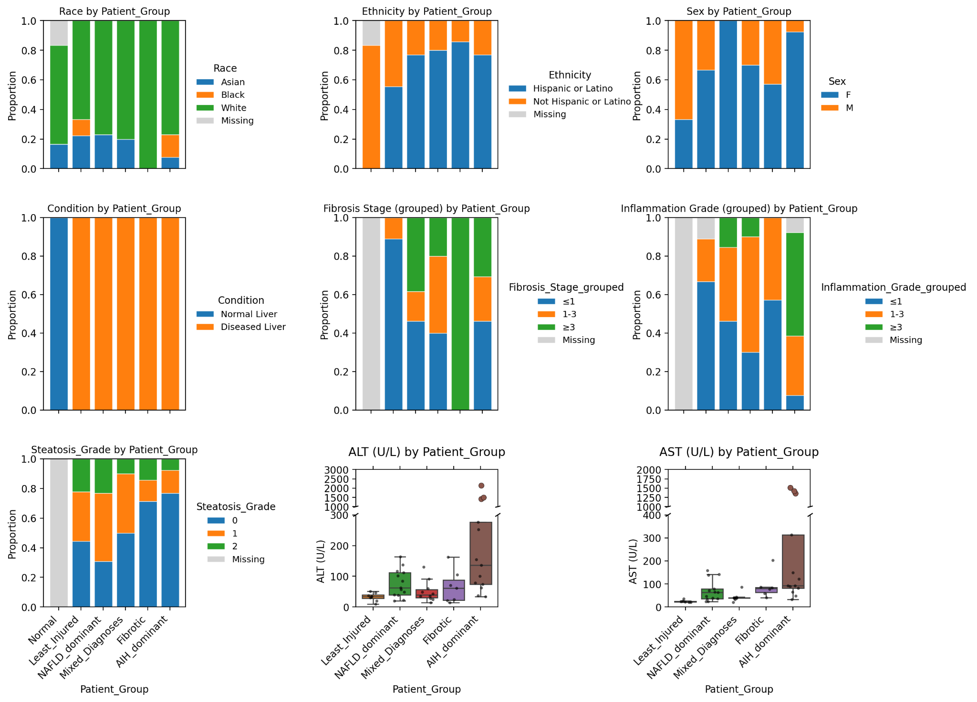
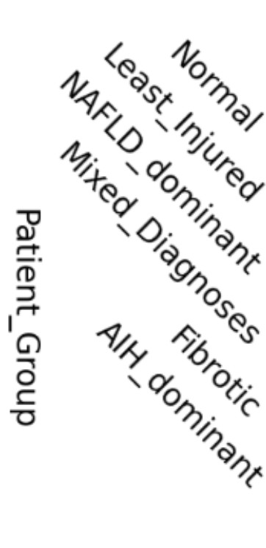
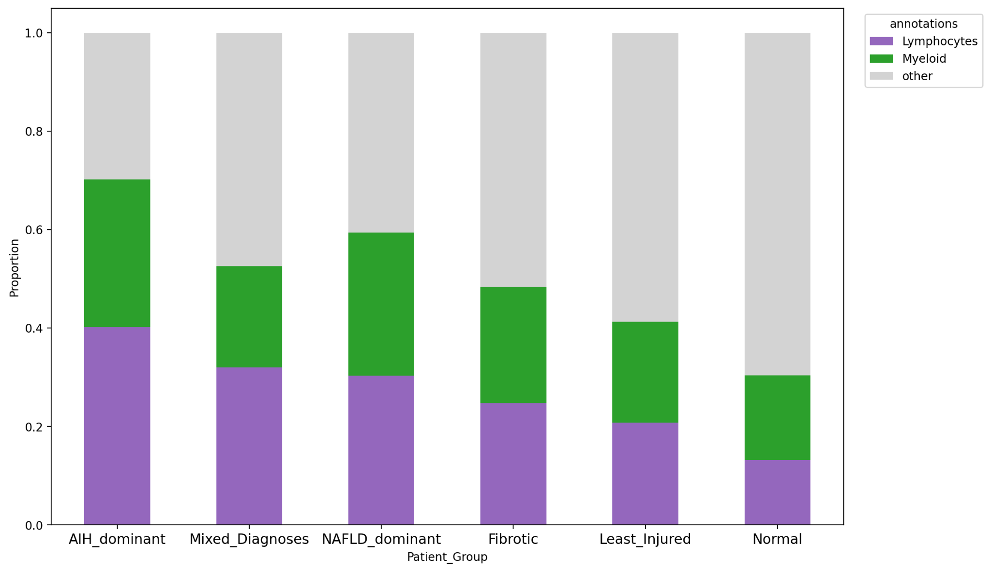
AIH-Dominant livers have the highest inflammation grade and ALT values
Lymphocytes and Myeloid cell proportions are increased in the Portal Region of the AIH-Dominant livers
AIH-Dominant group displays the highest level of inflammation
Notes:
These patient groups also roughly correspond with clinical metadata, and you can see that the AIH dominant group has the highest inflammation grade and the highest ALT serum marker values.
In line with this, we see that immune cells like Lymphocytes and Myeloid cells are enriched in the portal region of the AIH dominant patient group livers as compared to the rest.

Slide 11
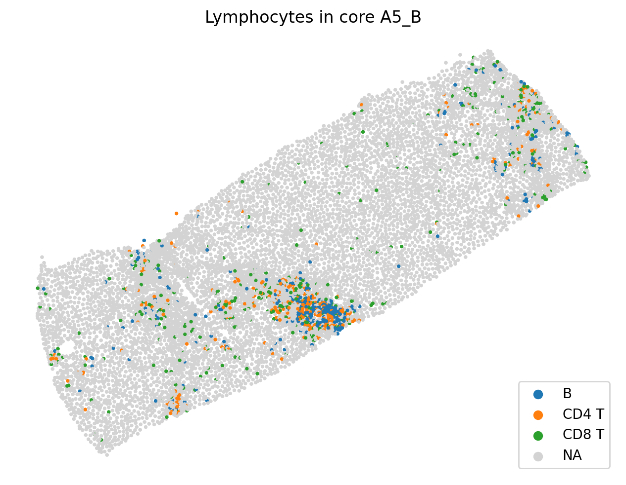
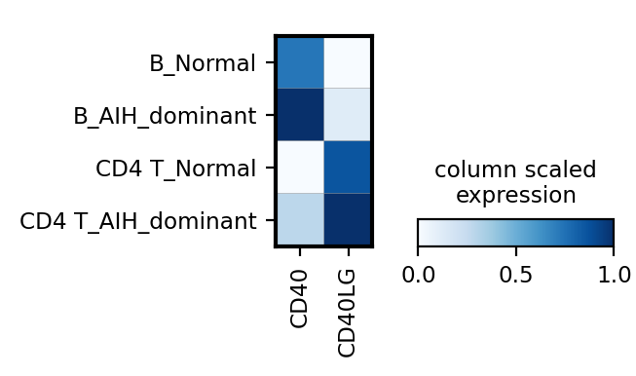
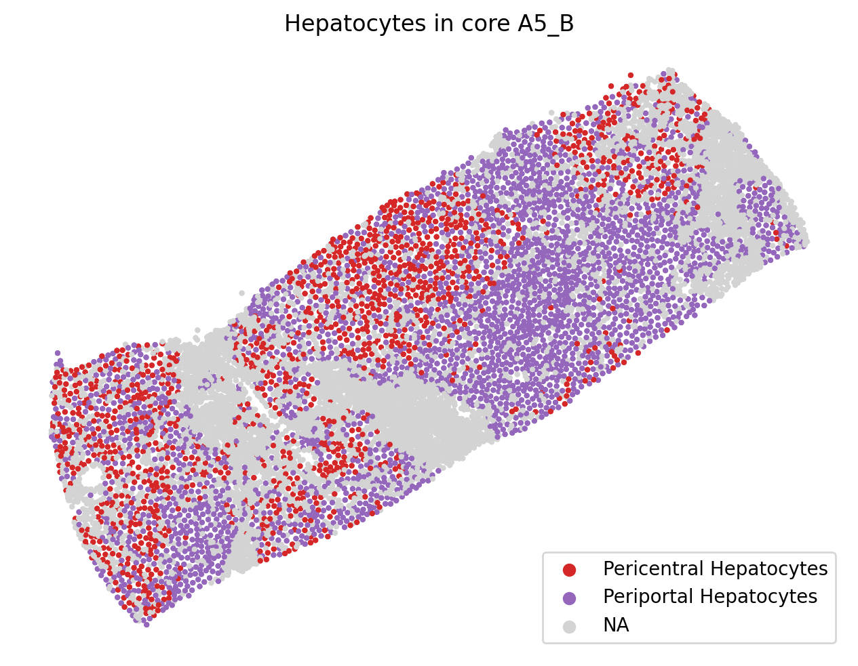
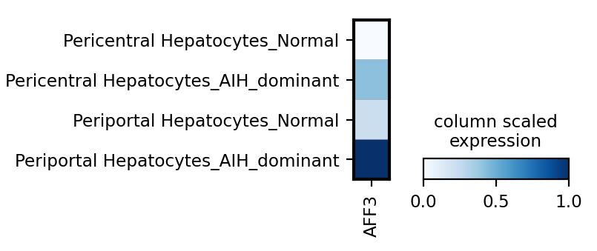
Validate CD40/CD40LG pathway and AFF3 expression in spatial dataset
Lymphocyte Annotations in core A5_B
Upregulation of CD40/CD40LG in B/CD4+T cells in AIH livers
Hepatocyte Annotations in core A5_B
Upregulation of AFF3 in Periportal Hepatocytes in AIH livers
Notes:
In our spatial dataset, we find the same upregulation of CD40/CD40LG in the B cells and CD4+T cells of AIH patient livers
We also see the same upregulation of AFF3 in the Periportal hepatocytes of AIH livers, validating our single-nuclei findings.

Slide 12
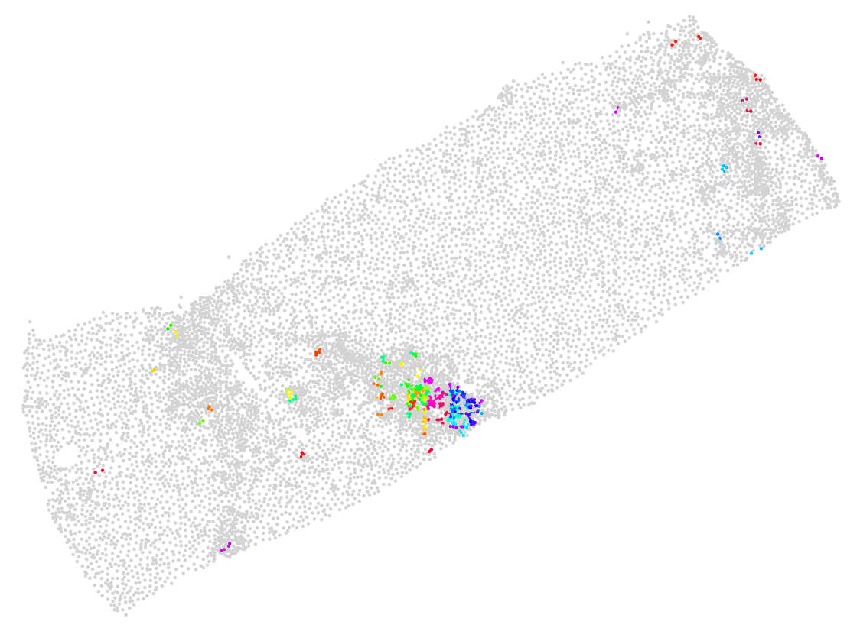
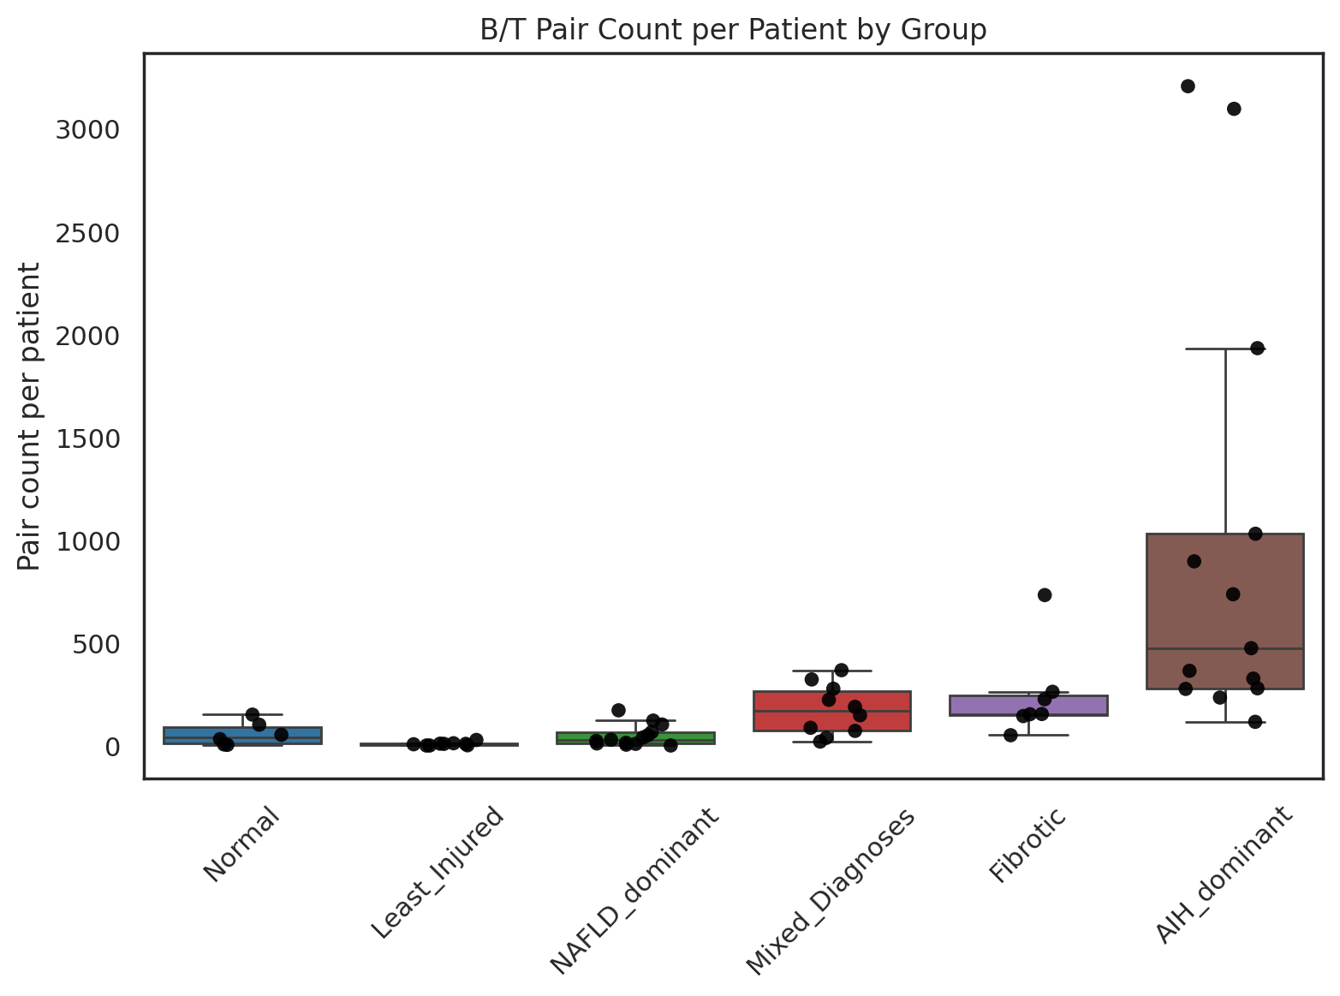
We also observe an increase in the number of B/T cell pairs across patient group
AIH dominant patient group has the highest number of B-T pairs
CD40LG-expressing
T
B
CD40-expressing
Notes:
Lastly, we can use spatial neighboring algorithms to identify pairs of B/T cells that co-express the CD40-CD40LG signal receptor pair.
When we plot the distribution of B/T pairs across Patient group, we see that the AIH dominant patient group has the highest number of b/t pairs.
Overall, these patient groups have a lot of potential usage for discovery, as we keep searching for other features that distinguish these patient groups and find other cell types and pathways that can be targeted in treating AIH.

Slide 13



Thank you!
Abhishek Murti
Aris Taychameekiachi
Cindy Ament
Elise Lelou
Jasmine Wang
Sydney Do
Bruce Wang
Michele Tana
Amar Nijagal
Ari Molofsky
nikita.sajai@ucsf.edu

Slide 14
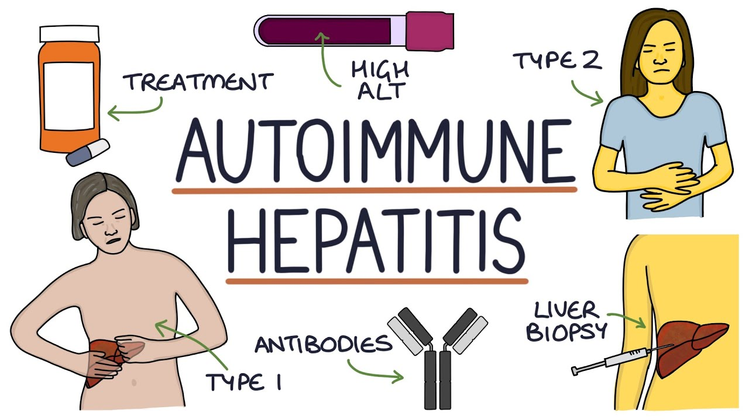

Diagnosis and treatment methods could use improvement
Steroids (prednisone/budesonide)
Immunosuppressants (azathioprine)
Invasive diagnostic methods
Limited treatment options
Better understanding of AIH = Better diagnostic methods
Notes:
However, current diagnostic methods are invasive, requiring liver biopsies, and treatment options are limited, requiring non-specific immunosuppression. A lot remains unknown about the pathology of AIH, so if we can develop a better understanding of AIH, we can develop better diagnostic methods.
Current diagnostic methods are invasive- Serum biomarkers lack sensitivity and specificity, leading practitioners to use invasive liver biopsies to procure a diagnosis
Treatment options are also limited, often requiring a lifetime of nonspecific immunosuppression
Currently, a lot remains unknown about the pathology of AIH, so if we can understand AIH better, we can develop better diagnostic methods.
AIH is likely caused by a combination of genetic risk factors and environmental triggers. Various medications (nitrofurantoin and minocycline, among others) and some viruses (Epstein-Barr virus, cytomegalovirus, herpes, hepatitis A, B, and C, and parvovirus B19) have been associated with AIH. Other environmental factors have also been considered, such as significant stress and chemical exposures

Slide 15
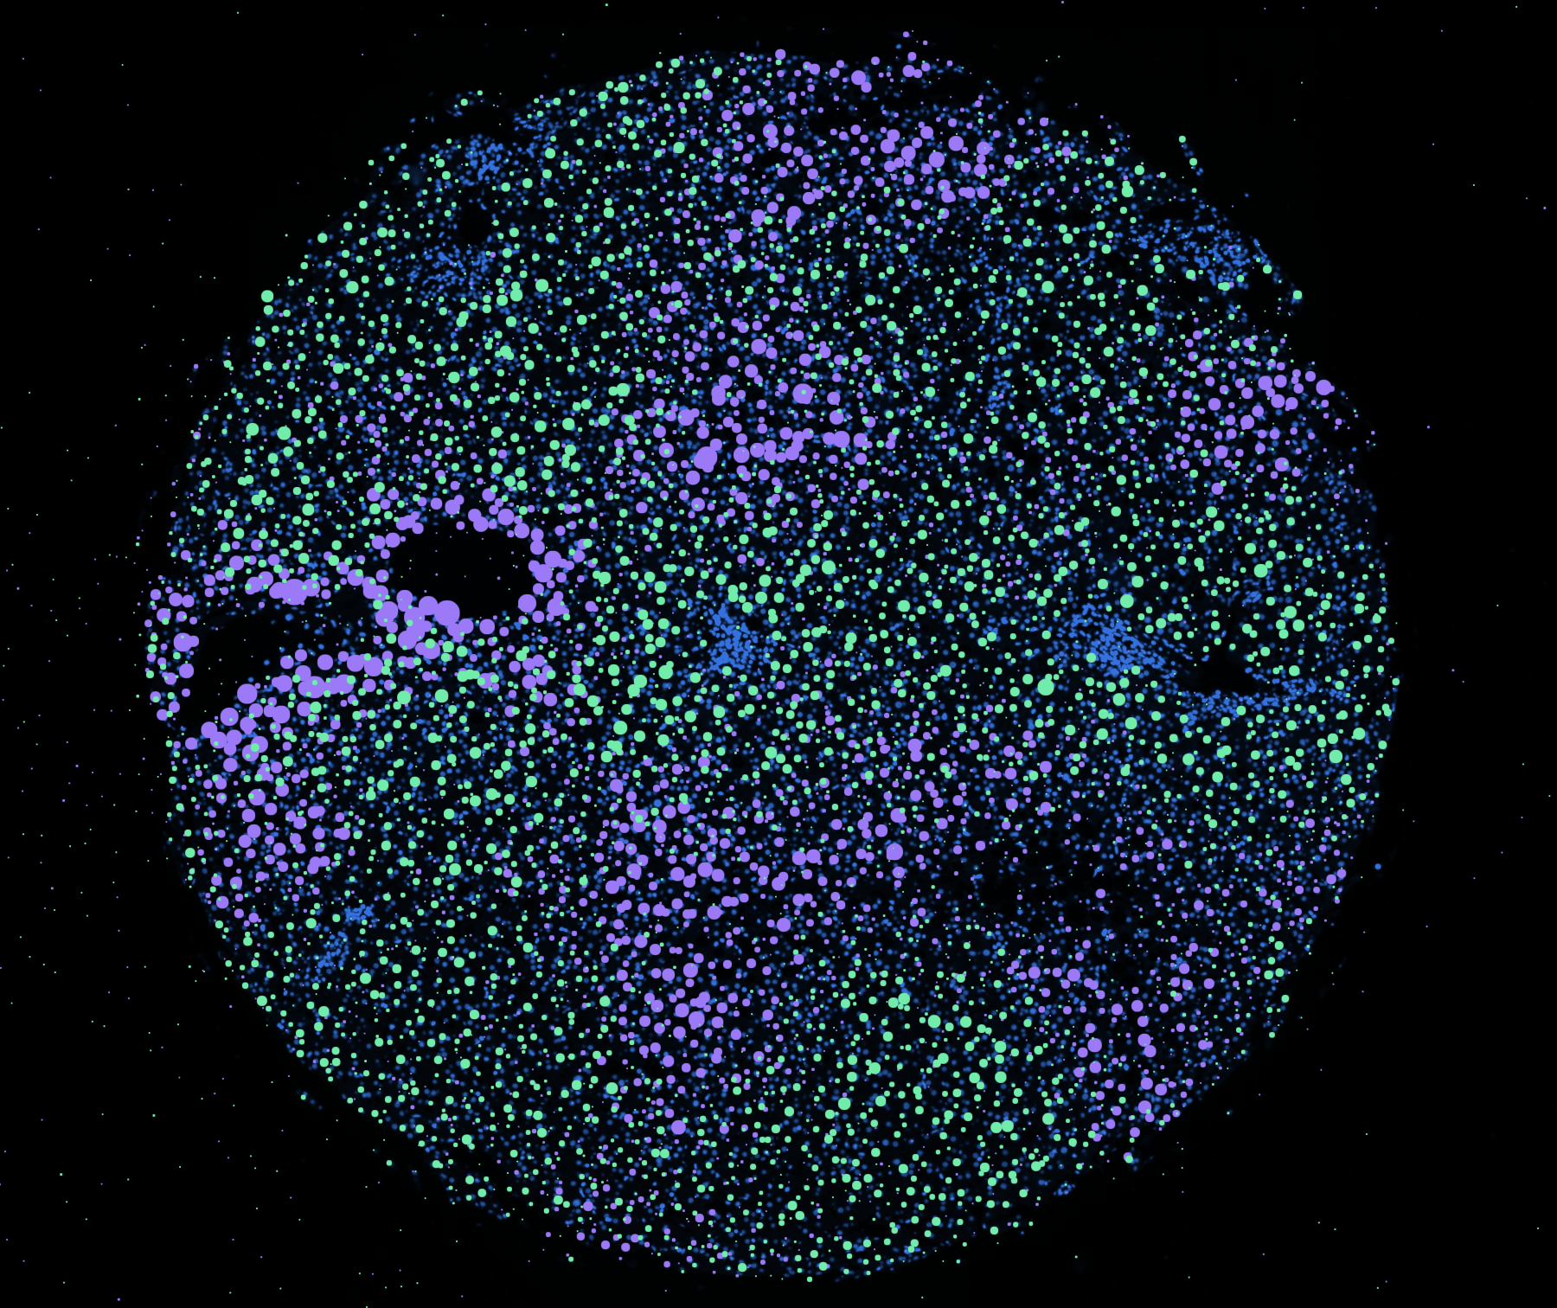

Spatial Data Snapshot: M, 59 yo
Segmented by boundary stain
Segmented by interior stain
Segmented by nucleus expansion
CYP1A2
HAL
Notes:
Here is a snapshot of what a single core from the TMA looks like, this core is from a 59 yo male.
On this core, I have plotted two hepatocyte zonation genes from our panel, with Cyp1a2 in purple and Hal in green. Cyp1a2 is primarily expressed in pericentral hepatocytes and Hal in periportal hepatocytes, giving us a preliminary glance at zonation within this tissue sample.
[CLICK] Here is a zoomed-in region of this core, in which you can see individual cells. The different cell boundary colors represent different cell segmentation techniques used to define each cell. [CLICK] These cells are segmented through Xenium’s technology using boundary antibody staining, interior protein staining, and nucleus expansion from DAPI staining.
You can also see dots scattered across this region. These dots represent individual transcripts which come from genes defined in our custom panel.

Slide 16
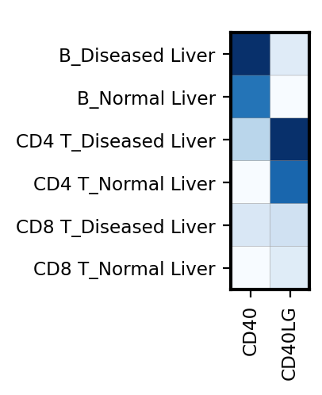
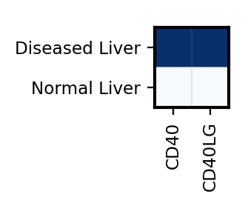
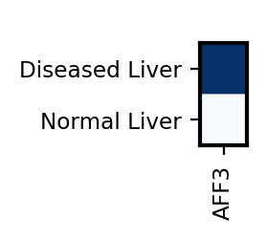
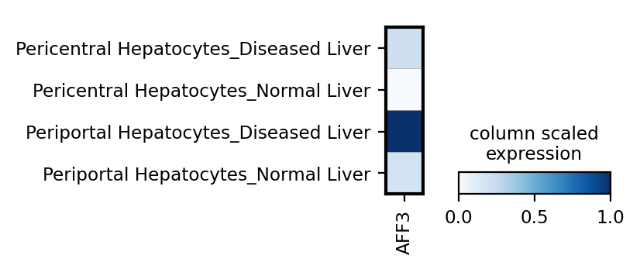
Validate CD40/CD40LG pathway and AFF3 expression in spatial dataset
Lymphocyte Annotations in core A5_B
Upregulation of CD40/CD40LG in B/T cells in AIH livers
Hepatocyte Annotations in core A5_B
Upregulation of AFF3 in Periportal Hepatocytes in AIH livers
Notes:
In our spatial dataset, we find the same upregulation of CD40/CD40LG in the B and CD4+T cells of diseased liver, and the upregulation of AFF3 in the Periportal hepatocytes of diseased livers, validating our single-nuclei findings

Slide 17
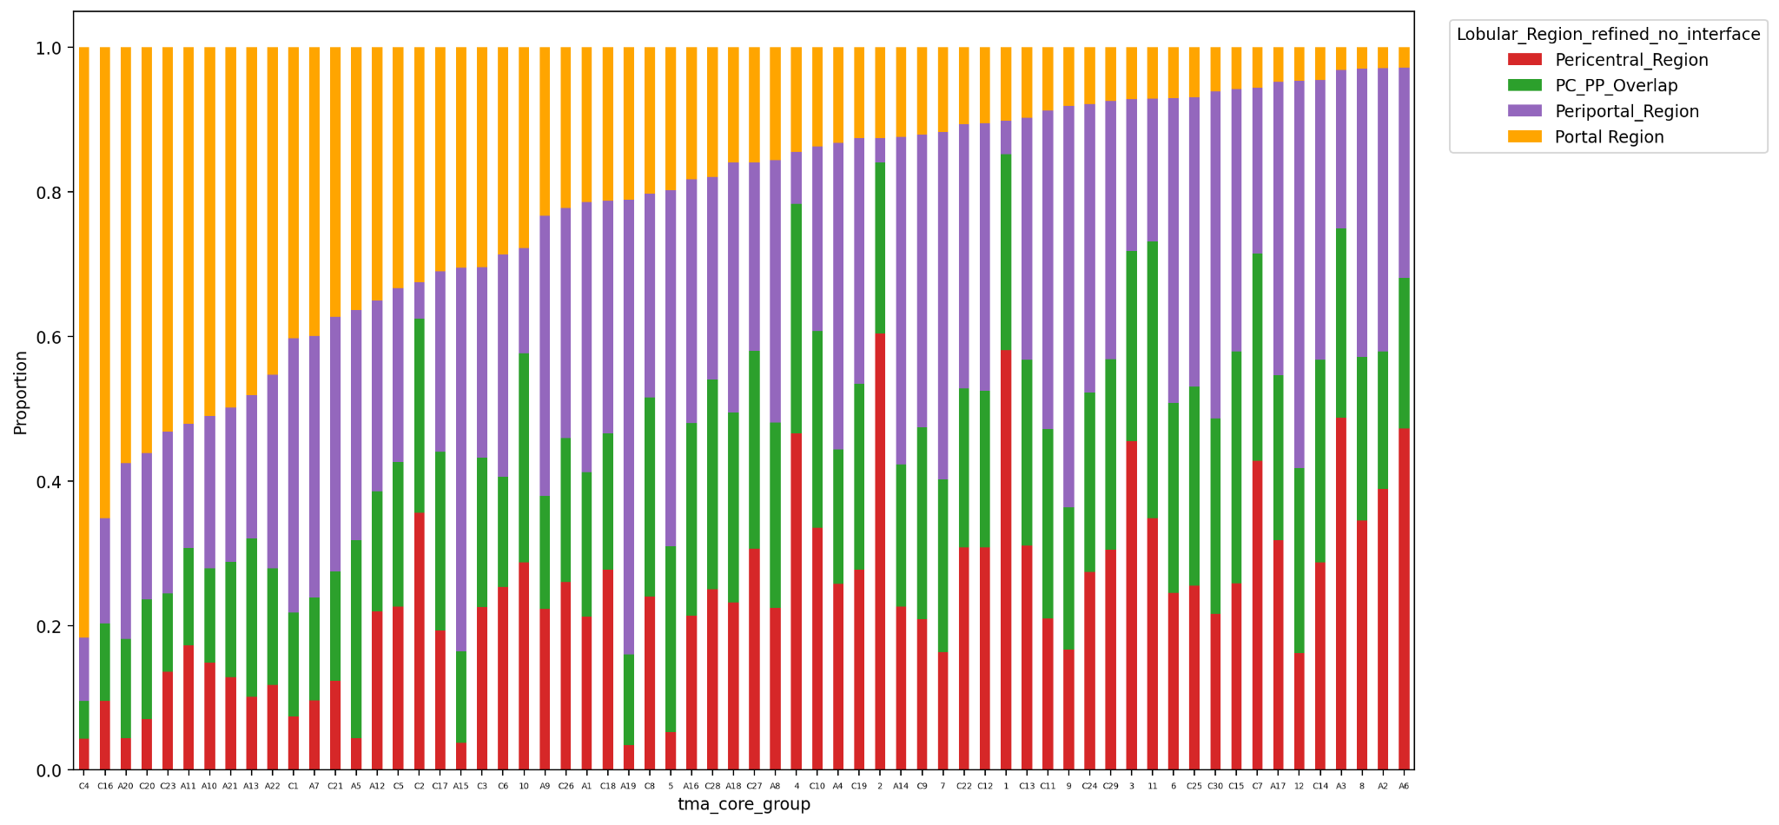
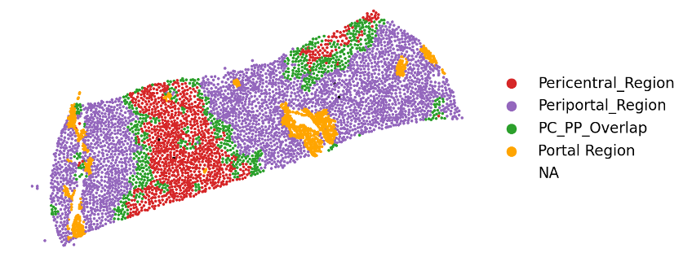
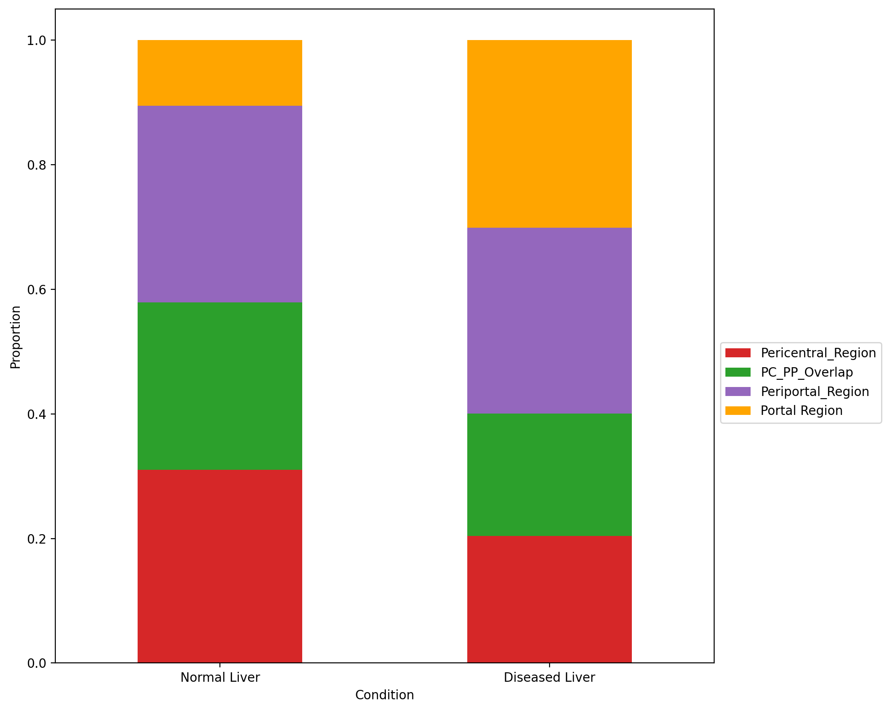
Portal Region proportions are increased in diseased livers
Notes:
We can identify lobular regions of the liver shown in this core. We find that the portal region proportion is increased in our diseased livers, emphasizing that the portal region seems to be the most affected by AIH.
Within the portal region, we can also calculate the proportions of each cell type. Lymphocyte and Myeloid proportion increases in the portal region of diseased livers, corroborating our previous findings that these cell types are implicated in AIH pathology.
However, the distribution of patients is not equal, even among the diseased livers, with some having smaller proportions of portal region and less lymphocytes/myeloid cells. So, we sought to figure out what spatial features differentiate these patients, and can we correlate those spatial differences to patient condition to identify clinically relevant patient groups?

Slide 18
Patient Groups roughly correspond with other clinical metadata
Notes:
These patient groups also roughly correspond with clinical metadata.
The Least injured group has the lowest fibrosis stage and the fibrotic group has the highest fibrosis stage.
The AIH dominant group has the highest inflammation grade and the highest ALT serum marker values.

Slide 19
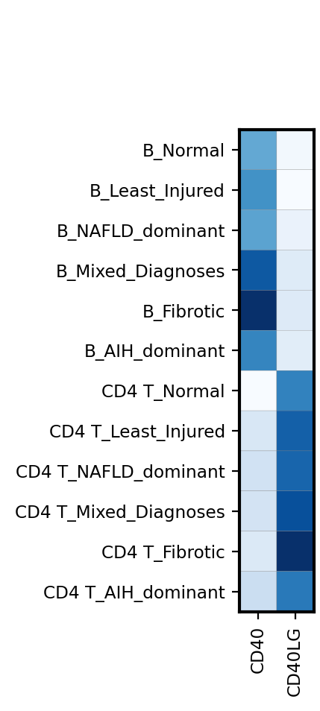
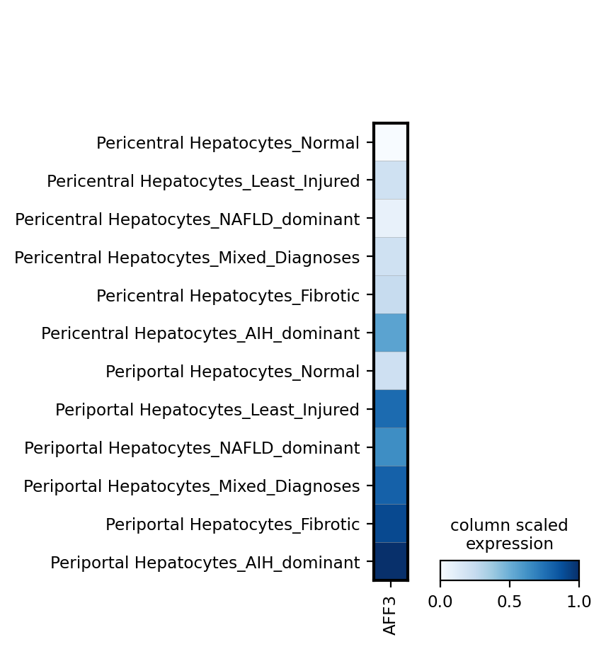
Validate CD40/CD40LG pathway and AFF3 expression in spatial dataset
Lymphocyte Annotations in core A5_B
Upregulation of CD40/CD40LG in B/CD4+T cells in AIH livers
Upregulation of AFF3 in Periportal Hepatocytes in AIH livers
Hepatocyte Annotations in core A5_B
Notes:
In our spatial dataset, we find the same upregulation of CD40/CD40LG in the B cells and CD4+T cells of AIH patient livers
We also see the same upregulation of AFF3 in the Periportal hepatocytes of AIH livers, validating our single-nuclei findings.

