Slide 1


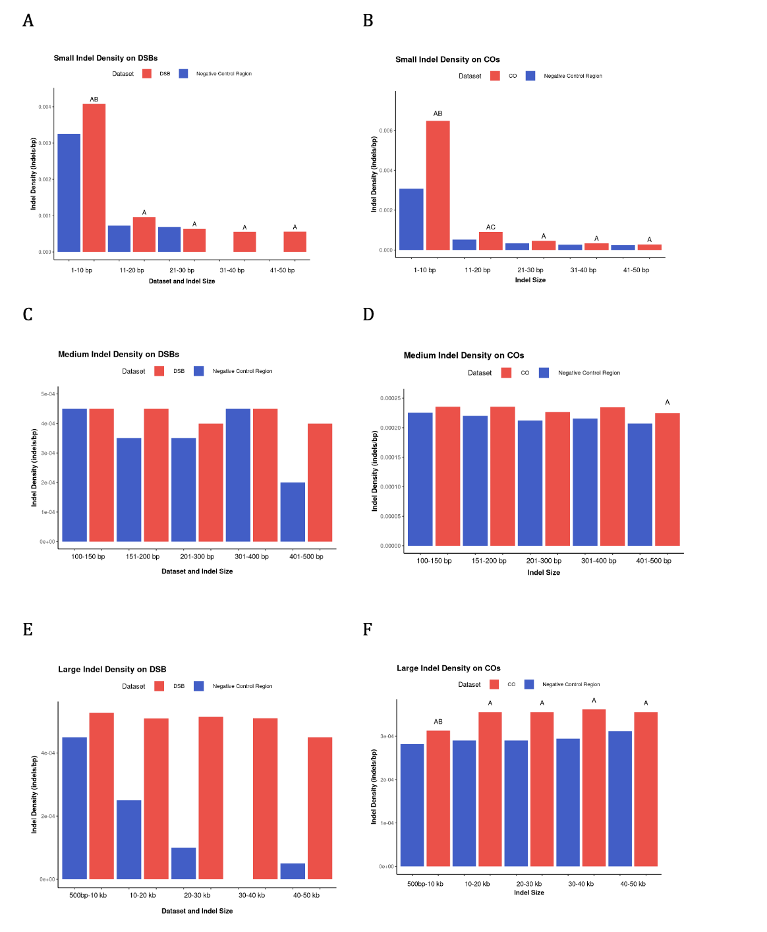
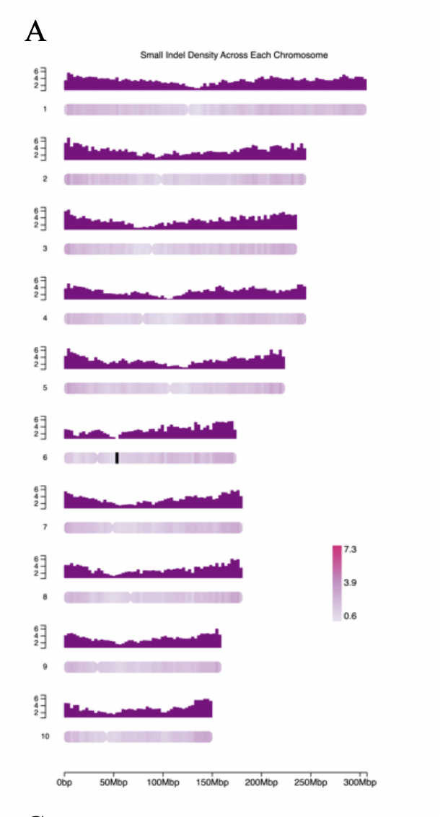
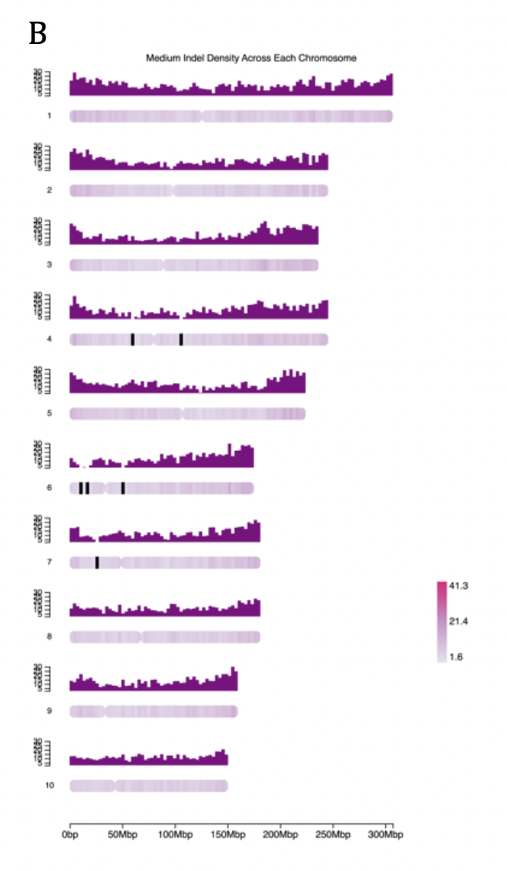
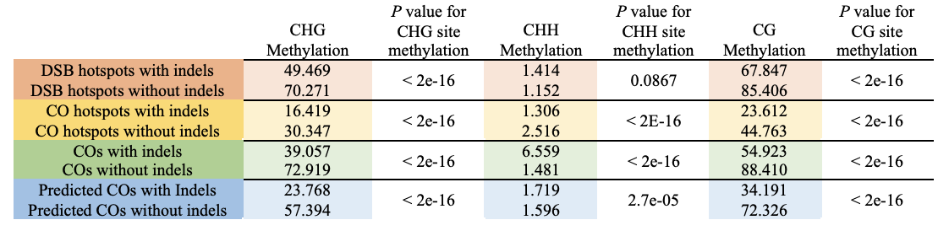
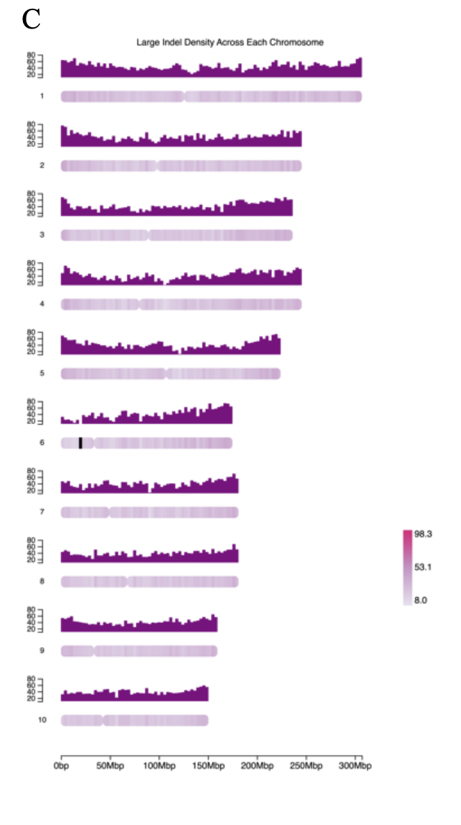
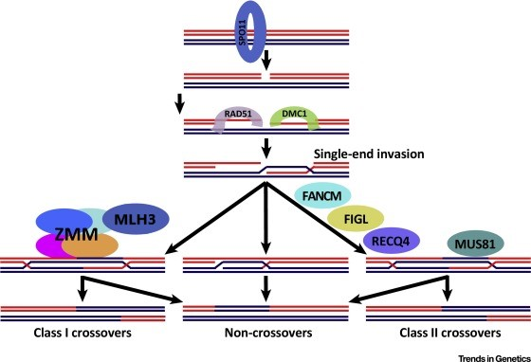
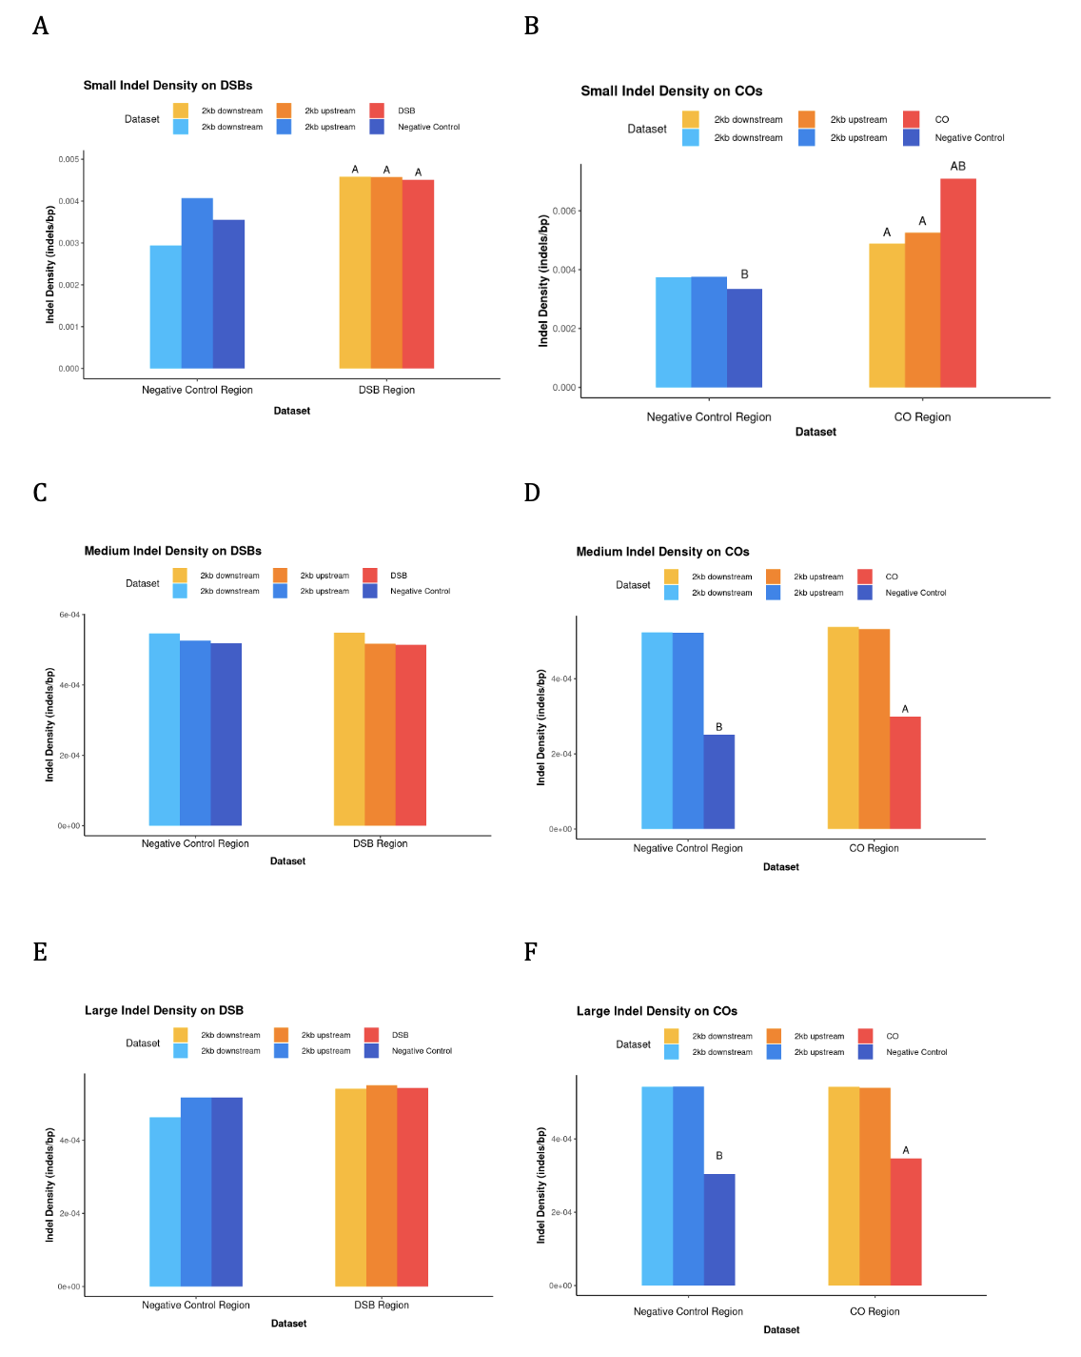
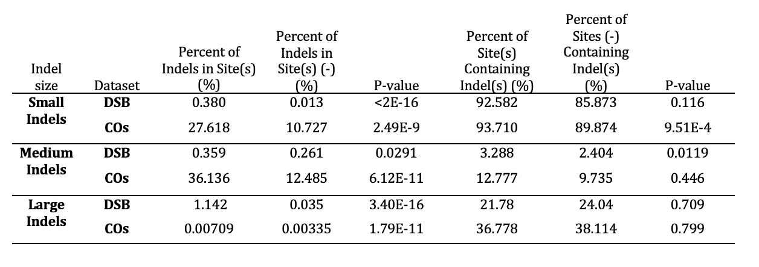

The Association of Indels with Meiotic Recombination Sites in Maize
Nikita Sajai and Wojtek P. Pawlowski
School of Integrative Plant Science, Cornell University
Abstract
Data
Results
Conclusions
The processes occurring during meiotic recombination, from the initiation of DNA double-strand breaks (DSBs) to the completion of crossing-over (CO) formation, have numerous opportunities for inaccuracy. In particular, several types of missteps during recombination, including the formation of double DSBs, could lead to genome deletions. To explore this phenomenon in maize, we examined the occurrence of indels at recombination sites. To do it, we mapped indels to meiotic DSB hotspots and CO sites and measured the presence and degree of enrichment of indels of different sizes. We assessed the indel generation potential of meiotic recombination by calculating three measures: indel overlap by recombination sites, recombination site overlap by indels, and indel density at recombination sites. We found substantial enrichment of small indels (1-50 bp) at CO sites, providing the first strong evidence of mutagenicity of meiotic recombination in plants. Small indel density decreased in regions 2 kb upstream and downstream from the recombination sites, implying that the indels were generated in a localized fashion. Indels have the potential to alter gene function and plant phenotype, marking their importance as a source of genetic diversity. Thus. understanding mechanisms of indel origination and their relationship to the recombination mechanism is important for efforts that exploit genetic diversity for crop improvement.
Recombination Sites: ~3100 DSB hotspots,~30000 empirical COs,~300 empirical CO hotspots,~60000 predicted CO sites,~32000 MLH3 hotspots identified at the diplotene stage of maize meiocytes
Indels: Small indels (1-50 base pair (bp) indels), medium indels (100-500 bp), large indels (500 bp-50kb).
Where do indels lie?
U-shaped pattern of indel density (Fig 1)
Is recombination mutagenic?
Enrichment of small indels (1-10 bp) at recombination sites, indicating the mutagenic effect of recombination. (Fig 2)
More indels ate CO hotspot and predicted CO sites than in 2kb up- and downstream regions. (Fig 3)
CO hotspots have the greatest increase in small indel density (Fig 4)
What fraction of indels are at recombination sites and what fraction of recombination sites overlap with indels?
Fewer than 50% of all indels were located at recombination sites (Tb 1)
Nearly all CO hotspots, COs, and DSBs intersected with at least one small indel
What explains the elevated indel density in CO regions?
Decrease in CG and CHG site methylation levels at recombination sites with indels (Tb 2)
Methodology
Characterizing Indel Distribution
Distribution plots using ChromoMap in R
Analyzing Indel Presence at Recombination Sites
Used bedtools intersect to assess three measures:
Indel overlap (%) = $\frac{\# of indels that intersect with each interval (CO/DSB)}{total \# of indels in dataset}∗100\%$
Feature overlap (%) = $\frac{\# of features (CO/DSB) that intersect with indels }{total \# of features in dataset}∗100\%$
Indel Density (indels/bp) = $\frac{\# of indels that intersect with each feature }{size of feature (bp)}$
Overall Question: To what extent is recombination in maize mutagenic and what factors control this mutagenicity?
Background
COs are key sources of genetic variation²
Associated with active chromatin
Frequent in gene promoters and terminators
Suppressed around the centromere
Potential sources of indels during recombination:
Double DSBs
Non-Homologous End-Joining Mediated DSB Repair
Microhomology-Mediated DSB Repair
Indels may alter phenotype, marking their importance as a source of genetic diversity
Figure 2: Comparison of indel density of different indel size groups at CO sites and negative control sites. Letters above the bars indicate a statistically significant group at P < 0.05. Different letters indicate different statistical groups (i.e. A represents difference between the CO sites and control)
Table 2: CG, CHG, and CHH methylation levels (%) at indels intersecting DSB hotspots, COs, CO hotspots, and predicted COs compared to recombination sites that do not intersect with indels.
Figure 1: Indel density distribution across chromosomes 1-10. Density was calculated as the number of indels per megabase (Mb). Shading across chromosome indicates indel density. Small indel density scaled down 1000 fold (7.3 represents 7300 indels).
Diagram of the meiotic pathway showing key proteins involved at each step. (Zelkowski et al., 2019)
Figure 4: Summary of small indel density among all recombination sites, including DSB hotspots, empirical COs, predicted COs, CO hotspots, and MLH3 hotpots.
Acknowledgements
I would like to thank Ruth Epstein, and Minghui Wang for their consistent guidance and support throughout my time in the lab. I would like to thank Ryan Chaffee, Quinn Johnson, and all the other members of the Pawlowski lab for their support throughout my project as well.
Table 1: Summary measures (percent of indels intersecting with recombination sites and percent of recombination sites intersecting with indels) for small (1-50bp), medium (100-500bp), and large (500bp-50kb) indels.
Figure 3: Comparison of small, medium, and large indel density at CO and negative control sites and their respective 2kb upstream and downstream regions. Letters above the bars indicate statistically significant differences at P < 0.05.

