Slide 1
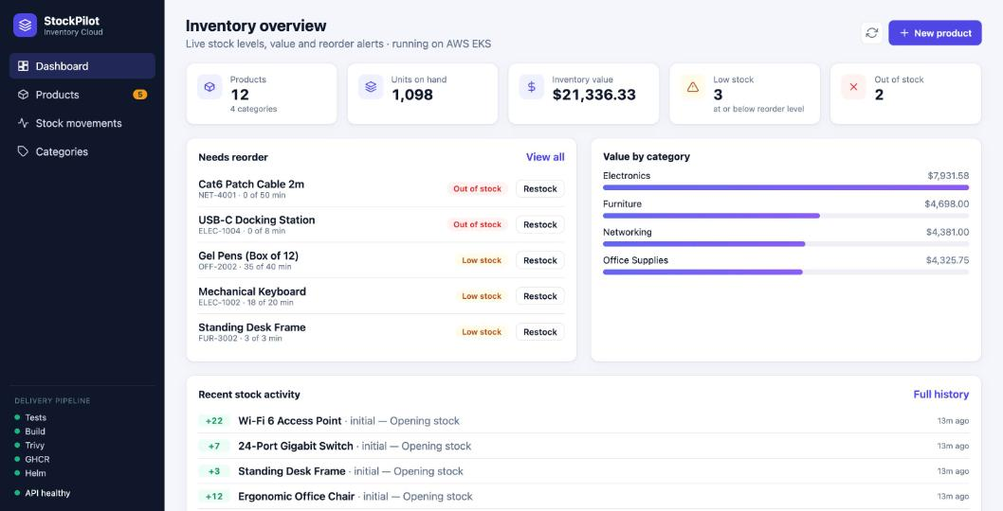
StockPilot
Inventory management, shipped from a Git push to a monitored Kubernetes cluster on AWS
Pragya Tripathi · Roll No 10032
DevOps Final Capstone · October 2026
Notes:
Hi, I'm Pragya Tripathi, roll number 10032. This is StockPilot, my DevOps final capstone. StockPilot is an inventory management app for warehouses and offices: it tracks products, categories and every stock movement, and warns you before something runs out. But the real subject of this project is the journey: how one Git commit travels through tests, security scanning, a container registry and Terraform-built AWS infrastructure, into a monitored, autoscaling Kubernetes cluster.

Slide 2
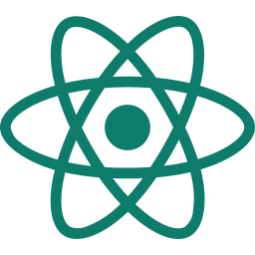
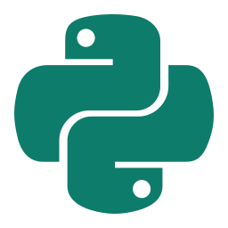
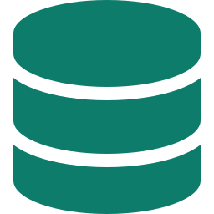

The application
React + Vite frontend
Dashboard, products, stock movements, categories; works on phones
FastAPI backend
14 REST endpoints plus /health, /ready and /metrics
PostgreSQL + Alembic
3 tables, versioned migrations, demo seed data
Live on AWS EKS, reached through the Ingress load balancer
21 automated tests
pytest on in-memory SQLite, plus ruff lint, on every push
Notes:
Here is the application. The frontend is React with Vite: a dashboard with KPIs, a reorder list, value by category, and pages for products, stock movements and categories. It also works on a phone. The backend is FastAPI with fourteen REST endpoints. Every quantity change goes through a stock adjustment, so there's a full audit trail. Data lives in PostgreSQL, and the schema is managed by Alembic migrations. There are twenty-one pytest tests that run against an in-memory SQLite database, so they never touch the real database, plus a ruff lint check. The backend also exposes health, readiness and Prometheus metrics endpoints, which Kubernetes and monitoring use later.

Slide 3



From commit to cluster
Git push
›
Lint + tests
›
Frontend build
›
Docker build
›
Trivy scan
›
GHCR
›
Helm
›
EKS
GitHub Actions
AWS, built by Terraform
Commit SHA
is the image tag, so every running pod traces back to one commit
Quality gate
a failed test or a fixable HIGH/CRITICAL CVE stops the release
No stored keys
GitHub OIDC assumes a short-lived AWS role to deploy
Notes:
This is the delivery path. A push to main starts GitHub Actions. First the backend is linted and tested and the React frontend is built. If that passes, both Docker images are built and scanned with Trivy. If any test fails, or Trivy finds a high or critical vulnerability that has a fix, the pipeline stops and nothing is released. Images are pushed to GitHub Container Registry, tagged with the Git commit SHA, never 'latest', so every running pod traces back to an exact commit. Finally Helm deploys the new version to Amazon EKS. The deploy job logs in to AWS with GitHub OIDC, so no AWS access keys are stored in GitHub at all.

Slide 4
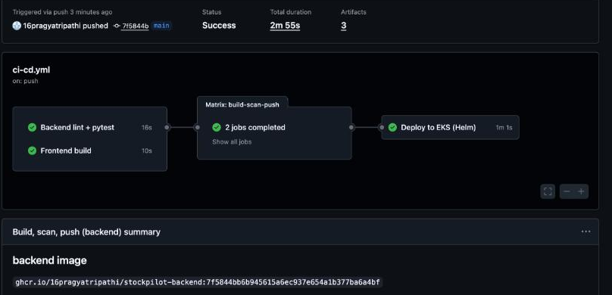
CI/CD and security
5 / 5 jobs
green, ending in the EKS deploy
0
fixable HIGH/CRITICAL CVEs in both images
Non-root
backend uid 10001, frontend uid 101
A real run: every job green, ending in the Helm deploy to EKS
Notes:
Here is a real pipeline run: lint and tests, frontend build, the build-scan-push job for each image, and the deploy to EKS, all green. Trivy reports zero fixable high or critical vulnerabilities. It did find some at first: four high CVEs in libraries that pip bundles inside the base image. The app never runs pip, so I removed pip from the final image and the scan came back clean. Both containers run as non-root users, and every third-party GitHub Action is pinned to a commit SHA, which protects the pipeline if an action's tags are ever tampered with.

Slide 5
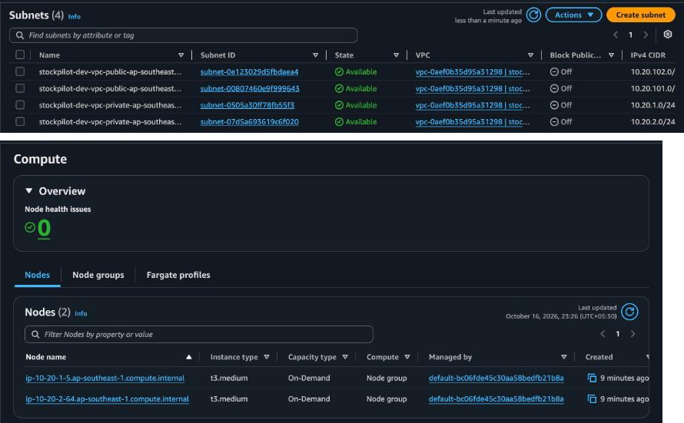
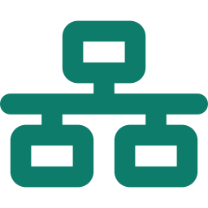
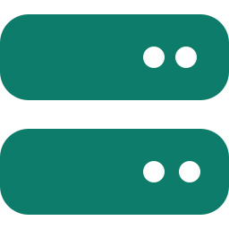


Infrastructure as code
VPC across 2 AZs
Public subnets + NAT gateway, private subnets for nodes
EKS 1.36 + managed nodes
2 × t3.medium; VPC CNI, CoreDNS, EBS CSI via Pod Identity
GitHub OIDC deploy role
Only the main branch of this repo can assume it
64 resources, one plan
terraform plan, apply, and destroy after the demo
AWS console: the Terraform VPC's 4 subnets and the 2 EKS nodes
Notes:
All of the AWS infrastructure is written in Terraform, not clicked together in the console. It creates a VPC across two availability zones, with public subnets for the load balancer and NAT gateway, and private subnets for the worker nodes. On top of that is an EKS cluster, version 1.36, with a managed node group of two t3.medium instances and the core add-ons. Terraform also creates the GitHub OIDC role that the pipeline uses, and only the main branch of this repository can assume it. That's sixty-four resources from one reviewed plan. Here you can see the four subnets and the two nodes in the AWS console. After the demo I destroyed everything with terraform destroy, so nothing keeps costing money.

Slide 6
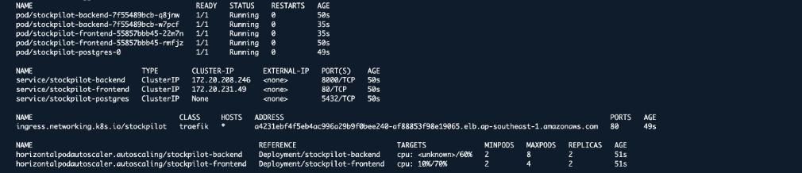
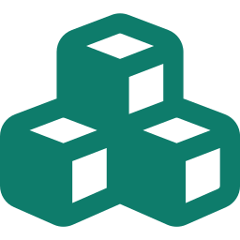


Kubernetes and Helm on EKS
Helm chart
2+ backend and frontend pods, PostgreSQL StatefulSet on a gp3 volume
Ingress
/ to React, /api to FastAPI, through an AWS Network Load Balancer
Self-healing
startup, readiness and liveness probes, plus PodDisruptionBudgets
Notes:
The application is packaged as a Helm chart, so one command deploys everything. Here's the result on EKS: two backend pods, two frontend pods and PostgreSQL, all running, with ClusterIP services and both autoscalers. The Ingress sends slash to the React frontend and slash-api to FastAPI, and it's exposed through an AWS Network Load Balancer. Kubernetes keeps it healthy: readiness checks the database before a pod gets traffic, liveness restarts a stuck pod, and disruption budgets keep at least one pod of each running during maintenance.

Slide 7
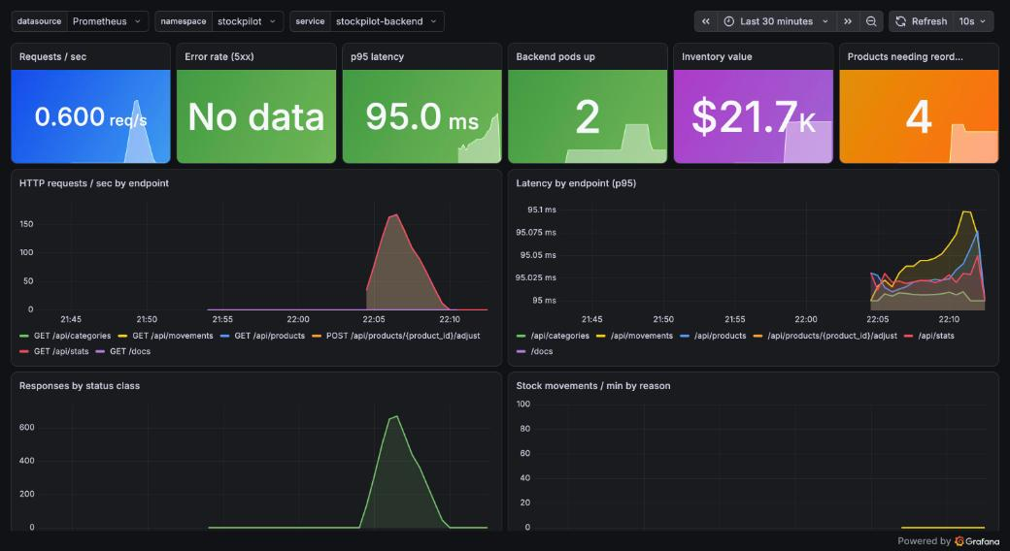
Autoscaling and monitoring
2 → 6 pods
HPA scaled the backend under load
~660 req/s
peak traffic during the load test
~95 ms
p95 latency, scraped by Prometheus
The Grafana dashboard ships with the Helm chart and loads automatically
Notes:
Next, autoscaling and monitoring. I ran an in-cluster load test against the backend. CPU went far above the sixty percent target, and the Horizontal Pod Autoscaler scaled the backend from two to six pods. Prometheus scrapes every backend pod's metrics endpoint through a ServiceMonitor, and this Grafana dashboard, which ships with the Helm chart, shows the load: about six hundred and sixty requests per second at the peak, with a p95 latency of around ninety-five milliseconds. It also shows business metrics, like inventory value and how many products need reordering, and there are alert rules for the backend going down, high error rate and slow requests.

Slide 8

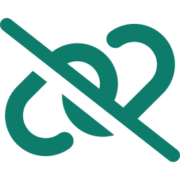

Troubleshooting lab
ImagePullBackOff
Wrong tag; describe pod names it; set image fixes it
$ kubectl get pods -l lab=broken-image
broken-image-695b… 0/1 ImagePullBackOff
$ kubectl describe pod -l lab=broken-image
Failed to pull …:v9.9.9-does-not-exist: not found
$ kubectl set image deploy/… backend=<real tag>
broken-image-585f… 1/1 Running
$ kubectl get endpointslices … api-broken
stockpilot-api-broken <unset> (no endpoints)
$ kubectl patch svc … selector=stockpilot-backend
stockpilot-api-broken 8000 10.244.1.23,10.244.1.14
Service with no endpoints
Selector didn't match the pod labels; patch the selector
Running but 0/1 Ready
/ready returns 503 on a bad DB password; no traffic sent
Notes:
Finally, troubleshooting. I built three deliberately broken manifests. First, a deployment with an image tag that doesn't exist. The pod goes to ImagePullBackOff; describe pod shows the registry said 'not found', and setting a real image fixes it. Second, a Service whose selector doesn't match any pod labels. It looks fine, but it has no endpoints, so it gets no traffic. Comparing the selector with the pod labels shows the mismatch, and patching the selector brings the endpoints back. Third, a backend with a wrong database password. The pod is Running but never Ready, because the readiness check fails, so Kubernetes never sends it traffic.

Slide 9
Every step automated and observable
21
automated tests
0
HIGH/CRITICAL CVEs
64
AWS resources
2 → 6
pods autoscaled
github.com/16pragyatripathi/devops-capstone-stockpilot
Pragya Tripathi · Roll No 10032
Notes:
To sum up: twenty-one automated tests, zero high or critical vulnerabilities, sixty-four AWS resources managed by Terraform, and autoscaling from two to six pods. All of it runs on a pipeline that goes from a Git push to a monitored Kubernetes cluster without manual steps. The code, Terraform, Helm chart, troubleshooting labs and screenshots are all in my GitHub repository. Thank you for watching.

