Slide 1


Machine Learning for Heart Disease Prediction
Author : Rasika Kulkarni
Date : 06.07.2023

Slide 2
Abstract
Heart diseases is the term that assigns a large number of medical conditions related to Heart. The key to Heart Diseases is to collect large amount of data and compare information that predict, prevent and manage such a disease.
Heart disease cause because of stress, family background and high blood pressure.
Notes:
Heart disease is more common death reason. according to research

Slide 3
Present Scenario
Cardiovascular disease is the most common type of heart disease, occurring mostly in adults 20 to 60
WHO has estimated 12 million deaths occur worldwide because of heart diseases every year.
WHO predicted in year 2030 over 80% deaths will be because of heart diseases which is 23.6 million.
25% deaths are in age group (25-69)(predicted)
Notes:
Cardiovascular diseases (CVDs) are the number 1 cause of death globally

Slide 4
CONFIGURATION USED
SOFTWARE CONFIGURATION
Operating System : Windows 7
Programming Language: Python
Application : Steamlit
Machine Learning (Supervised)
HARDARE CONFIGURATION
Processor: Intel core i5

Slide 5
STEPS FOLLOWED
Selecting proper Dataset
Feature Selection
Upload Training Data
Modelling Data
Testing Test Data
Checking Accuracy
Predicting heart disease
Graphical Presentation

Slide 6
Dataset ANALYSIS ON FEATURES
Thal : Blood disorder
Thalach : Maximum heart rate achieved
Cp: Chest pain
Trestbps : Resting Blood pressure
Fbs : Fasting blood sugar level (Diabetes)
Age : age

Slide 7
Model ACCURACY LEVEL
Name of the Model Percentage of accuracy
Random Forest 92.45%
Decision Tree 90.09%
Logistic Regression 80.66%
Notes:
Random forest has highest accurracy

Slide 8

Data Analysis

Slide 9
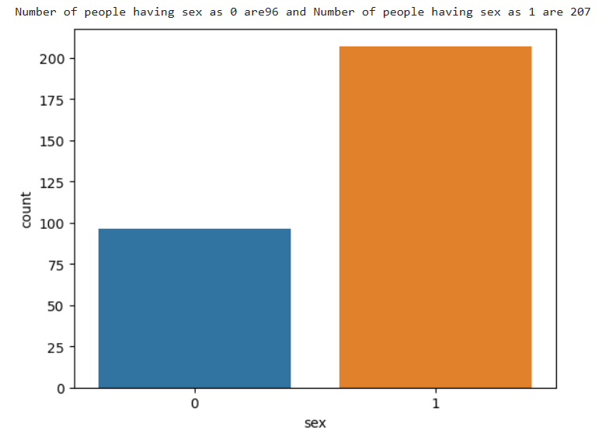
Data Analysis Based on gender
0 = Female
1 = Male
Notes:
Total number Cases: 303
Heart diseases cases are 165 No Heart disease cases are 138
Heart Disease male count 207 Heart Disease female count 96

Slide 10
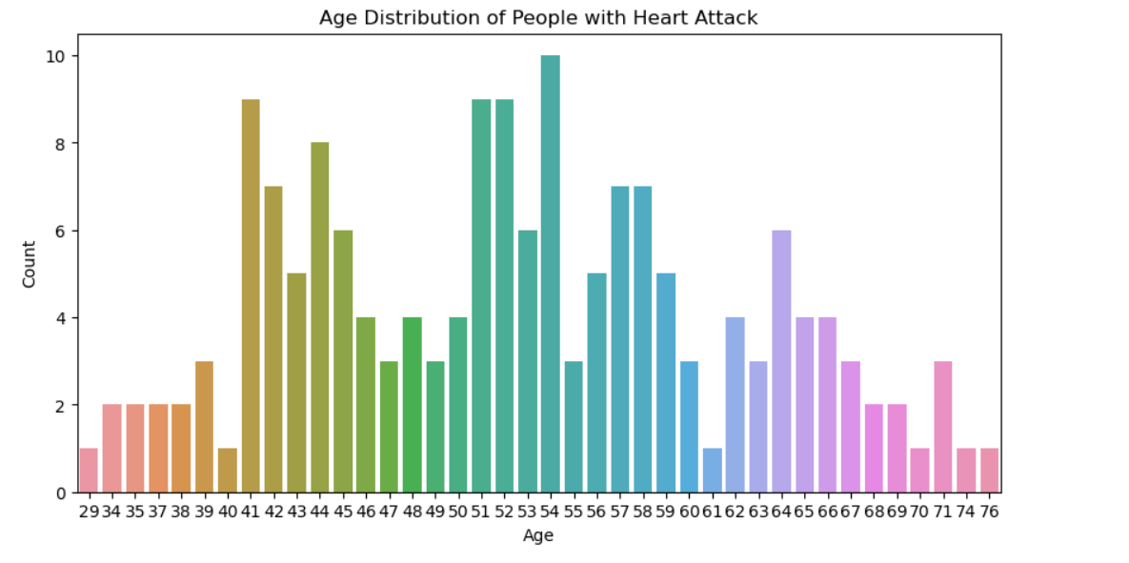
Data Analysis Age Distribution
Age : 40 to 65

Slide 11
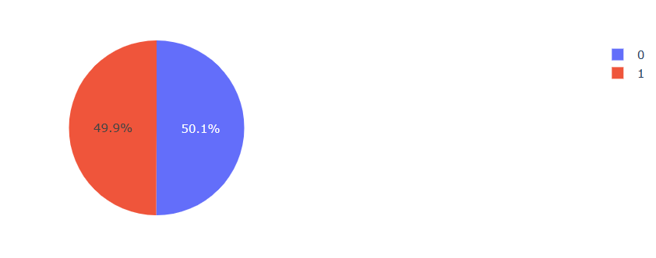
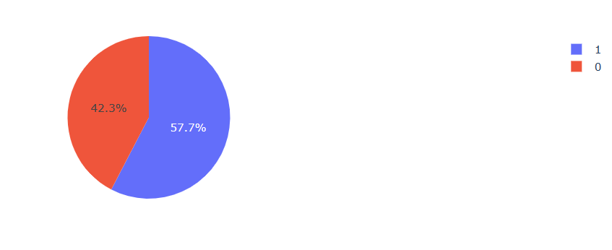
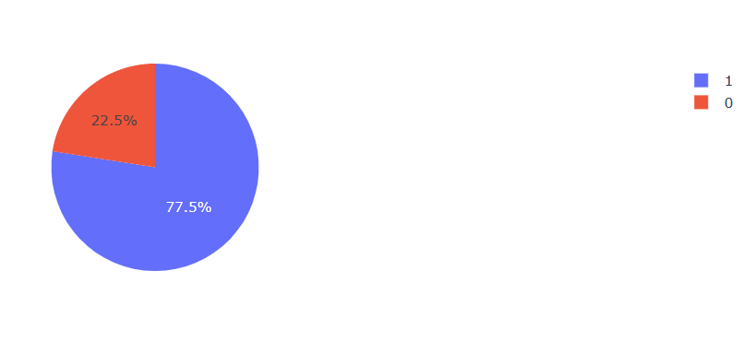
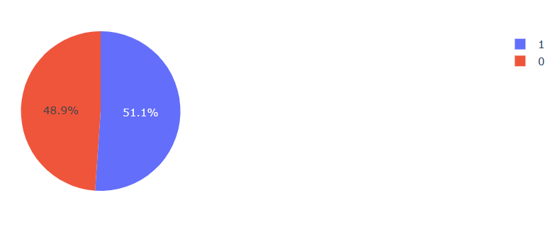
Data Analysis Major Features
Maximum heart rate
Blood disorder
Chest pain
Diabetes

Slide 12
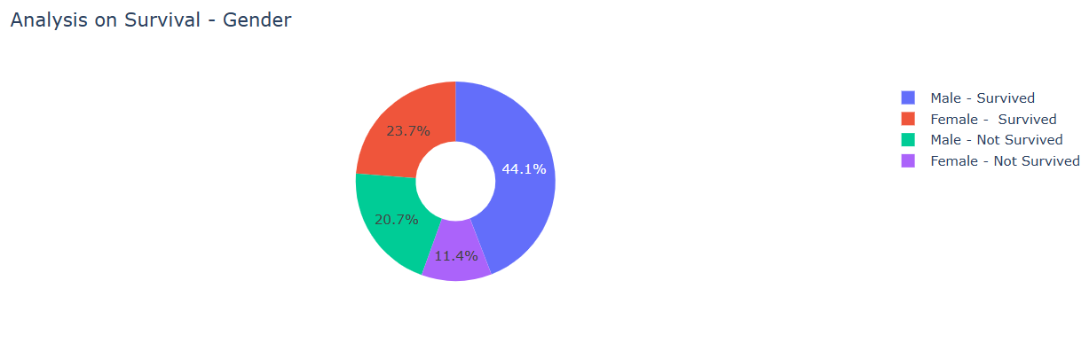
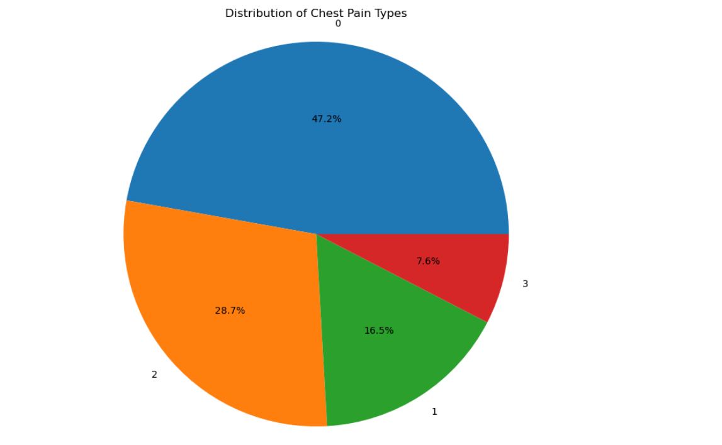
Data Analysis Survival and chest paint types

Slide 13
Heart Dieses Prediction App
https://heartdiseases.streamlit.app

Slide 14
Thank you

