Slide 1
All stacks are vertical
QVFT’s future in cyberspace

Slide 2
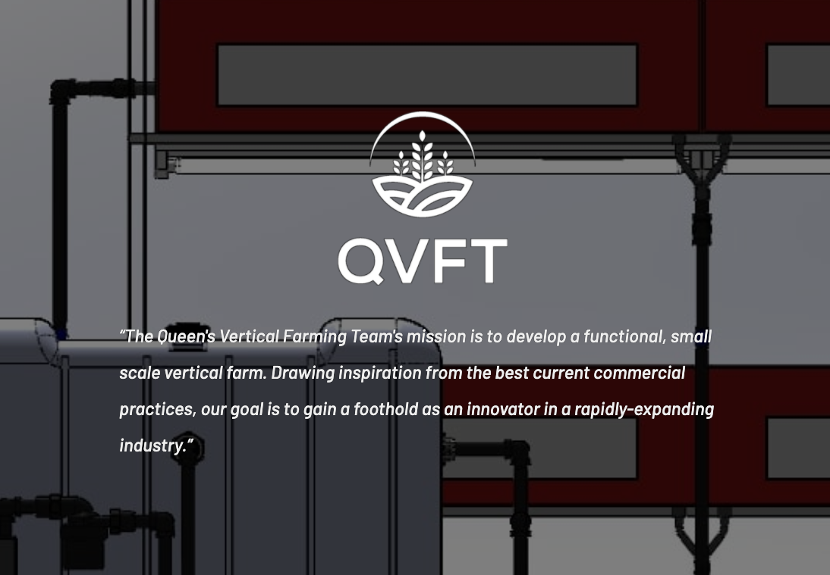
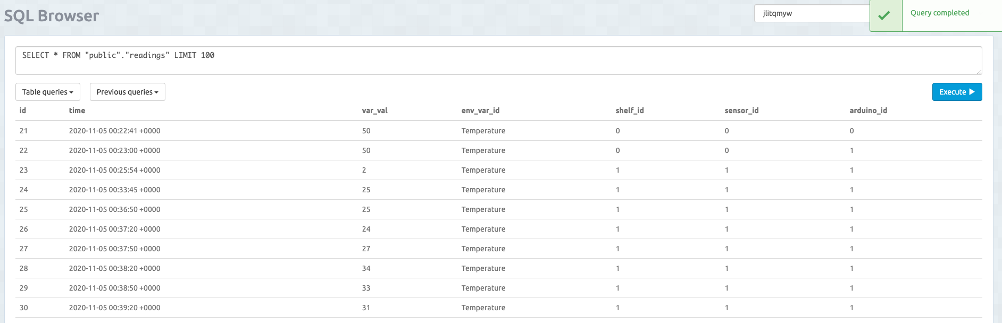
QVFT in cyberspace
qvft.ca
Svelte
static
ElephantSQL – Database host
✨AWS ✨
VERY dynamic

Slide 3

The situation
Database architecture
Frontend
Backend

Slide 4
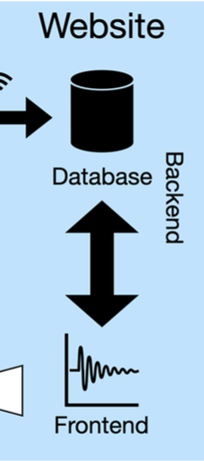

The stack
Database
Backend
Front end
Database – MySQL
Backend – Scripting Language (Python/php/JavaScript)
Frontend – HTML/CSS

Slide 5

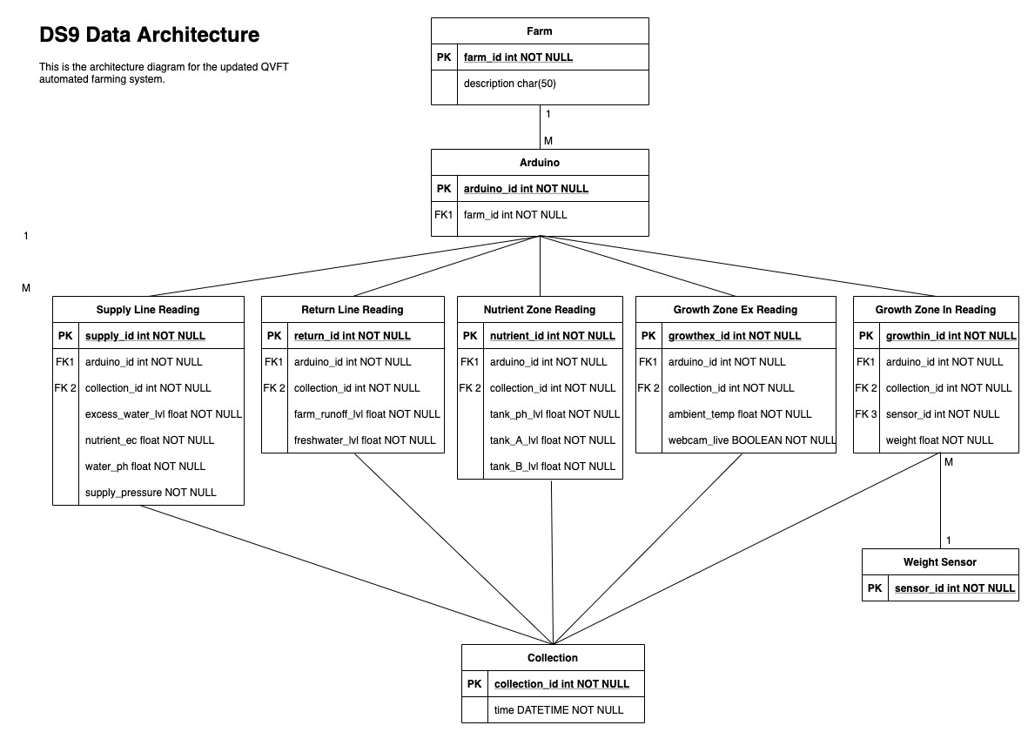
You only need to write MySQL once!
Ish
ElehpantSQL
DDL

Slide 6


Our holy grail is a flask!
Python
ElephantSQL
Bootstrap
Hosting
Community

Slide 7

Hosting
Scripting languages need a computer to run them
$$$
www.pythonanywhere.com

Slide 8
The Stack
Hosted by ElephantSQL
{
MySQL
Flask
Hosted by TBD
Flask

Slide 9
What is next?
Winter 2021
Ensure Database architecture works with our current and future goals
DDL to Elephant SQL
Local Flask Server
Summer 2021
Hosting Flask server online
Sample data
GitHub

Slide 10

Thank you

