Slide 1
Managing Sessions of Multiple Server
백엔드 면접 대비 CS스터디
2021105 김근태

Slide 2
목차
Sticky Session
Session Clustering
Distributed Session Manager

Slide 3
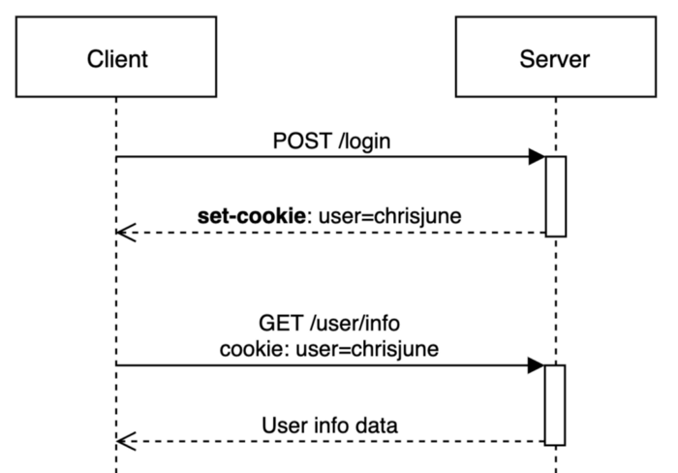
Session 이란?

Slide 4
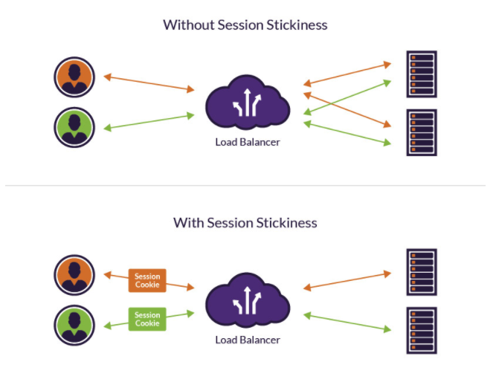
1. Sticky Session

Slide 5
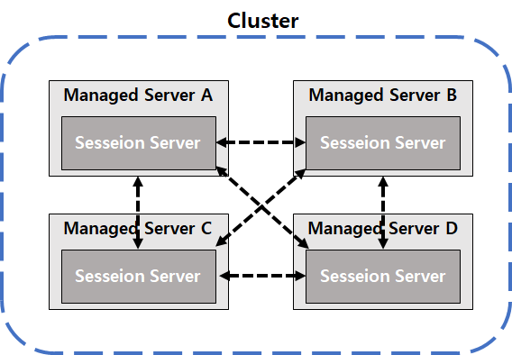
2. Session Clustering

Slide 6
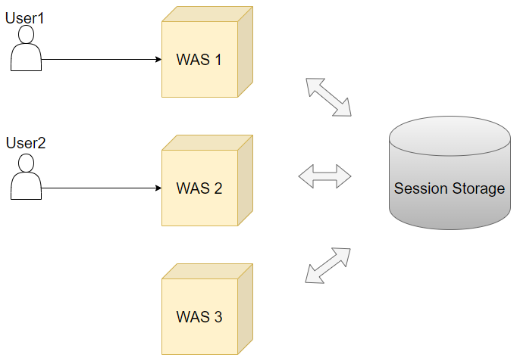
3. Distributed Session Manager

Slide 7
출처
https://chrisjune-13837.medium.com/web-%EC%BF%A0%ED%82%A4-%EC%84%B8%EC%85%98%EC%9D%B4%EB%9E%80-aa6bcb327582
https://www.imperva.com/learn/availability/sticky-session-persistence-and-cookies/
https://www.imperva.com/learn/availability/load-balancing-algorithms/
https://s01va.github.io/WAS-Clustering/
https://thenewstack.io/how-to-build-intelligence-into-your-session-stores/
https://ignite.apache.org/use-cases/caching/web-session-clustering.html
https://ko.wikipedia.org/wiki/%EC%9D%B8%EB%A9%94%EB%AA%A8%EB%A6%AC_%EB%8D%B0%EC%9D%B4%ED%84%B0%EB%B2%A0%EC%9D%B4%EC%8A%A4
https://tjdrnr05571.tistory.com/3
https://dololak.tistory.com/147
https://velog.io/@hyeminn/%EB%8B%A4%EC%A4%91-%EC%84%9C%EB%B2%84-%ED%99%98%EA%B2%BD%EC%97%90%EC%84%9C-%EC%84%B8%EC%85%98%EC%9D%84-%EA%B4%80%EB%A6%AC%ED%95%98%EB%8A%94-%EB%B0%A9%EB%B2%95

Slide 8
끝!

