Slide 1
SSR 과 CSR 그리고 SSG
백엔드 면접 대비 CS스터디
2021105 김근태

Slide 2
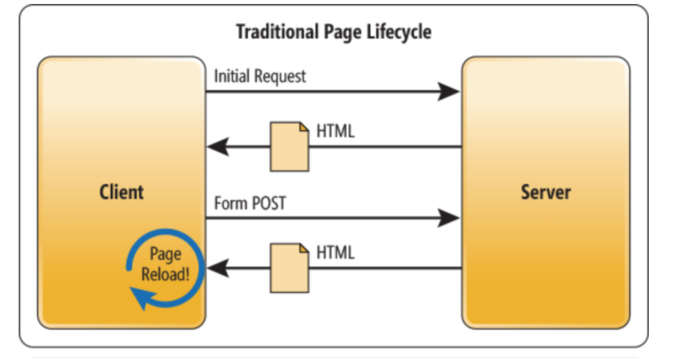
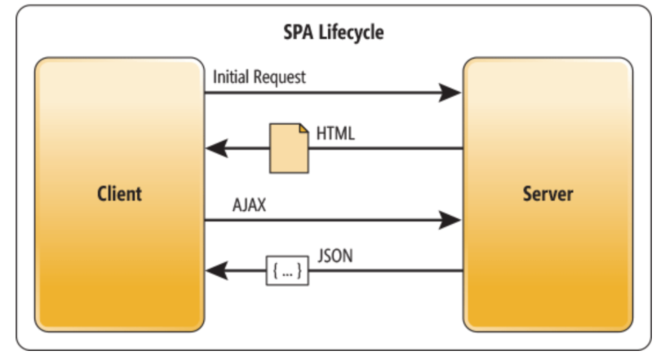
MPA 와 SPA
(Multi Page Application, Single Page Application)

Slide 3
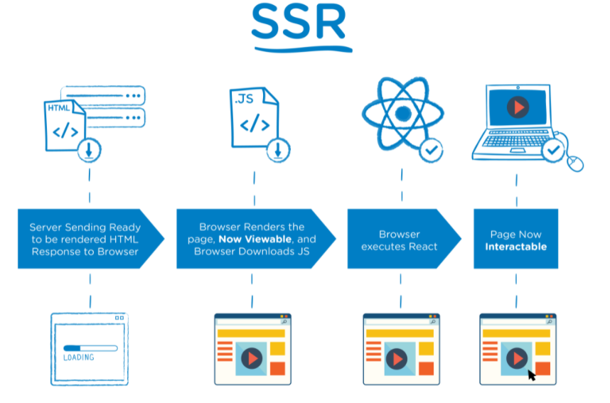
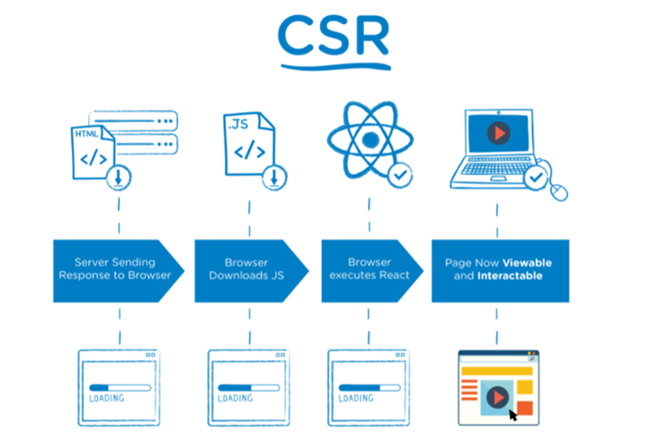
SSR 과 CSR
(Server Side Rendering, Client Side Rendering)

Slide 4
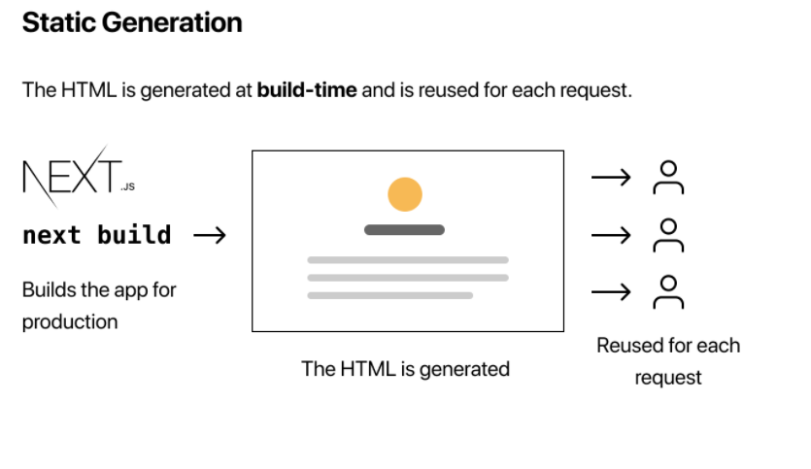
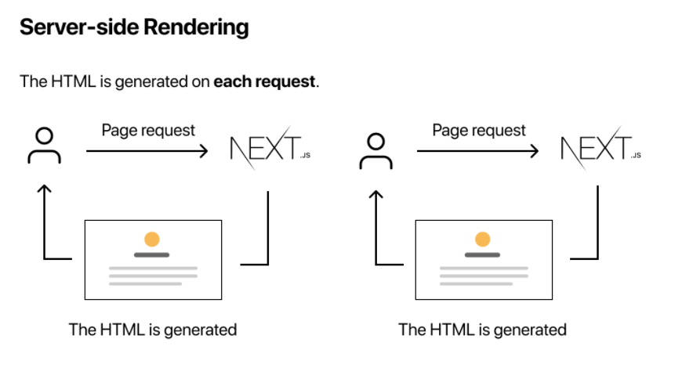
SSG
(Server Site Generation)

Slide 5
출처
웹동작원리 원문 (영문)
https://www.html5rocks.com/en/tutorials/internals/howbrowserswork/
웹동작원리 번역 (한글)
https://d2.naver.com/helloworld/59361
https://velog.io/@longroadhome/FE-CSRClient-Side-Rendering-vs-SSRServer-Side-Rendering-feat.-React%EB%A5%BC-%EC%A4%91%EC%A0%90%EC%9C%BC%EB%A1%9C
https://velog.io/@longroadhome/FE-SSRServer-Side-Rendering-%EA%B7%B8%EB%A6%AC%EA%B3%A0-SSGStatic-Site-Generation-feat.-NEXT%EB%A5%BC-%EC%A4%91%EC%8B%AC%EC%9C%BC%EB%A1%9C

Slide 6
끝!

