Slide 1
DOM과 Virtual DOM
백엔드 면접 대비 CS스터디
2021105 김근태

Slide 2
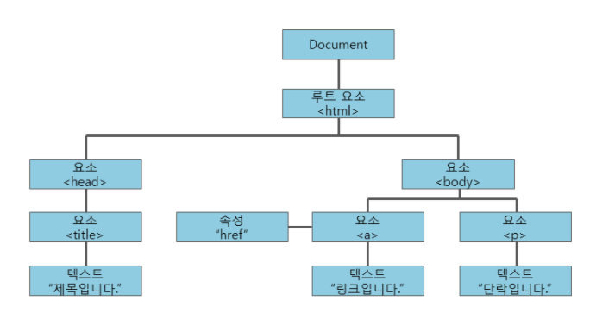
DOM 이란?
(Document Object Model)

Slide 3
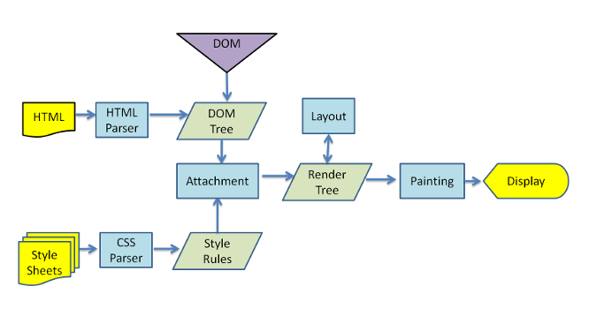
Rendering 과정

Slide 4
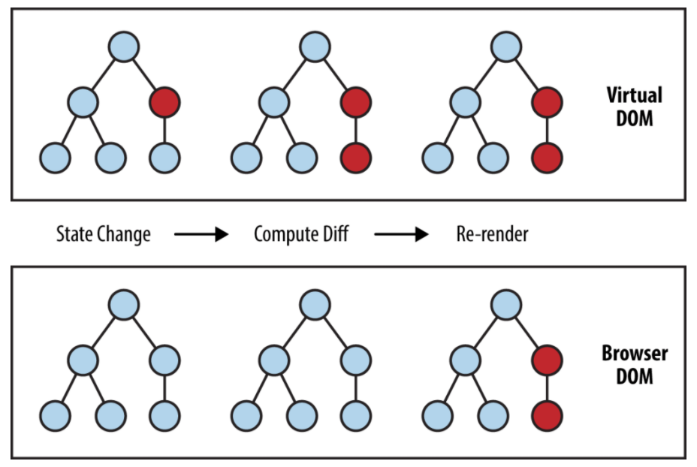
Virtual DOM

Slide 5
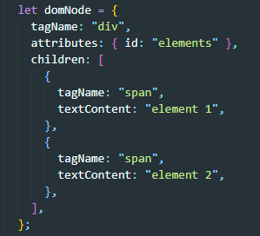

Virtual DOM Example

Slide 6
출처
https://hashnode.com/post/the-one-thing-that-no-one-properly-explains-about-react-why-virtual-dom-cisczhfj41bmssp53mvfwmgrq
http://tcpschool.com/javascript/js_dom_concept
http://52.78.22.201/tutorials/translate/virtual-dom/
https://yceffort.kr/2020/07/change-detection-in-angular-react
https://medium.com/js-dojo/whats-new-in-vue-js-2-0-virtual-dom-dc4b5b827f40

Slide 7
끝!

