Slide 1
INTRODUCTION
GRAPH

Slide 2
History of Graph | THEORY
Origin
Problem: (of) Königsberg bridge, in 1735.
In 1735, the city of K Königsberg (present-day Kaliningrad and part of Russia) was divided into four districts by the Pregel River.
The four districts were connected by seven bridges.

Slide 3
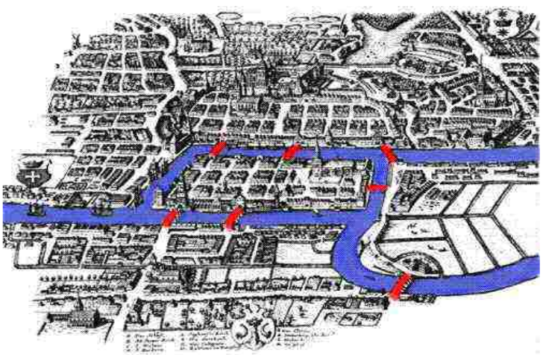
Is it possible to design a walking tour of Königsberg in which you cross each of the seven bridges exactly once?

Slide 4
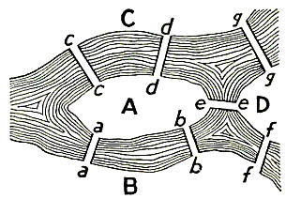
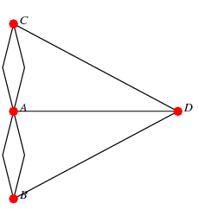
Königsberg Bridge Problem
This problem was answered in the negative by Euler

Slide 5
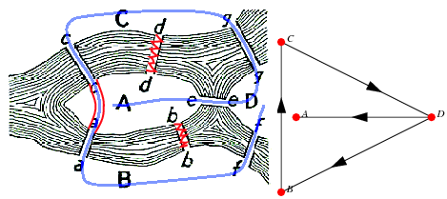
J. Kåhre observes using the modern Königsberg bridges
that bridges b b and d d no longer exist and that a a and c c are now a
single bridge passing above with a stairway in the middle leading down
to . Even so, there is still no Eulerian cycle on the nodes A,B ,C , and D.

Slide 6
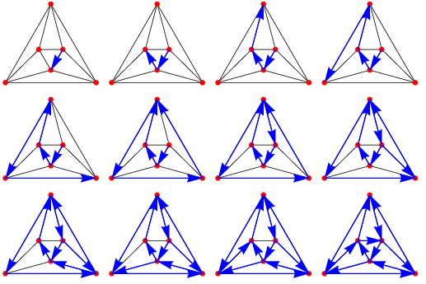
Eulerian Cycle
An Eulerian cycle, also called an Eulerian circuit, Euler circuit, Eulerian tour, or Euler tour, is a trail which starts and ends at the same graph vertex.
In other words, it is a graph cycle which uses each graph edge exactly once.

Slide 7
The Mathematics of Networks
The mathematical models we need to solve the Konigsberg problem is a graph.
designing travel routes
connecting networks efficiently
scheduling tasks
coloring regions of maps

Slide 8
Graphs
Things that can be modeled with graphs include
maps
Molecules
flow charts
family trees
Internet (web pages connected by links)
Facebook/Google+ (people connected by friendship)

Slide 9
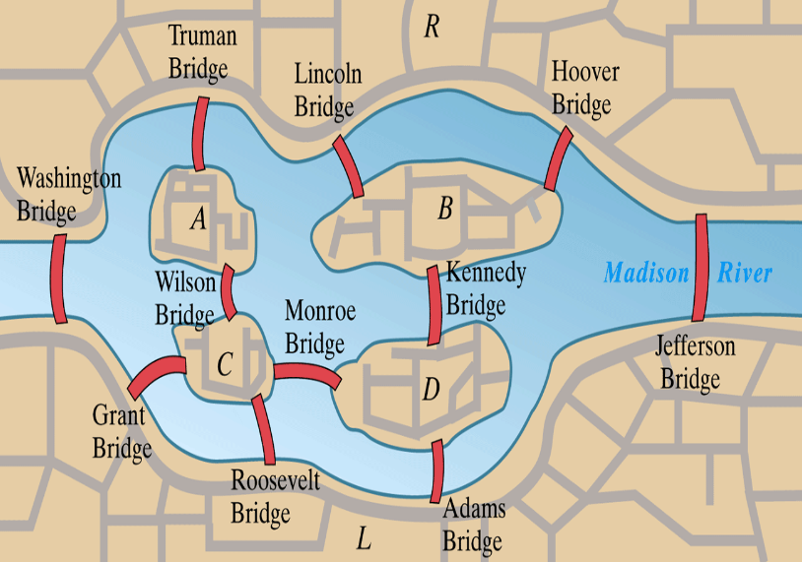

Slide 10
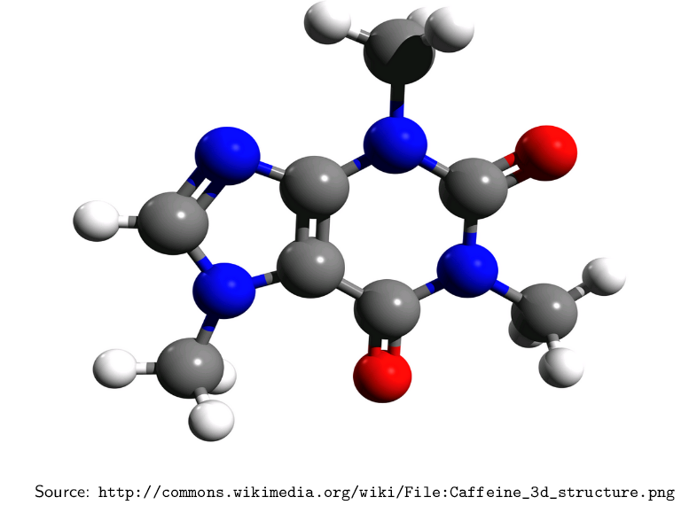

Slide 11
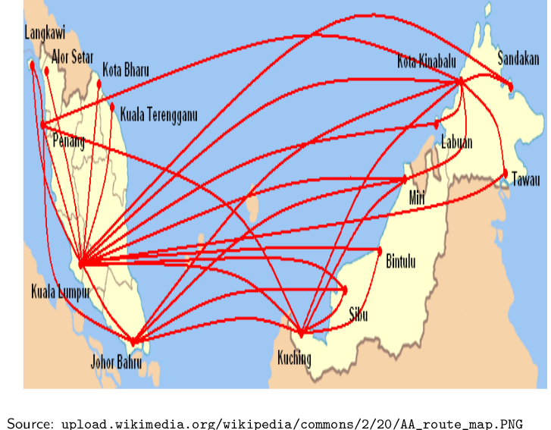

Slide 12
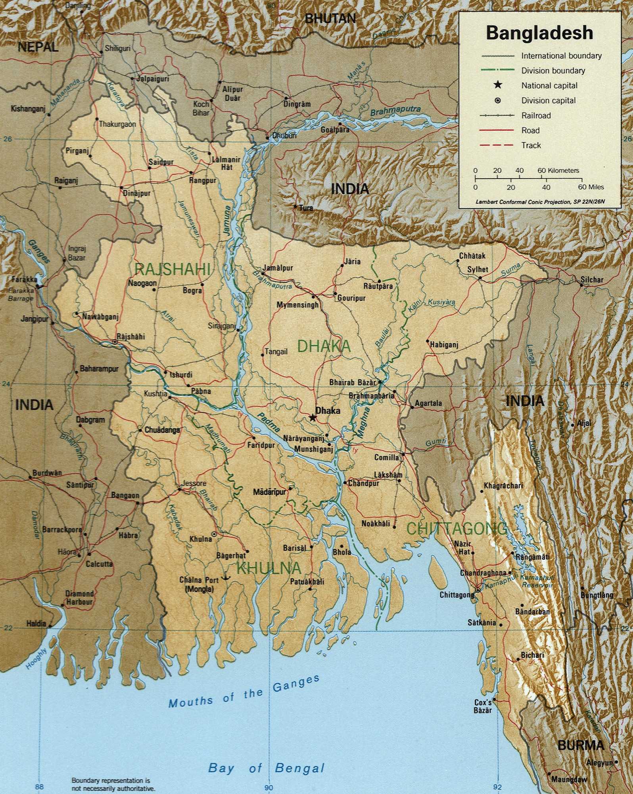

Slide 13
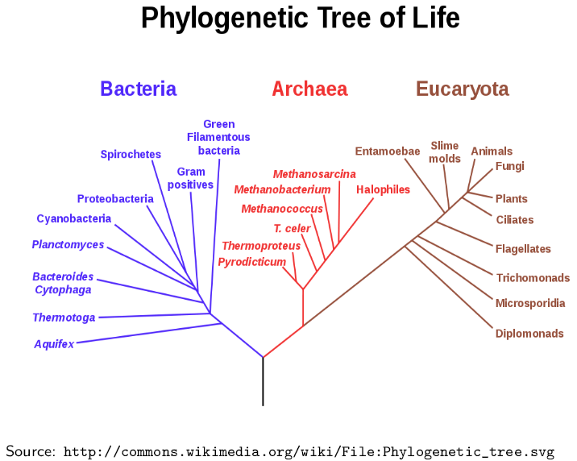

Slide 14
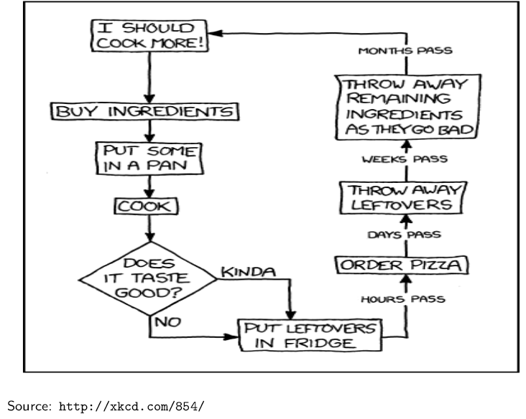

Slide 15
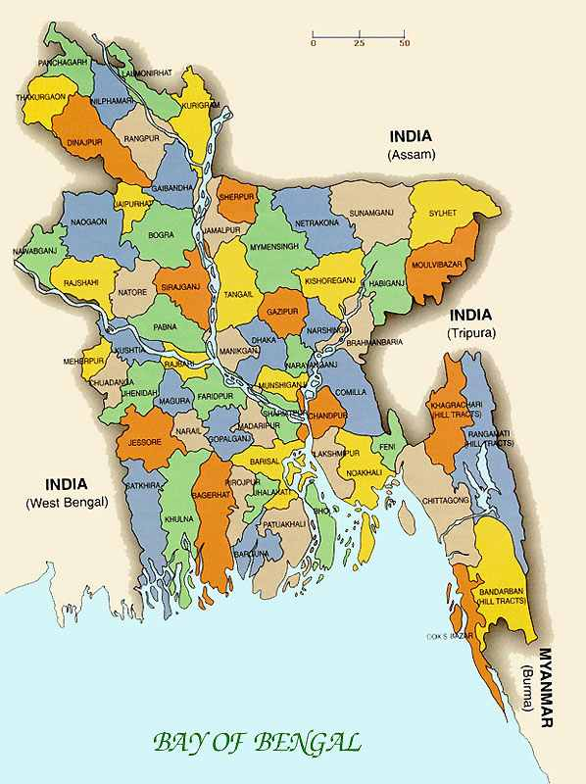

Slide 16
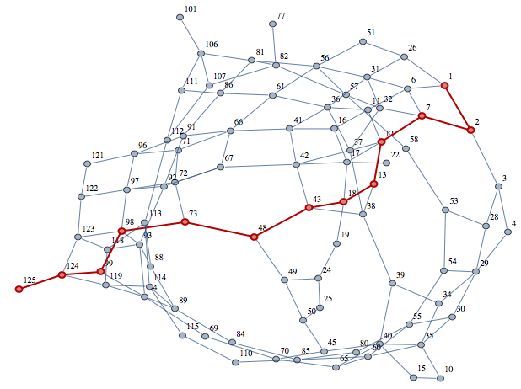

Slide 17
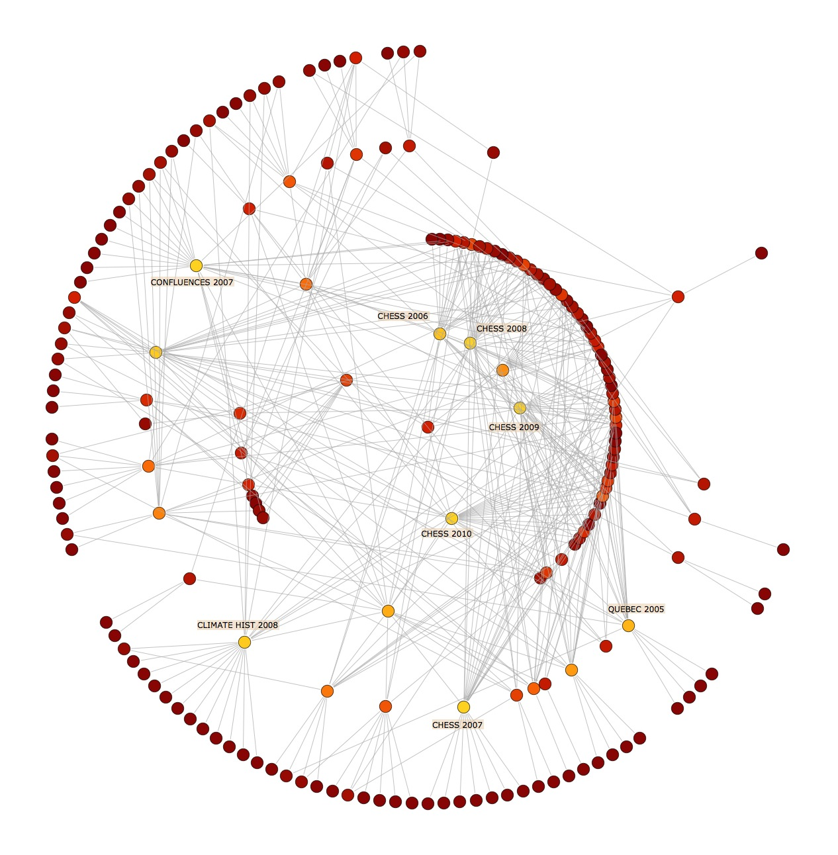

Slide 18
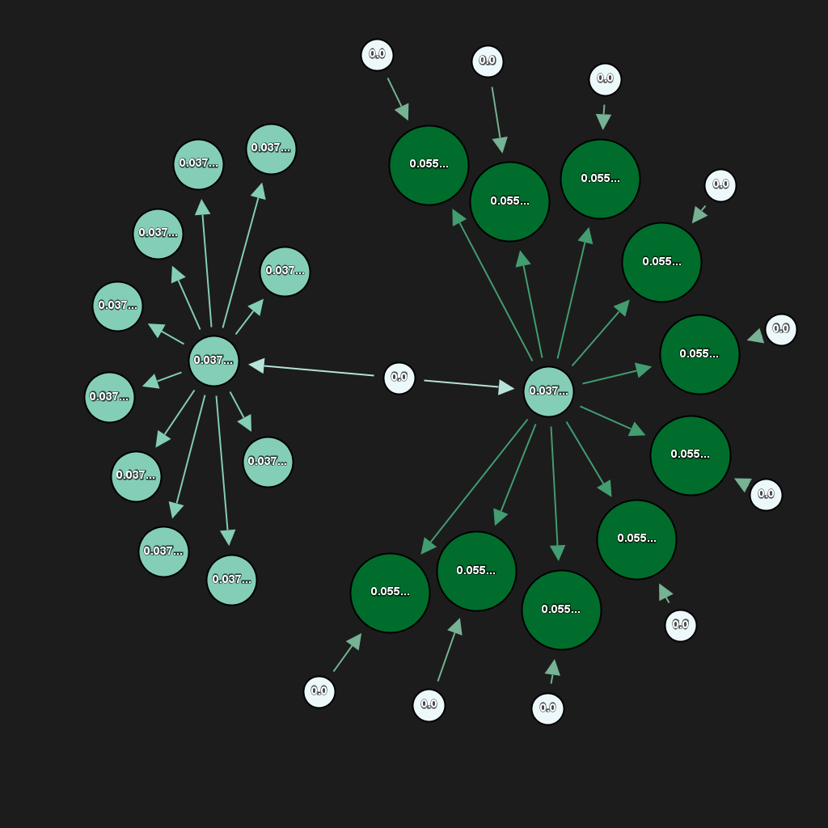

Slide 19
Graph applications | in computer science
Data base designing
In data base designing graphs are used as graph data bases.
Graph database uses graph representation with nodes, edges, and properties to represent and store data.
This graph structure has key role in designing database, because it gives fast implementation process using different functionality and properties of graph structure

Slide 20
Software engineering
During Requirements Specification, Data Flow diagrams are used where vertices represent transformations and edges represents the data flows.
During Design phase, graphical design is used for describing relations among modules;
During Testing, the control flow of a program associated with McCabe's complexity measure which employs directed graphs for addressing the sequence of executed instructions and etc.

Slide 21
Network system
The term graph and network are equal. Both refer to a type of structure in which there exists vertices (i.e. nodes, dots) and edges (i.e. links, lines).
There are numerous types of graphs and networks which yield more or less structure

Slide 22
Computer hardware
Graph theory concepts are used in hardware world to provide:
Register allocation by graph coloring
Representation of instruction sequences by graphs by adjacency matrix
In instruction parallel processing
Process of allocation scheduling

Slide 23
Data structure
The logical or mathematical model of a particular organization of data is called a “data structure”. The choice of data model depends on two considerations:
It must be rich enough in structure to mirror actual relationship of data in real world.
The structure should be simple enough that one can effectively process data when necessary.
These two considerations is fulfilled by the graph theoretical concepts.

Slide 24
Image processing
The applications of graphs in image processing are:
to find edge boundaries using graph search algorithms in segmentation.
To calculate he alignment of the picture
Finding mathematical constraints such as entropy by using minimum spanning tree.
Finding distance transforms of the pixels and calculates the distance between the interior pixels by using shortest path algorithms.

Slide 25
Data mining
Graph mining represents the relational aspect of data.
There are five theoretical based approaches of graph based data mining.
They are sub graph categories, sub graph isomorphism, graph invariants, mining measures and solution methods

Slide 26
Operating system
Many practical problems can be solved with the help of graph in the field of operating system such as job scheduling and resource allocation problems.
For example graph coloring concept can be applied in job scheduling problems of CPU, jobs are assumed as vertices of the graph and there will be an edge between two jobs that cannot be executed simultaneously and there will be one to one relationship between feasible scheduling of graphs

Slide 27
Website designing
There are many advantages of using graph representation in website development such as:
Searching and community discovery.
Graph representation (directed graph) in web site utility evaluation and link structure.
Finding all connected component and provide easy detection.

