Slide 1
Graphs
Graphs provide a convenient way to represent various kinds of mathematical objects.
Essentially, any graph is made up of two sets:
1- A set of vertices
2- A set of edges.
Graph G = (V, E)
V = {1,…n} = set of vertices, E = set of e edges

Slide 2
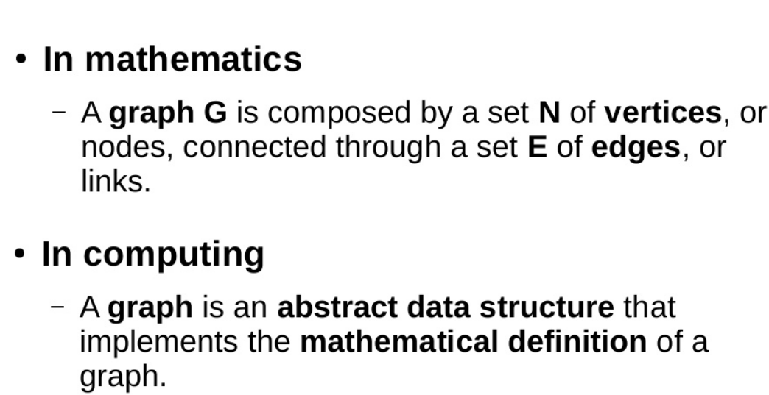

Slide 3
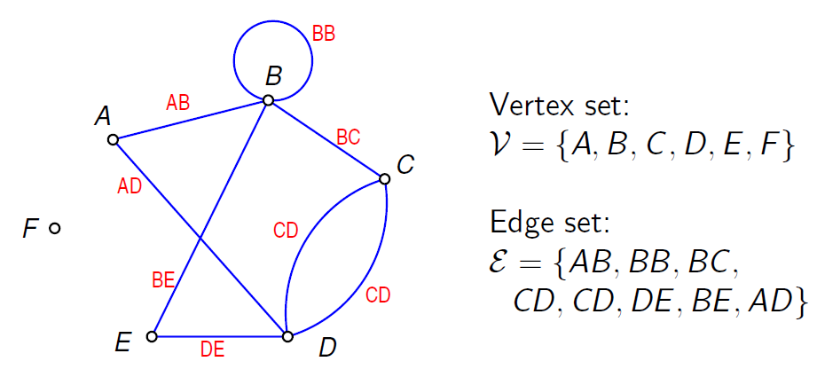
Graph Terminology

Slide 4
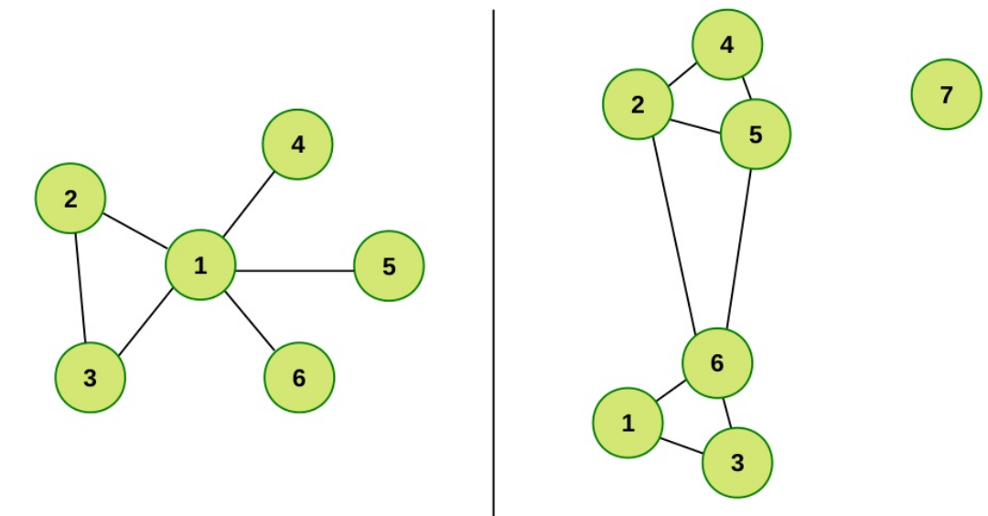
Graph Examples

Slide 5
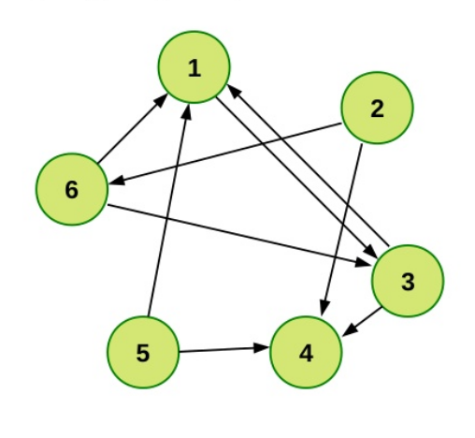
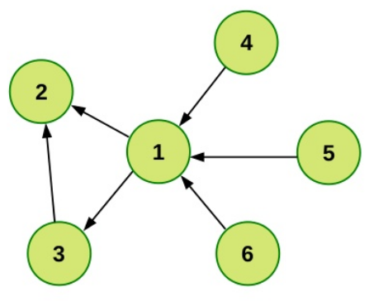
Directed & Undirected Graph
Undirected graph:
edge (u, v) = edge (v, u)
no self-loops
Directed graph (digraph):
edge (u, v) goes from vertex u to vertex v

Slide 6
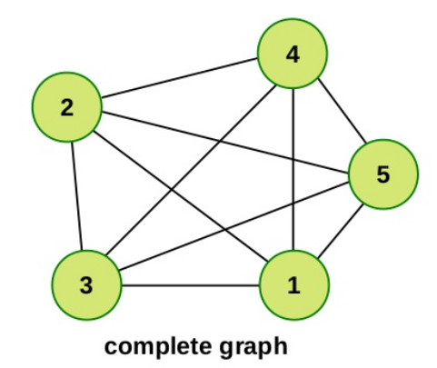
Complete Graph
Every pair of node is connected with and edge

Slide 7
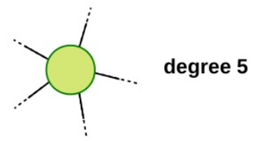
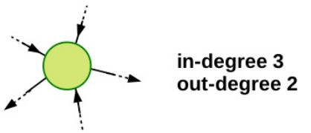
Degree
Degree (Valence) of a Vertex
Is the number of adjacent edges
In directed graph each node contains and in-degree and out-degree
In regular graph each vertex represent the same degree

Slide 8
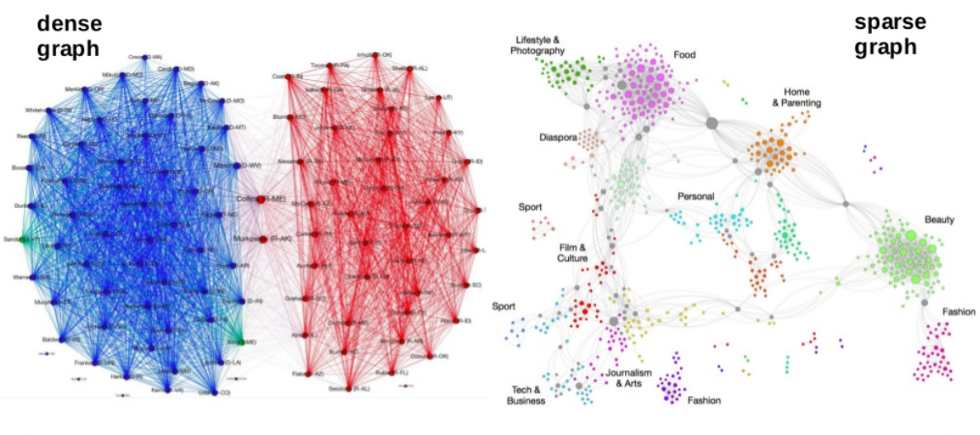
Sparse or Dense Graph

Slide 9
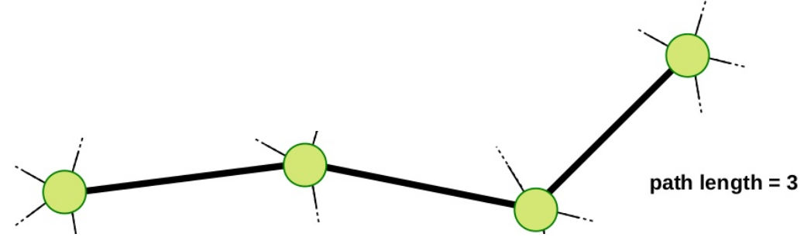
Path
In a sequence of nodes where adjacent nodes are connected with an edge.
In a directed graph, the edge must be directed according to the direction of the path.
Path Length-
Is the number of edges along the path

Slide 10
Paths and Circuits
Rule: A trip cannot use the same edge more than once, but it may pass through the same vertex more than once.
A trip is called a path if its starting and ending vertices are different.
It is called a circuit if the starting and ending vertices are the same.

Slide 11
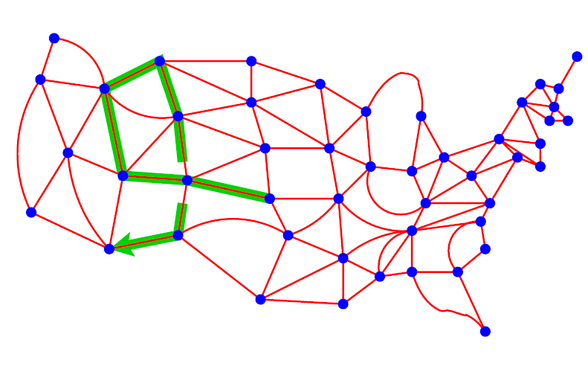
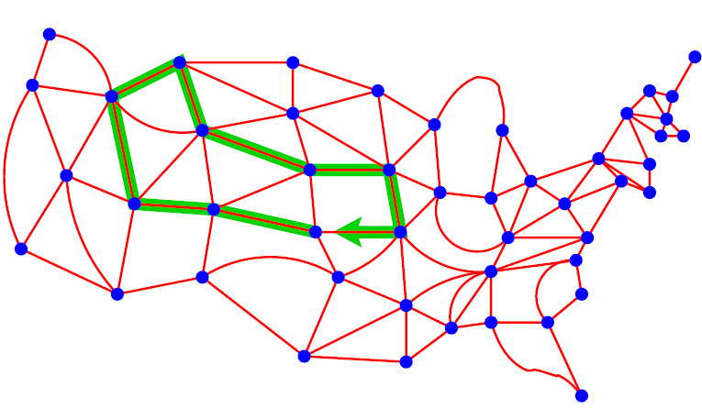
Identify Paths and Circuits

Slide 12
Graph Terminology

Slide 13
Graph Examples

Slide 14
Directed & Undirected Graph
Undirected graph:
edge (u, v) = edge (v, u)
no self-loops
Directed graph (digraph):
edge (u, v) goes from vertex u to vertex v

Slide 15
Complete Graph
Every pair of node is connected with and edge

Slide 16
Degree
Degree (Valence) of a Vertex
Is the number of adjacent edges
In directed graph each node contains and in-degree and out-degree
In regular graph each vertex represent the same degree

Slide 17
Sparse or Dense Graph

Slide 18
Path
In a sequence of nodes where adjacent nodes are connected with an edge.
In a directed graph, the edge must be directed according to the direction of the path.
Path Length-
Is the number of edges along the path

Slide 19
Paths and Circuits
Rule: A trip cannot use the same edge more than once, but it may pass through the same vertex more than once.
A trip is called a path if its starting and ending vertices are different.
It is called a circuit if the starting and ending vertices are the same.

Slide 20
Identify Paths and Circuits

Slide 21
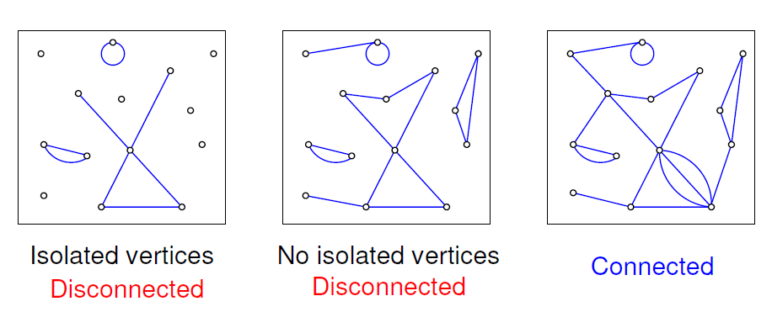
Connectedness
A graph is called connected if any two vertices can be linked by a path. Otherwise, it is disconnected.

Slide 22
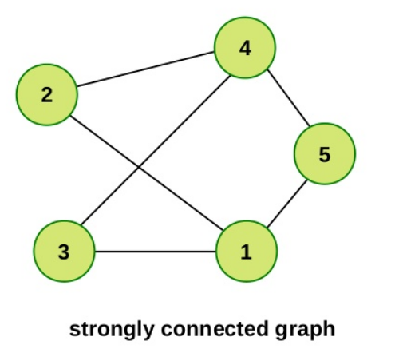
Strongly Connected Graph
Strongly Connected Graph represent a path between every pair of nodes

Slide 23
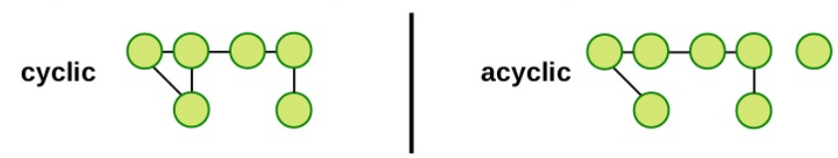
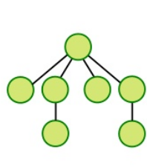
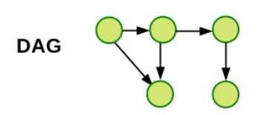
Cyclic or Acyclic
Connected acyclic undirected graph: trees
Directed Acyclic Graph (DAG)

Slide 24
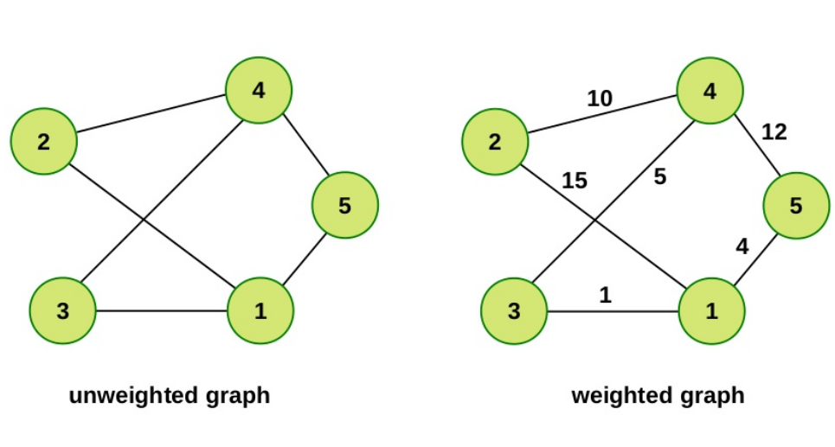
Unweighted & Weighted

Slide 25
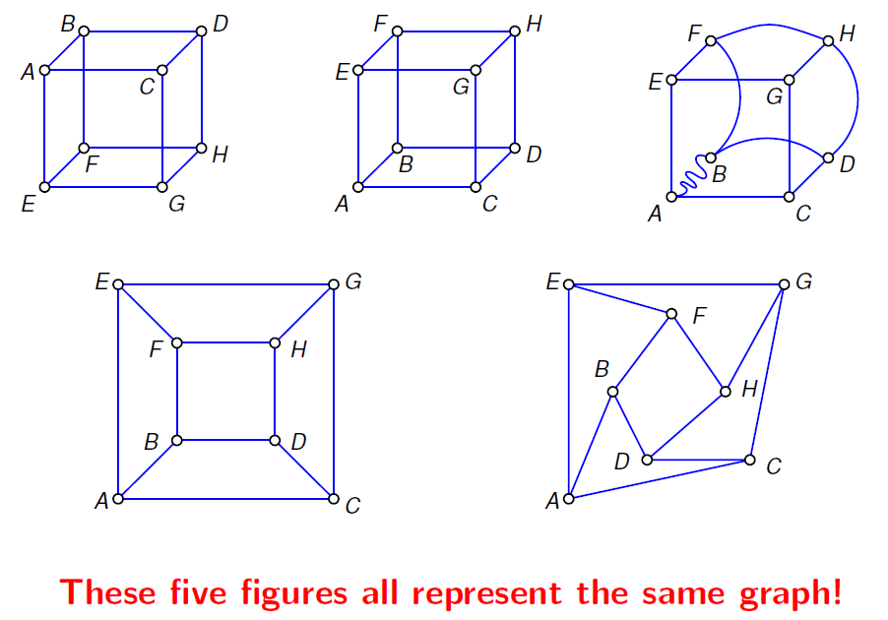
Different Representations of Graphs

Slide 26
Recognizing and Representing a Graph

Slide 27
Recognizing a graph problem
The first key to solving a graph related problem is recognizing that it is a graph problem.
Nearly all graph problems will somehow use a grid or network in the problem, but sometimes these will be well disguised.
Secondly, if you are required to find a path of any sort, it is usually a graph problem as well
Some common keywords associated with graph problems are:
vertices, nodes, edges, connections, connectivity, paths, cycles and direction.

Slide 28
An example
"Bob has become lost in his neighborhood.
He needs to get from his current position back to his home.
Bob’s neighborhood is a 2 dimensional grid, that starts at (0, 0) and (width – 1, height – 1).
There are empty spaces upon which bob can walk with no difficulty, and houses, which Bob cannot pass through.
Bob may only move horizontally or vertically by one square at a time.

Slide 29

An example
Bob’s initial position will be represented by a ‘B’ and the house location will be represented by an ‘H’.
Empty squares on the grid are represented by ‘.’ and houses are represented by ‘X’.
Find the minimum number of steps it takes Bob to get back home, but if it is not possible for Bob to return home, return -1.

Slide 30
Graph Implementation
Once you have recognized that the problem is a graph problem it is time to start building up your representation of the graph in memory.

Slide 31
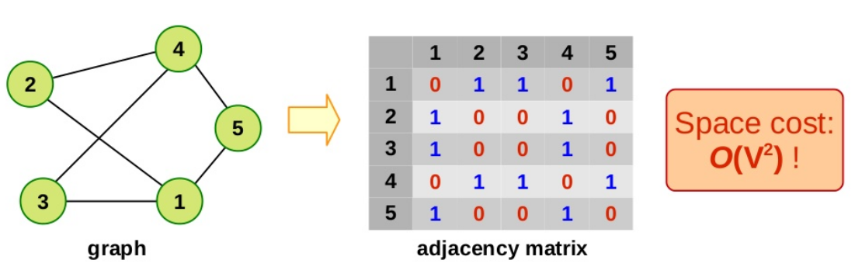
Adjacency Matrix
Matrix is used to store the connectivity information
The Matrix is symmetric for undirected graph.

Slide 32
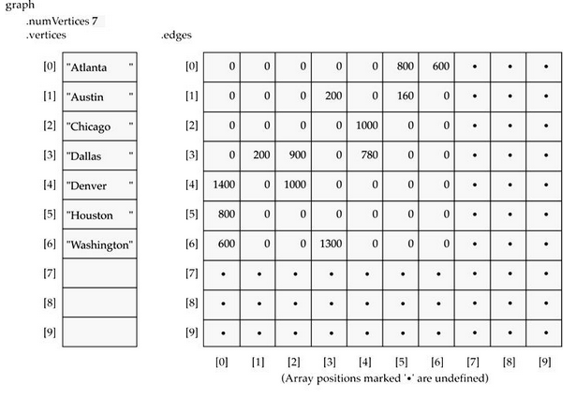
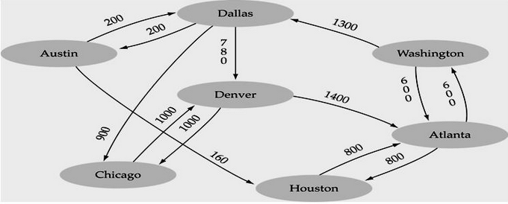
Array representation

Slide 33
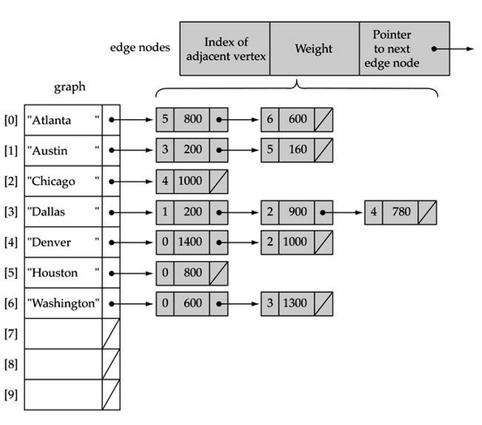
Linked-list representation

Slide 34
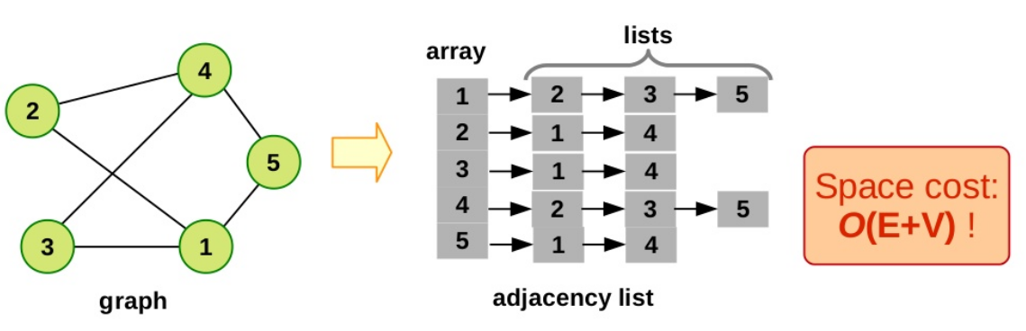
Adjacency List
Lists are used to store the connectivity information

Slide 35
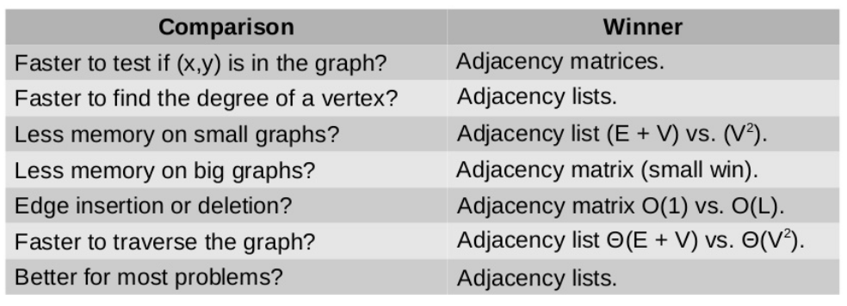
Comparisons

Slide 36
Graphs and Their Data Structures
Stack: A stack is one of the simplest data structures available.
There are four main operations on a stack:
Push – Adds an element to the top of the stack
Pop – Removes the top element from the stack
Top – Returns the top element on the stack
Empty – Tests if the stack is empty or not
In C++, this is done with the STL class stack:
#include <stack>
std::stack<int> myStack;

Slide 37
Graphs and Their Data Structures
Queue :A queue is a simple extension of the stack data type. Whereas the stack is a FILO (first-in last-out) data structure the queue is a FIFO (first-in first-out) data structure.
What this means is the first thing that you add to a queue will be the first thing that you get when you perform a pop().
There are four main operations on a queue:
Push – Adds an element to the back of the queue
Pop – Removes the front element from the queue
Front – Returns the front element on the queue
Empty – Tests if the queue is empty or not
In C++, this is done with the STL class queue:
#include <queue>
queue<int> myQueue;

