Slide 1
Merge Sort
Sarwar J. Morshed

Slide 2
Merging
The key to Merge Sort is merging two sorted lists into one, such that if you have two lists X (x₁≤x₂≤…≤x_{m}) and Y(y₁≤y₂≤…≤y_{n}) the resulting list is Z(z₁≤z₂≤…≤z_{m+n})
Example:
L₁ = { 3 8 9 } L₂ = { 1 5 7 }
merge(L₁, L₂) = { 1 3 5 7 8 9 }

Slide 3
Merging (cont.)
X:
3 | 10 | 23 | 54
Y:
1 | 5 | 25 | 75
Result:

Slide 4
Merging (cont.)
X:
3 | 10 | 23 | 54
Y:
 | 5 | 25 | 75
Result:
1

Slide 5
Merging (cont.)
X:
 | 10 | 23 | 54
Y:
 | 5 | 25 | 75
Result:
1 | 3

Slide 6
Merging (cont.)
X:
 | 10 | 23 | 54
Y:
 |  | 25 | 75
Result:
1 | 3 | 5

Slide 7
Merging (cont.)
X:
 |  | 23 | 54
Y:
 |  | 25 | 75
Result:
1 | 3 | 5 | 10

Slide 8
Merging (cont.)
X:
 |  |  | 54
Y:
 |  | 25 | 75
Result:
1 | 3 | 5 | 10 | 23

Slide 9
Merging (cont.)
X:
 |  |  | 54
Y:
 |  |  | 75
Result:
1 | 3 | 5 | 10 | 23 | 25

Slide 10
Merging (cont.)
X:
Y:
 |  |  | 75
Result:
1 | 3 | 5 | 10 | 23 | 25 | 54

Slide 11
Merging (cont.)
X:
Y:
Result:
1 | 3 | 5 | 10 | 23 | 25 | 54 | 75

Slide 12
Divide And Conquer
Merging a two lists of one element each is the same as sorting them.
Merge sort divides up an unsorted list until the above condition is met and then sorts the divided parts back together in pairs.
Specifically this can be done by recursively dividing the unsorted list in half, merge sorting the right side then the left side and then merging the right and left back together.

Slide 13
Merge Sort Algorithm
Given a list L with a length k:
If k == 1 → the list is sorted
Else:
Merge Sort the left side (1 thru k/2)
Merge Sort the right side (k/2+1 thru k)
Merge the right side with the left side

Slide 14
Merge Sort Example
99 | 6 | 86 | 15 | 58 | 35 | 86 | 4 | 0

Slide 15
Merge Sort Example
99 | 6 | 86 | 15 | 58 | 35 | 86 | 4 | 0
99 | 6 | 86 | 15
58 | 35 | 86 | 4 | 0

Slide 16
Merge Sort Example
99 | 6 | 86 | 15 | 58 | 35 | 86 | 4 | 0
99 | 6 | 86 | 15
58 | 35 | 86 | 4 | 0
99 | 6
86 | 15
58 | 35
86 | 4 | 0

Slide 17
Merge Sort Example
99 | 6 | 86 | 15 | 58 | 35 | 86 | 4 | 0
99 | 6 | 86 | 15
58 | 35 | 86 | 4 | 0
99 | 6
86 | 15
58 | 35
86 | 4 | 0
99
6
86
15
58
35
86
4 | 0

Slide 18
Merge Sort Example
99 | 6 | 86 | 15 | 58 | 35 | 86 | 4 | 0
99 | 6 | 86 | 15
58 | 35 | 86 | 4 | 0
99 | 6
86 | 15
58 | 35
86 | 4 | 0
99
6
86
15
58
35
86
4 | 0
4
0

Slide 19
Merge Sort Example
99
6
86
15
58
35
86
0 | 4
Merge
4
0

Slide 20
Merge Sort Example
6 | 99
15 | 86
58 | 35
0 | 4 | 86
99
6
86
15
58
35
86
0 | 4
Merge

Slide 21
Merge Sort Example
6 | 15 | 86 | 99
0 | 4 | 35 | 58 | 86
6 | 99
15 | 86
58 | 35
0 | 4 | 86
Merge

Slide 22
Merge Sort Example
0 | 4 | 6 | 15 | 35 | 58 | 86 | 86 | 99
6 | 15 | 86 | 99
0 | 4 | 35 | 58 | 86
Merge

Slide 23
Merge Sort Example
0 | 4 | 6 | 15 | 35 | 58 | 86 | 86 | 99

Slide 24
Implementing Merge Sort
There are two basic ways to implement merge sort:
In Place: Merging is done with only the input array
Pro: Requires only the space needed to hold the array
Con: Takes longer to merge because if the next element is in the right side then all of the elements must be moved down.
Double Storage: Merging is done with a temporary array of the same size as the input array.
Pro: Faster than In Place since the temp array holds the resulting array until both left and right sides are merged into the temp array, then the temp array is appended over the input array.
Con: The memory requirement is doubled.

Slide 25
Merge Sort Analysis
The Double Memory Merge Sort runs O (N log N) for all cases, because of its Divide and Conquer approach.
T(N) = 2T(N/2) + N = O(N logN)

Slide 26
Finally…
There are other variants of Merge Sorts including k-way merge sorting, but the common variant is the Double Memory Merge Sort. Though the running time is O(N logN) and runs much faster than insertion sort and bubble sort, merge sort’s large memory demands makes it not very practical for main memory sorting.

Slide 27
What is a Heapsort?
Heapsort is a comparison-based sorting algorithm to create a sorted array (or list)
Part of the selection sort family
Not a stable sort, but rather an in-place algorithm
In-place algorithm: an algorithm that transforms input using a data structure with a small, constant amount of storage space

Slide 28
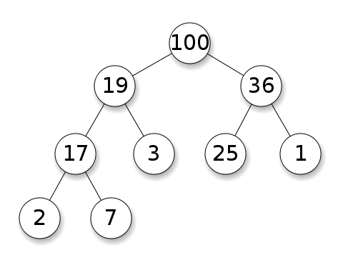
What is Heap?
A heap is a nearly complete binary tree with the following two properties:
Structural property: all levels are full, except possibly the last one, which is filled from left to right
Order (heap) property: for any node x
Parent(x) ≥ x

Slide 29
Classification of Heap?
Choose type of heap
Min Heap
The value of each node is greater than or equal to the value of its parents, with the minimum-value at the root
Max Heap
The value of each node is less than or equal to the value of its parents, with the maximum-value element at the root.

Slide 30
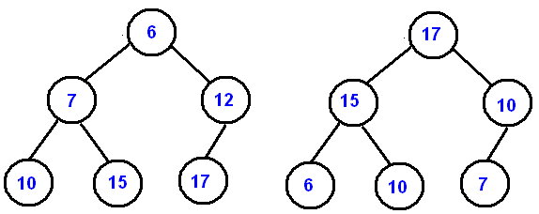
Classification of Heap?

Slide 31
How to construct a heap
Inserting elements into the binary tree
0th value of array becomes the root
1st and 2nd value of array become left and right node to the root
3rd and 4th value of array become left and right node to the 1st value node
5th and 6th value of array become left and right node to the 2nd value node…

Slide 32
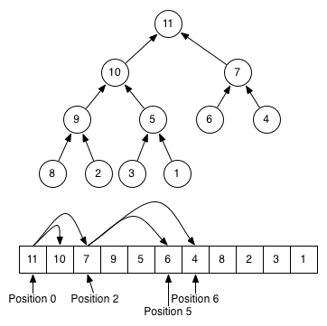
How to construct a heap

Slide 33
How to construct a heap
What if the array is not ordered properly so that each parent node is greater than their children?
When adding elements to the [max] heap, if a new element is larger than its parent, then the parent and child will switch places.
If the child is larger than its grandparent node then first switch the child and parent then switch the child and grandparent

Slide 34
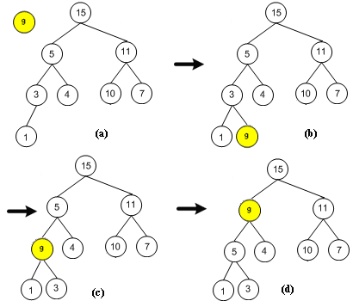
How to Insert a value into heap

Slide 35
Implement Heapsort?
1. Build a heap out of data
2. Remove root and insert into array
3. Reconstruct heap
4. Repeat steps 2 and 3 until all elements are gone and heap is empty

Slide 36
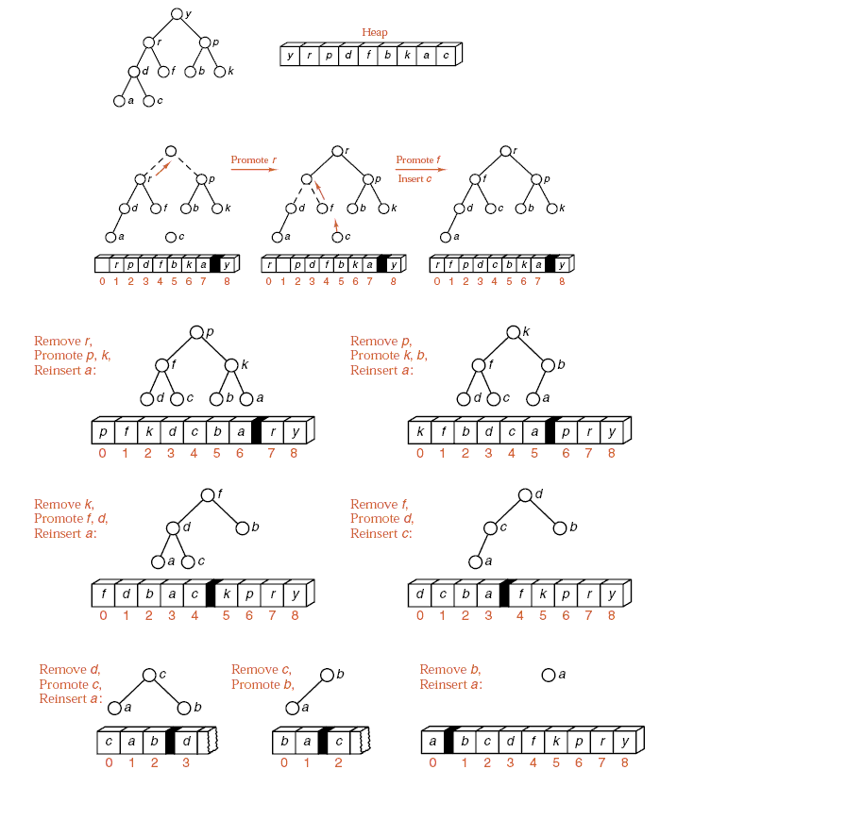

Slide 37
Advantages
The primary advantage of the heap sort is its efficiency.
Execution time efficiceny: O(n log n)
Memory efficiency: O(1)
The heap sort algorithm is not recursive
Heap sort algorithm is in place
In-place algorithm: an algorithm that transforms input using a data structure with a small, constant amount of storage space

Slide 38
Advantages
Best at sorting huge sets of items because it doesn’t use recursion
If the array is partially sorted, Heap Sort generally performs much better than quick sort or merge sort

Slide 39
Disadvantages
Generally slower than quick and merge sorts

