Slide 1
CSC2211: Algorithms
Greedy Graph Algorithm
Sarwar J. Morshed
msjmo@aiub.edu
American International University Bangladesh

Slide 2
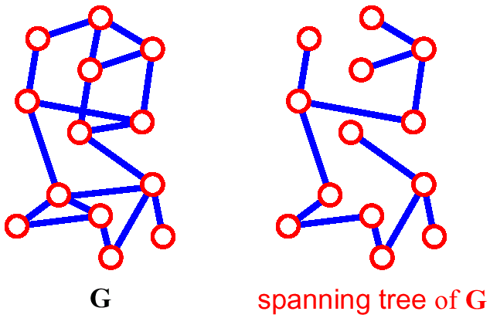
Spanning Tree
A spanning tree of G is a subgraph which
  is a tree
  contains all vertices of G
How many edges are there in a spanning tree, if there are V vertices?
CSC2211: Algorithms
Sarwar J. Morshed
Graph Algorithm→<number>

Slide 3
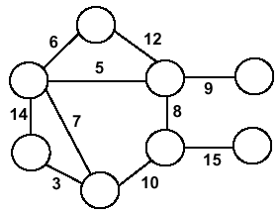
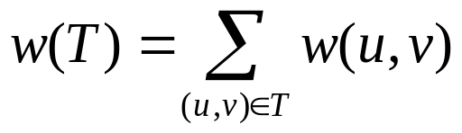
Minimum Spanning Trees
Undirected, connected graph
G = (V,E)
Weight function W: E → ℜ (assigning cost or length or other values to edges)
Spanning tree: tree that connects all vertices
Minimum spanning tree (MST): spanning tree T that minimizes
CSC2211: Algorithms
Sarwar J. Morshed
Graph Algorithm→<number>

Slide 4
Generic MST Algorithm
Generic-MST(G, w)
1 A := ∅ // Contains edges that belong to a MST
2 while A does not form a spanning tree do
3 Find an edge (u,v) that is safe for A
4 A := A ∪ {(u,v)}
5 return A
A safe edge is an edge that does not destroy A’s property.
MoreSpecific-MST(G, w)
1 A := ∅ // Contains edges that belong to a MST
2 while A does not form a spanning tree do
3.1 Make a cut (S, V-S) of G that respects A
3.2 Take the min-weight edge (u,v) connecting S to V-S
4 A := A ∪ {(u,v)}
5 return A
CSC2211: Algorithms
Sarwar J. Morshed
Graph Algorithm→<number>

Slide 5
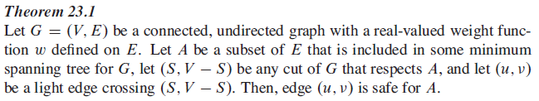
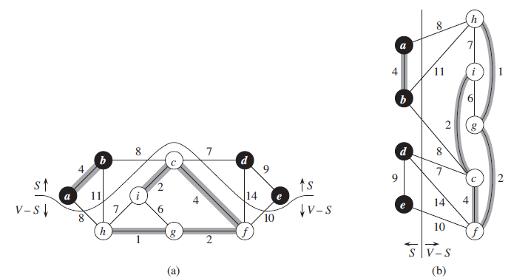
CSC2211: Algorithms
Sarwar J. Morshed
Graph Algorithm→<number>

Slide 6
Optimal Substructure
MST(G ) = T
MST(G’ ) = T – (u,v )
u
”u +v”
v
Rationale:
  If G’ would have a cheaper ST T’, then we would get a cheaper ST of G: T’ + (u, v)
CSC2211: Algorithms
Sarwar J. Morshed
Graph Algorithm→<number>

Slide 7
Idea for an Algorithm
We have to make V–1 choices (edges of the MST) to arrive at the optimization goal.
After each choice we have a sub-problem that is one vertex smaller than the original problem.
  A dynamic programming algorithm would consider all possible choices (edges) at each vertex.
  Goal: at each vertex cheaply determine an edge that definitely belongs to an MST.
CSC2211: Algorithms
Sarwar J. Morshed
Graph Algorithm→<number>

Slide 8
Greedy Choice
Greedy choice property: locally optimal (greedy) choice yields a globally optimal solution.
Theorem on Greedy choice for MST
  Let G=(V, E) and S ⊆ V
  S is a cut of G (it splits G into parts S and V-S)
  (u,v) is a light edge if it is a min-weight edge of G that connects S and V-S
  Then (u,v) belongs to a MST T of G.
CSC2211: Algorithms
Sarwar J. Morshed
Graph Algorithm→<number>

Slide 9
...Greedy Choice
Proof
  Suppose (u,v) is light but (u,v) ∉ any MST
  look at path from u to v in some MST T
  Let (x, y) be the first edge on a path from u to v in T that crosses from S to V–S. Swap (x, y) with (u,v) in T.
  this improves cost of T ➔ contradiction (T is supposed to be an MST)
V-S
S
y
x
u
v
CSC2211: Algorithms
Sarwar J. Morshed
Graph Algorithm→<number>

Slide 10
Prim-Jarnik Algorithm
Vertex based algorithm
Grows a single MST T one vertex at a time
The set A covers the portion of T that was already computed
Annotate all vertices v outside of the set A with v.key the minimum weight of an edge that connects v to a vertex in A
(v.key = ∞ if no such edge exists)
CSC2211: Algorithms
Sarwar J. Morshed
Graph Algorithm→<number>

Slide 11
...Prim-Jarnik Algorithm
MST-Prim(G, s)
01 for each vertex u ∈ G.V
02 u.key := ∞
03 u.pred := NIL
04 s.key := 0
05 init(Q, G.V) // Q is a priority queue
06 while not isEmpty(Q)
07 u := extractMin(Q) // add u to T
08 for each v ∈ u.adj do
09 if v ∈ Q and w(u,v) < v.key then
v.key := w(u,v)
11 modifyKey(Q,v)
12 v.pred := u
updating keys
CSC2211: Algorithms
Sarwar J. Morshed
Graph Algorithm→<number>

Slide 12
Prim-Jarnik’s Example
Q
Node | Pred | key
A | NIL | 0
B | NIL | ∞
C | NIL | ∞
D | NIL | ∞
E | NIL | ∞
F | NIL | ∞
G | NIL | ∞
H | NIL | ∞
I | NIL | ∞
8
6
D
B
C
4
A
3
4
13
9
12
6
I
8
H
10
5
F
E
3
MST-Prim(Graph,A)
1
G
A
Node
Pred
Key
CSC2211: Algorithms
Sarwar J. Morshed
Graph Algorithm→<number>

Slide 13
...Prim-Jarnik’s Example
Q
Node | Pred | key
B | A | 4
H | A | 8
C | NIL | ∞
D | NIL | ∞
E | NIL | ∞
F | NIL | ∞
G | NIL | ∞
I | NIL | ∞
8
6
D
B
C
4
3
4
13
9
A
12
6
I
8
H
10
5
F
E
3
1
G
A
Node | A
Pred | NIL
Key | 0
CSC2211: Algorithms
Sarwar J. Morshed
Graph Algorithm→<number>

Slide 14
...Prim-Jarnik’s Example
Q
Node | Pred | key
H | A | 8
C | B | 8
F | NIL | ∞
E | NIL | ∞
F | NIL | ∞
G | NIL | ∞
I | NIL | ∞
8
6
D
B
C
4
A
3
4
13
9
12
6
I
8
H
10
5
F
E
3
1
G
A
Node | A | B
Pred | NIL | A
Key | 0 | 4
CSC2211: Algorithms
Sarwar J. Morshed
Graph Algorithm→<number>

Slide 15
...Prim-Jarnik’s Example
Q
Node | Pred | key
G | H | 1
I | H | 6
C | B | 8
D | NIL | ∞
E | NIL | ∞
F | NIL | ∞
8
6
D
B
C
4
A
3
4
13
9
12
6
I
8
H
10
5
F
E
3
1
G
A
Node | A | B | H
Pred | NIL | A | A
Key | 0 | 4 | 8
CSC2211: Algorithms
Sarwar J. Morshed
Graph Algorithm→<number>

Slide 16
...Prim-Jarnik’s Example
Q
Node | Pred | key
F | G | 3
I | G | 5
C | B | 8
D | NIL | ∞
E | NIL | ∞
8
6
D
B
C
4
A
3
4
13
9
12
6
I
8
H
10
5
F
E
3
1
G
A
Node | A | B | H | G
Pred | NIL | A | A | H
Key | 0 | 4 | 8 | 1
CSC2211: Algorithms
Sarwar J. Morshed
Graph Algorithm→<number>

Slide 17
...Prim-Jarnik’s Example
Q
Node | Pred | key
C | F | 4
I | G | 5
E | F | 10
D | F | 13
8
6
D
B
C
4
A
3
4
13
9
12
6
I
8
H
10
5
F
E
3
1
G
A
Node | A | B | H | G | F
Pred | NIL | A | A | H | G
Key | 0 | 4 | 8 | 1 | 3
CSC2211: Algorithms
Sarwar J. Morshed
Graph Algorithm→<number>

Slide 18
...Prim-Jarnik’s Example
Q
Node | Pred | key
I | C | 3
D | C | 6
E | F | 10
8
6
D
B
C
4
A
3
4
13
9
12
6
I
8
H
10
5
F
E
3
1
G
A
Node | A | B | H | G | F | C
Pred | NIL | A | A | H | G | F
Key | 0 | 4 | 8 | 1 | 3 | 4
CSC2211: Algorithms
Sarwar J. Morshed
Graph Algorithm→<number>

Slide 19
...Prim-Jarnik’s Example
Q
Node | Pred | key
D | C | 6
E | F | 10
8
6
D
B
C
4
A
3
4
13
9
12
6
I
8
H
10
5
F
E
3
1
G
A
Node | A | B | H | G | F | C | I
Pred | NIL | A | A | H | G | F | C
Key | 0 | 4 | 8 | 1 | 3 | 4 | 3
CSC2211: Algorithms
Sarwar J. Morshed
Graph Algorithm→<number>

Slide 20
...Prim-Jarnik’s Example
Q
Node | Pred | key
E | D | 9
8
6
D
B
C
4
A
3
4
13
9
12
6
I
8
H
10
5
F
E
3
1
G
A
Node | A | B | H | G | F | C | I | D
Pred | NIL | A | A | H | G | F | C | C
Key | 0 | 4 | 8 | 1 | 3 | 4 | 3 | 6
CSC2211: Algorithms
Sarwar J. Morshed
Graph Algorithm→<number>

Slide 21
...Prim-Jarnik’s Example
Q is empty
Node | Pred | key
8
6
D
B
C
4
A
3
4
13
9
12
6
I
8
H
10
5
F
E
3
1
G
A
Node | A | B | H | G | F | C | I | D | E
Pred | NIL | A | A | H | G | F | C | C | D
Key | 0 | 4 | 8 | 1 | 3 | 4 | 3 | 6 | 9
CSC2211: Algorithms
Sarwar J. Morshed
Graph Algorithm→<number>

Slide 22
...Prim-Jarnik’s Example
Q is empty
Node | Pred | Key
6
D
B
C
4
A
3
4
9
8
I
H
E
3
F
1
G
A
Node | A | B | H | G | F | C | I | D | E | Total Cost
Pred | NIL | A | A | H | G | F | C | C | D
Key | 0 | 4 | 8 | 1 | 3 | 4 | 3 | 6 | 9 | 38
CSC2211: Algorithms
Sarwar J. Morshed
Graph Algorithm→<number>

Slide 23
Implementation Issues
MST-Prim(G,r)
01 for each vertex u ∈ G.V
02 u.key := ∞
03 u.parent := NIL
04 r.key := 0
05 init(Q, G.V) // Q is a priority queue
06 while not isEmpty(Q)
07 u := extractMin(Q) // add u to T
08 for each v ∈ u.adj do
09 if v ∈ Q and w(u,v) < v.key then
v.key := w(u,v)
11 modifyKey(Q,v)
12 v.parent := u
CSC2211: Algorithms
Sarwar J. Morshed
Graph Algorithm→<number>

Slide 24
Priority Queues
A priority queue maintains a set S of elements, each with an associated key value.
We need PQ to support the following operations
  init( Q: PriorityQueue, S: VertexSet)
  extractMin( Q: PriorityQueue): Vertex
  modifyKey( Q: PriorityQueue, v: Vertex)
To choose how to implement a PQ, we need to count how many times the operations are performed:
  init is performed just once and runs in O(n)
CSC2211: Algorithms
Sarwar J. Morshed
Graph Algorithm→<number>

Slide 25
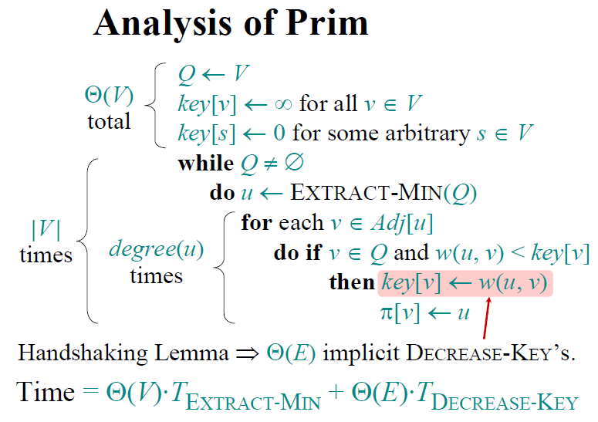
CSC2211: Algorithms
Sarwar J. Morshed
Graph Algorithm→<number>

Slide 26
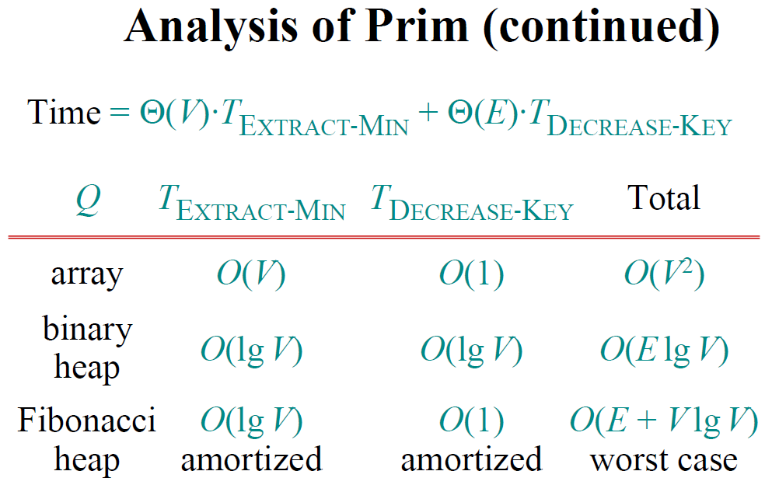
CSC2211: Algorithms
Sarwar J. Morshed
Graph Algorithm→<number>

Slide 27
Prim-Jarnik’s Running Time
Time = |V|*T(extractMin) + O(E)*T(modifyKey)
Q | T(extractMin) | T(modifyKey) | Total
array | O(V) | O(1) | O(V²)
binary heap | O(log V) | O(log V) | O(E logV)
E ≥ V-1, E < V², E = O(V²)
Binary heap implementation:
  Time = O(V logV + E logV) = O(V² logV) = O(E logV)
CSC2211: Algorithms
Sarwar J. Morshed
Graph Algorithm→<number>

Slide 28
Kruskal's Algorithm
Edge based algorithm
Add edges one at a time in increasing weight order.
The algorithm maintains A: a forest of trees.
An edge is accepted if it connects vertices of distinct trees (the cut respects A).
CSC2211: Algorithms
Sarwar J. Morshed
Graph Algorithm→<number>

Slide 29
...Kruskal's Algorithm
The algorithm keeps adding the cheapest edge that connects two trees of the forest
MST-Kruskal(G)
01 A := ∅
02 init(S) // Init disjoint-set
03 for each vertex v ∈ G.V
04 addSingletonSet(S,v)
05 sort the edges of G.E by non-decreasing w(u,v)
06 for each edge (u,v) ∈ E in sorted order do
07 if findSet(S,u) ≠ findSet(S,v) then
08 A := A ∪ {(u,v)}
09 unionSets(S,u,v)
10 return A
CSC2211: Algorithms
Sarwar J. Morshed
Graph Algorithm→<number>

Slide 30
Kruskal’s Example
8
6
D
B
C
4
A
3
4
13
9
12
6
I
8
H
10
5
F
E
3
1
G
S = { A, B, C, D, E, F, G, H, I }
E’ = { HG-1, CI-3, GF-3, CF-4, AB-4, HI-6, CD-6, BC-8, AH-8, DE-9, EF-10, BH-12, DF-13 }
S = { A, B, C, D, E, F, G, H, I }
E’ = { HG-1, CI-3, GF-3, CF-4, AB-4, HI-6, CD-6, BC-8, AH-8, DE-9, EF-10, BH-12, DF-13 }
CSC2211: Algorithms
Sarwar J. Morshed
Graph Algorithm→<number>

Slide 31
...Kruskal’s Example
8
6
D
B
C
4
A
3
4
13
9
12
6
I
8
H
10
5
F
E
3
1
G
S = { A, B, C, D, E, F, GH, I }
E’ = { CI-3, GF-3, CF-4, AB-4, HI-6, CD-6, BC-8, AH-8, DE-9, EF-10, BH-12, DF-13 }
CSC2211: Algorithms
Sarwar J. Morshed
Graph Algorithm→<number>

Slide 32
...Kruskal’s Example
8
6
D
B
C
4
A
3
4
13
9
12
6
I
8
H
10
5
F
E
3
1
G
S = { A, B, CI, D, E, F, GH }
E’ = { GF-3, CF-4, AB-4, HI-6, CD-6, BC-8, AH-8, DE-9, EF-10, BH-12, DF-13 }
CSC2211: Algorithms
Sarwar J. Morshed
Graph Algorithm→<number>

Slide 33
...Kruskal’s Example
8
6
D
B
C
4
A
3
4
13
9
12
6
I
8
H
10
5
F
E
3
1
G
S = { A, B, CI, D, E, FGH }
E’ = { CF-4, AB-4, HI-6, CD-6, BC-8, AH-8, DE-9, EF-10, BH-12, DF-13 }
CSC2211: Algorithms
Sarwar J. Morshed
Graph Algorithm→<number>

Slide 34
...Kruskal’s Example
8
6
D
B
C
4
A
3
4
13
9
12
6
I
8
H
10
5
F
E
3
1
G
S = { A, B, CFGHI, D, E }
E’ = { AB-4, HI-6, CD-6, BC-8, AH-8, DE-9, EF-10, BH-12, DF-13 }
CSC2211: Algorithms
Sarwar J. Morshed
Graph Algorithm→<number>

Slide 35
...Kruskal’s Example
8
6
D
B
C
4
A
3
4
13
9
12
6
I
8
H
10
5
F
E
3
1
G
S = { AB, CFGHI, D, E }
E’ = { HI-6, CD-6, BC-8, AH-8, DE-9, EF-10, BH-12, DF-13 }
CSC2211: Algorithms
Sarwar J. Morshed
Graph Algorithm→<number>

Slide 36
...Kruskal’s Example
8
6
D
B
C
4
A
3
4
13
9
12
6
I
8
H
10
5
F
E
3
1
G
S = { AB, CDFGHI, E }
E’ = { BC-8, AH-8, DE-9, EF-10, BH-12, DF-13 }
CSC2211: Algorithms
Sarwar J. Morshed
Graph Algorithm→<number>

Slide 37
...Kruskal’s Example
8
6
D
B
C
4
A
3
4
13
9
12
6
I
8
H
10
5
F
E
3
1
G
S = { ABCDFGHI, E }
E’ = { AH-8, DE-9, EF-10, BH-12, DF-13 }
CSC2211: Algorithms
Sarwar J. Morshed
Graph Algorithm→<number>

Slide 38
...Kruskal’s Example
8
6
D
B
C
4
A
3
4
13
9
12
6
I
8
H
10
5
F
E
3
1
G
S = { ABCDEFGHI }
E’ = { EF-10, BH-12, DF-13 }
CSC2211: Algorithms
Sarwar J. Morshed
Graph Algorithm→<number>

Slide 39
...Kruskal’s Example
8
6
D
B
C
4
A
3
4
9
I
H
E
3
F
1
G
S = { ABCDEFGHI }
E’ = { HG-1, CI-3, GF-3, CF-4, AB-4, CD-6, BC-8, DE-9 }; Total Cost := 38
CSC2211: Algorithms
Sarwar J. Morshed
Graph Algorithm→<number>

Slide 40
Implementation Factors:
Disjoint Sets
We need to maintain a disjoint partitioning of a set, i.e., a collection S of disjoint sets. Operations:
  addSingeltonSet(S:Set, x:Vertex)
    S := S ∪ {{x}}
  findSet(S:Set, x:Vertex): Set
    returns X ∈ S such that x ∈ X
  unionSets(S:Set, x:Vertex, y:Vertex)
    X := findSet(S:Set, x)
    Y := findSet(S:Set, y)
    S := S – {X, Y} ∪ {X ∪ Y}
CSC2211: Algorithms
Sarwar J. Morshed
Graph Algorithm→<number>

Slide 41
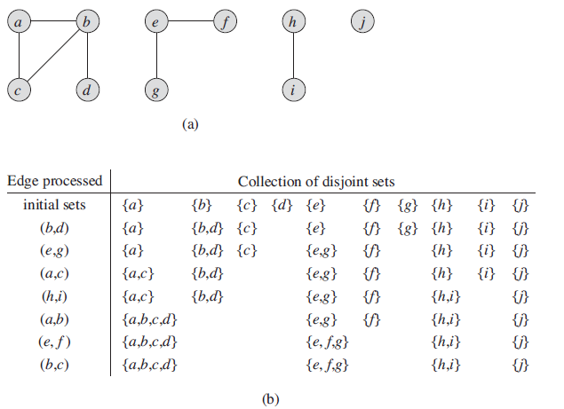
CSC2211: Algorithms
Sarwar J. Morshed
Graph Algorithm→<number>

Slide 42
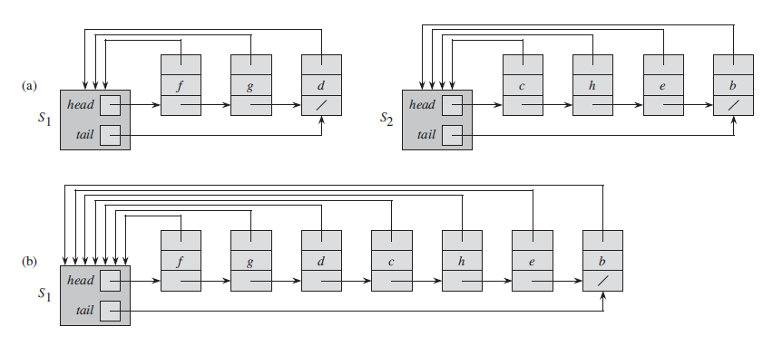
CSC2211: Algorithms
Sarwar J. Morshed
Graph Algorithm→<number>

Slide 43
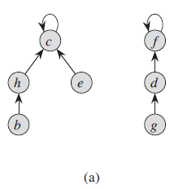
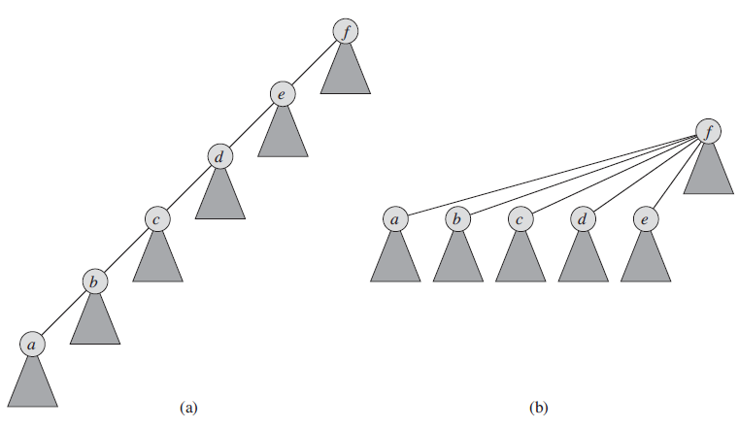
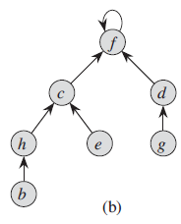
Disjoint-set forests
CSC2211: Algorithms
Sarwar J. Morshed
Graph Algorithm→<number>

Slide 44
Implementation Factors:
Disjoint Sets as Lists
Each set is a list of elements identified by the first element, all elements in the list point to the first element
UnionSets: add a shorter list to a longer one, O(min{|C(u)|, |C(v)|})
MakeSet/FindSet: O(1)
1
2
3
4
A
B
C
∅
∅
1
2
3
4
A
B
C
∅
CSC2211: Algorithms
Sarwar J. Morshed
Graph Algorithm→<number>

Slide 45
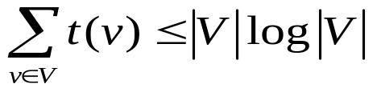
Kruskal Running Time
Initialization O(V) time
Sorting the edges Θ(E log E) = Θ(E log V)
O(E) calls to FindSet
Union costs
  Let t(v) be the number of times v is moved to a new cluster
  Each time a vertex is moved to a new cluster the size of the cluster containing the vertex at least doubles: t(v) ≤ log V
  Total time spent doing Union
Total time: O(E log V)
CSC2211: Algorithms
Sarwar J. Morshed
Graph Algorithm→<number>

