Slide 1
4. Numpy basics: Arrays and vectorized computation (Part 1)

Slide 2
NumPy
NumPy(Numerical Python) is the fundamental package required for high performance scientific computing and data analysis.
ndarray, a fast and space-efficient multidimensional array providing vectorized arithmetic operations and sophisticated broadcasting capabilities
Standard mathematical functions for fast operations on entire arrays of data without having to write loops
Tools for reading / writing array data to disk and working with memory-mapped files
Linear algebra, random number generation, and Fourier transform capabilities
Tools for integrating code written in C, C++, and Fortran

Slide 3
Things can do with NumPy and Pandas
Fast vectorized array operations for data munging and cleaning, subsetting and filtering, transformation, and any other kinds of computations
Common array algorithms like sorting, unique, and set operations
Efficient descriptive statistics and aggregating/summarizing data
Data alignment and relational data manipulations for merging and joining together heterogeneous data sets
Expressing conditional logic as array expressions instead of loops with if-elif-else branches
Group-wise data manipulations (aggregation, transformation, function application).

Slide 4
NumPy ndarray
ndarray is a multidimensional (N-dimensional) array object, which is a fast, flexible container for large data sets in Python
ndarray enables you to perform mathematical operations on whole blocks of data using similar syntax to the equivalent operations between scalar elements:
In [12]: import numpy as np
# Generate some random data
In [13]: data = np.random.randn(2, 3) In [14]: data
Out[14]:
array( [[-0.2047, 0.4789, -0.5194],
[-0.5557, 1.9658, 1.3934]])
In [15]: data * 10
Out[15]:
array( [[ -2.0471, 4.7894, -5.1944],
[ -5.5573, 19.6578, 13.9341]])
In [16]: data + data
Out[16]:
array( [[-0.4094, 0.9579, -1.0389],
[-1.1115, 3.9316, 2.7868]])

Slide 5
NumPy ndarray (Cont.)
ndarray is a generic multidimensional container for homogeneous data; that is, all of the elements must be the same type.
ndarray has a shape, a tuple indicating the size of each dimension, and a dtype, an object describing the data type of the array:
In [17]: data.shape
Out[17]: (2, 3)
In [18]: data.dtype
Out[18]: dtype('float64')
Becoming proficient in array-oriented programming and thinking is a key step along the way to becoming a scientific Python guru.

Slide 6
Creating ndarrays
The easiest way to create an array is to use the array() function
This accepts any sequence-like object (including other arrays) and produces a new NumPy array containing the passed data.
In [19]: data1 = [6, 7.5, 8, 0, 1]
In [20]: arr1 = np.array(data1)
In [21]: arr1
Out[21]: array([ 6. , 7.5, 8. , 0. , 1. ])
Use the standard NumPy convention of always using ”import numpy as np”. You are, of course, welcome to put ”from numpy import *” in your code to avoid having to write np., but I would caution you against making a habit of this.

Slide 7
Creating ndarrays (Cont.)
Nested sequences, like a list of equal-length lists, will be converted into a multidimensional array:
In [22]: data2 = [[1, 2, 3, 4], [5, 6, 7, 8]]
In [23]: arr2 = np.array(data2)
In [24]: arr2
Out[24]:
array([[1, 2, 3, 4],
[5, 6, 7, 8]])
In [25]: arr2.ndim
Out[25]: 2
In [26]: arr2.shape
Out[26]: (2, 4)

Slide 8
Creating ndarrays (Cont.)
Unless explicitly specified, np.array tries to infer a good data type for the array that it creates.
The data type is stored in a special dtype object; for example, in the previous two examples we have:
In [27]: arr1.dtype
Out[27]: dtype('float64')
In [28]: arr2.dtype
Out[28]: dtype('int64')

Slide 9
Other ndarray Creation Functions
np.array provides a number of other functions for creating new arrays:
Function | Description
array | Convert input data (list, tuple, array, or other sequence type) to an ndarray either by inferring a dtype or explicitly specifying a dtype. Copies the input data by default.
asarray | Convert input to ndarray, but do not copy if the input is already an ndarray
arange | Like the built-in range but returns an ndarray instead of a list.
ones, ones_like | Produce an array of all 1’s with the given shape and dtype. ones_like takes another array and produces a ones array of the same shape and dtype.
zeros, zeros_like | Like ones and ones_like but producing arrays of 0’s instead
empty, empty_like | Create new arrays by allocating new memory, but do not populate with any values like ones and zeros
eye, identity | Create a square N x N identity (or unit) matrix (1’s on the diagonal and 0’s elsewhere)

Slide 10
Creating ndarrays with initial values
zeros() and ones() functions create arrays of 0’s or 1’s, respectively, with a given length or shape.
To create a higher dimensional array with these methods, pass a tuple for the shape:
arange() is an array-valued version of the built-in Python range function:
In [29]: np.zeros(10)
Out[29]: array([ 0., 0., 0., 0., 0., 0., 0., 0., 0., 0.])
In [30]: np.zeros((3, 6))
Out[30]:
array([[ 0., 0., 0., 0., 0., 0.],
[ 0., 0., 0., 0., 0., 0.],
[ 0., 0., 0., 0., 0., 0.]])
In [26]: np.arange(15)
Out [26]: array([ 0, 1, 2, 3, 4, 5, 6, 7, 8, 9, 10, 11, 12, 13, 14])

Slide 11
Creating ndarrays with initial values (Cont.)
empty() function creates an array without initializing its values to any particular value.
In [31]: np.empty((2, 3, 2))
Out[31]:
array([[[0., 0.],
[0., 0.],
[0., 0.]],
[[0., 0.],
[0., 0.],
[0., 0.]]])
CAUTION: It’s not safe to assume that np.empty() will return an array of all zeros. In many cases, as previously shown, it will return uninitialized “garbage” values.

Slide 12
Data Types for ndarrays
The data type or dtype is a special object containing the information the ndarray needs to interpret a chunk of memory as a particular type of data:
In most cases they map directly onto an underlying machine representation, which makes it easy to read and write binary streams of data to disk and also to connect to code written in a low-level language like C or Fortran.
In [27]: arr1 = np.array([1, 2, 3], dtype=np.float64)
In [28]: arr2 = np.array([1, 2, 3], dtype=np.int32)
In [29]: arr1.dtype
Out[29]: dtype('float64')
In [30]: arr2.dtype
Out[30]: dtype('int32')

Slide 13
NumPy Data Types I
Type | Type Code | Description
int8, uint8 | i1, u1 | Signed and unsigned 8-bit (1 byte) integer types
int16, uint16 | i2, u2 | Signed and unsigned 16-bit integer types
int32, uint32 | i4, u4 | Signed and unsigned 32-bit integer types
int64, uint64 | i8, u8 | Signed and unsigned 64-bit integer types
float16 | f2 | Half-precision floating point
float32 | f4 or f | Standard single-precision floating point. Compatible with C float
float64 | f8 or d | Standard double-precision floating point. Compatible with C double and Python floatobject
float128 | f16 or g | Extended-precision floating point

Slide 14
NumPy Data Types II
Type | Type Code | Description
complex64, complex128, complex256 | c8, c16, c32 | Complex numbers represented by two 32, 64, or 128 floats, respectively
bool | ? | Boolean type storing True and False values
object | O | Python object type
string_ | S | Fixed-length string type (1 byte per character). For example, to create a string dtype with length 10, use 'S10'.
unicode_ | U | Fixed-length unicode type (number of bytes platform specific). Same specification semantics as string_ (e.g., 'U10').

Slide 15
Converting Data Types
Can explicitly convert or cast an array from one dtype to another using ndarray’s astype() method:
In [37]: arr = np.array([1, 2, 3, 4, 5])
In [38]: arr.dtype
Out[38]: dtype('int64')
In [39]: float_arr = arr.astype(np.float64)
In [40]: float_arr.dtype
Out[40]: dtype('float64')

Slide 16
Converting Data Types (Cont.)
If floating point numbers are casted to be of integer dtype, the decimal part will be truncated:
In [41]: arr = np.array([3.7, -1.2, -2.6, 0.5, 12.9, 10.1])
In [42]: arr
Out[42]: array([ 3.7, -1.2, -2.6, 0.5, 12.9, 10.1])
In [43]: arr.astype(np.int32)
Out[43]: array([ 3, -1, -2, 0, 12, 10], dtype=int32)

Slide 17
Converting Data Types (Cont.)
Should you have an array of strings representing numbers, you can use astype() to convert them to numeric form:
If casting were to fail for some reason (like a string that cannot be converted to float64), a TypeError will be raised.
Can simply use float instead of np.float64; NumPy is smart enough to alias the Python types to the equivalent dtypes.
In [44]: numeric_strings = np.array(['1.25', '-9.6', '42'], dtype=np.string_)
In [45]: numeric_strings.astype(float)
Out[45]: array([ 1.25, -9.6 , 42. ])

Slide 18
Converting Data Types (Cont.)
There are shorthand type code strings you can also use to refer to a dtype:
In [49]: empty_uint32 = np.empty(8, dtype='u4')
In [50]: empty_uint32
Out[50]:
array([0, 1075314688, 0, 1075707904, 0, 1075838976, 0, 1072693248], dtype=uint32)
Calling astype() always creates a new array (a copy of the data), even if the new dtype is the same as the old dtype.

Slide 19
Operations between Arrays and Scalars
Arrays are important because they enable you to express batch operations on data without writing any for loops; This is usually called vectorization.
Arithmetic operations with scalars are as you would expect, propagating the value to each element:
In [51]: arr = np.array([[1., 2., 3.], [4., 5., 6.]])
In [55]: 1 / arr
Out[55]:
array([[ 1. , 0.5 , 0.3333],
[ 0.25 , 0.2 , 0.1667]])
In [56]: arr ** 0.5
Out[56]:
array([[ 1. , 1.4142, 1.7321],
[ 2. , 2.2361, 2.4495]])

Slide 20
Operations between Arrays and Scalars (Cont.)
Any arithmetic operations between equal-size arrays applies the operation elementwise:
Operations between differently sized arrays causes a TypeError, and it can be solved with broadcasting and will be discussed in later.
In [51]: arr = np.array([[1., 2., 3.], [4., 5., 6.]])
In [52]: arr
Out[52]:
array([[ 1., 2., 3.], [ 4., 5., 6.]])
In [53]: arr * arr In [54]: arr - arr
Out[53]: Out[54]:
array([[ 1., 4., 9.], array([[ 0., 0., 0.],
[ 16., 25., 36.]]) [ 0., 0., 0.]])
Different with the Matrix Multiplication; compare with numpy.matmul()

Slide 21
Basic Indexing and Slicing
Indexing and slicing on ndarray is basically similar to Python lists:
In [60]: arr = np.arange(10)
In [61]: arr
Out[61]: array([0, 1, 2, 3, 4, 5, 6, 7, 8, 9])
In [62]: arr[5]
Out[62]: 5
In [63]: arr[5:8]
Out[63]: array([5, 6, 7])
In [64]: arr[5:8] = 12
In [65]: arr
Out[65]: array([ 0, 1, 2, 3, 4, 12, 12, 12, 8, 9])
A broadcasting(propagation) functionality with np.array; Not supported by Python lists

Slide 22
Basic Indexing and Slicing (Cont.)
An important distinction from lists is that array slices are views on the original array; this means that the data is not copied, and any modifications to the view will be reflected in the source array:
In [66]: arr_slice = arr[5:8]
In [68]: arr_slice[1] = 12345
In [69]: arr
Out[69]: array([ 0, 1, 2, 3, 4, 12, 12345, 12, 8, 9])
In [70]: arr_slice[:] = 64
In [71]: arr
Out[71]: array([ 0, 1, 2, 3, 4, 64, 64, 64, 8, 9])
If you want a copy of a slice of an ndarray instead of a view, you will need to explicitly copy the array; for example, arr[5:8].copy().
As NumPy has been designed with large data use cases, you could imagine performance and memory problems if NumPy insisted on copying data.

Slide 23
Basic Indexing and Slicing (Cont.)
In a two-dimensional array, the elements at each index are no longer scalars but rather one-dimensional arrays:
In [72]: arr2d = np.array([[1, 2, 3], [4, 5, 6], [7, 8, 9]])
In [73]: arr2d[2]
Out[73]: array([7, 8, 9])
Thus, individual elements can be accessed recursively like Python lists; but that is a bit too much work, so you can also pass a comma-separated list of indices to select individual elements. So these on the left are equivalent:
In [74]: arr2d[0][2]
Out[74]: 3
In [75]: arr2d[0, 2]
Out[75]: 3

Slide 24
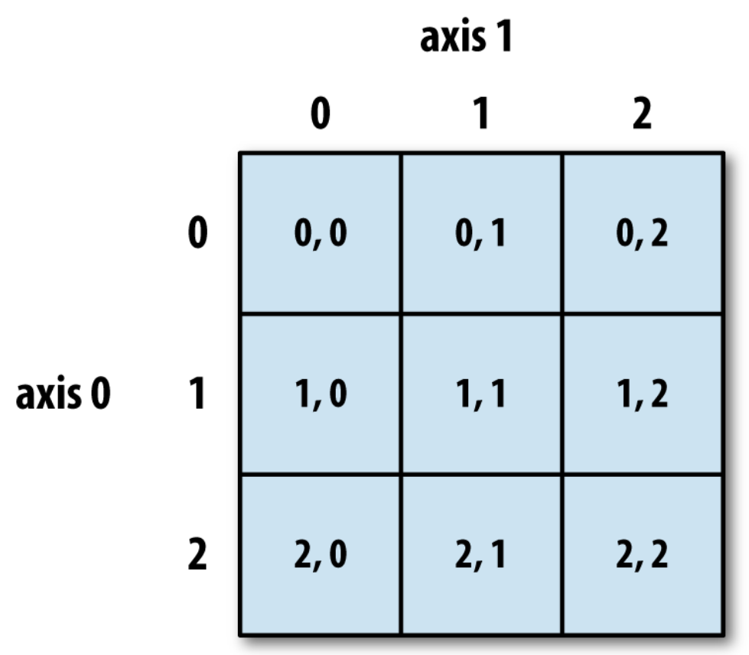
Indexing on a 2D array

Slide 25
Indexing with slices
In multidimensional arrays, if you omit later indices, the returned object will be a lower-dimensional ndarray consisting of all the data along the higher dimensions:
In [76]: arr3d = np.array([[[1, 2, 3], [4, 5, 6]],
[[7, 8, 9], [10, 11, 12]]])
In [77]: arr3d
Out[77]: array([ [ [ 1, 2, 3],
[ 4, 5, 6] ],
[ [ 7, 8, 9],
[10, 11, 12] ] ])
In [78]: arr3d[0]
Out[78]:
array([[1, 2, 3],
[4, 5, 6]])
In [84]: arr3d[1, 0]
Out[84]: array([7, 8, 9])

Slide 26
Indexing with slices (Cont.)
Like one-dimensional objects such as Python lists, ndarrays can be sliced using the familiar syntax:
Higher dimensional objects give you more options as you can slice one or more axes and also mix integers. Consider the 2D array below, arr2d. Slicing this array is a bit different:
In [89]: arr[1:6]
Out[89]: array([ 1, 2, 3, 4, 64])
In [90]: arr2d
Out[90]:
array([[1, 2, 3],
[4, 5, 6],
[7, 8, 9]])
In [91]: arr2d[:2]
Out[91]:
array([[1, 2, 3],
[4, 5, 6]])

Slide 27
Indexing with slices (Cont.)
You can pass multiple slices just like you can pass multiple indexes:
Also, you can mix the integer indexes and slices:
In [92]: arr2d[:2, 1:]
Out[92]: array([[2, 3],
[5, 6]])
In [93]: arr2d[1, :2]
Out[93]: array([4, 5])
In [94]: arr2d[:2, 2]
Out[94]: array([3, 6])
Note that a colon by itself means to take the entire axis, so you can slice only higher dimensional axes by doing:
In [95]: arr2d[:, :1]
Out[95]: array([[1],
[4],
[7]])

Slide 28
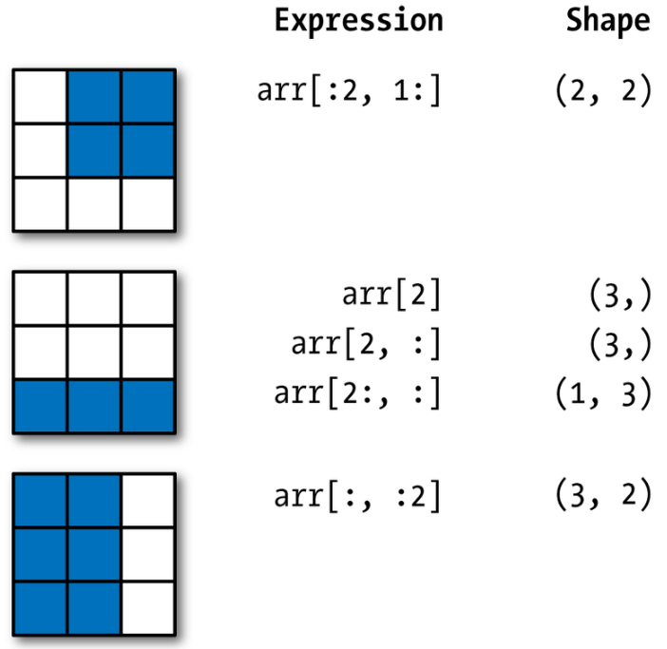
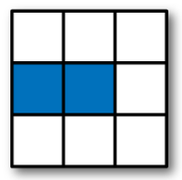
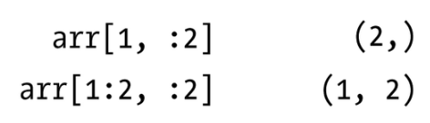
Two-dimensional array slicing

Slide 29
Boolean (Conditional) Indexing
Let’s consider an example where we have some data in an array and an array of names with duplicates.
In [98]: names = np.array(['Bob', 'Joe', 'Will', 'Bob', 'Will', 'Joe', 'Joe'])
In [99]: data = np.random.randn(7, 4)
In [100]: names
Out[100]: array(['Bob', 'Joe', 'Will', 'Bob', 'Will', 'Joe', 'Joe'], dtype='<U4')
In [101]: data
Out[101]: array([[ 0.0929, 0.2817, 0.769 , 1.2464],
[ 1.0072, -1.2962, 0.275 , 0.2289],
[ 1.3529, 0.8864, -2.0016, -0.3718],
[ 1.669 , -0.4386, -0.5397, 0.477 ],
[ 3.2489, -1.0212, -0.5771, 0.1241],
[ 0.3026, 0.5238, 0.0009, 1.3438],
[-0.7135, -0.8312, -2.3702, -1.8608]])
Symbol ‘<‘ represents the little endian, and the big endian is represented by ‘>’.

Slide 30
Boolean (Conditional) Indexing (Cont.)
Suppose each name corresponds to a row in the data array and we wanted to select all the rows with corresponding name 'Bob'.
Like arithmetic operations, comparisons (such as ==) with arrays are also vectorized. Thus, comparing names with the string 'Bob' yields a boolean array:
This boolean array can be passed when indexing the array:
In [102]: names == 'Bob'
Out[102]:
array([ True, False, False, True, False, False, False], dtype=bool)
In [103]: data[names == 'Bob']
Out[103]:
array([[ 0.0929, 0.2817, 0.769 , 1.2464],
[ 1.669 , -0.4386, -0.5397, 0.477 ]])

Slide 31
Boolean (Conditional) Indexing (Cont.)
The boolean array must be of the same length as the axis it’s indexing. You can even mix and match boolean arrays with slices or integers (or sequences of integers, more on this later):
To select everything but 'Bob', you can either use != or negate the condition using ~:
In [104]: data[names == 'Bob', 2:]
Out[104]: array([[ 0.769 , 1.2464],
[-0.5397, 0.477 ]])
In [105]: data[names == 'Bob', 3]
Out[105]: array([ 1.2464, 0.477 ])
In [106]: names != 'Bob'
Out[106]: array([False, True, True, False, True, True, True], dtype=bool)
In [107]: data[~(names == 'Bob')]

Slide 32
Boolean (Conditional) Indexing (Cont.)
The ~ operator can be useful when you want to invert a general condition:
In [108]: cond = names == 'Bob'
In [109]: data[~cond]
Out[109]: array([[ 1.0072, -1.2962, 0.275 , 0.2289],
[ 1.3529, 0.8864, -2.0016, -0.3718],
[ 3.2489, -1.0212, -0.5771, 0.1241],
[ 0.3026, 0.5238, 0.0009, 1.3438],
[-0.7135, -0.8312, -2.3702, -1.8608]])

Slide 33
Boolean (Conditional) Indexing (Cont.)
Selecting two of the three names to combine multiple boolean conditions, use boolean arithmetic operators like & (and) and | (or):
In [110]: mask = (names == 'Bob') | (names == 'Will')
In [111]: mask
Out[111]: array([True, False, True, True, True, False, False], dtype=bool)
In [112]: data[mask]
Out[112]:
array( [[ 0.0929, 0.2817, 0.769 , 1.2464],
[ 1.3529, 0.8864, -2.0016, -0.3718],
[ 1.669 , -0.4386, -0.5397, 0.477 ],
[ 3.2489, -1.0212, -0.5771, 0.1241]])
The Python keywords ‘and’ and ‘or’ do not work with boolean arrays. Use & and | instead.
arr = data[(names == 'Bob')]
arr[:] = 0
print(data); print(arr)
Try this.
NOTE: Selecting data from an array by boolean indexing always creates a copy of the data, even if the returned array is unchanged.

Slide 34
Boolean (Conditional) Indexing (Cont.)
Setting values with boolean arrays works in a common-sense way. To set all of the negative values in data to 0 we need only do:
In [113]: data[data < 0] = 0
In [114]: data
Out[114]: array([[ 0.0929 , 0.2817 , 0.769 , 1.2464 ],
[ 1.0072 , 0. , 0.275 , 0.2289 ],
[ 1.3529 , 0.8864 , 0. , 0. ],
[ 1.669 , 0. , 0. , 0.477 ],
[ 3.2489 , 0. , 0. , 0.1241 ],
[ 0.3026 , 0.5238 , 0.0009 , 1.3438 ],
[ 0. , 0. , 0. , 0. ]])

Slide 35
Boolean (Conditional) Indexing (Cont.)
Setting whole rows or columns using a 1D boolean array is also easy:
In [115]: data[names != 'Joe'] = 7
In [116]: data
Out[116]: array([[ 7. , 7. , 7. , 7. ],
[ 1.0072, 0. , 0.275 , 0.2289 ],
[ 7. , 7. , 7. , 7. ],
[ 7. , 7. , 7. , 7. ],
[ 7. , 7. , 7. , 7. ],
[ 0.3026 , 0.5238 , 0.0009 , 1.3438 ],
[ 0. , 0. , 0. , 0. ]])

Slide 36
Fancy Indexing
Fancy indexing is a term adopted by NumPy to describe indexing using integer arrays; it always copies the data into a new array unlike slicing.
Suppose we had a 8 × 4 array:
In [117]: arr = np.empty((8, 4))
In [118]: for i in range(8): arr[i] = i
In [119]: arr
Out[119]: array([[ 0., 0., 0., 0.],
[ 1., 1., 1., 1.],
[ 2., 2., 2., 2.],
[ 3., 3., 3., 3.],
[ 4., 4., 4., 4.],
[ 5., 5., 5., 5.],
[ 6., 6., 6., 6.],
[ 7., 7., 7., 7.]])

Slide 37
Fancy Indexing (Cont.)
To select out a subset of the rows in a particular order, you can simply pass a list or ndarray of integers specifying the desired order:
Hopefully this code did what you expected! Using negative indices select rows from the end:
In [120]: arr[[4, 3, 0, 6]]
Out[120]: array([[ 4., 4., 4., 4.],
[ 3., 3., 3., 3.],
[ 0., 0., 0., 0.],
[ 6., 6., 6., 6.] ])
In [121]: arr[[-3, -5, -7]]
Out[121]: array([[ 5., 5., 5., 5.],
[ 3., 3., 3., 3.],
[ 1., 1., 1., 1.]])

Slide 38
Fancy Indexing (Cont.)
Passing multiple index arrays does something slightly different; it selects a 1D array of elements corresponding to each tuple of indices:
In [122]: arr = np.arange(32).reshape((8, 4))
In [123]: arr
Out[123]: array([[ 0, 1, 2, 3],
[ 4, 5, 6, 7],
[ 8, 9, 10, 11],
[12, 13, 14, 15], [16, 17, 18, 19],
[20, 21, 22, 23],
[24, 25, 26, 27],
[28, 29, 30, 31]])
In [124]: arr[[1, 5, 7, 2], [0, 3, 1, 2]]
Out[124]: array([ 4, 23, 29, 10])
Only four elements (1, 0), (5, 3), (7, 1), and (2, 2) were selected (Not a rectangular area).
=> The behavior of fancy indexing in this case is a bit different from what we expected, which should be the rectangular region formed by selecting a subset of the matrix’s rows and columns (See next slide)

Slide 39
Fancy Indexing (Cont.)
Use slicing with fancy indexing, in order to get the rectangular region formed by selecting a subset of the matrix’s rows and columns:
Another way is to use the np.ix_ function, which converts two 1D integer arrays to an indexer that selects the square region:
Firstly, create a subset by a fancy indexing arr[[1, 5, 7, 2]] and apply a fancy indexing [:, [0, 3, 1, 2]] to the interim result.
In [125]: arr[[1, 5, 7, 2]][:, [0, 3, 1, 2]]
Out[125]: array([[ 4, 7, 5, 6],
[20, 23, 21, 22],
[28, 31, 29, 30],
[ 8, 11, 9, 10]])
Compare with arr[1:4, [0, 3, 1, 2]]; what is the benefit of the above one?
In: arr[np.ix_([1, 5, 7, 2], [0, 3, 1, 2])]
Out: array( [[ 4, 7, 5, 6],
[20, 23, 21, 22],
[28, 31, 29, 30],
[ 8, 11, 9, 10]])
Compare with the results of “arr[[1, 5, 7, 2], [0, 3, 1, 2]]”
Using ix_ one can quickly construct index arrays that will index the cross product. a[np.ix_([1,3],[2,5])] returns the array [[a[1,2] a[1,5]], [a[3,2] a[3,5]]].
https://docs.scipy.org/doc/numpy/reference/generated/numpy.ix_.html

Slide 40
Transposing Arrays and Swapping Axes
Transposing is a special form of reshaping which similarly returns a view on the underlying data without copying anything. Arrays have the transpose method and also the special T attribute:
When doing matrix computations, you will do this very often, like for example computing the inner (matrix) product X^{T}X using np.dot:
In [126]: arr = np.arange(15).reshape((3, 5))
In [127]: arr
Out[127]:
array( [[ 0, 1, 2, 3, 4],
[ 5, 6, 7, 8, 9],
[10, 11, 12, 13, 14]])
In [128]: arr.T
Out[128]:
array( [[ 0, 5, 10],
[ 1, 6, 11],
[ 2, 7, 12],
[ 3, 8, 13],
[ 4, 9, 14]])
In [129]: arr = np.random.randn(6, 3)
In [131]: np.dot(arr.T, arr)
Out[131]: array([[ 9.2291, 0.9394, 4.948 ],
[ 0.9394, 3.7662, -1.3622],
[ 4.948 , -1.3622, 4.3437]])
Note: np.dot() calculates of the inner product and it is identical to np.matmul();
np.outer() calculates the outer product.

Slide 41
Transposing Arrays and Swapping Axes (Cont.)
For higher dimensional arrays, transpose will accept a tuple of axis numbers to permute the axes:
axis 1
axis 2
In [132]: arr = np.arange(16).reshape((2, 2, 4))
In [133]: arr
Out[133]: array([[[ 0, 1, 2, 3],
[ 4, 5, 6, 7]],
[[ 8, 9, 10, 11],
[12, 13, 14, 15]]])
In [134]: arr.transpose((1, 0, 2))
Out[134]: array([[[ 0, 1, 2, 3],
[ 8, 9, 10, 11]],
[[ 4, 5, 6, 7],
[12, 13, 14, 15]]])
axis 0
4 5 6 7
0 1 2 3
12 13 14 15
8 9 10 11
axis 1
axis 1
axis 0
0 4
8 12
axis 0
0 8
4 12
1 5
9 13
1 9
5 13
…
Transpose on axis 0 and axis 1
…

Slide 42
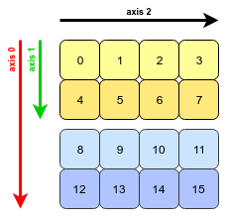
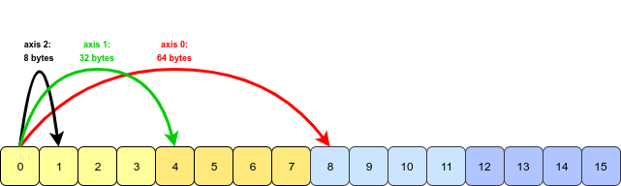
Transposing Arrays and Swapping Axes (Cont.)
The stride value represents the number of bytes that must be travelled in memory in order to reach the next value of an axis of an array.
Now, our 3D array arr looks this (with labelled axes):
This array is stored in a contiguous block of memory; essentially it is one-dimensional.
To interpret it as a 3D object, NumPy must jump over a certain constant number of bytes in order to move along one of the three axes:

Slide 43
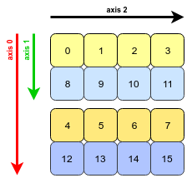
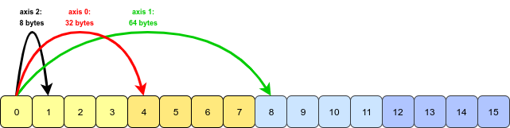
Transposing Arrays and Swapping Axes (Cont.)
arr.transpose(1, 0, 2) performs swapping axes 0 and 1. The transposed array looks like this:
All that NumPy needs to do is to swap the stride information for axis 0 and axis 1 (axis 2 is unchanged).
Now we must jump further to move along axis 1 than axis 0:
참고: https://stackoverflow.com/questions/32034237/how-does-numpys-transpose-method-permute-the-axes-of-an-array

Slide 44
Transposing Arrays and Swapping Axes (Cont.)
Simple transposing with .T is just a special case of swapping axes. ndarray has the method swapaxes which takes a pair of axis numbers:
In [136]: arr.swapaxes(1, 2)
Out[136]: array([[[ 0, 4],
[ 1, 5],
[ 2, 6],
[ 3, 7]],
[[ 8, 12],
[ 9, 13],
[10, 14],
[11, 15]]])
NOTE: All the transpose methods inclusing swapaxes() return a view on the data without making a copy.

Slide 45
Thank You !

