Slide 1
4. Numpy basics: Arrays and vectorized computation (Part 2)

Slide 2
Universal Functions: Fast Element-wise Array Functions
A universal function, or ufunc, is a function that performs element-wise operations on data in ndarrays.
You can think of them as fast vectorized wrappers for simple functions that take one or more scalar values and produce one or more scalar results.

Slide 3
Universal Functions: Fast Element-wise Array Functions (Cont.)
Many ufuncs are simple elementwise transformations, like sqrt() or exp(); these are referred to as unary ufuncs.
In [137]: arr = np.arange(10)
In [138]: arr
Out[138]: array([0, 1, 2, 3, 4, 5, 6, 7, 8, 9])
In [139]: np.sqrt(arr)
Out[139]: array([ 0. , 1. , 1.4142, 1.7321, 2. , 2.2361, 2.4495, 2.6458, 2.8284, 3. ])
In [140]: np.exp(arr)
Out[140]: array([ 1. , 2.7183, 7.3891, 20.0855, 54.5982, 148.4132, 403.4288, 1096.6332, 2980.958 , 8103.0839])

Slide 4
Universal Functions: Fast Element-wise Array Functions (Cont.)
Others, such as add() or maximum(), take 2 arrays (thus, binary ufuncs) and return a single array as the result:
In [141]: x = np.random.randn(8)
In [142]: y = np.random.randn(8)
In [143]: x
Out[143]: array([ 0.0749, 0.0974, 0.2002, -0.2551, 0.4655, 0.9222, 0.446 , -0.9337])
In [144]: y
Out[144]: array([ 0.267 , -1.1131, -0.3361, 0.6117, -1.2323, 0.4788, 0.4315, -0.7147])
In [145]: np.maximum(x, y) # element-wise maximum of two arrays
Out[145]: array([ 0.267 , 0.0974, 0.2002, 0.6117, 0.4655, 0.9222, 0.446 , -0.7147])

Slide 5
Universal Functions: Fast Element-wise Array Functions (Cont.)
While not common, a ufunc can return multiple arrays.
modf() is one example, a vectorized version of math.modf(); it returns the fractional and integer parts of a floating point array (i.e., modf stands for a mod operation for a floating number):
In [146]: arr = np.random.randn(7) * 5
In [146]: arr
Out [147]: array([-3.2623, -6.0915, -6.663 , 5.3731, 3.6182, 3.45 , 5.0077])
In [148]: remainder, whole_part = np.modf(arr)
In [149]: remainder
Out[149]: array([-0.2623, -0.0915, -0.663 , 0.3731, 0.6182, 0.45 , 0.0077]) In [150]: whole_part
Out[150]: array([-3., -6., -6., 5., 3., 3., 5.])

Slide 6
Universal Functions: Fast Element-wise Array Functions (Cont.)
Ufuncs accept an optional 'out' argument that allows them to operate in-place on arrays:
In [151]: arr
Out[151]: array([-3.2623, -6.0915, -6.663 , 5.3731, 3.6182, 3.45 , 5.0077])
In [152]: np.sqrt(arr)
Out[152]: array([ nan, nan, nan, 2.318 , 1.9022, 1.8574, 2.2378])
In [153]: np.sqrt(arr, arr)
Out[153]: array([ nan, nan, nan, 2.318 , 1.9022, 1.8574, 2.2378])
In [154]: arr
Out[154]: array([ nan, nan, nan, 2.318 , 1.9022, 1.8574, 2.2378])
Optional “out” argument, i.e., it outputs the results to “arr” object itself in this case.

Slide 7
List of Unary ufuncs
Function | Description
abs, fabs | Compute the absolute value element-wise for integer, floating point, or complex values. Use fabs as a faster alternative for non-complex-valued data
sqrt | Compute the square root of each element (equivalent to arr**0.5)
square | Compute the square of each element (equivalent to arr**2)
exp | Compute the exponent e^{x} of each element
log, log10, log2, log1p | Natural logarithm (base e), log base 10, log base 2, and log(1 + x), respectively
sign | Compute the sign of each element: 1 (positive), 0 (zero), or -1 (negative)
ceil | Compute the ceiling of each element, i.e. the smallest integer greater than or equal to each element (e.g., np.ceil(-2.4) => -2.0)
floor | Compute the floor of each element, i.e. the largest integer less than or equal to each element (e.g., np.floor(2.4) => 2.0)

Slide 8
List of Unary ufuncs (Cont.)
Function | Description
rint | Round elements to the nearest integer, preserving the dtype
modf | Return fractional and integer parts of array as separate array
isnan | Return boolean array indicating whether each value isNaN (Not a Number)
isfinite, isinf, isneginf, isposinf | Return boolean array indicating whether each element is finite (non-inf, non-NaN) or infinite, respectively
cos, cosh, sin, sinh, tan, tanh | Regular and hyperbolic trigonometric functions
arccos, arccosh, arcsin, arcsinh, arctan, arctanh | Inverse trigonometric functions
logical_not | Compute truth value of not x element-wise (equivalent to ~arr).

Slide 9
Test functions for NaN, Finite, and Infinity
Test element-wise for NaN, Finiteness, and Infinity of numbers, and return result as a boolean array:
In: arr = np.array([np.log(-1), np.log(0), np.log(1)])
In: arr
Out: array([ nan -inf 0.])
In: np.isnan(arr)
Out: array([ True False False])
In: np.isinf(arr)
Out: array([False True False])
In: np.isneginf(arr)
Out: array([False True False])
참고: https://docs.scipy.org/doc/numpy/reference/generated/numpy.isnan.html

Slide 10
List of Binary ufuncs
Function | Description
add, subtract, multiply, divide | Element-wise add, subtract, multiply, and divide, respectively. Equivalent to infix operators +, -, *, /
floor_divide | floor divide (truncating the remainder)
power | Raise elements in first array to powers indicated in second array (same as a**b)
maximum, fmax | Element-wise maximum (NaN results in maximum); fmax ignores NaN
minimum, fmin | Element-wise minimum (NaN results in minimum); fmin ignores NaN

Slide 11
List of Binary ufuncs (Cont.)
Function | Description
mod | Element-wise modulus (remainder of division)
copysign | Copy sign of values in second argument to values in first argument
greater, greater_equal, less, less_equal, equal, not_equal | Perform element-wise comparison, yielding boolean array (equivalent to infix operators >, >=, <, <=, ==, !=)
logical_and, logical_or, logical_xor | Compute element-wise truth value of logical operation (equivalent to infix operators &, |, ^)

Slide 12
Array-Oriented Programming with Arrays
Using NumPy arrays enables you to express many kinds of data processing tasks as concise array expressions that might otherwise require writing loops.
This practice of replacing explicit loops with array expressions is commonly referred to as vectorization.
In general, vectorized array operations will often be faster than their pure Python equivalents, with the biggest impact in any kind of numerical computations.

Slide 13
Array-Oriented Programming with Arrays
As a simple example, suppose we wished to evaluate the function sqrt(x^2 + y^2) across a regular grid of values.
The np.meshgrid() function takes two 1D arrays and produces two 2D matrices corresponding to all pairs of (x, y) in the two arrays:
In [155]: points = np.arange(-5, 5, 0.01) # 1000 equally spaced points
In [156]: xs, ys = np.meshgrid(points, points)
In [157]: xs
Out[157]: array([[-5. , -4.99, -4.98, ..., 4.97, 4.98, 4.99],
[-5. , -4.99, -4.98, ..., 4.97, 4.98, 4.99],
...,
[-5. , -4.99, -4.98, ..., 4.97, 4.98, 4.99], [-5. , -4.99, -4.98, ..., 4.97, 4.98, 4.99]])

Slide 14
Array-Oriented Programming with Arrays
In [157]: ys
Out[157]: array([[-5. , -5. , -5. , ..., -5. , -5. , -5. ],
[-4.99, -4.99, -4.99, ..., -4.99, -4.99, -4.99],
...,
[ 4.98, 4.98, 4.98, ..., 4.98, 4.98, 4.98],
[ 4.99, 4.99, 4.99, ..., 4.99, 4.99, 4.99]])
Now, evaluating the function is a matter of writing the same expression you would write with two points:
In [158]: z = np.sqrt(xs ** 2 + ys ** 2)
In [159]: z
Out[159]: array([[ 7.0711, 7.064 , 7.0569, ..., 7.0499, 7.0569, 7.064 ],
[ 7.064 , 7.0569, 7.0499, ..., 7.0428, 7.0499, 7.0569],
...,
[ 7.0569, 7.0499, 7.0428, ..., 7.0357, 7.0428, 7.0499],
[ 7.064 , 7.0569, 7.0499, ..., 7.0428, 7.0499, 7.0569]])

Slide 15
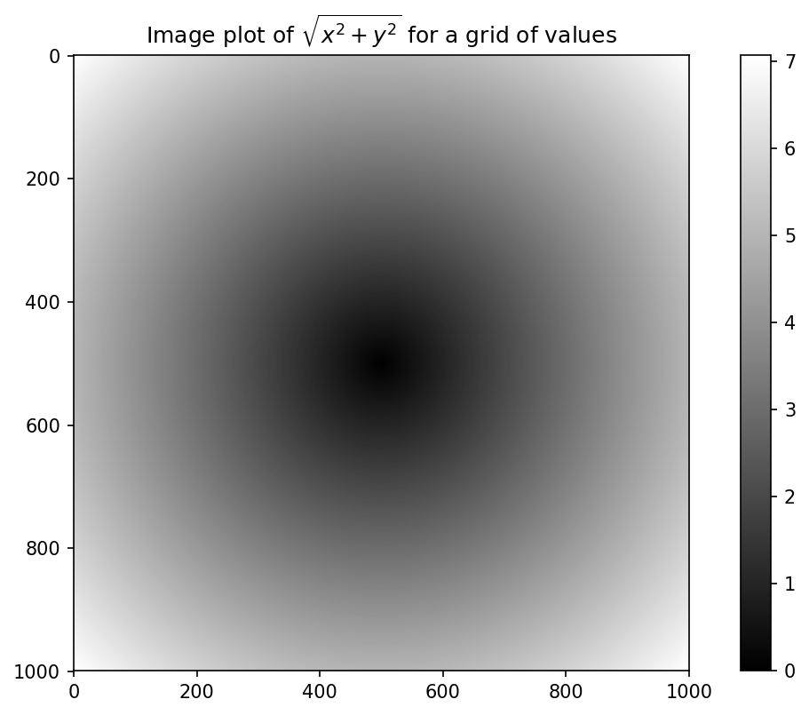
Array-Oriented Programming with Arrays
We can visualize the two-dimensional array using matplotlib, which will be introduced more detail in Chapter 9:
In [160]: import matplotlib.pyplot as plt
In [161]: plt.imshow(z, cmap=plt.cm.gray)
In [162]: plt.title("Image plot of $\sqrt{x^2 + y^2}$ for a grid of values")

Slide 16
Expressing Conditional Logic as Array Operations
The numpy.where() function is a vectorized version of the ternary expression x if condition else y.
Suppose we had a boolean array and two arrays of values:
Suppose we wanted to take a value from xarr whenever the corresponding value in cond is True, and otherwise take the value from yarr. A list comprehension doing this might look like:
This has multiple problems; first, it will not be very fast for large arrays (because all the work is being done in interpreted Python code). second, it will not work with multidimensional arrays.
In [165]: xarr = np.array([1.1, 1.2, 1.3, 1.4, 1.5])
In [166]: yarr = np.array([2.1, 2.2, 2.3, 2.4, 2.5])
In [167]: cond = np.array([True, False, True, True, False])
In [168]: result = [(x if c else y) for x, y, c in zip(xarr, yarr, cond)]
In [169]: result
Out[169]: [1.1, 2.2, 1.3, 1.4, 2.5]

Slide 17
Expressing Conditional Logic as Array Operations (Cont.)
With np.where() you can write this very concisely:
The second and third arguments to np.where() don’t need to be arrays; one or both of them can be scalars.
A typical use of where in data analysis is to produce a new array of values based on another array.
Suppose you had a matrix of randomly generated data and you wanted to replace all positive values with 2 and all negative values with –2. This is very easy to do with np.where:
In [170]: result = np.where(cond, xarr, yarr)
In [171]: result
Out[171]: array([ 1.1, 2.2, 1.3, 1.4, 2.5])
Try np.where(cond, 1, 0)

Slide 18
Expressing Conditional Logic as Array Operations (Cont.)
In [172]: arr = np.random.randn(4, 4)
In [173]: arr
Out[173]: array([[-0.5031, -0.6223, -0.9212, -0.7262],
[ 0.2229, 0.0513, -1.1577, 0.8167],
[ 0.4336, 1.0107, 1.8249, -0.9975],
[ 0.8506, -0.1316, 0.9124, 0.1882]])
In [174]: arr > 0
Out[174]: array([[False, False, False, False],
[ True, True, False, True],
[ True, True, True, False],
[ True, False, True, True]], dtype=bool)
In [175]: np.where(arr > 0, 2, -2)
Out[175]: array([[-2, -2, -2, -2],
[ 2, 2, -2, 2],
[ 2, 2, 2, -2],
[ 2, -2, 2, 2]])

Slide 19
Expressing Conditional Logic as Array Operations (Cont.)
You can combine scalars and arrays when using np.where(). For example, we can replace only the positive values in arr with the constant 2 like so:
The arrays passed to np.where() can be more than just equal-sized arrays or scalars (i.e., not necessary to equal to the size of condition array)
In [176]: np.where(arr > 0, 2, arr) # set only positive values to 2
Out[176]: array([[-0.5031, -0.6223, -0.9212, -0.7262],
[ 2. , 2. , -1.1577, 2. ],
[ 2. , 2. , 2. , -0.9975],
[ 2. , -0.1316, 2. , 2. ]])

Slide 20
Mathematical and Statistical Methods
A set of mathematical functions that compute statistics about an array are provided as methods of the array class.
It contains aggregations like sum, mean, and std (standard deviation) either by calling the array instance method or using the top-level NumPy function.
In [177]: arr = np.random.randn(5, 4)
In [178]: arr
Out[178]: array([[ 2.1695, -0.1149, 2.0037, 0.0296],
[ 0.7953, 0.1181, -0.7485, 0.585 ],
[ 0.1527, -1.5657, -0.5625, -0.0327],
[-0.929 , -0.4826, -0.0363, 1.0954],
[ 0.9809, -0.5895, 1.5817, -0.5287]])
In [179]: arr.mean()
In [180]: np.mean(arr)
In [181]: arr.sum()

Slide 21
Mathematical and Statistical Methods (Cont.)
Functions like mean() and sum() take an optional axis argument that computes the statistic over the given axis, resulting in an array with one fewer dimension:
In [182]: arr.mean(axis=1)
Out[182]: array([ 1.022 , 0.1875, -0.502 , -0.0881, 0.3611])
In [183]: arr.sum(axis=0)
Out[183]: array([ 3.1693, -2.6345, 2.2381, 1.1486])
Or arr.mean(1)
Or arr.sum(0)
In the above example, arr.mean(1) means “compute mean across the columns” where arr.sum(0) means “compute sum down the rows.”
Note that the index of axis starts from shallow depth.

Slide 22
Mathematical and Statistical Methods (Cont.)
Other methods like cumsum() and cumprod() do not aggregate, instead producing an array of the intermediate cumulated results:
In [184]: arr = np.array([0, 1, 2, 3, 4, 5, 6, 7])
In [185]: arr.cumsum()
Out[185]: array([ 0, 1, 3, 6, 10, 15, 21, 28])
In multidimensional arrays, accumulation functions like cumsum() return an array of the same size, but with the partial aggregates computed along the indicated axis according to each lower dimensional slice:
In [187]: arr
Out[187]:
array([ [0, 1, 2],
[3, 4, 5],
[6, 7, 8]])
In [188]:
arr.cumsum(axis=0)
Out[188]:
array([ [ 0, 1, 2],
[ 3, 5, 7],
[ 9, 12, 15]])
In [189]:
arr.cumprod(axis=1)
Out[189]:
array([ [ 0, 0, 0],
[ 3, 12, 60],
[ 6, 42, 336]])

Slide 23
Mathematical and Statistical Methods (Cont.)
Table 4-5. Basic array statistical methods
Method | Description
sum | Sum of all the elements in the array or along an axis; zero-length arrays have sum 0
mean | Arithmetic mean; zero-length arrays have NaN mean
std, var | Standard deviation and variance, respectively, with optional degrees of freedom adjustment (default denominator n)
min, max | Minimum and maximum
argmin, argmax | Indices of minimum and maximum elements, respectively
cumsum | Cumulative sum of elements starting from 0
cumprod | Cumulative product of elements starting from 1

Slide 24
Methods for Boolean Arrays
Boolean values are coerced to 1 (True) and 0 (False) in the preceding methods. Thus, sum is often used as a means of counting True values in a boolean array:
In [190]: arr = np.random.randn(100)
In [191]: (arr > 0).sum() # Number of positive values
Out[191]: 42
There are two additional methods, any() and all(), useful especially for boolean arrays. any() tests whether one or more values in an array is True, while all() checks if every value is True:
In [192]: bools = np.array([False, False, True, False])
In [193]: bools.any() Out[193]: True
In [194]: bools.all() Out[194]: False
Note: These methods also work with non-boolean arrays, where non-zero elements evaluate to True.

Slide 25
Sorting
Like Python’s built-in list type, NumPy arrays can be sorted in-place with the sort method:
In [195]: arr = np.random.randn(6)
In [196]: arr
Out[196]: array([ 0.6095, -0.4938, 1.24 , -0.1357, 1.43 , -0.8469])
In [197]: arr.sort()
In [198]: arr
Out[198]: array([-0.8469, -0.4938, -0.1357, 0.6095, 1.24 , 1.43 ])

Slide 26
Sorting (Cont.)
You can sort each one-dimensional section of values in a multidimensional array in-place along an axis by passing the axis number to sort:
In [199]: arr = np.random.randn(5, 3)
In [200]: arr
Out[200]: array([[ 0.6033, 1.2636, -0.2555],
[-0.4457, 0.4684, -0.9616],
[-1.8245, 0.6254, 1.0229],
[ 1.1074, 0.0909, -0.3501],
[ 0.218 , -0.8948, -1.7415]])
In [201]: arr.sort(1)
In [202]: arr
Out[202]: array([[-0.2555, 0.6033, 1.2636],
[-0.9616, -0.4457, 0.4684],
[-1.8245, 0.6254, 1.0229],
[-0.3501, 0.0909, 1.1074],
[-1.7415, -0.8948, 0.218 ]])

Slide 27
Unique and Other Set Logic
NumPy has some basic set operations for one-dimensional ndarrays. A commonly used one is np.unique(), which returns the sorted unique values in an array:
In [206]: names = np.array(['Bob', 'Joe', 'Will', 'Bob', 'Will', 'Joe', 'Joe']) In [207]: np.unique(names)
Out[207]: array(['Bob', 'Joe', 'Will'], dtype='<U4')
In [208]: ints = np.array([3, 3, 3, 2, 2, 1, 1, 4, 4])
In [209]: np.unique(ints)
Out[209]: array([1, 2, 3, 4])
Equivalent with “sorted(set(names))”, however it returns a list instead of ndarray

Slide 28
Unique and Other Set Logic
Another function, np.in1d(), tests membership of the values in one array in another, returning a boolean array:
In [211]: values = np.array([6, 0, 0, 3, 2, 5, 6])
In [212]: np.in1d(values, [2, 3, 6])
Out[212]: array([ True, False, False, True, True, False, True], dtype=bool)

Slide 29
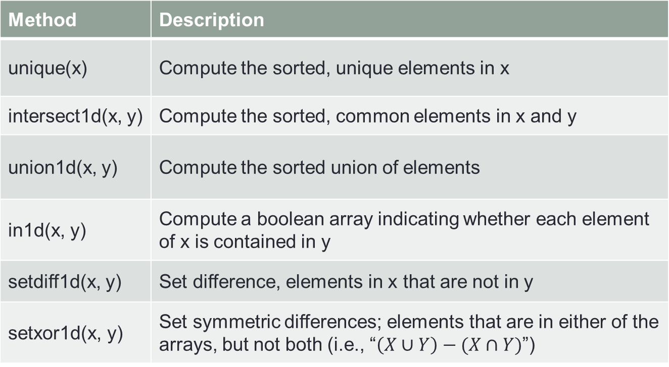
Unique and Other Set Logic (Cont.)
Table 4-6. Array set operations
Method | Description
unique(x) | Compute the sorted, unique elements in x
intersect1d(x, y) | Compute the sorted, common elements in x and y
union1d(x, y) | Compute the sorted union of elements
in1d(x, y) | Compute a boolean array indicating whether each element of x is contained in y
setdiff1d(x, y) | Set difference, elements in x that are not in y
setxor1d(x, y) | Set symmetric differences; elements that are in either of the arrays, but not both (i.e., “$\left(X∪Y\right)−(X∩Y)$”)

Slide 30
File Input and Output with Arrays
NumPy is able to save and load data to and from disk either in text or binary format.
In this section, we only discuss NumPy’s built-in binary format, since most developers will prefer pandas and other tools for loading text or tabular data.
np.save() and np.load() are the two main functions for efficiently saving and loading array data on disk. Arrays are saved by default in an uncompressed raw binary format with file extension .npy:
In [213]: arr = np.arange(10)
In [214]: np.save('some_array', arr)
If the file path does not have any extension, “.npy” extension will be automatically appended.

Slide 31
File Input and Output with Arrays (Cont.)
The array on disk can be loaded with np.load():
In [215]: np.load('some_array.npy')
Out[215]: array([0, 1, 2, 3, 4, 5, 6, 7, 8, 9])
Multiple arrays can be saved in an uncompressed archive file with an extension, .npz using np.savez() with keyword arguments:
In [216]: np.savez('array_archive.npz', a=arr, b=arr)
The ‘.npz’ extension can be also automatically attached.
When loading an .npz file, it returns a dict-like object(NpzFile object) that loads the individual arrays lazily:
In [217]: arch = np.load('array_archive.npz')
In [218]: arch['b']
Out[218]: array([0, 1, 2, 3, 4, 5, 6, 7, 8, 9])

Slide 32
Linear Algebra (Matrix Multiplication)
Unlike some languages like MATLAB, multiplying two two-dimensional arrays with * is an element-wise product instead of a matrix dot product.
Thus, there is a function dot(), both an array method and a function in the numpy namespace, for inner product and matrix multiplication:
In [225]: x
Out[225]: array([[ 1., 2., 3.],
[ 4., 5., 6.]])
In [226]: y
Out[226]: array([[ 6., 23.],
[ -1., 7.],
[ 8., 9.]])
In [227]: x.dot(y)
Out[227]:
array([ [ 28., 64.],
[ 67., 181.]])
Equivalent with np.dot(x,y),
and x@y (as of Python 3.5)

Slide 33
Linear Algebra (Cont.)
Table 4-7. Commonly used numpy.linalg functions
Function | Description
diag | Return the diagonal (or off-diagonal) elements of a square matrix as a 1D array, or convert a 1D array into a square matrix with zeros on the off-diagonal
dot | Compote inner(dot) product, i.e., matrix multiplication
outer | Compute the outer product of two vectors.
inv | Compute the inverse of a square matrix
det | Compute the matrix determinant
eig | Compute the eigenvalues and eigenvectors of a square matrix
inv | Compute the inverse of a square matrix
svd | Compute the singular value decomposition (SVD)
solve | Solve the linear system Ax = b for x, where A is a square matrix

Slide 34
Pseudorandom Number Generation
The numpy.random module supplements the built-in Python random with functions for efficiently generating whole arrays of sample values from many kinds of probability distributions.
For example, you can get a 4 × 4 array of samples from the standard normal distribution using normal:
In [238]: samples = np.random.normal(size=(4, 4))
In [239]: samples
Out[239]: array([[ 0.5732, 0.1933, 0.4429, 1.2796],
[ 0.575 , 0.4339, -0.7658, -1.237 ],
[-0.5367, 1.8545, -0.92 , -0.1082],
[ 0.1525, 0.9435, -1.0953, -0.144 ]])

Slide 35
Pseudorandom Number Generation (Cont.)
Python’s built-in random module, by contrast, only samples one value at a time. As you can see from this benchmark, numpy.random() is well over an order of magnitude faster for generating very large samples:
In [240]: from random import normalvariate
In [241]: N = 1000000
In [242]: %timeit samples = [normalvariate(0, 1) for _ in range(N)]
1.54 s +- 81.9 ms per loop (mean +- std. dev. of 7 runs, 1 loop each)
In [243]: %timeit np.random.normal(size=N)
71.4 ms +- 8.53 ms per loop (mean +- std. dev. of 7 runs, 10 loops each)

Slide 36
Pseudorandom Number Generation (Cont.)
We say that these are pseudorandom numbers because they are generated by an algorithm with deterministic behavior based on the seed of the random number generator.
You can change NumPy’s random number generation seed using np.random.seed:
In [244]: np.random.seed(1234)
The data generation functions in numpy.random() use a global random seed. To avoid global state, you can use numpy.random.RandomState() to create a random number generator isolated from others:
In [245]: rng = np.random.RandomState()
In [246]: rng.randn(10)

Slide 37
Pseudorandom Number Generation (Cont.)
Table 4-8. Partial list of numpy.random functions
Function | Description
seed | Seed the random number generator
shuffle | Modify a sequence in-place by shuffling its contents in an array
randint | Draw random integers from a given low-to-high range
rand | Draw samples from a standard uniform [0, 1) distribution
uniform | Draw samples from a uniform distribution
randn | Draw samples from a standard normal distribution with mean 0 and standard deviation 1 (MATLAB-like interface)
normal | Draw samples from a normal (Gaussian) distribution
binomial | Draw samples from a binomial distribution

Slide 38
Thank You !

