Slide 1


Slide 2
Basic steps:
Enter two names
List out FLAMES
Now check the common characters and cancel them off
Now count the remaining characters
With that count you have to cancel out the left over characters in the word FLAMES
The left over character will be declaring your relationship

Slide 3
FLAMES
F
L
F = Friends
L = Lovers
A = Affection
M = Marriage
E = Enemies
S = Siblings
A
E
S

Slide 4


ENTER YOUR NAME:
Karthik
ENTER YOUR CRUSH NAME:
Aparna

Slide 5
NOW IT COVERTS BOTH THE NAMES INTO SINGLE CASE
(EITHER UPPER CASE OR LOWER CASE)
Karthik -
KARTHIK
Aparna -
APARNA

Slide 6
FLAMES
KARTHIK
APARNA

Slide 7
In this step it will cancel out the similar characters and count the remaining and store.
FLAMES
KARTHIK
APARNA

Slide 8
Now checking the number of unsimilar characters we get it as 7.
Checking the left over characters and executing we will get to know their relationship.

Slide 9

THE RELATIONSHIP:
ENEMIES
KARTHIK
APARNA

Slide 10
LOOKING INTO THE CODE:

Slide 11
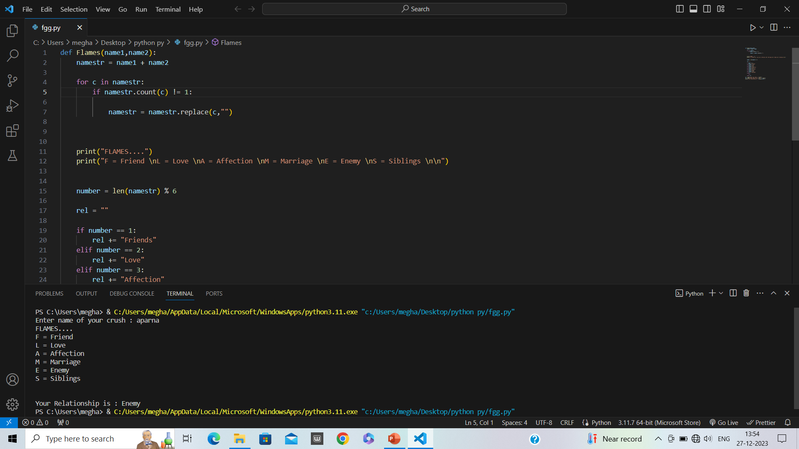

Slide 12
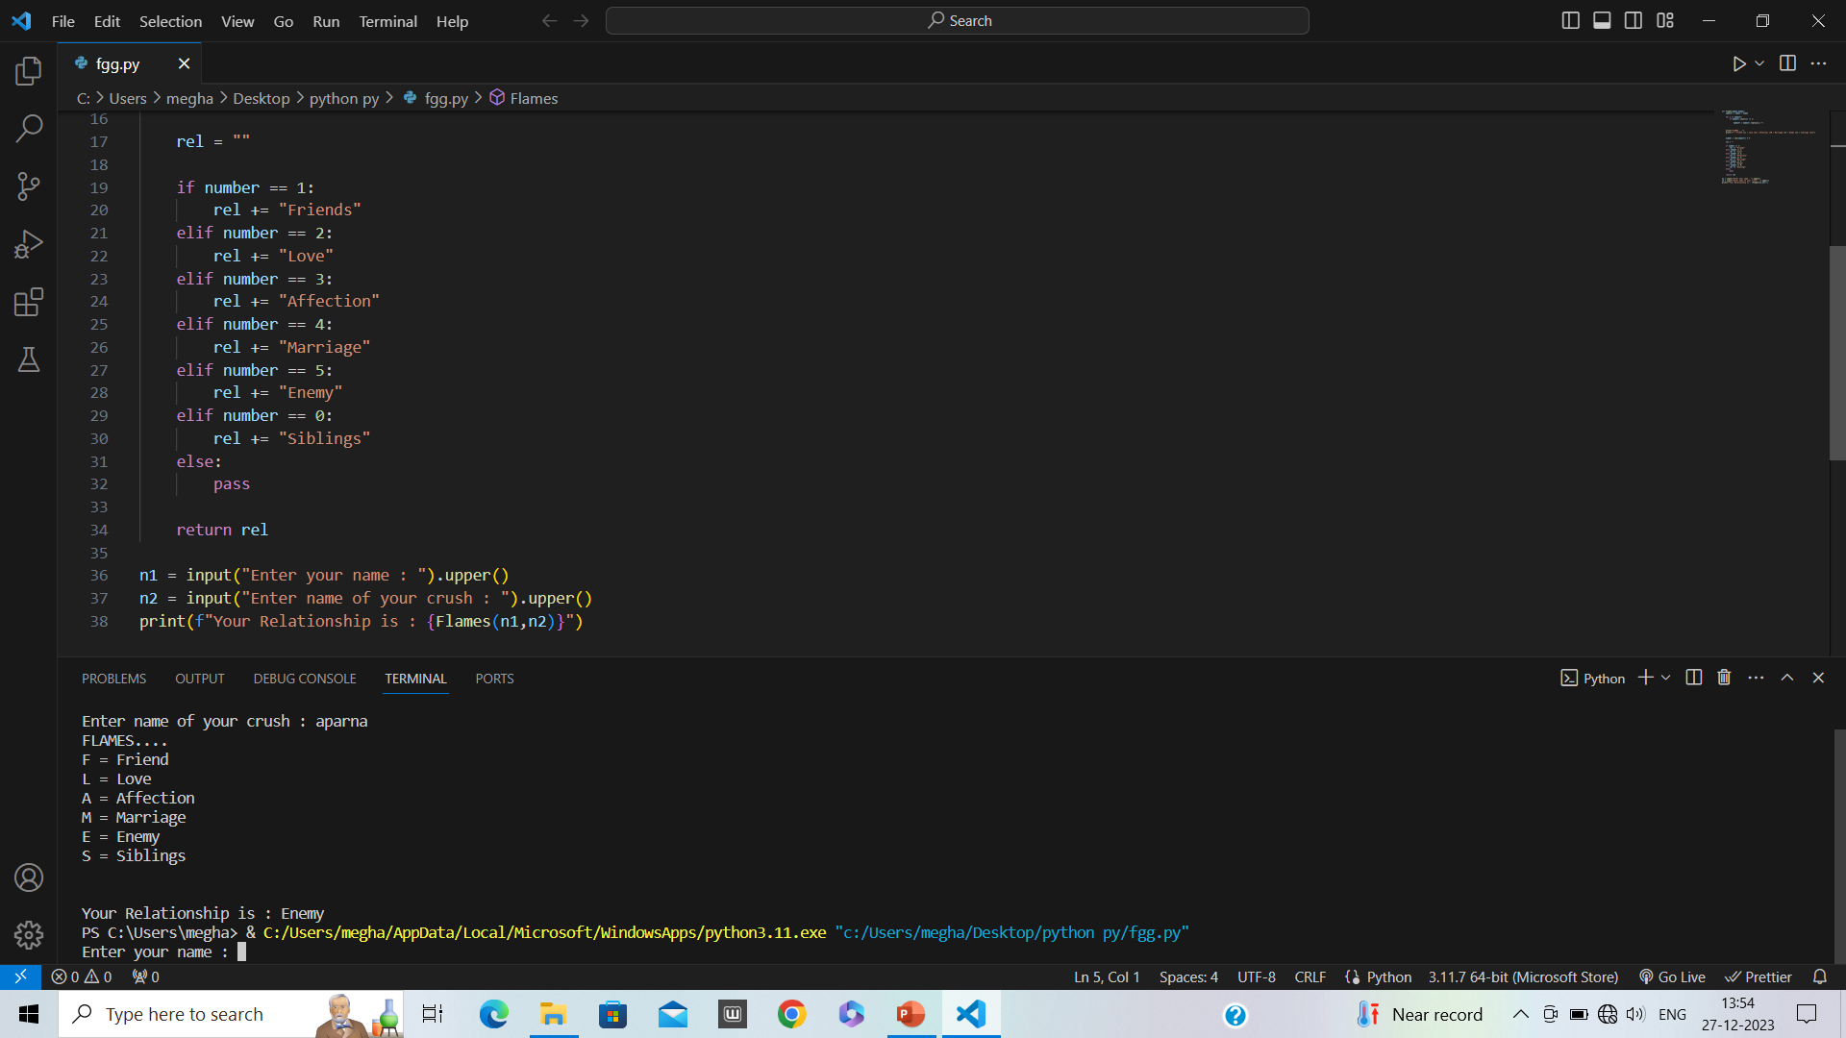

Slide 13
Firstly we are defining a function named Flames with passing two arguments name1 and name2.

Slide 14
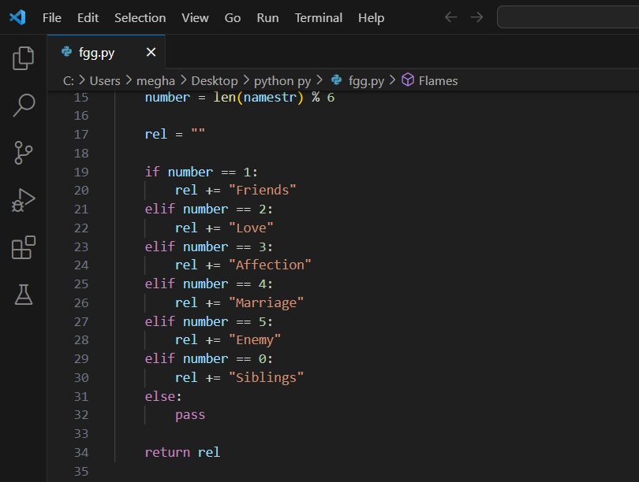
As you can see here we used if and else condition for the main part

Slide 15
In the last step we are inputting two name form whom we wanted to know the relationship.
You can observer that they are converted into upper case.

Slide 16
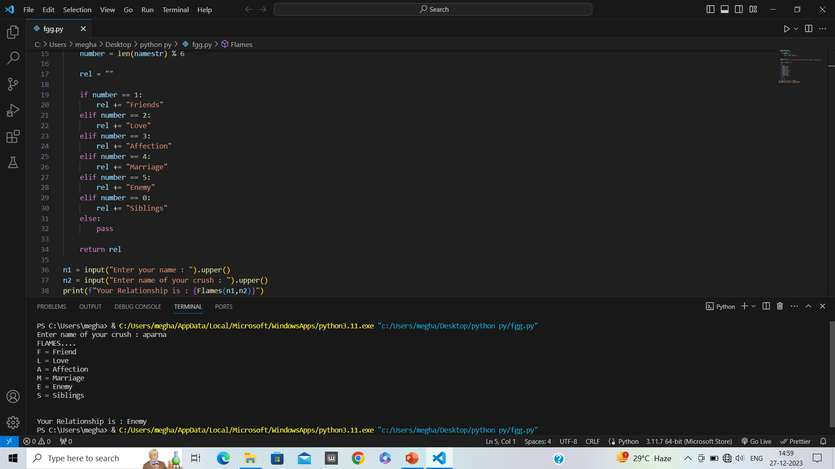
Final output:

Slide 17

ARE ANYONE INTRESTED TO CHECK OUT BY SUGGESTING TWO NAMES?

Slide 18
THANK YOU

