Slide 1
prolog
By
Sana mateen

Slide 2
Prolog
Prolog is a logic programming language. It has important role in artificial intelligence. Unlike many other programming languages, Prolog is intended primarily as a declarative programming language.
In prolog, logic is expressed as relations (called as Facts and Rules).
Core heart of prolog lies at the logic being applied.
Formulation or Computation is carried out by running a query over these relations.

Slide 3
Applications of Prolog
The applications of prolog are as follows:
Specification Language
Robot Planning
Natural language understanding
Machine Learning
Problem Solving
Intelligent Database retrieval
Expert System
Automated Reasoning

Slide 4
Starting Prolog
Prolog system is straightforward. From one person to other person, the precise details of Prolog will vary.
Prolog will produce a number of lines of headings in the starting, which is followed by a line. It contains just
?-
The above symbol shows the system prompt. The prompt is used to show that the Prolog system is ready to specify one or more goals of sequence to the user. Using a full stop, we can terminate the sequence of goals.
?- prompt shows the sequence of goal which is entered by the user. The user will not type the prompt. Prolog system will automatically generate this prompt. It means that it is ready to receive a sequence of goals.

Slide 5
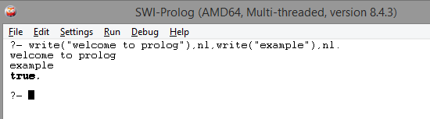
?- write("welcome to prolog"),nl,write("example"),nl.
welcome to prolog
example
true.
The above sequence of goals has to succeed in order to be succeeded.
write('Welcome to Javatpoint') On the screen of the user, Welcome to Javatpoint has to be displayed
nl On the screen of the user, a new line has to be output
write('Example of Prolog') On the screen of the user, Example of Prolog has to be displayed
nl On the screen of the user, a new line has to be output

Slide 6
Write and nl are called as built-in predicates.
Halt and statistics are the two other built-in predicates. In almost all Prolog versions, these predicates are provided as standard.
?- halt.
The above command is used to terminate the Prolog system.
?- statistics.
This command will cause the Prolog system statistics.
'Query' is a sequence of one or more goals. These goals are entered by the user at the prompt

Slide 7
To write a Prolog program, firstly, the user has to write a program which is written in the Prolog language, load that program, and then specify a sequence of one or more goals at the prompt.
To create a program in Prolog, the simple way is to type it into the text editor and then save it as a text file like prolog1.pl.
The following example shows a simple program of Prolog.
The program contains three components, which are known as clauses. Each clause is terminated using a full stop.
Using the built-in predicate 'consult', the above program can be loaded in the Prolog system.

Slide 8
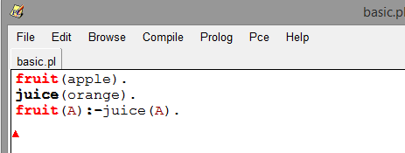

The example of rule is the final line of the program.
fruit(A) :- juice(A).
The colon(:-) character will be read as 'if'.
Here A is a variable, and it represents any value. In a natural way, the rule can be read as "If A is an fruit, then A is used in juice".
The above clause shows that the orange is an juice. Such deduction can also make by Prolog:

Slide 9
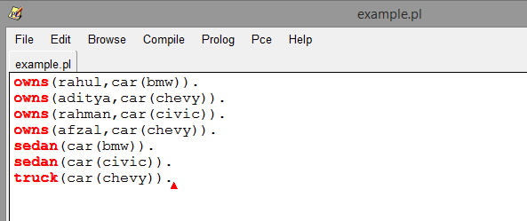
owns(rahul,car(bmw)). | Rahul owns a bmw car
owns(aditya,car(chevy)). | Aditya owns chevy car
owns(rahman,car(civic)) | Rahman owns civic car
owns(afzal,car(chevy)). | Afzal owns chevy car
sedan(car(bmw)). | Bmw car is sedan
sedan(car(civic)). | Civic car is sedan
truck(car(chevy)). | Chevy car is truck

Slide 10

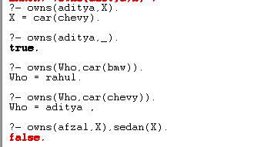

What does aditya own?
Does aditya own something?
Who owns car bmw?
Who owns car chevy?
Does afzal own sedan?
Does afzal own truck?

Slide 11
An example program
defining family relations Prolog is a programming language for symbolic, non-numeric computation.
It is specially well suited for solving problems that involve objects and relations between objects.
Figure 1.1 shows an example: a family relation.
The fact that Tom is a parent of Bob can be written in Prolog as: parent( tom, bob).
Here we choose parent as the name of a relation; tom and bob are its arguments.

Slide 12
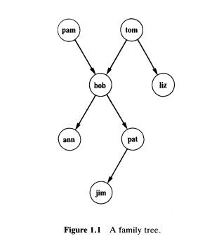

Slide 13
The whole family tree of Figure 1.1 is defined by the following Prolog program:
parent( pam, bob).
parent( tom, bob).
parent( tom, liz).
parent( bob, ann).
parent( bob, pat).
parent( pat, jim).

Slide 14
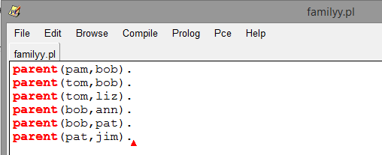
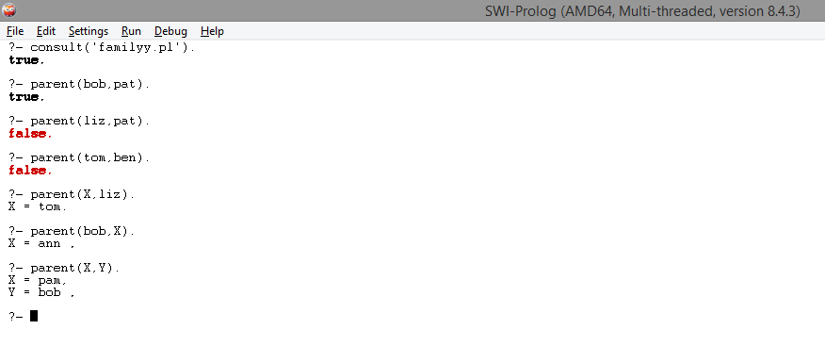

Slide 15
Symbols
Prolog expressions are comprised of the following truth-functional symbols, which have the same interpretation as in the predicate calculus.
English | Predicate Calculus | PROLOG
and | ^ | ,
or | v | ;
if | --> | :-
not | ~ | not

Slide 16
Variable
Variable is a string. The string can be a combination of lower case or upper case letters. The string can also contain underscore characters that begin with an underscore or an upper-case letter. Rules for forming names and predicate calculus are the same.
female
Male
X
y
mother_of
_father
Pro34

Slide 17
Facts
A fact is a predicate expression that makes a declarative statement about the problem domain.
Whenever a variable occurs in a Prolog expression, it is assumed to be universally quantified.
Note that all Prolog sentences must end with a period.
holi.
cat(tom). /* tom is a cat */
dog(spike). /* spike is a dog */
likes(Jolie, coding). /* Jolie likes coding */
likes(A, Kevin). /* Everyone likes Kevin */
likes(Jolie, B). /* Jolie likes everybody */
likes(B, Jolie), likes(Jolie, B). /* Everybody likes Jolie and Jolie likes everybody */
likes(Jolie, coding); likes(Jolie, playing). /* Jolie likes coding or Jolie likes playing*/
not(likes(Jolie, pasta)). /* Jolie does not like pasta */

Slide 18

Queries
In Prolog, the query is the action of asking the program about the information which is available within its database. When a Prolog program is loaded, we will get the query prompt,
?-
After this, we can ask about the information to the run time system. we can ask a question to the program like
?- 'It is sunny'.
and it will give the answer
yes
?-

Slide 19
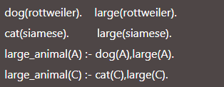
Rules
Rules extend the logic program capabilities. Rules are used to provide the decision-making process in Prolog. Rules are specified in the form:
head:- t1, t2, t3,….., tk. Where k>=1
The head is known as the clause of the head.
:- is known as the clause neck. It is read as 'if'. The body of the clause is specified by t1, t2, t3,…, tk. It contains one or more components, and it can be separated using the commas. A rule will read as 'head is true if t1, t2, t3,…., tk are all true'
The above rules mean that 'large_animal(A) is true if dog(A) is true, and large(A) is true, etc.'
The last line means that 'large_animal(C) is true if cat(C) is true, and large(C) is true.

Slide 20
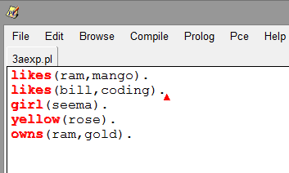
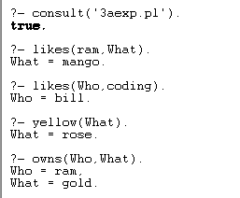

Slide 21
Harivansh bachchan
Teji bachchan
Jaya bachchan
Amitabh bachchan
Abhishek Bachchan
Shweta
Aishwarya
Aradhya

Slide 22
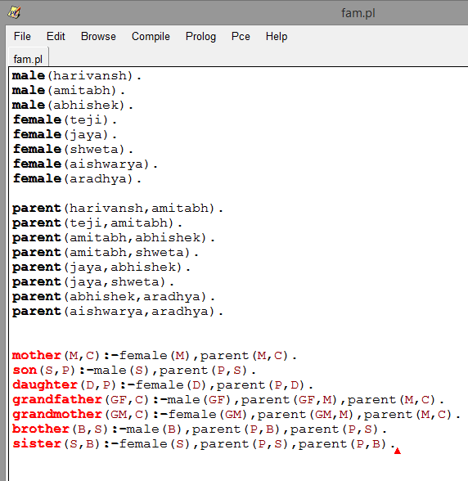
FACTS AND RULES

Slide 23
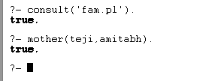
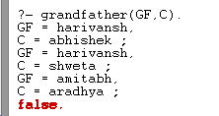
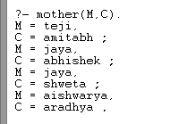
1. To check if TEJI is a mother of AMITABH
3. check whether somebody is grandfather of some object
2. print all those mother relationship between two objects. M& C

Slide 24
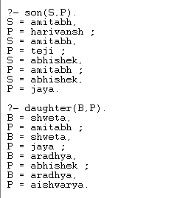
4. Check how many children are there for a person

