Slide 1
Pew Pew Shooter

Slide 2
Game Idea
Our game will be a first person shooter. You can only move left and right.
Enemies will start spawning walking towards player. Player have to prevent the enemies to reach them.

Slide 3
Game Mechanics
Left click to shoot
A and D to move left and right
Gain health by shooting at health pack
Win Condition : Surviving a certain amount of time
Lose Condition : losing all the health

Slide 4
Game Features

Slide 5
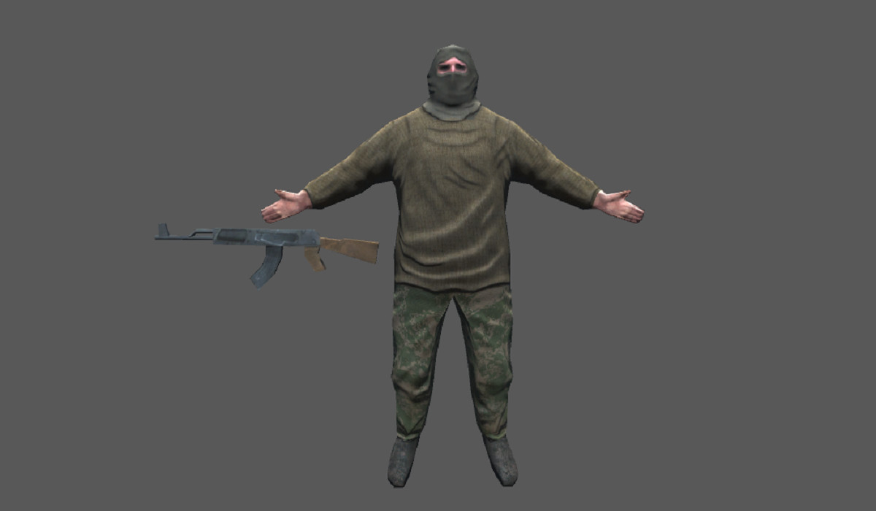
Art Style

Slide 6
Version Control
GitHub

