Slide 1
Shoot Out

Slide 2
Game Idea
Our game will be a first person shooter. You can only move left and right.
Enemies will start spawning in the level and starts walking towards the player. Player have to prevent the enemies to reach them.

Slide 3
Game Mechanics
Left click to shoot
A and D to move left and right
Gain health by shooting at health pack
Win Condition : Surviving a certain amount of time
Lose Condition : losing all the health

Slide 4
Game Features
Enemies shoot back
Countdown Timer
- If the player killed an enemy the countdown timer increases
by a certain amount.
Enemy speed increase
- After a certain amount of time, the speed of the enemies
increases.

Slide 5
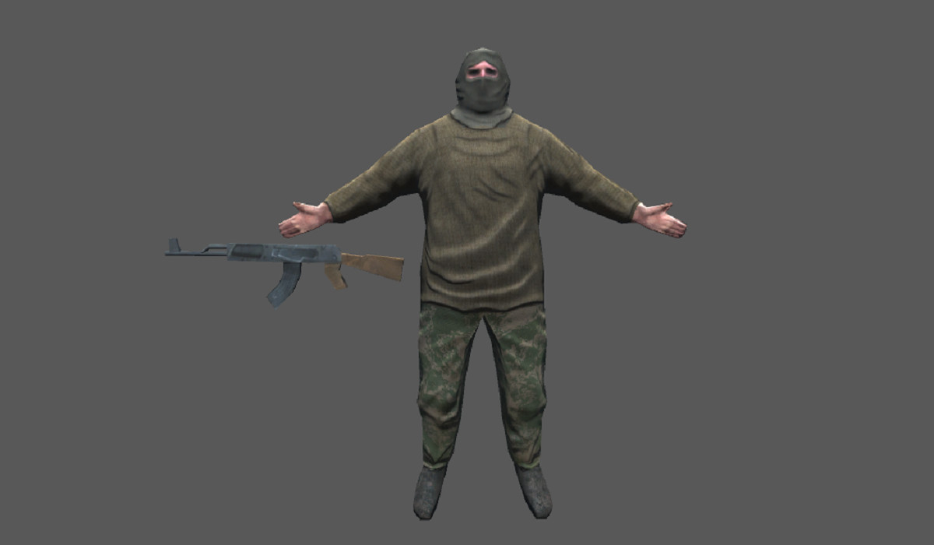
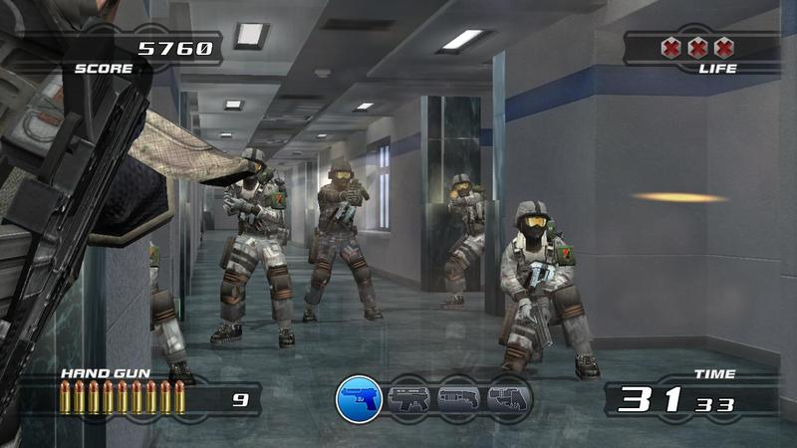
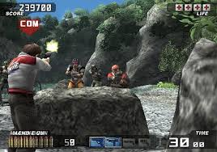
Art Style

Slide 6

Version Control

Slide 7
Project Timeline
Week 1: Brainstorming ideas for the game, finding assets and creating the prototype of what the game idea is.
Week 2: Development of the game, debugging the game, fixing if there is a bug in the game. Creating the test case.

Slide 8
Project Workflow
Wynn: Player movement, Player mechanics, enemy spawning Lucas: Enhancement of the game
(Implementing the increase of the countdown timer,
increase the speed of the enemies, etc.) Vanness: Finding of the assets and adding it into the game, Game UI.

Slide 9
Project Plan
Day | Date | Things to do
Thurs | 10/11 | Presentation
Fri | 11/11 | Idea creation
Sat | 12/11 | Idea Creation
Sun | 13/11 | Idea Creation
Mon | 14/11 | Idea implementation
Tues | 15/11 | Adding assets
Wed | 16/11 | Fixing the game if there is a bug
Thurs | 17/11 | Finalizing the game and Test cases

Slide 10
Project Prototype
---

