Slide 1







STOCK MARKET ANALYSIS
500 COMPANIES LISTED IN STOCK MARKET WHOSE MARKET CAPITAL IS LESS THAN 500 CRORE
PRESENTED BY – GUMMA ANKITA

Slide 2

CONTENTS
SERIAL NUMBER | TOPIC
1 | Title Slide
2 | Objective of Analysis
3 | Dataset and Scope
4 | Market Landscape
5 | Client Potential
6 | Regional Opportunities
7 | Website Quality Assessment
8 | UX vs Performance Impact
9 | Opportunity for Inmogic Technologies
10 | Recommendation Series
11 | Business Impact
12 | Conclusion

Slide 3
OBJECTIVE OF ANALYSIS
01
04
02
05
03
06
To segment 500 companies based on market cap, sector, and performance metrics
To recommend strategies for Inmogic technologies to growth and develop.
To create visualizations that highlight top trends, and growth potential
To derive insights that can support business decision-making
To identify patterns across sectors that might indicate future investment opportunities
To analyze 500 stock market companies with market cap below 500 crore

Slide 4
Data Set and Analysis Scope
DATA SOURCES
ANALYSIS SCOPE
Platform:
Microsoft Power BI
01
Market Landscape
Industry & Competitor Analysis
Data Type:
Stock Market Data
02
Client Potential
Business Performance Metrics
Companies:
50+ Technology Firms
03
Regional Opportunity
Geographic Distribution & Demand
Sectors:
CRM, ERP, SaaS Solutions
04
Website Quality
UX & Performance Benchmarking
Time Period:
Multi-Year Historical Data
05
Problem Identification
Geography:
India Markets
Gap Analysis & Pain Points
06
Opportunity Mapping
Records:
10,000+ Data Points
Strategic Recommendations

Slide 5
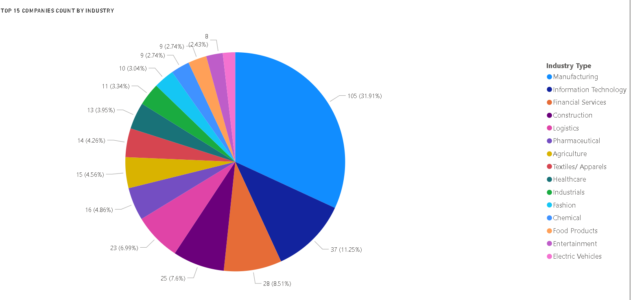
1
Market Landscape
"These industries are our target market — here's why they need our solutions."
Manufacturing dominates the dataset, contributing the highest number of companies (~32%), indicating strong presence of industrial and production-based firms
Information Technology and Financial Services follow as the next major sectors, showing consistent representation in the small-cap space
Mid-level sectors like Construction, Logistics, and Pharmaceuticals show moderate participation, reflecting steady but not dominant growth
Sectors such as Agriculture, Textiles, and Healthcare have smaller shares, indicating niche or specialized market presence
Emerging sectors like Electric Vehicles and Entertainment have minimal representation, suggesting early-stage growth opportunities
Overall, the distribution highlights a diversified market with no complete dependency on a single sector
By looking at which industries have the most small-cap companies, Inmogic Technologies can see where the growth is happening—like in manufacturing or IT.
This helps us figure out which industries we might want to partner with or invest in as they grow. For example, IT and financial services are rising fast, so we could explore new tech collaborations or tailored solutions.
Even smaller sectors, like electric vehicles, could be future goldmines, and being early to those trends could set us apart.
In short, this gives us a clearer sense of where the market is heading and where we might focus next.

Slide 6
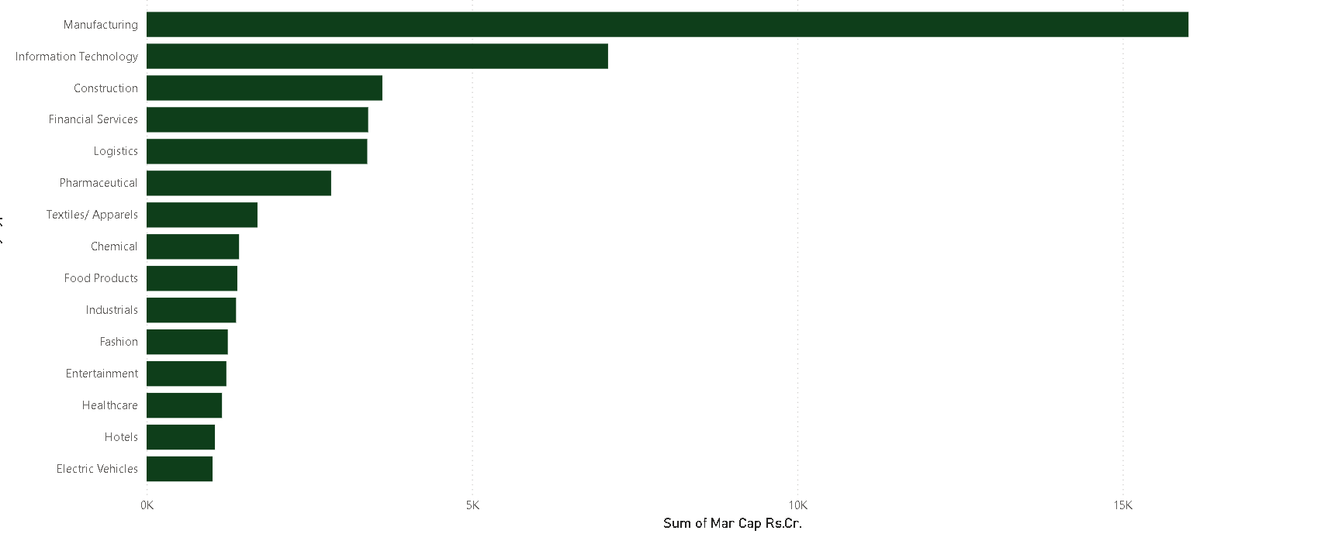
Sum of Market Capital By Industry Type
Manufacturing clearly dominates in terms of total market capitalization, which shows strong stability and scale in this sector
Information Technology stands as the second major contributor, indicating strong growth potential and innovation-driven opportunities
Sectors like Construction, Financial Services, and Logistics show moderate market presence, making them suitable for targeted partnerships
Smaller sectors such as Electric Vehicles, Healthcare, and Entertainment have lower market cap, but they indicate emerging opportunities.
The dominance of Manufacturing shows a large pool of potential clients, allowing Inmogic Technologies to target this sector for maximum outreach
Strong presence of Information Technology indicates opportunities for tech-based solutions, collaborations, and service offerings
Mid-level sectors like Construction, Financial Services, and Logistics provide diversified business opportunities across industries
Smaller sectors such as Electric Vehicles and Healthcare highlight emerging markets where Inmogic can enter early and build long-term relationships
Overall, this helps Inmogic prioritize industries based on both volume and growth potential, improving targeting and strategy

Slide 7
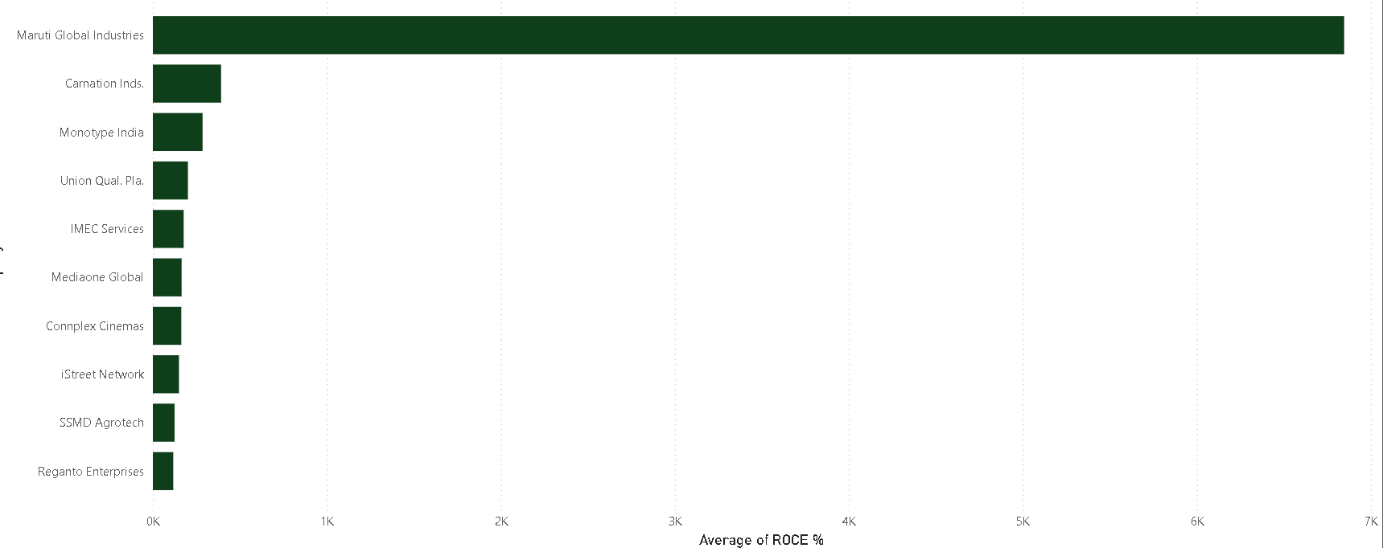
2
Client Potential
“Identifying high-potential companies based on profitability, growth trends, and financial performance.”
Companies with higher ROCE indicate better efficiency in using their capital
Top-performing companies show strong financial management and operational performance
These companies are more stable and reliable for long-term collaboration
High ROCE also reflects better returns, making them attractive potential clients
This helps us focus on companies that are financially strong and growth-oriented
Maruti Global Industries has a significantly higher ROCE compared to all other companies, clearly standing out
Companies like Carnation Industries, Monotype India, and Union Quality Plastics have relatively low to moderate ROCE
Other companies such as IMEC Services, Mediaone Global, and Complex Cinemas show similar performance levels
iStreet Network, SSMD Agrotech, and Reganto Enterprises have comparatively lower ROCE values

Slide 8
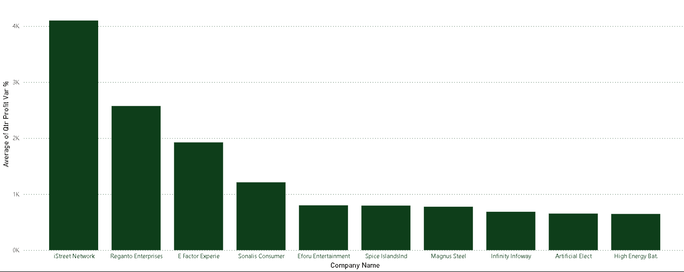
Average Profit % By Companies
Companies with higher profit percentages indicate strong financial performance
High profitability reflects efficient operations and good revenue management
These companies are more likely to sustain growth and expand further
Profitable companies have higher potential for long-term business relationships
This helps us identify companies that are not just active, but financially strong
iStreet Network has the highest profit percentage, clearly standing out from the rest
Reganto Enterprises and E Factor Experience also show strong profit performance
Companies like Somi’s Consumer and eTour Entertainment have moderate profit levels
Other companies such as Spice Islands, Magnus Steel, and Infinity Highway show relatively lower but stable profit percentages
Overall, most companies fall in a mid to low profit range, with only a few high performers

Slide 9
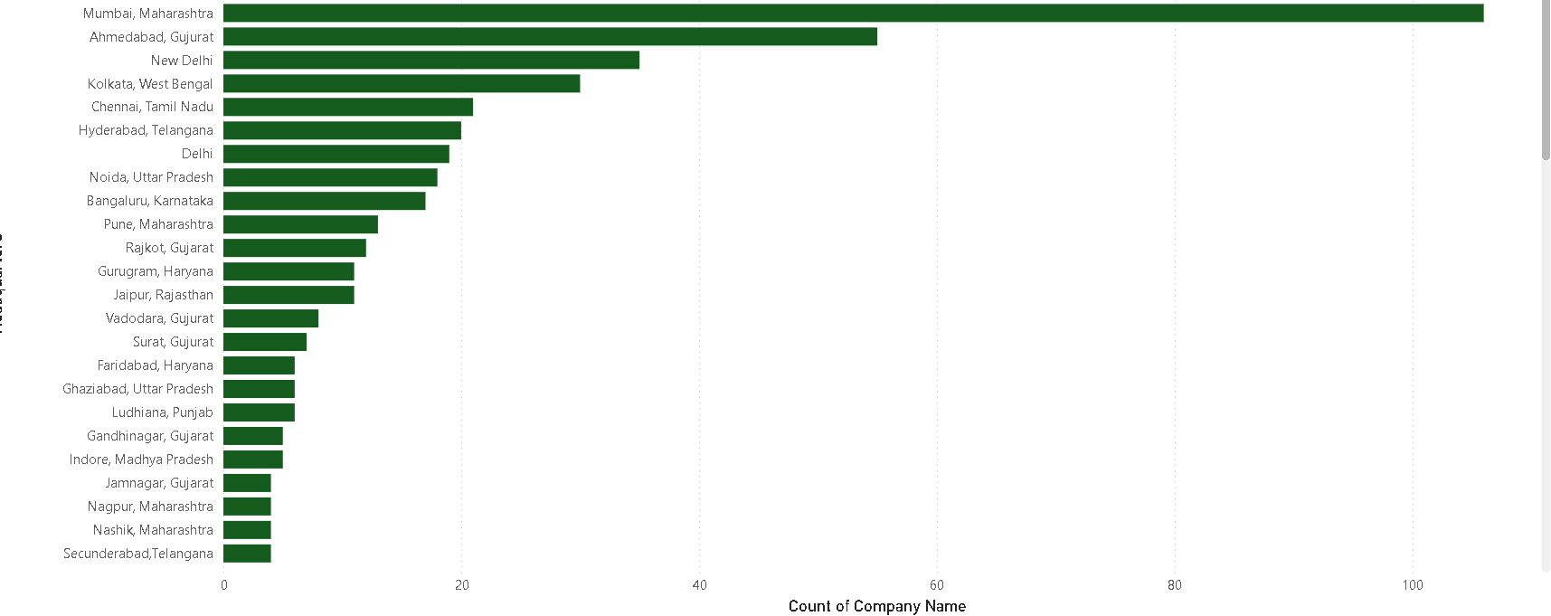
3
Regional Opportunities
“These regions are our key target areas — offering a mix of high company presence and strong business potential.”
Mumbai, Maharashtra has the highest number of companies, making it a major business hub
Ahmedabad, Gujarat and New Delhi also show strong presence, indicating important regional clusters
Cities like Chennai, Hyderabad, and Noida have moderate company presence, showing growing opportunities
Noida, Chennai, and Vadodara show higher average market capitalization, indicating financially strong companies
Regions like Pune, Rajkot, and Surat also contribute but with relatively smaller presence
Cities like Mumbai, Ahmedabad, and New Delhi have a high concentration of companies, helping Inmogic Technologies target more clients in one region
Regions such as Noida and Chennai, with higher market capitalization, allow Inmogic Technologies to focus on financially strong and high-value clients
Growing cities like Pune, Hyderabad, and Surat provide opportunities to enter emerging markets early
Understanding regional distribution helps Inmogic Technologies plan location-based strategies for sales, marketing, and expansion
It enables us to prioritize regions based on both volume (more companies) and value (strong companies)

Slide 10
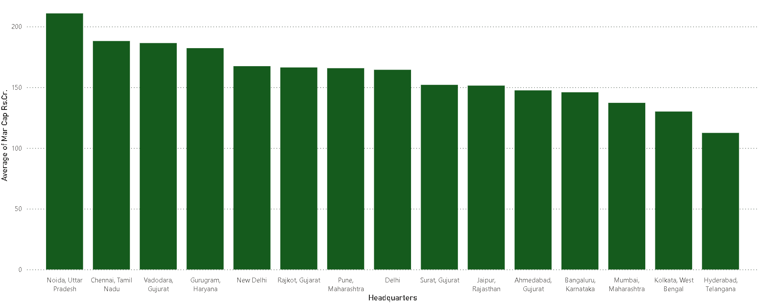
Average Market Capital By Headquarters
Noida, Chennai, and Vadodara have the highest average market capitalization, indicating stronger companies
Cities like Gurugram, New Delhi, and Rajkot also show good financial strength
Regions such as Mumbai, Kolkata, and Hyderabad have relatively lower average market cap in this dataset
Overall, different cities show varying levels of financial strength
Inmogic Technologies can focus on cities like Noida, Chennai, and Vadodara to target financially strong and high-value clients
Regions with moderate values like Delhi and Gurugram provide balanced opportunities for business expansion
Cities with lower market cap can be targeted for early-stage partnerships and long-term growth
This helps Inmogic plan region-wise strategies based on financial strength of companies

Slide 11
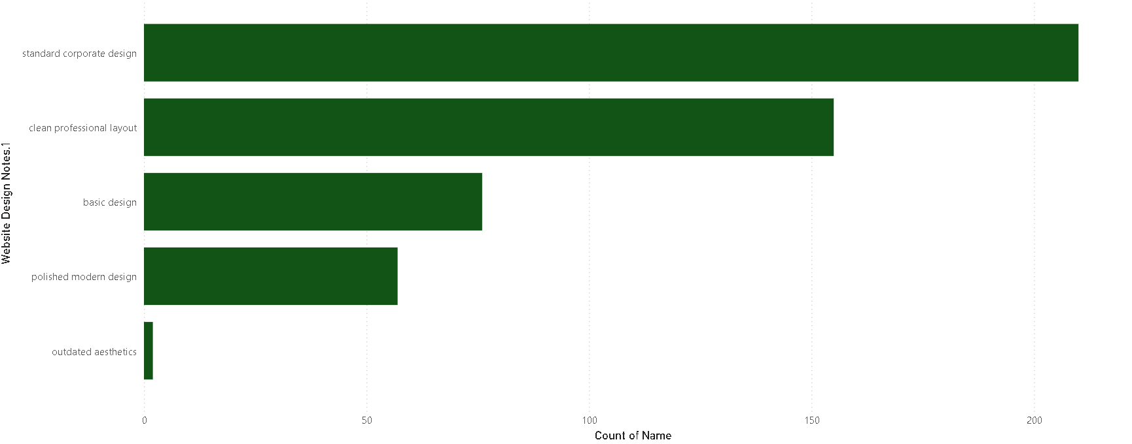
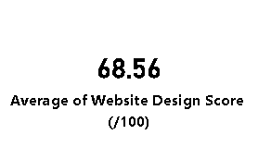
Website Quality Assessment
4
“Evaluating overall website quality to identify design gaps and improvement opportunities.”
The average website design score is around 68, indicating moderate overall quality
Most companies use standard or clean professional designs, while fewer use basic or outdated designs
Some industries show better design quality, while others still have scope for improvement
There is a noticeable gap between high-quality and average websites

Slide 12
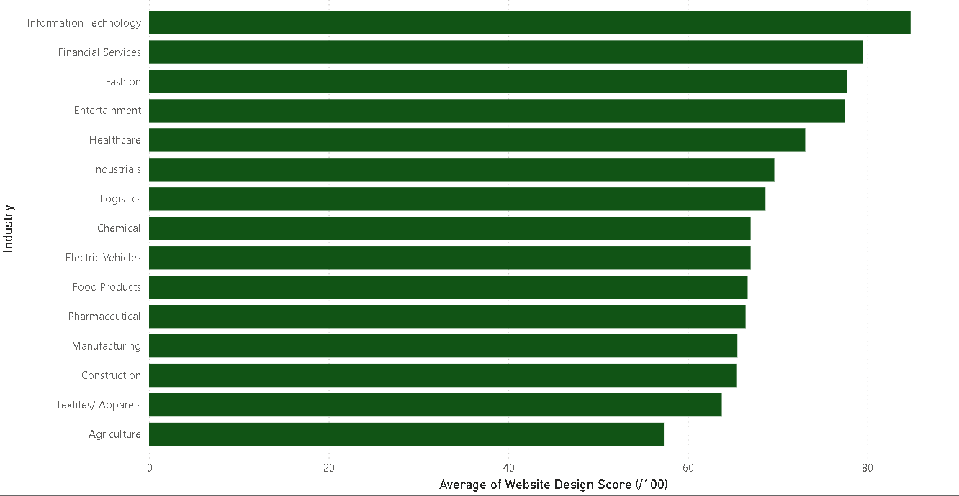
Average Website Design by Industries
Inmogic can identify companies with poor or average website quality and offer improvement solutions
Companies using basic or outdated designs become high-potential clients
Industry-wise insights help Inmogic target sectors with lower design quality
It enables Inmogic to position itself as a solution provider for website enhancement and digital presence

Slide 13
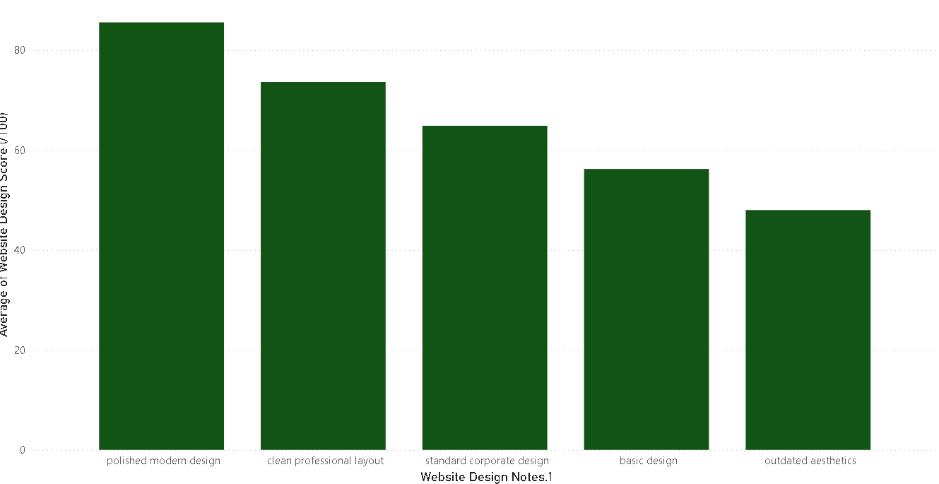
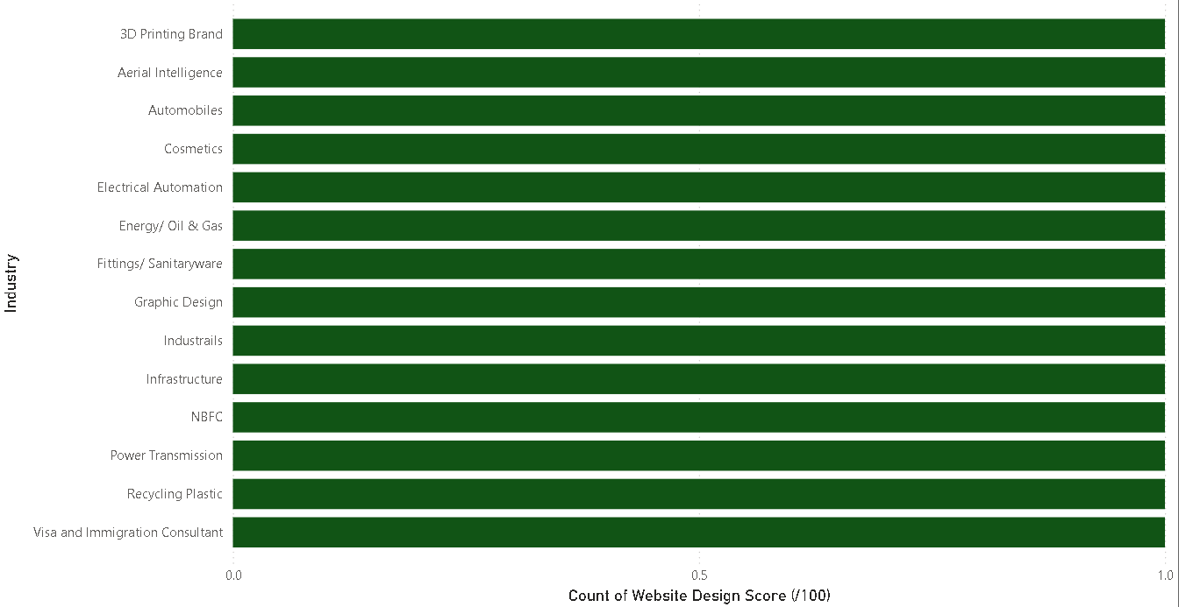
5
UX vs Performance
“Analyzing how user experience design impacts overall website performance.”
Most companies fall within a mid-range score, showing average user experience
Better design types (clean/professional) are associated with higher performance scores
Basic or outdated designs tend to have lower scores and weaker performance
There is a clear relationship between good UX design and better performance
Inmogic can promote modern UX design solutions to improve client performance
Helps in convincing clients that better design leads to better results
Allows Inmogic to offer UX-focused services as a value addition
Supports building data-driven proposals for clients

Slide 14
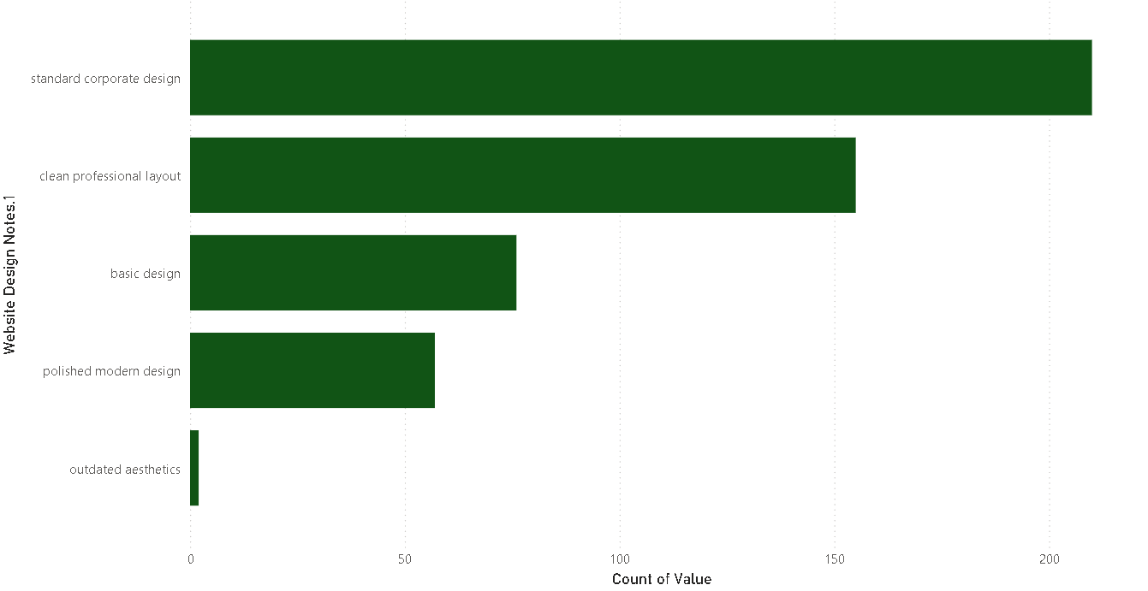
Website Design vs Design Issues
Standard corporate design has the highest number of issues, indicating common but not fully optimized designs
Clean professional layouts also show a high number of issues, suggesting room for improvement despite being widely used
Basic design has a moderate number of issues, reflecting limited functionality and user experience gaps
Polished modern design has fewer issues, indicating better design quality and optimization
Outdated aesthetics have very low count, meaning fewer companies are using completely outdated designs
Inmogic can target companies using standard and clean designs, as they have the highest number of improvement opportunities
It helps identify common problem areas in website design, allowing Inmogic to offer specific solutions
Companies with basic designs can be targeted for complete redesign services
Encourages Inmogic to promote modern and optimized designs as a better alternative
Enables a problem-solution approach instead of generic service pitching

Slide 15
6
Problem Identification
Website quality is only moderate (avg ~68/100), indicating significant room for improvement across companies
High concentration of design issues in commonly used layouts (standard & clean), showing lack of optimization
Inconsistent UX performance—wide variation in scores across companies
Limited adoption of modern design practices, despite better performance outcomes
Weak alignment between UX and business performance in several companies
Only a few companies show high ROCE, while most operate at average efficiency levels
Profitability is uneven, with a small set of high performers and many mid/low performers
Industry concentration risk—heavy dominance of Manufacturing reduces diversification focus
Regional imbalance—major cities (Mumbai, Ahmedabad, Delhi) dominate, while others are underutilized
Financial strength varies by region, indicating uneven market maturity
Most companies fall in similar market cap range, leading to high competition within the same segment
Emerging sectors (EV, Healthcare, etc.) are underrepresented, indicating missed early-stage opportunities
Lack of differentiation in digital presence, as many companies use similar design approaches
Limited focus on user-centric design, impacting engagement and conversion potential

Slide 16
6
Opportunity for Inmogic Technologies
Target companies with poor or average website quality for redesign and improvement services
Offer UX optimization solutions to improve performance and user engagement
Focus on industries like Manufacturing and IT with high company concentration for better reach
Approach companies with high ROCE and profitability for premium service offerings
Enter emerging sectors like Electric Vehicles and Healthcare for early-stage opportunities
Leverage regional insights to focus on high-density cities like Mumbai, Ahmedabad, and Delhi
Target financially strong regions like Noida and Chennai for high-value clients
Provide standardized solutions for companies with similar market cap and needs
Use identified design issues to offer problem-specific digital solutions
Position Inmogic as a data-driven technology partner for business growth

Slide 17
6
Recommendations
Improve website quality by adopting modern, user-friendly design practices
Focus on enhancing UX to improve overall performance and user engagement
Prioritize fixing common design issues in standard and clean layouts
Target industries with lower design quality for digital transformation initiatives
Develop region-specific strategies to focus on high-potential cities
Offer customized solutions for high-performing companies and scalable solutions for mid-level companies
Explore opportunities in emerging sectors for early market entry
Use data insights to create targeted marketing and client acquisition strategies
Continuously monitor performance metrics like ROCE, profit, and growth for better decision-making
Position Inmogic Technologies as a technology and UX-driven solution provider

Slide 18
6
Conclusion
Through this analysis, I was able to identify key gaps in website quality, user experience, and overall performance across companies.
I also analyzed industry distribution, regional opportunities, and financial performance metrics such as ROCE, profit, and growth to understand where the strongest opportunities lie.
Based on these insights, I was able to highlight areas where improvements are needed and how these gaps can be converted into business opportunities.
This analysis helped me understand how Inmogic Technologies can use data-driven strategies to target the right companies, improve digital solutions, and focus on high-potential industries and regions for future growth.

Slide 19




THANK YOU

