Slide 1
PROJECT TITLE-INTELLIGENT NOTEPAD
Presented By
Md: Sabbir Ahamed
ID:ASH2225005M

Slide 2
OVERVIEW
Developing a Java Swing-based Notepad application that includes features such as creating, saving, and editing txt files. The application also integrates spell-checking and next word prediction functionality.

Slide 3

FUNCTI0NALITY
Text Editing : create, edit, and delete text within the editor.
Save : Provide functionality to save a file.
Spell Check and Auto-Correction: Check for misspelled words and offer suggestions for corrections.
Next Word Prediction: Predict the next word based on the context of the text.

Slide 4
LEARNT FOR THIS PROJECT
JAVA SWING
N-gram model
Levenshtien edit distance algorithm

Slide 5

N-gram MODEL
N-gram: sequence of n word. Like “he is a king”
Unigram: (He)(is)(a)(king)
Bigram: (he is)(is a)(a king)
Trigram: (he is a)(is a king)
N-gram model work on probability theory, “Bayes rule”
Bayes rule=P(A|B)=$\frac{P(A∩ B)}{P(B)}$.
Unigram probability P(W)=$\frac{Count(W)}{N}$
Bigram probability P(W$i$| W$i−1$)= $\frac{Count(Wi−1 ,Wi )}{count(W i−1 )}$.
Trigram Probability P(W$i$| W$i−2 ,Wi−1$)= $\frac{Count(Wi−2 ,Wi−1 ,W i)}{count(Wi−2 ,Wi−1 )}$

Slide 6

Suppose we have a txt file:
The boy bought the chocolate. The girl ate the chocolate. The girl played with the toy.
Unigram P(boy | the)=$\frac{count(the,boy)}{count(the)}$=$\frac{1}{6}=0.1666…$
Likely P(girl|the)=$\frac{2}{6}=0.333…$
Unigram P(bought | the, girl)=$\frac{count(the,girl,bought)}{count(the,girl)}$=$\frac{0}{2}=0$
Likely P(bought | the, boy)=$\frac{count(the,boy,bought)}{count(the,boy)}$=$\frac{1}{1}=1$
Trigram P(the |the, girl, ate)= $\frac{1}{1}=1.$

Slide 7
Levenshtien edit distance
Process of minimum edit distance:
Step 1:Check User Input:
If the user input matches a word in the dictionary, return the word as correct. Else, proceed to find the word in the dictionary with the minimum edit distance.
Step 2:Calculate Minimum Edit Distance help of Levenshtien edit distance algorithm.
Step 3:Return Suggested Correction & show display.

Slide 8
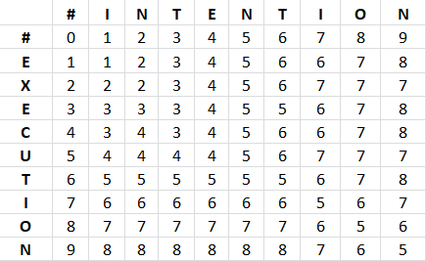
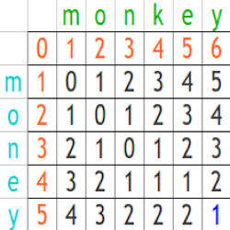
Example of minimum edit distance:
Intention & Execution:
Monkey & Money:
Example of minimum edit distance:
monkey and money
Intention & Execution:

Slide 9
PROGESS
GUI Setup: Completed the main application window and text editing area.
File Operations: Users to create, open, and save files.
Spell-Check: Fully Implemented.

Slide 10
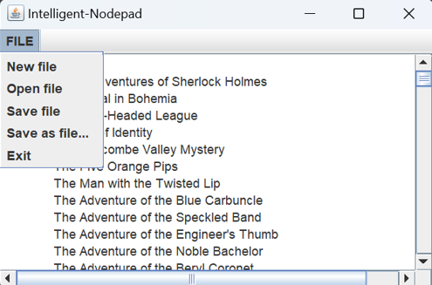
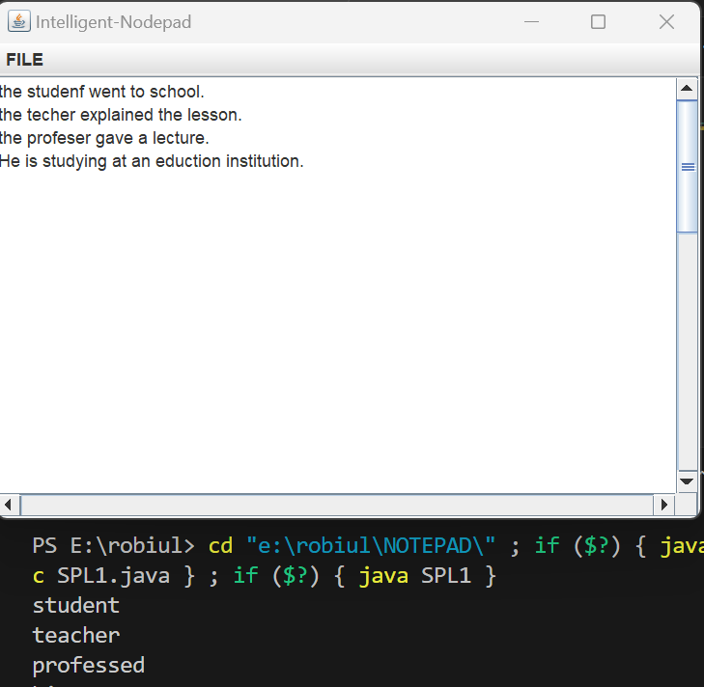
GUI setup and
file operation:
Spell check:

Slide 11
FUTURE WORK
Implementation of N-gram Model.
Show Correct Words in JTextArea(word add to GUI).

Slide 12
Q/A

