Slide 1
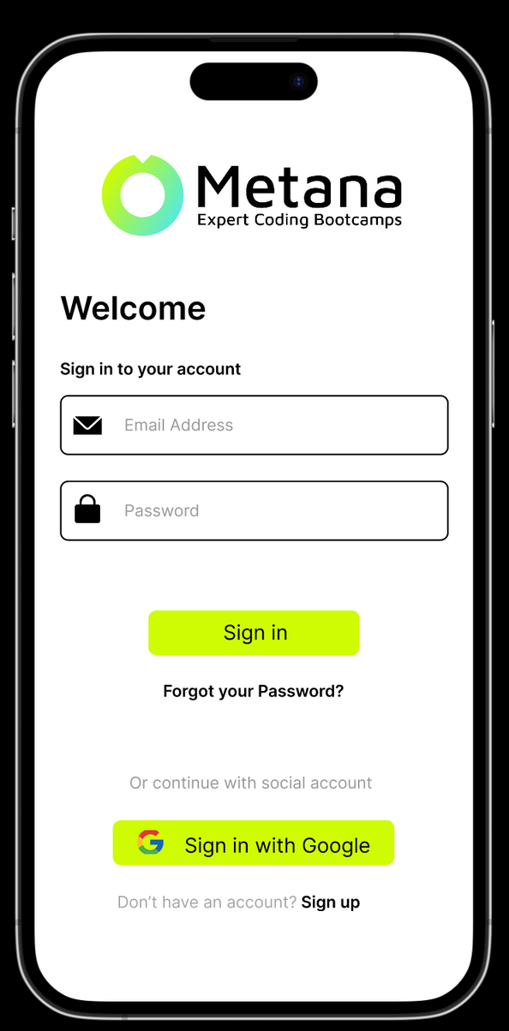
Unison App
Custom Marketing App: A Centralized Platform for All Your Marketing Needs
Imeth Vinnath
2023/08/10
CB010675
SE Undegraduate
Sri Lanka

Slide 2
Unsion App is an idea originated from working in an E-learning Start-up
After working for several months and associating with different Start Ups,
I noticed that an all-in-one organizational app, centralizing data customized to cater the business operations was ideal to bridge inefficiencies that arise due to switching between platforms.
The idea is simple... Integrations + Centralization

Slide 3

About the App
Problem
What does it have to do with marketing?
So what you really want is
During my experience working in a start up, I noticed that most start-ups are using a wide array of online tools as each of them provide a more granular control over different aspects of the business process.
An all-in-one App, designed for your business, Seamless integrations with all your marketing and sales needs. And your data is yours!
A key part of marketing is to know what works and what doesn't. Dashboards and reports generated by analyzing record data in multiple platforms help marketing teams in visualizing and tracking the success of a marketing strategy

Slide 4
01
Sign Up : Organization can facilitate the onboarding process of an employee by Signing up for the organizational email
reference
02
Once logged into the app with organizational email, user can set up his/her accounts into app. ( Slack, LinkedIn, Gmail, Hubspot, TypeForm)
Features
03
The user can also then view all the events, tasks and manage them via the events view.
04
The app will have several dashboard including lead analytics which help the marketing team analyze performance of their strategies and overall marketing
Note: The features developed in this app, will be to cater to the business requirements identified in a specific company
05
Leads can be added as contacts, and you can also import contacts from your phone.

Slide 5
01
Clarity: The app is easy to understand and use.
02
Consistency: The app has a consistent look and feel throughout.
Design
03
Efficiency: The app is efficient and easy to navigate.
04
Simplicity: App is designed to be as simple as possible, without extraneous features or distractions that detract from the user's experience.
05
Emotion: The app is designed to be engaging and enjoyable to use.

Slide 6
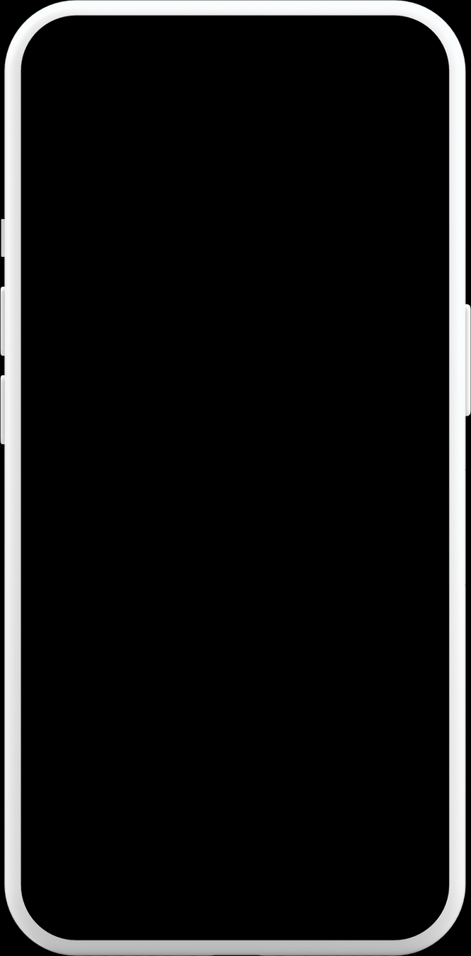
User Interactions
See prototype
If user has an organizational account, he can simply log in using the password or a social login (google)
If user, doesn't have an account, he can sign up for an account, after authorization from the admin, user will get the credentials via e-mail, where the user can enter the application using his newly created account
User can view messaging channels by clicking the message icon on the navbar and set up their slack, linkedin and hubspot accounts using the organizational email address
'Notch' Product Mockups

Slide 7
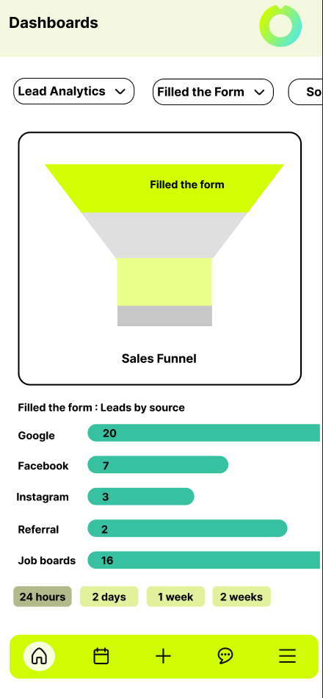
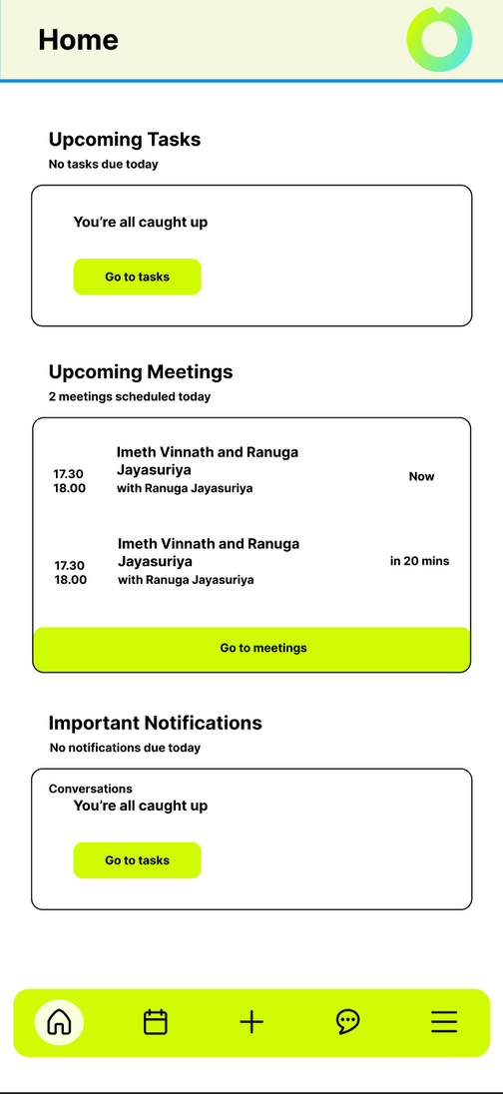
User Interactions
See prototype
Depending on the role of the user, he/she is able to view all accessible reports, analytics, tasks from the side menu
User is also able to import contacts and create deals
and create tasks by clicking on the + icon on the navigation bar
User can view messaging channels by clicking the message icon on the navbar and set up their slack, linkedin and hubspot accounts using the organizational email address
User's home view is mainly populated with tasks assigned and upcoming meetings that is synchronized from the users organizational email address
'Notch' Product Mockups

Slide 8
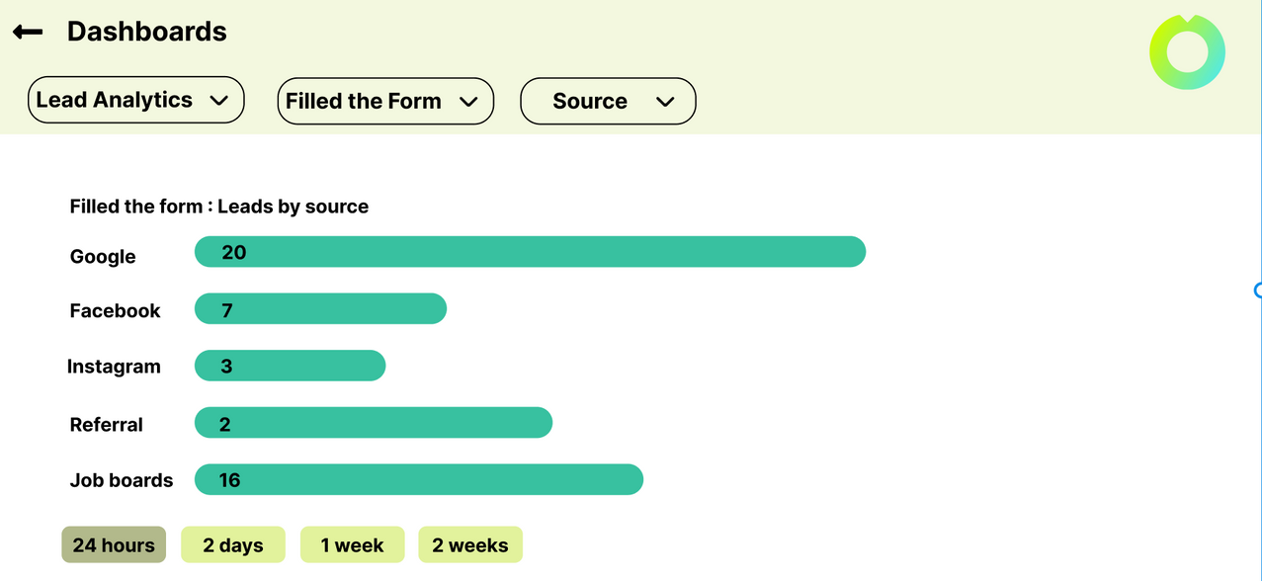
Mock up
Landscape design is adopted whenever the portrait restricts the view, such as displaying charts etc.

Slide 9
01
The app has a loading animation that will be displayed in order to facilitate any latency issues, the design has been made to engage the user and not to worry about the speed.
Transitions
02
When transitioning between screens it's mostly an instant or a dissolve animation.
03
When clicking buttons the button transition is always highlighted if screen is not changed, for the user to know which button he clicked on

Slide 10
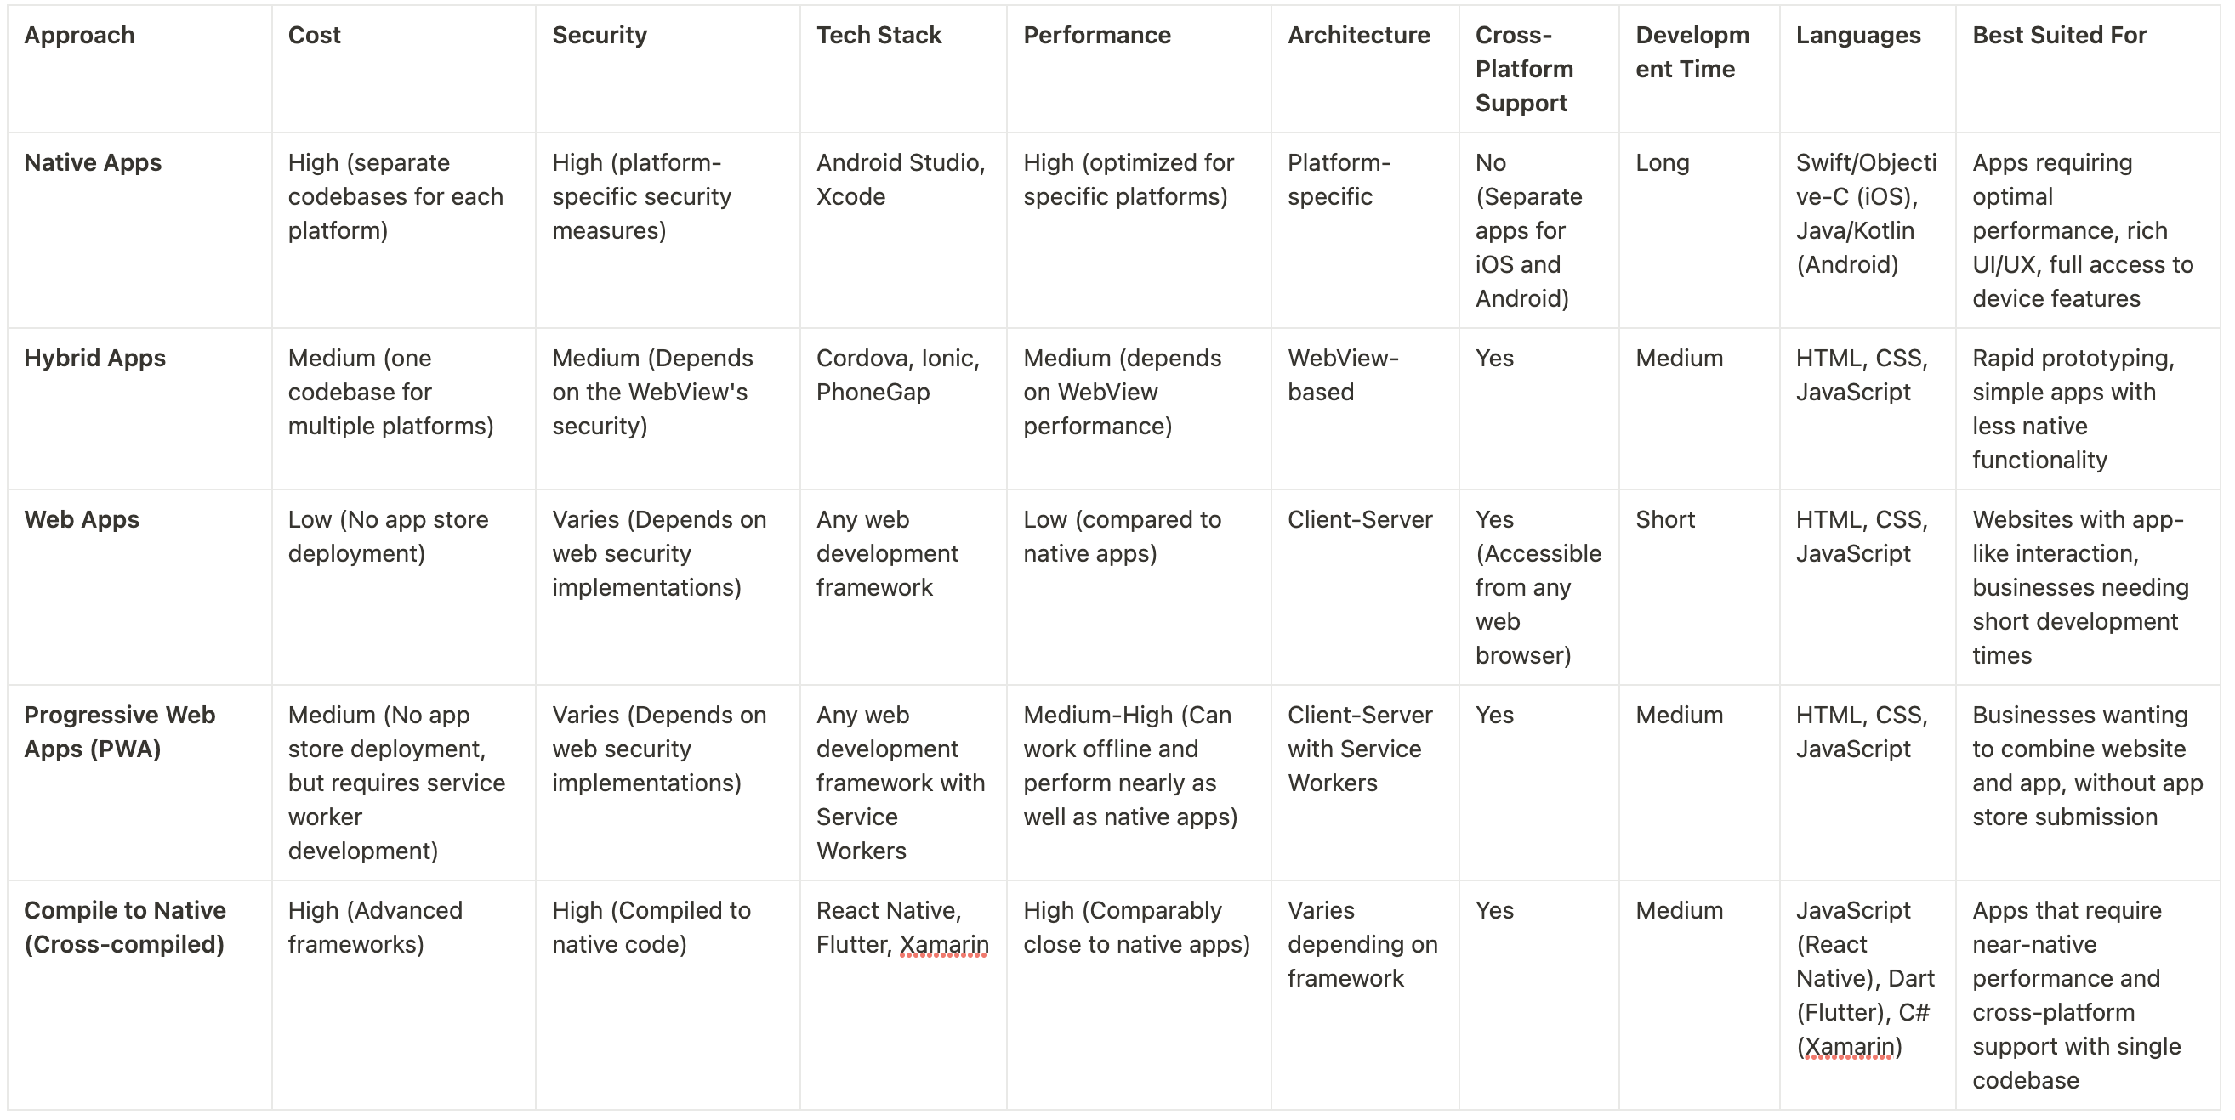
Different approaches taken in modern mobile app development
Notes:
Native Apps:
Cost: Developing native applications can be costly because they require separate codebases for each platform (iOS, Android), hence the development and maintenance time are effectively doubled.
Security: Native apps offer robust security. They are developed using platform-specific languages and frameworks, providing access to inbuilt security features of each operating system.
Hybrid Apps:
Cost: Hybrid apps are generally cheaper to develop than native apps because they use a single codebase for multiple platforms, reducing the development and maintenance time.
Security: The security of hybrid apps depends on the WebView's security (a component used to display web content in the app). While they can implement standard web security measures, they might lack some security features that are native to specific platforms.
Web Apps:
Cost: Web apps are generally the cheapest to develop because they don't require app store deployment. They are accessible via a web browser and use standard web technologies.
Security: The security of web apps largely depends on web security implementations including SSL/TLS, secure HTTP headers, and other common web security practices.
Progressive Web Apps (PWAs):
Cost: PWAs generally have a moderate cost, similar to web apps, but with additional developments like service workers necessary for offline functionality.
Security: PWAs use web security measures like Web Apps, and additionally, they are always served over HTTPS to ensure the information is always encrypted.
Compile to Native (Cross-compiled) Apps:
Cost: These apps can be costlier to develop as they use advanced frameworks (like React Native or Flutter) and need developers with specific skills. However, they allow a single codebase to be used across multiple platforms.
Security: These apps compile to native code, providing an equivalent level of security to Native Apps. They can implement the standard security features of both iOS and Android.

Slide 11
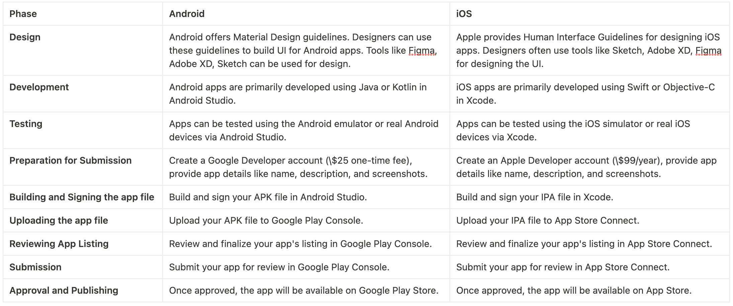
Design and publishing process

Slide 12
References
Design principles
Direduryan, C. (2018). The Basics of UX/UI Design Principles. (Accessed: July 29, 2023)Available at: https://www.linkedin.com/pulse/basics-ux-ui-design-principles-chris-direduryan/ .
Different approaches in mobile app development
Majchrzak, T.A., Biørn-Hansen, A. and Grønli, T.M., 2016, July. Comprehensive analysis of innovative cross-platform app development frameworks.(Accessed: August 4 2023) URL : https://www.researchgate.net/publication/317423949_Comprehensive_Analysis_of_Innovative_Cross-Platform_App_Development_Frameworks
Mobiloud. (n.d.) Native, Web, or Hybrid Apps? What’s the Difference?. (Accessed: August 5 2023). Available at: https://www.mobiloud.com/blog/native-web-or-hybrid-apps
Documentation
Android Developers. (n.d.) App Basics. (Accessed: : August 9 2023,).Available at: https://developer.android.com/guide
Apple Developer Documentation. (n.d.) (Accessed: : August 9 2023). Apple Developer Documentation. Available at: https://developer.apple.com/documentation/
Flutter. (n.d.). Docs. (Accessed: Date).Available at: https://flutter.dev/docs
Apple Developer. (n.d.) Submit apps to the App Store. (Accessed: Date). Available at: https://developer.apple.com/app-store/submissions/
Android Developers. (n.d.) Publish your app. (Accessed: Date).Available at: https://developer.android.com/studio/publish
Google Play Console Help. (n.d.) Create an app. (Accessed: Date).Available at: https://support.google.com/googleplay/android-developer/answer/113469?hl=en
API documentation URLs
https://api.slack.com/docs/conversations-api
https://discord.com/developers/docs/intro
https://developers.hubspot.com/docs/api/overview
https://developers.google.com/admin-sdk/directory/v1/guides/manage-users

