Slide 1
The Amazing Acro-Cats!
(And Their Fascinating Facts!)
by Amelia Hackworth

Slide 2
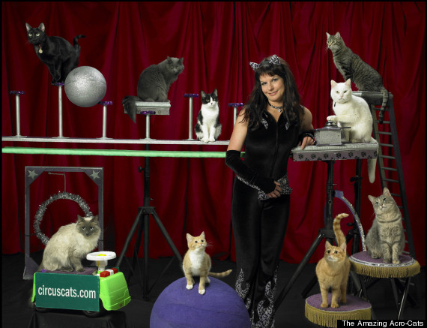
Samantha and the Amazing Acro-Cats!

Slide 3
What is so interesting about the Acro-Cats?
Founded by animal trainer Samantha Martin
Features the “Rock Cats” band
Traveling cat circus has its own tour bus
Tours 9-10 months out of the year
Based in Chicago, IL
Made several TV appearances including The Steve Harvey Show and The Late Show with Stephen Colbert
Feline performers are strays and shelter cats and are mostly female

Slide 4
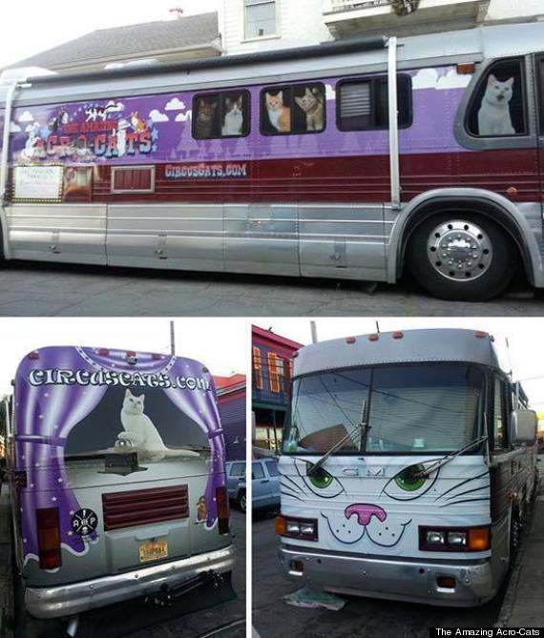
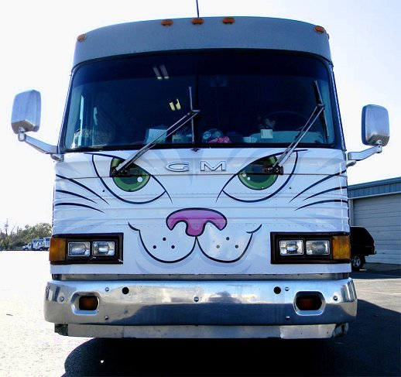
Amazing Acro-Cats Tour Bus

Slide 5
Amazing Facts about Samantha Martin
She started out with a rat circus show called “The Amazing Acro-Rats”
Worked as a zookeeper and animal training specialist for commercial and industrial advertising
She sells instruction videos on clicker training for cats at her shows and promotes cat training
She helps orphan kittens find permanent homes.
She has assistants that help her with the show and caring for all the animals

Slide 6
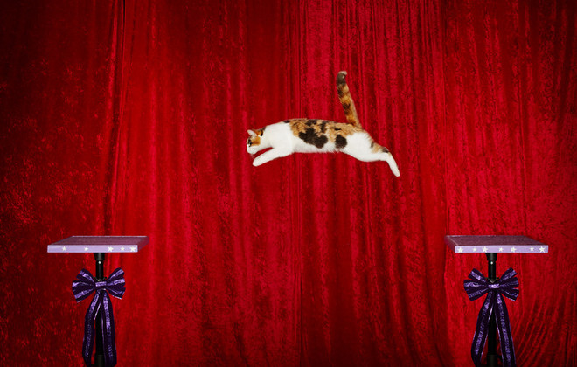
Guinness Book of World Records?
Alley the cat holds the Guinness Book of World Records for the longest jump recorded by a cat, of the featured performers of the Amazing Acro-Cats!
The cat jumped 182.88cm (6ft) on October 27, 2013 in Austin, TX

Slide 7
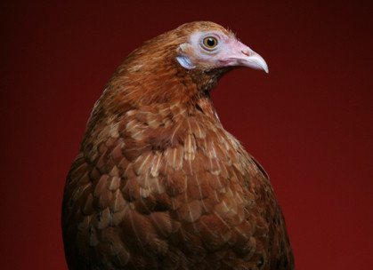
Not Just Cats!
The circus also features a hen named Cluck Norris
Additionally, the show features a groundhog named Garfield
Other animals such as rats, ferrets, and kinkajous have been used too

Slide 8
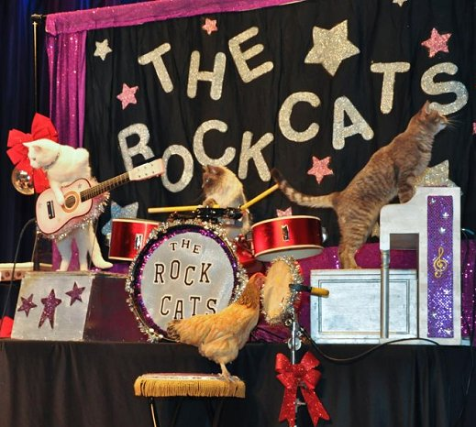
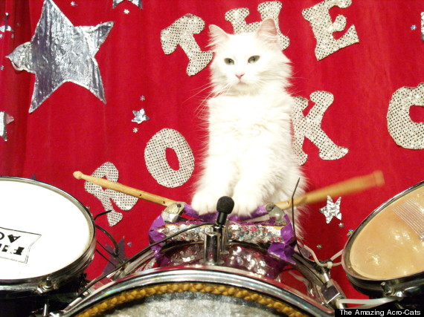
The Rock-Cats!

Slide 9
Current Rock-Cats Lineup
Oz, a male tabby cat with green eyes, on guitar
Nola, a female domestic short-hair with Siamese markings and blue eyes, also on guitar
Dakota, a female white Turkish Angora with a small black Mohawk, on drums
Fiji, a female Himalayan (white and gray) is the backup drummer
Nue, a female tabby cat with blue eyes, is on keyboards
Snookie, a female tortoiseshell, is on chimes
Tuna, the former lead of the Rock-Cats died of cancer in 2017

Slide 10
Questions?

Slide 11
Sources
https://en.wikipedia.org/wiki/The_Amazing_Acro-Cats
http://circuscats.com/rockcats.html#.WNxxY6IpDIV
https://www.yelp.com/biz/acro-cats-chicago
http://www.huffingtonpost.com/2015/04/10/amazing-acrocats-cat-circus_n_7040256.html
http://www.sbnation.com/lookit/2015/11/17/9748976/stephen-colbert-cat-circus
http://www.guinnessworldrecords.com/world-records/111847-longest-jump-by-a-cat
https://www.youtube.com/watch?v=eAx6F2OYbGM

