Slide 1

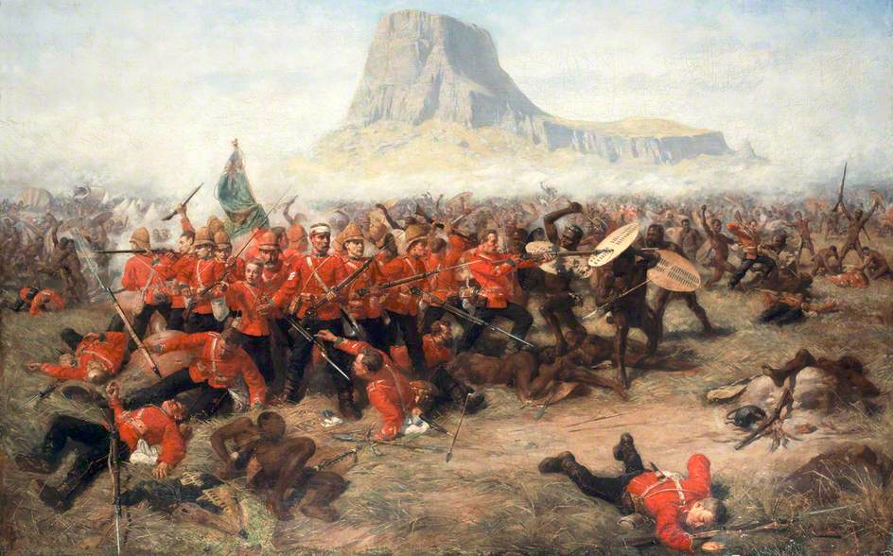
ARTIFICIAL WAR
Agent-based Simulation of Historical Battles

Slide 2
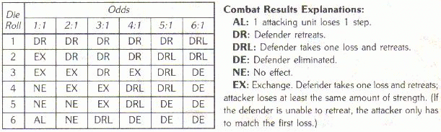
A CENTURY OF WARGAMING
Lanchester's Equations
Frederick Lanchester, Aircraft in Warfare, 1916
Differential equations of power relationships
Defining model of battle analysis to this day
Very detail oriented, with a focus on attrition

Slide 3
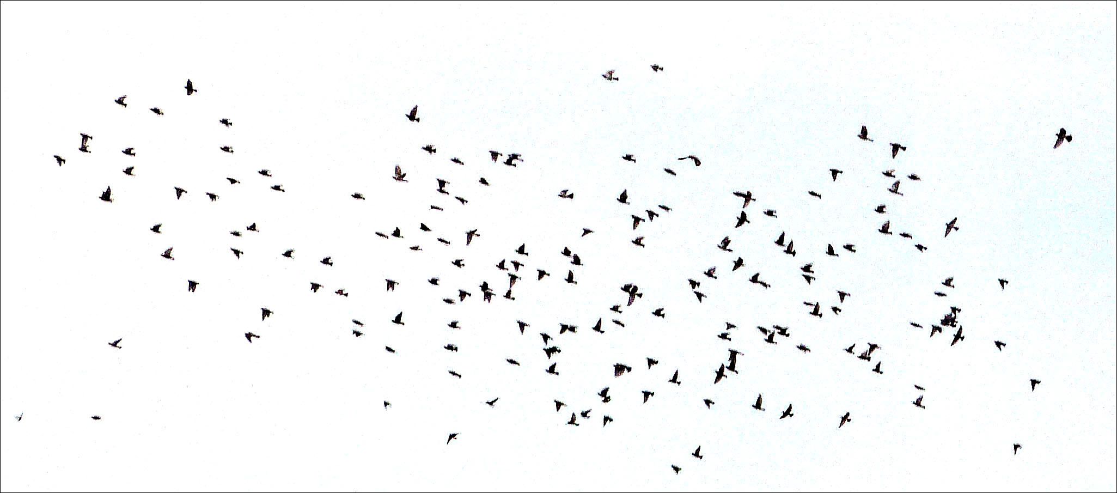
ARTIFICIAL LIFE
A New Solution To Complexity
Agent-based modeling with computing, not math
Patterns emerge on their own from simple rules

Slide 4
CASE STUDIES
Various Applications of Agent-based Modeling
Caravan trade routes of the Silk Road
Byzantine Medieval military logistics
Asymmetric guerrilla warfare
Spanish Flu epidemic in 1918 Manitoba
The Battle of Trafalgar
Disappearance of Anasazi settlement

Slide 5
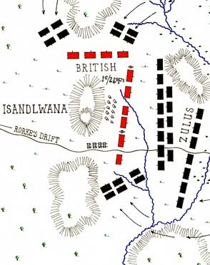
THE BATTLE OF ISANDLWANA
January 22, 1879, Isandlwana Hill,
Anglo-Zulu War
Surprise attack on British encampment
Greatest defeat of British troops against a force armed only with traditional weapons

Slide 6
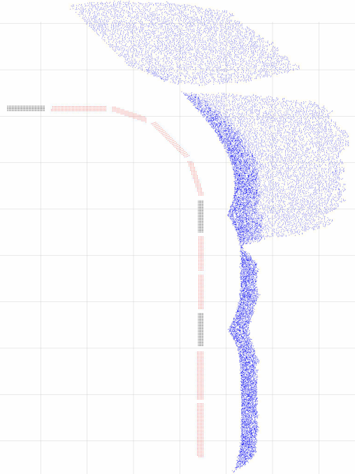
AN AGENT-BASED MODEL OF THE BATTLE OF ISANDLWANA
20,000 agents: 1600 British army, colonial, and native African troops vs Zulu warriors
Zulu forces march on British line, pausing when fired upon
Finite ammunition, far less guns for native line troops on British side

Slide 7
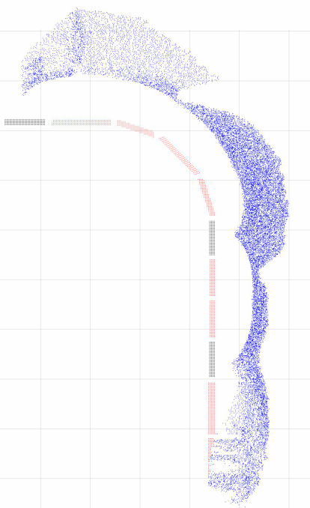
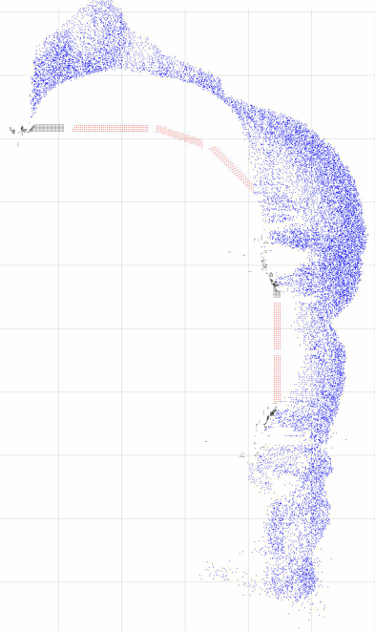

AN AGENT-BASED MODEL OF THE BATTLE OF ISANDLWANA

Slide 8
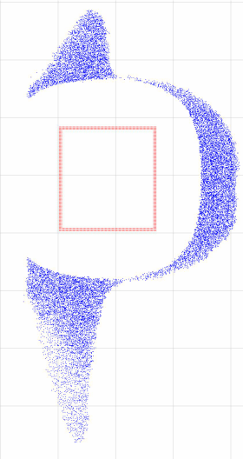
AN AGENT-BASED MODEL OF THE BATTLE OF ISANDLWANA
What-if scenarios possible:
  No native auxiliary troops
  Plenty of ammunition
  Close access to supplies
Room for model improvement:
  Terrain and weather
  Complex decision-making
  Wider range of weaponry

Slide 9
CITATIONS
Ilachinski, Andrew. “Artificial War: Multiagent-based Simulation of Combat.” Singapore: World Scientific Pub, 2004.
Scogings, Chris, and Ken Hawick. “An agent-based model of the battle of Isandlwana.” Proceedings of the Winter Simulation Conference. Winter Simulation Conference, 2012.

