Slide 1

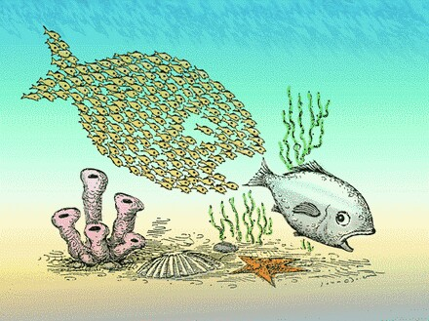
GETTING INTO ABM
Agent-Based Modeling

Slide 2
REVIEW
Agent-Based Modeling is a computing model simulating the actions of agents
Emergence, macro-phenomenon understood from studying behavior of micro-level agents
Useful for various sciences to model complex behavior of large numbers of individual actors

Slide 3
MODELING
Encapsulation and Abstraction of Reality
Successful ABMs simplify complex, real-world actors and environments too difficult to model as-is
Classical models are mechanical, Newtonian, predictable like clockwork, not adaptive
Deductive vs Inductive, Dynamics and Scale
Result: Model Parameters and Agent Rules

Slide 4
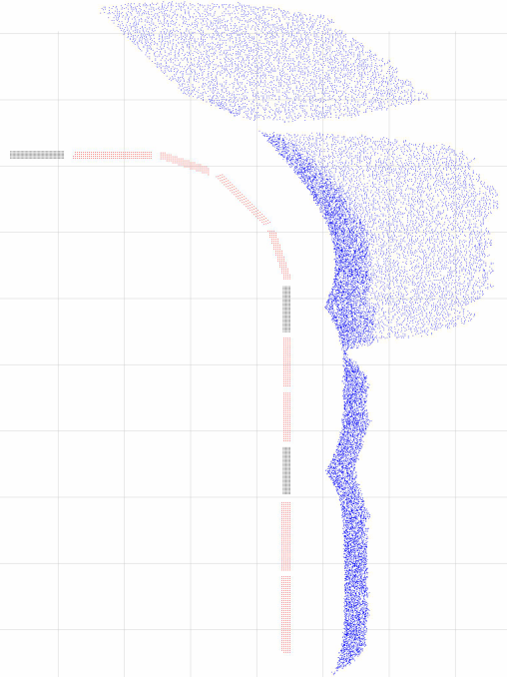
EXAMPLE ALGORITHM
The Battle of Isandlwana
Rules for British agents:
1. if Zulu adjacent, melee combat
2. if rifle loaded & Zulu in range, fire
3. if rifle not loaded & ammunition available, load rifle
Rules for Native ally (NNC) agents:
1. if Zulu adjacent, move away from Zulu
2. if Zulu adjacent, melee combat
Rules for Zulu agents:
1. if British/NNC adjacent, melee combat
2. if other Zulu adjacent, spread out
3. if British/NNC within range, charge
4. move according to preset movement vector
Outcomes
1. If fired upon and hit, remove
2. If fired upon and missed, pause rules

Slide 5
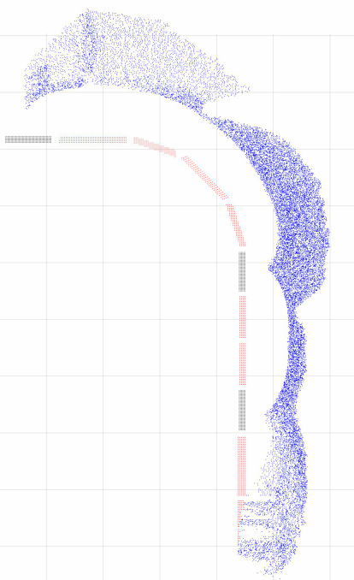
EXAMPLE ALGORITHM
The Battle of Isandlwana
Algorithm Outline
initialize N agents on battlefield
for time t<-1 to tsteps do
for agent i<-1 to Nagents do
identify agents near agent i
start with rule j<-1 for agent i
repeat
attempt rule j for agent i
j<-j+1
until rule succeeds or j > max rules
note new agent i state at step t+1
end for
commit new state t+1 for all agents
gather metrics for time step t+1
end for

Slide 6
ABM FRAMEWORKS
JABM – Java Agent-Based Modeling Toolkit
jabm.sourceforge.net
JADE – Java Agent DEvelopment Framework
jade.tilab.com
JAS-mine – Java Agent-based Simulation library. Modeling in a Networked Environment
jas-mine.net

