Slide 1

TSUGI Framework Data Model
Charles Severance
www.tsugi.org

Slide 2
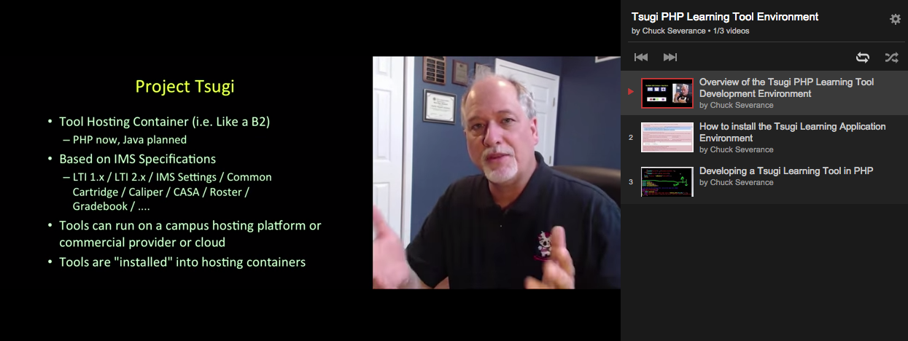
YouTube Channel
http://youtube.tsugi.org/

Slide 3
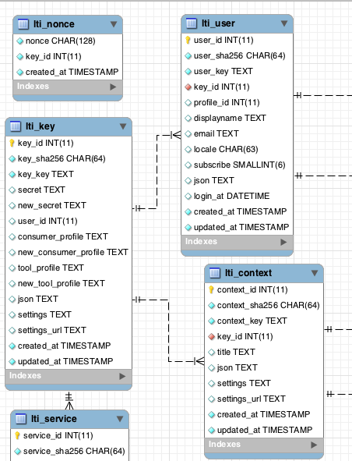
MySQL WorkBench
A free tool from Oracle / MySQL
Database design, visualization, etc...
http://www.mysql.com/products/workbench/design/

Slide 4
The Primary Objects in Tsugi
$USER – The current Logged in user
$CONTEXT – A more general word for "course" – could also mean "worksite"
$LINK – Which "resource link" within the context are we "in" at this moment
Tennant – Tsugi can serve learning tools to multiple tenants and keep the data separate
http://do1.dr-chuck.com/tsugi/phpdoc/classes/Tsugi.Core.Context.html

Slide 5
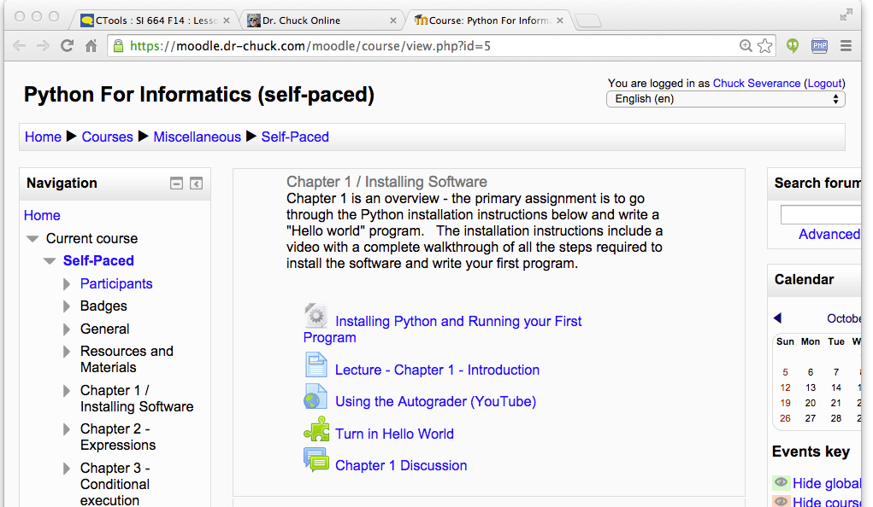
Tenant
Context
User
Link (Many)

Slide 6
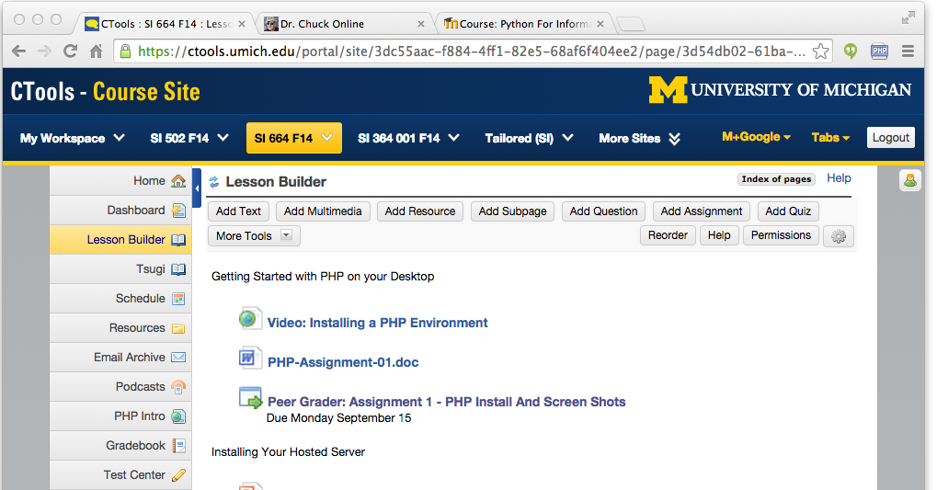
Tenant
Context
User
Link (Many)

Slide 7
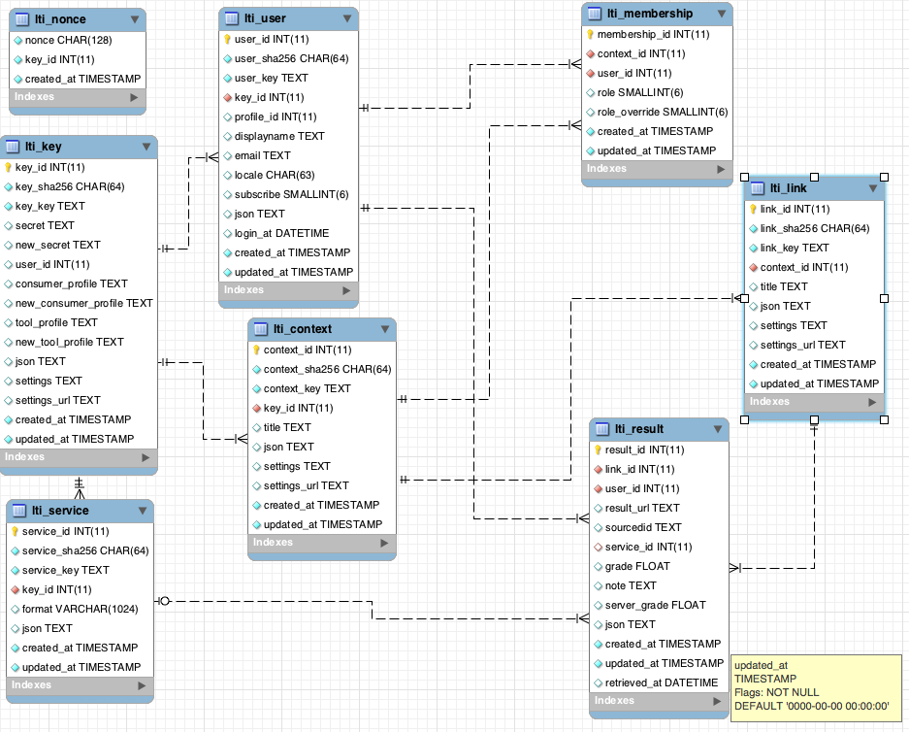
tsugi/docs/lectures/02-Data-Model-Workbench.mwb

Slide 8
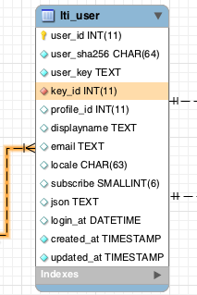
Conventions (Rails like)
All rows have auto-increment integer primary key
Date fields "..._at"
Foreign key names "table_id"

Slide 9
Not 100% Rails-Like
Primary key names "table_id"
Column and table names are both singular

Slide 10
Sha256 Key Conventions
Logical keys like user_id coming from the LMS can be long (>4096)
We model these as TEXT to avoid length limitations
We SHA256 these and index/unique the SHA256 column

Slide 11
ON DELETE Convention
We expect this to be a multi-tenant container
Tenants may come and go
We want to be able to do the "transitive closure" of a tenant
We want to be able to delete a tenant and all associated data in a single command.

Slide 13
ON DELETE for Tool Tables
Every table that is created for tool data must connect to one or more of these tables with an ON DELETE CASCADE clause
lti_link
lti_context
lti_user
lti_key

Slide 14
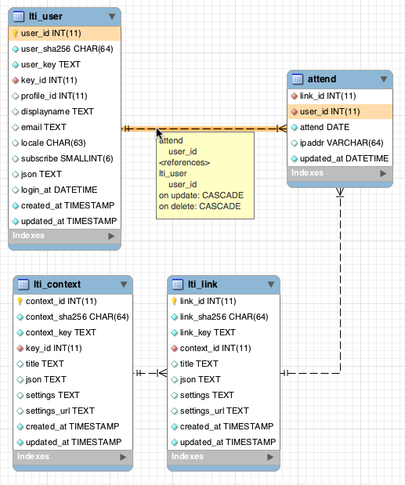

Slide 15
tsugi/mod/attend/database.php
create table {$CFG->dbprefix}attend (
link_id INTEGER NOT NULL,
user_id INTEGER NOT NULL,
attend DATE NOT NULL,
ipaddr VARCHAR(64),
updated_at DATETIME NOT NULL,
CONSTRAINT `{$CFG->dbprefix}attend_ibfk_1`
FOREIGN KEY (`link_id`)
REFERENCES `{$CFG->dbprefix}lti_link` (`link_id`)
ON DELETE CASCADE ON UPDATE CASCADE,
CONSTRAINT `{$CFG->dbprefix}attend_ibfk_2`
FOREIGN KEY (`user_id`)
REFERENCES `{$CFG->dbprefix}lti_user` (`user_id`)
ON DELETE CASCADE ON UPDATE CASCADE,
UNIQUE(link_id, user_id, attend)
) ENGINE = InnoDB DEFAULT CHARSET=utf8

Slide 16
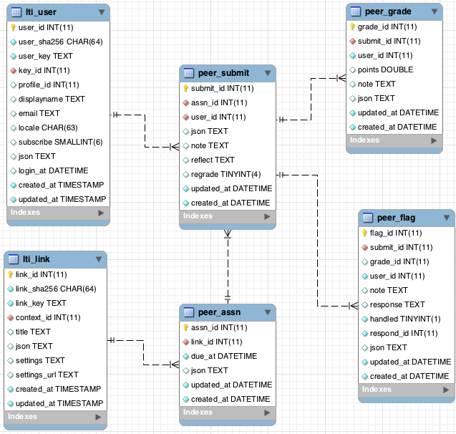

Slide 17
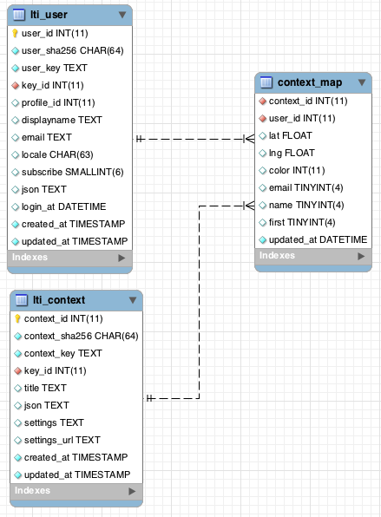
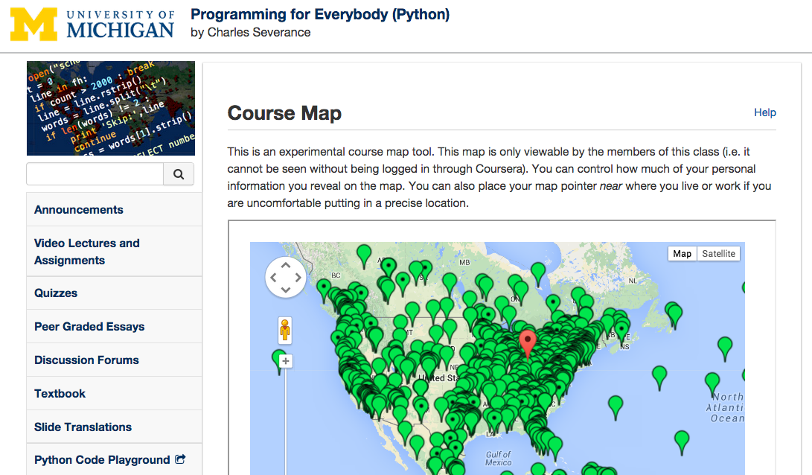

Slide 18
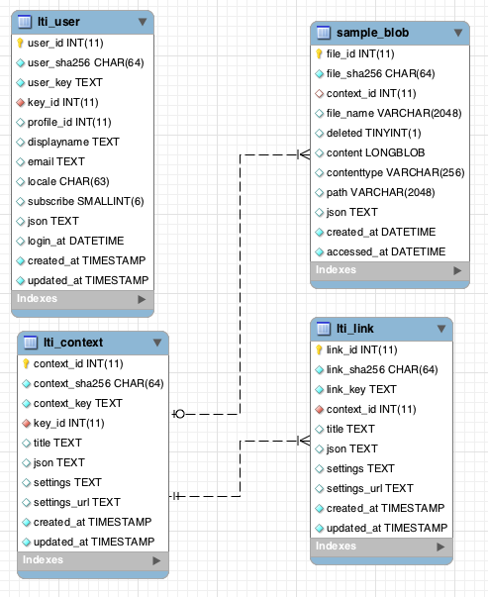

Slide 19
IMS Learning Tools Interoperability (LTI) Launch
Quick Review...

Slide 20
LTI Launch
When the user clicks a link in the LMS
The tool is launched using LTI/OAuth
May be a new window or in an iframe
LMS data is signed using a shared secret and and passed to the external tool
The tool provisions the context, user, and link and then sets up a session automatically logging the user into the tool
http://developers.imsglobal.org/

Slide 21
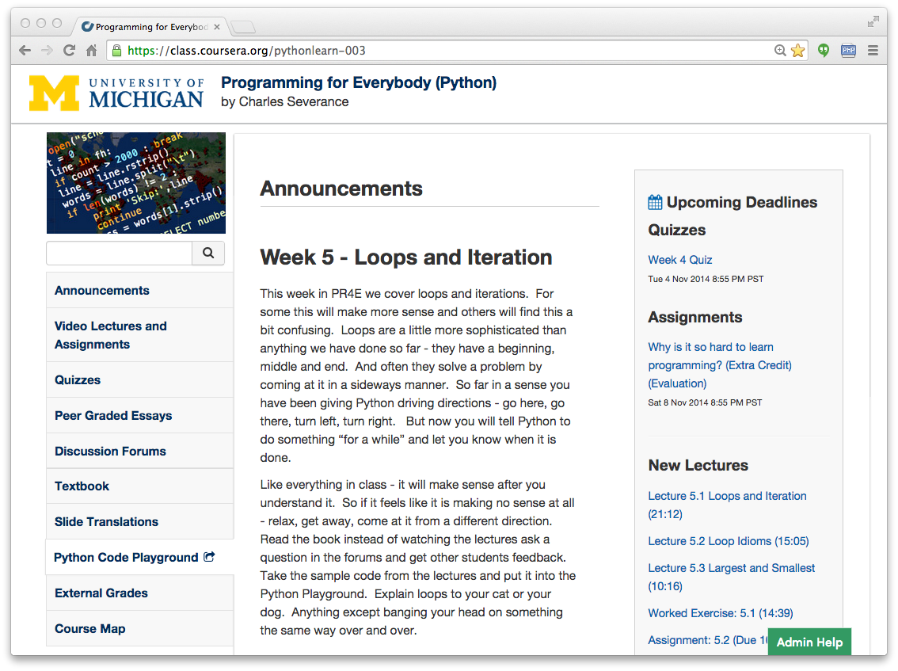

Slide 22
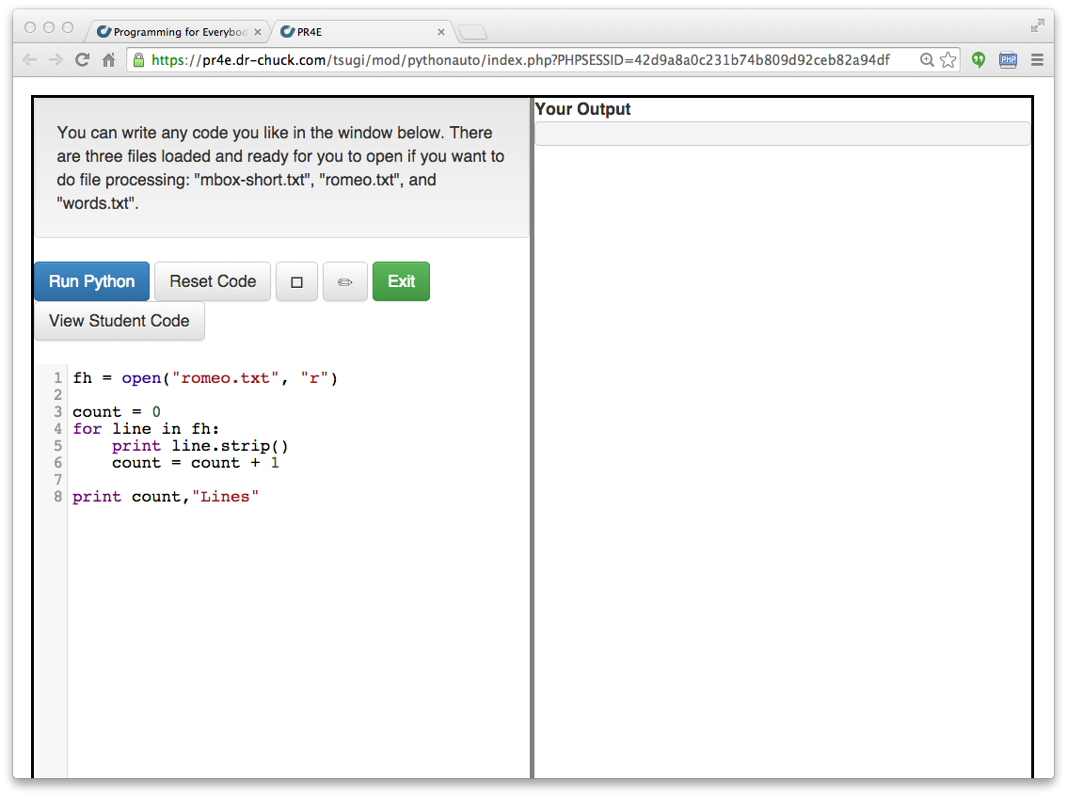

Slide 23
LTI Sample Launch Data
lti_version=LTI-1p0
lti_message_type=basic-lti-launch-request
context_id=456434513
context_title=SI301 – PHP
resource_link_id=120988f929-274612
user_id=292832126
roles=Instructor
lis_person_name_full=Charles R. Severance
lis_person_contact_email_primary = csev@umich.edu
tool_consumer_instance_description=University of School
oauth_consumer_key=lmsng.school.edu
...

Slide 24
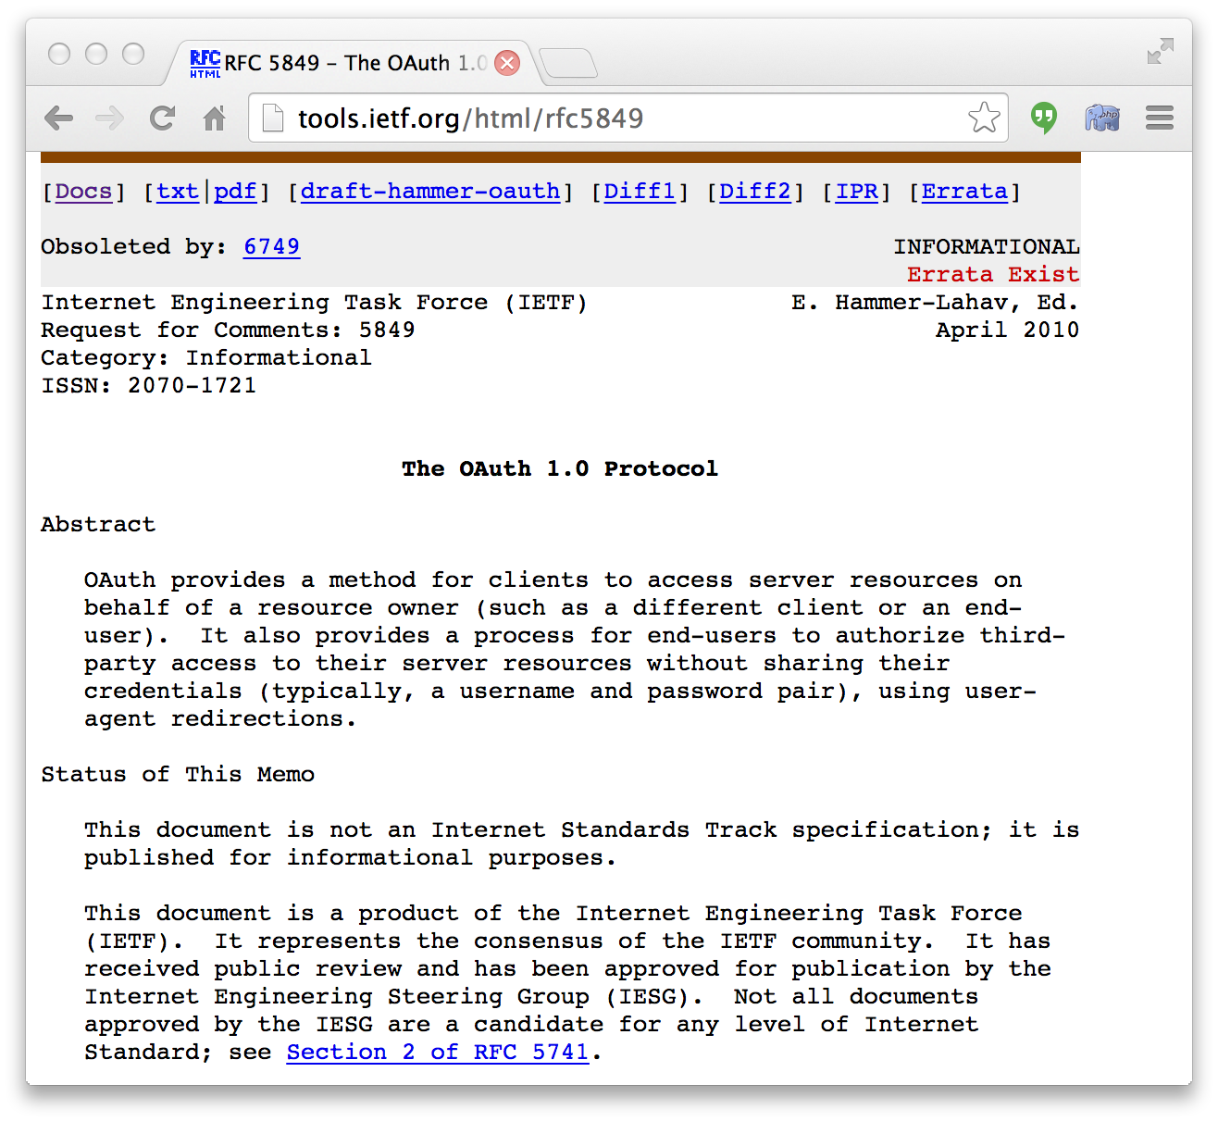


Slide 25
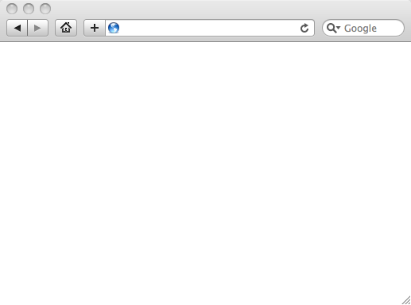
LMS (LTI Consumer)
LMS Looks up User and Course Information in LMS session.
Information is signed using
OAuth using a shared secret
Week 1
Local Resource
Local Resource
LTI Tool
Movie
Form data sent to Browser
Tool (LTI Provider)

Slide 26
LMS (LTI Consumer)
Form is immediately auto-submitted using JavaScript.
<form action=”tool”/>
<input name=”user_id”
value=”2348d8dd” />
<input name=”oauth_token”
value=”abc.edu” />
</form>
Tool (LTI Provider)
Tool looks up secret and validates signature.
Tool provisions user, course, and session.
Tool sends redirect

Slide 27
LMS (LTI Consumer)
Browser follows redirect…
<head>
<meta redirect
page=”main.php”>
</head>
Tool (LTI Provider)
Tool produces
first page.

Slide 28
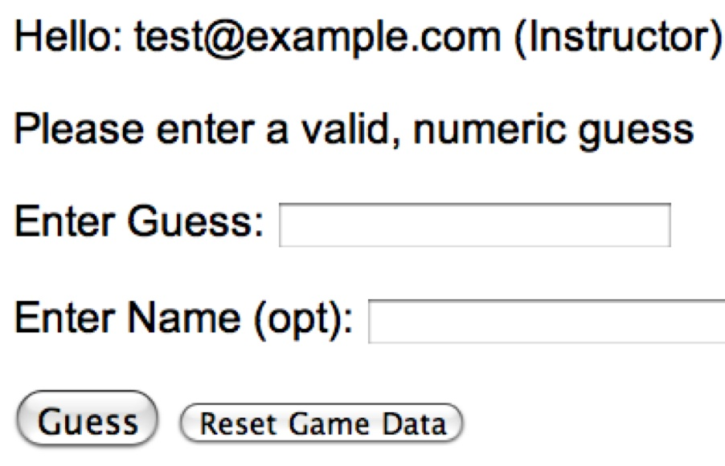
LMS (LTI Consumer)
Tool (LTI Provider)

Slide 29
LTI Launch and the Core Tables
a.k.a. "The big join"

Slide 30
LMS (LTI Consumer)
<form action=”tool”/>
<input name=”user_id”
value=”2348d8dd” />
<input name=”oauth_token”
value=”abc.edu” />
</form>
Tool (LTI Provider)
Tool looks up secret and validates signature.
Tool provisions user, course, and session.
Tool sends redirect

Slide 31
tsugi/docs/lectures/02-Data-Model-Workbench.mwb

Slide 32
Problems to Solve
Might be seeing context, link and user for the first time – need to create
Might already have records in place but see new data like name, title or email
Might already have the data no changed are needed (most common)
Need to provision the session and global objects ($USER, $CONTEXT, and $LINK)

Slide 33
SELECT k.key_id, k.key_key, k.secret, k.new_secret, c.settings_url AS key_settings_url,
n.nonce,
c.context_id, c.title AS context_title, context_sha256, c.settings_url AS context_settings_url,
l.link_id, l.title AS link_title, l.settings AS link_settings, l.settings_url AS link_settings_url,
u.user_id, u.displayname AS user_displayname, u.email AS user_email,
u.subscribe AS subscribe, u.user_sha256 AS user_sha256,
m.membership_id, m.role, m.role_override,
p.profile_id, p.displayname AS profile_displayname, p.email AS profile_email,
p.subscribe AS profile_subscribe,
s.service_id, s.service_key AS service,
r.result_id, r.sourcedid, r.grade, r.result_url
FROM lti_key AS k
LEFT JOIN lti_nonce AS n ON k.key_id = n.key_id AND n.nonce = :nonce
LEFT JOIN lti_context AS c ON k.key_id = c.key_id AND c.context_sha256 = :context
LEFT JOIN lti_link AS l ON c.context_id = l.context_id AND l.link_sha256 = :link
LEFT JOIN lti_user AS u ON k.key_id = u.key_id AND u.user_sha256 = :user
LEFT JOIN lti_membership AS m ON u.user_id = m.user_id AND c.context_id = m.context_id
LEFT JOIN profile AS p ON u.profile_id = p.profile_id
LEFT JOIN lti_service AS s ON k.key_id = s.key_id AND s.service_sha256 = :service
LEFT JOIN lti_result AS r ON u.user_id = r.user_id AND l.link_id = r.link_id
WHERE k.key_sha256 = :key LIMIT 1
tsugi/lib/vendor/Tsugi/Core/LTIX.php loadAllData()

Slide 34
After the "Big Join"
The join may be
Completely empty (all new data)
Match launch data perfectly
Partially there or updated data
LTIX::adjustData() uses INSERT and UPDATE statements to make sure the data in the lti_ tables matches incoming LTI data
Session is provisioned and tool is launched
tsugi/lib/vendor/Tsugi/Core/LTIX.php

Slide 35
Migrations
A blend of Moodle and Rails

Slide 36
Creating and Updating Schema
We want completely automated schema upgrades like Moodle and Rails
Should be convenient for both new installations and continuous evolution during development
Each table has a version number based on date/time that the change was made
201409242100

Slide 37
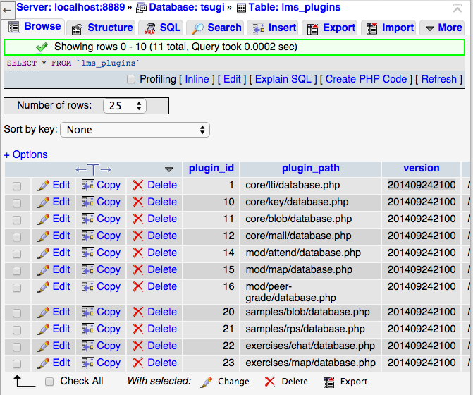

Slide 38
Global Database Version
The global database version should be the maximum version across all database.php files
It is stored in setup.php
Used to remind folks when to run upgrade.php
<?php
// This is where we change the overall database version to trigger
// upgrade checking - don't change this unless you want to trigger
// database upgrade messages it should be the max of all versions in
// all database.php files.
$CFG->dbversion = 201410150800;

Slide 39
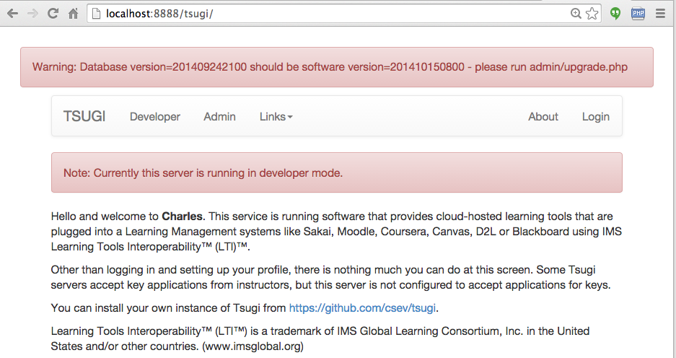

Slide 40
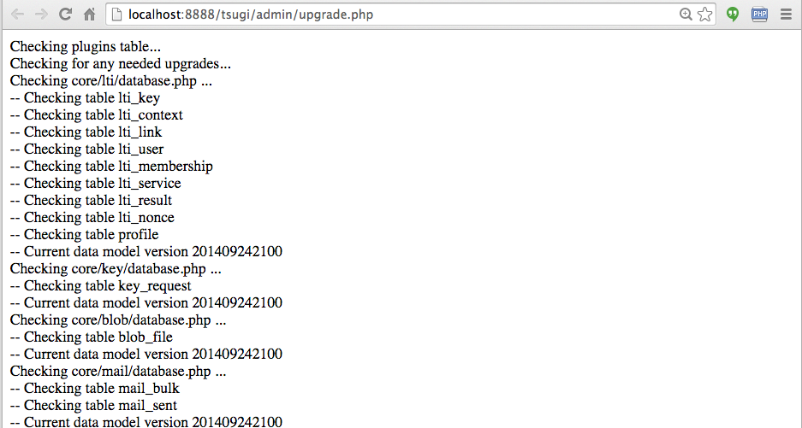
Goes through all of the database.php files below the $CFG->tool_folders and checks for any needed new tables and/or tables to upgrade.

Slide 41
Structure of a database.php
$DATABASE_UNINSTALL
Array of statements to drop all tables for the tool
$DATABASE_INSTALL
Array of table names and CREATE statements
$DATABASE_UPGRADE(optional)
A function which is given the "old version" and returns the "new version" after patching the table appropriately

Slide 42
<?php
// The SQL to uninstall this tool
$DATABASE_UNINSTALL = array(
"drop table if exists {$CFG->dbprefix}attend"
);
// The SQL to create the tables if they don't exist
$DATABASE_INSTALL = array(
array( "{$CFG->dbprefix}attend",
"create table {$CFG->dbprefix}attend (
link_id INTEGER NOT NULL,
user_id INTEGER NOT NULL,
...
CONSTRAINT `{$CFG->dbprefix}attend_ibfk_2`
FOREIGN KEY (`user_id`)
REFERENCES `{$CFG->dbprefix}lti_user` (`user_id`)
ON DELETE CASCADE ON UPDATE CASCADE,
UNIQUE(link_id, user_id, attend)
) ENGINE = InnoDB DEFAULT CHARSET=utf8")
);
tsugi/mod/attend/database.php

Slide 43
// Database upgrade
$DATABASE_UPGRADE = function($oldversion) {
global $CFG;
// Version 2014042200 improvements
if ( $oldversion < 2014042200 ) {
$sql= "ALTER TABLE
{$CFG->dbprefix}peer_submit ADD regrade TINYINT NULL";
echo("Upgrading: ".$sql."<br/>\n");
error_log("Upgrading: ".$sql);
$q = $PDOX->queryDie($sql);
}
return 2014042200;
}; // Don't forget the semicolon on anonymous functions :)
tsugi/mod/peer-grade/database.php

Slide 44
...
array( "{$CFG->dbprefix}peer_submit",
"create table {$CFG->dbprefix}peer_submit (
submit_id INTEGER NOT NULL KEY AUTO_INCREMENT,
assn_id INTEGER NOT NULL,
user_id INTEGER NOT NULL,
json TEXT NULL,
note TEXT NULL,
reflect TEXT NULL,
regrade TINYINT NULL,
updated_at DATETIME NOT NULL,
created_at DATETIME NOT NULL,
....
At the same time you add the migration to $DATABASE_UPGRADE, you change the schema in $DATABASE_INSTALL. The upgrade will be called with a "later" version for fresh installs.
tsugi/mod/peer-grade/database.php

Slide 45
Summary
Database structure for the core LTI launch data
Column and table naming rules
Sha256 key convention
Rules for tool tables
LTI Launch Review
Handling launch data with the "Big Join"
Tool table creation and migration

