Slide 1

TSUGI Framework Data Model
Charles Severance
www.tsugi.org

Slide 2
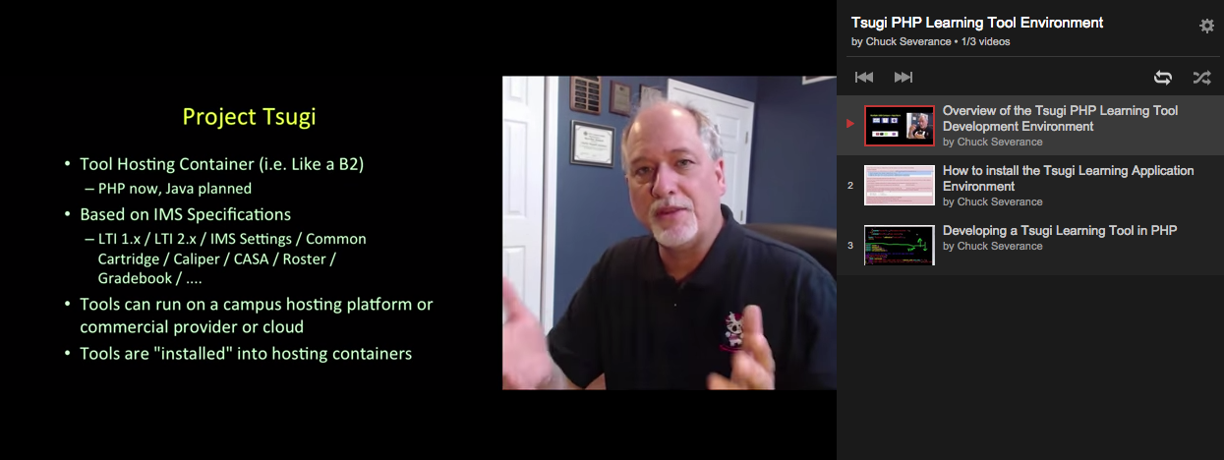
YouTube Channel
http://youtube.tsugi.org/

Slide 3
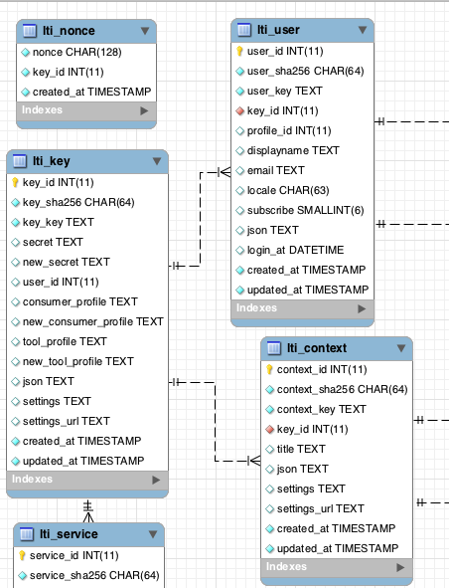
MySQL WorkBench
A free tool from Oracle / MySQL
Database design, visualization, etc...
http://www.mysql.com/products/workbench/design/

Slide 4
The Primary Objects in Tsugi
$USER – The current Logged in user
$CONTEXT – A more general word for "course" – could also mean "worksite"
$LINK – Which "resource link" within the context are we "in" at this moment
Tennant – Tsugi can serve learning tools to multiple tenants and keep the data separate
http://do1.dr-chuck.com/tsugi/phpdoc/classes/Tsugi.Core.Context.html

Slide 5
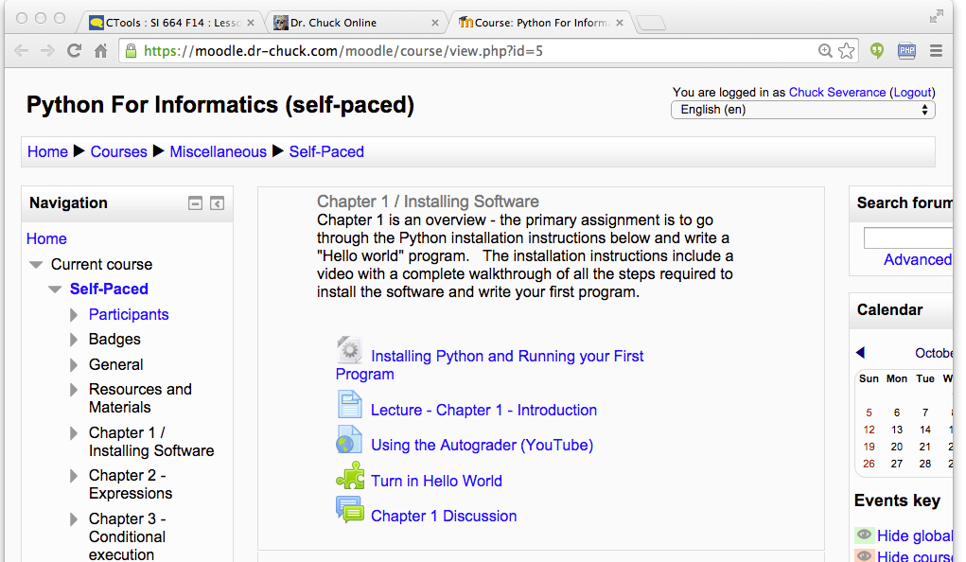
Tenant
Context
User
Link (Many)

Slide 6
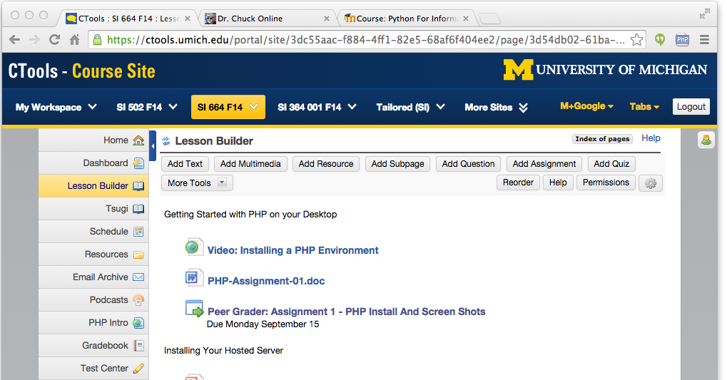
Tenant
Context
User
Link (Many)

Slide 7
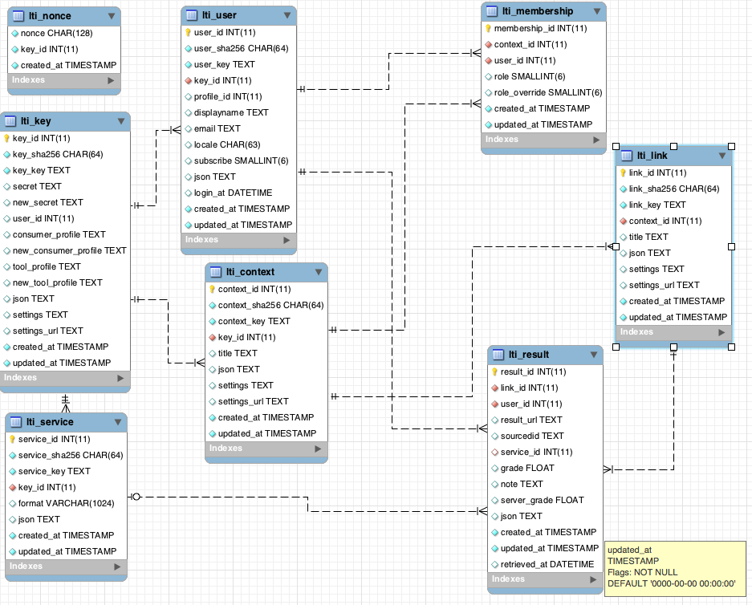
tsugi/docs/lectures/02-Data-Model-Workbench.mwb

Slide 8
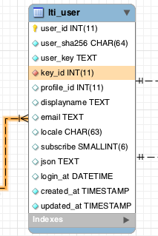
Conventions (Rails like)
All rows have auto-increment integer primary key
Date fields "..._at"
Foreign key names "table_id"

Slide 9
Not 100% Rails-Like
Primary key names "table_id"
Column and table names are both singular

Slide 10
Sha256 Key Conventions
Logical keys like user_id coming from the LMS can be long (>4096)
We model these as TEXT to avoid length limitations
We SHA256 these and index/unique the SHA256 column

Slide 11
ON DELETE Convention
We expect this to be a multi-tenant container
Tenants may come and go
We want to be able to do the "transitive closure" of a tenant
We want to be able to delete a tenant and all associated data in a single command.

Slide 13
ON DELETE for Tool Tables
Every table that is created for tool data must connect to one or more of these tables with an ON DELETE CASCADE clause
lti_link
lti_context
lti_user
lti_key

Slide 14
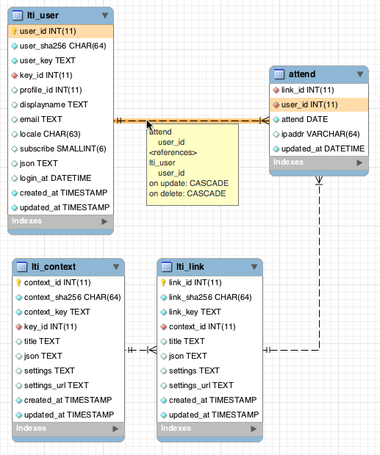

Slide 15
create table {$CFG->dbprefix}attend (
link_id INTEGER NOT NULL,
user_id INTEGER NOT NULL,
attend DATE NOT NULL,
ipaddr VARCHAR(64),
updated_at DATETIME NOT NULL,
CONSTRAINT `{$CFG->dbprefix}attend_ibfk_1`
FOREIGN KEY (`link_id`)
REFERENCES `{$CFG->dbprefix}lti_link` (`link_id`)
ON DELETE CASCADE ON UPDATE CASCADE,
CONSTRAINT `{$CFG->dbprefix}attend_ibfk_2`
FOREIGN KEY (`user_id`)
REFERENCES `{$CFG->dbprefix}lti_user` (`user_id`)
ON DELETE CASCADE ON UPDATE CASCADE,
UNIQUE(link_id, user_id, attend)
) ENGINE = InnoDB DEFAULT CHARSET=utf8
tsugi/mod/attend/database.php

Slide 16
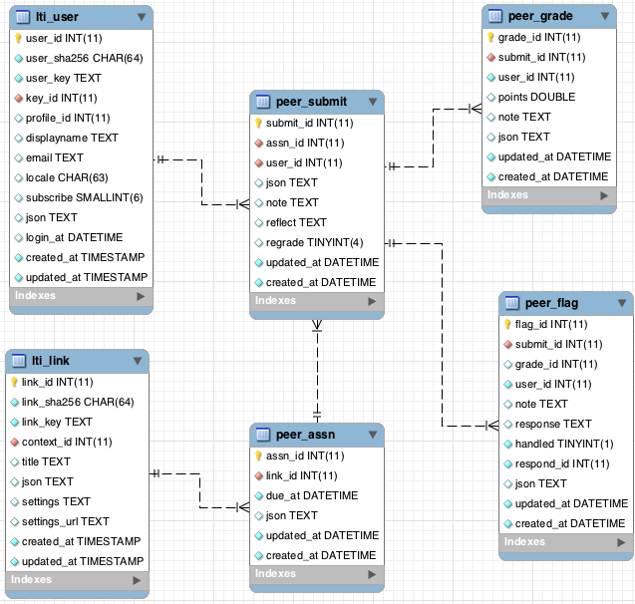

Slide 17
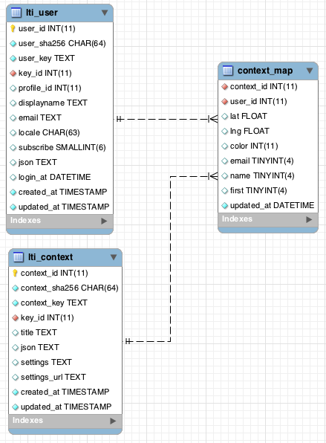
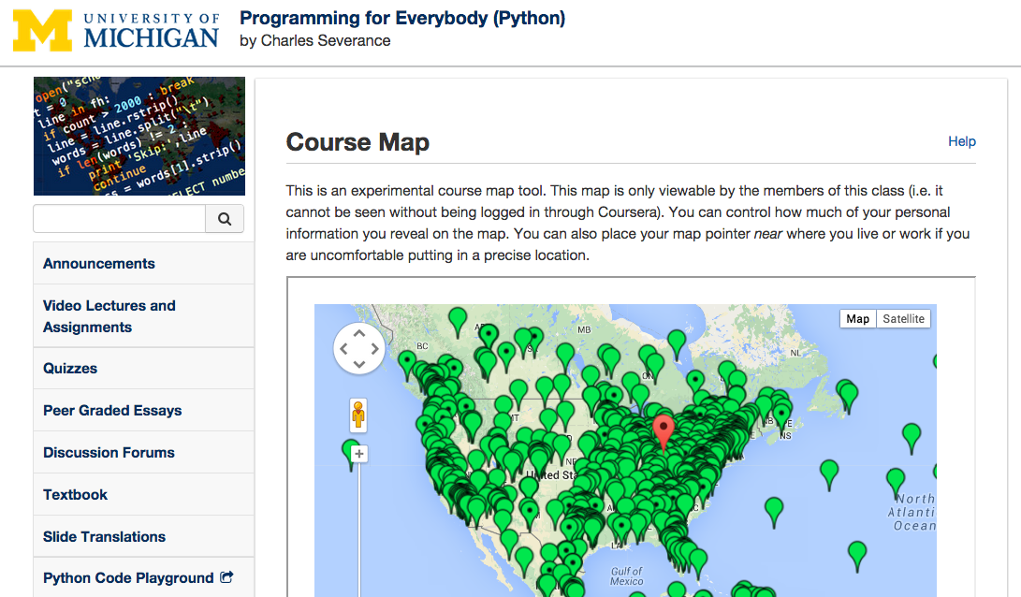

Slide 18
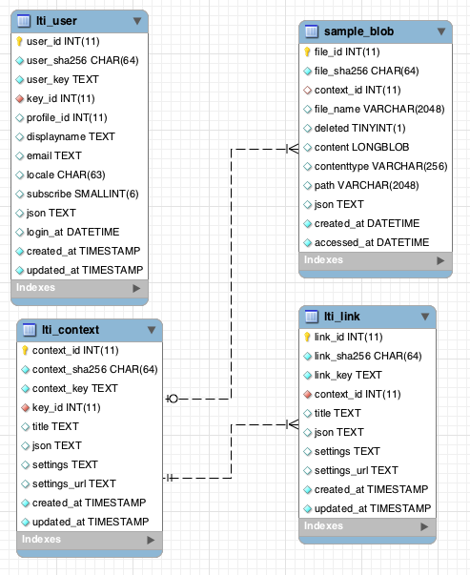

Slide 19
Migrations
A blend of Moodle and Rails

Slide 20
Creating and Updating Schema
We want completely automated schema upgrades like Moodle and Rails
Should be convenient for both new installations and continuous evolution during development
Each table has a version number based on date/time that the change was made
201409242100

Slide 21
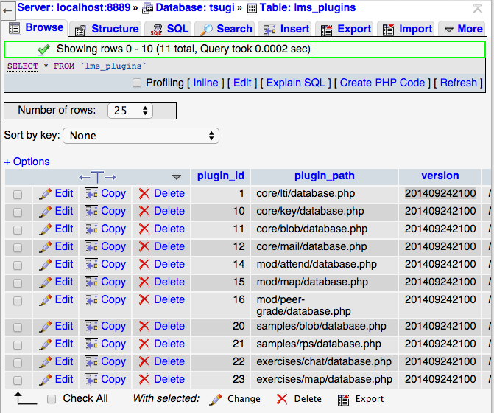

Slide 22
Global Database Version
The global database version should be the maximum version across all database.php files
It is stored in setup.php
Used to remind folks when to run upgrade.php
<?php
// This is where we change the overall database version to trigger
// upgrade checking - don't change this unless you want to trigger
// database upgrade messages it should be the max of all versions in
// all database.php files.
$CFG->dbversion = 201410150800;

Slide 23
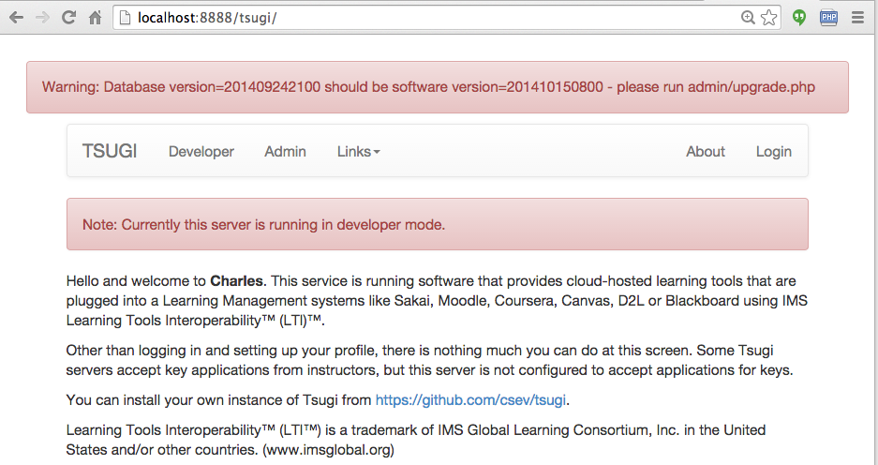

Slide 24
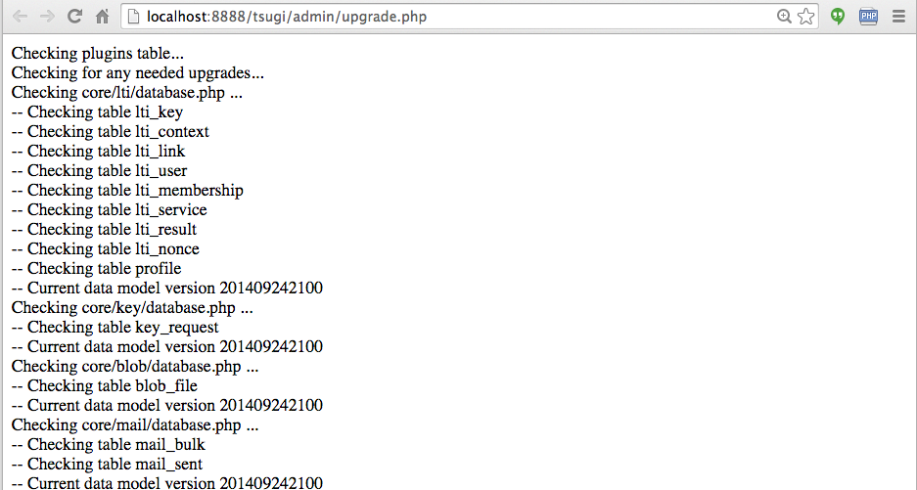
Goes through all of the database.php files below the $CFG->tool_folders and checks for any needed new tables and/or tables to upgrade.

Slide 25
Structure of a database.php
$DATABASE_UNINSTALL
Array of statements to drop all tables for the tool
$DATABASE_INSTALL
Array of table names and CREATE statements
$DATABASE_UPGRADE(optional)
A function which is given the "old version" and returns the "new version" after patching the table appropriately

Slide 26
<?php
// The SQL to uninstall this tool
$DATABASE_UNINSTALL = array(
"drop table if exists {$CFG->dbprefix}attend"
);
// The SQL to create the tables if they don't exist
$DATABASE_INSTALL = array(
array( "{$CFG->dbprefix}attend",
"create table {$CFG->dbprefix}attend (
link_id INTEGER NOT NULL,
user_id INTEGER NOT NULL,
...
CONSTRAINT `{$CFG->dbprefix}attend_ibfk_2`
FOREIGN KEY (`user_id`)
REFERENCES `{$CFG->dbprefix}lti_user` (`user_id`)
ON DELETE CASCADE ON UPDATE CASCADE,
UNIQUE(link_id, user_id, attend)
) ENGINE = InnoDB DEFAULT CHARSET=utf8")
);
tsugi/mod/attend/database.php

Slide 27
// Database upgrade
$DATABASE_UPGRADE = function($oldversion) {
global $CFG;
// Version 2014042200 improvements
if ( $oldversion < 2014042200 ) {
$sql= "ALTER TABLE
{$CFG->dbprefix}peer_submit ADD regrade TINYINT NULL";
echo("Upgrading: ".$sql."<br/>\n");
error_log("Upgrading: ".$sql);
$q = $PDOX->queryDie($sql);
}
return 2014042200;
}; // Don't forget the semicolon on anonymous functions :)
tsugi/mod/peer-grade/database.php

Slide 28
...
array( "{$CFG->dbprefix}peer_submit",
"create table {$CFG->dbprefix}peer_submit (
submit_id INTEGER NOT NULL KEY AUTO_INCREMENT,
assn_id INTEGER NOT NULL,
user_id INTEGER NOT NULL,
json TEXT NULL,
note TEXT NULL,
reflect TEXT NULL,
regrade TINYINT NULL,
updated_at DATETIME NOT NULL,
created_at DATETIME NOT NULL,
....
At the same time you add the migration to $DATABASE_UPGRADE, you change the schema in $DATABASE_INSTALL. The upgrade will be called with a "later" version for fresh installs.
tsugi/mod/peer-grade/database.php

Slide 29
Summary
Database structure for the core LTI launch data
Column and table naming rules
Sha256 key convention
Rules for tool tables
Tool table creation and migration

