Slide 1

Looking at the Data Model for the TSUGI Framework
Charles Severance
www.dr-chuck.com
www.tsugi.org

Slide 2
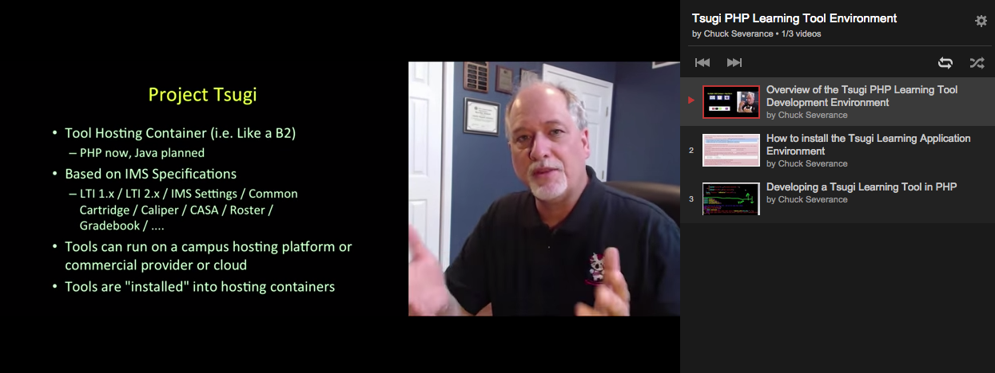
YouTube Channel
http://youtube.tsugi.org/

Slide 3
The Primary Objects in Tsugi
$USER – The current Logged in user
$CONTEXT – A more general word for "course" – could also mean "worksite"
$LINK – Which "resource link" within the context are we "in" at this moment
Tennant – Tsugi can serve learning tools to multiple tenants and keep the data separate

Slide 4
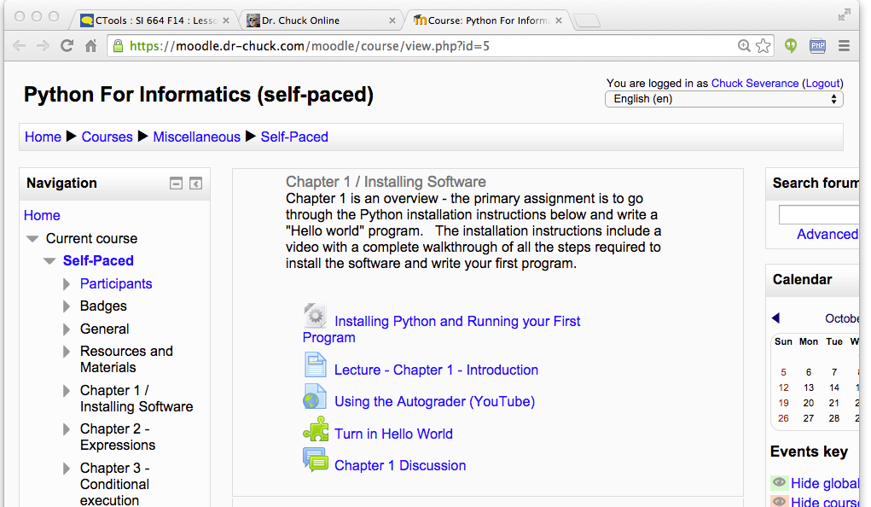
Tenant
Context
User
Link (Many)

Slide 5
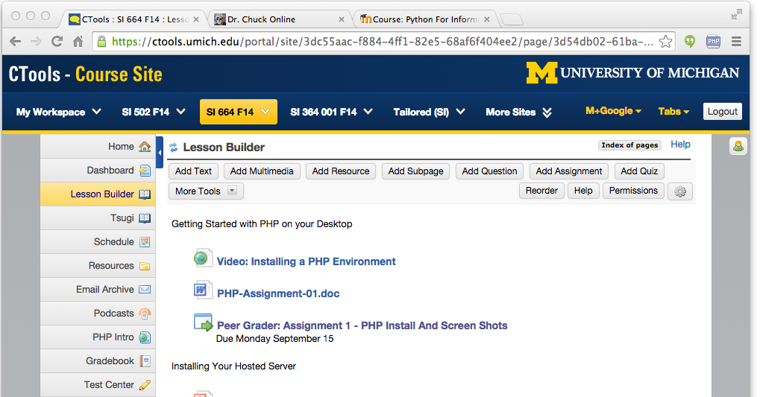
Tenant
Context
User
Link (Many)

