Slide 1





NOUNS
Atika Nur Hidayah, S.Pd

Slide 2
LET'S START!

Slide 3
Now, we will learn about?
01
04
What is a Noun?
Noun as a name of a thing
02
05
Noun as a name of a person
Noun as a name of an animal
03
06
Noun as a name of a place
Noun as a name of an idea

Slide 4


What is a Noun?
It is a word for a person, place, thing, animal, or idea. It can be a concrete or abstract and a common or proper noun.

Slide 5
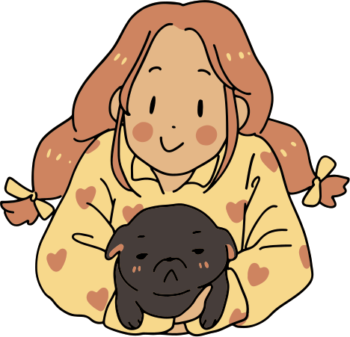

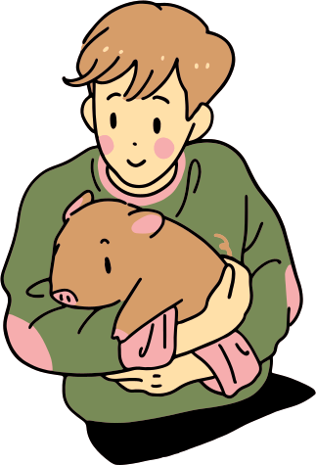
Example noun is a name of a person
girl
doctor
Albert

Slide 6


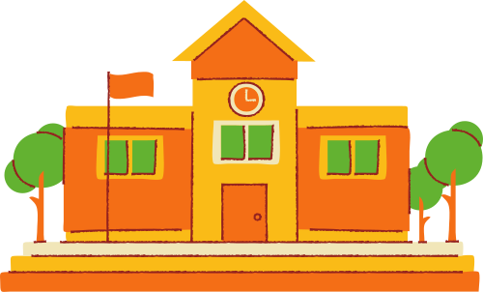
Example noun is a name of a place
mountain
school
Mall

Slide 7



Example
noun is a name of a thing
book
Sunflower
car

Slide 8

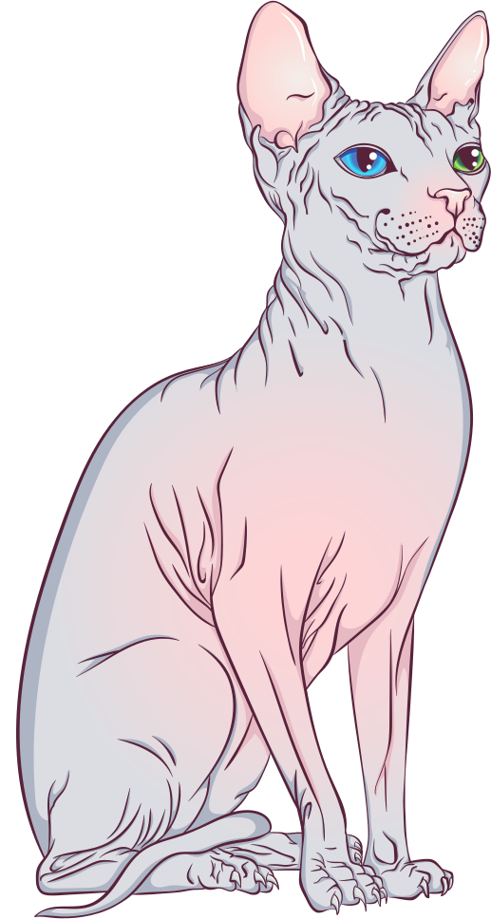

Example
noun is a name of an animal
dog
bird
Sphynx

Slide 9

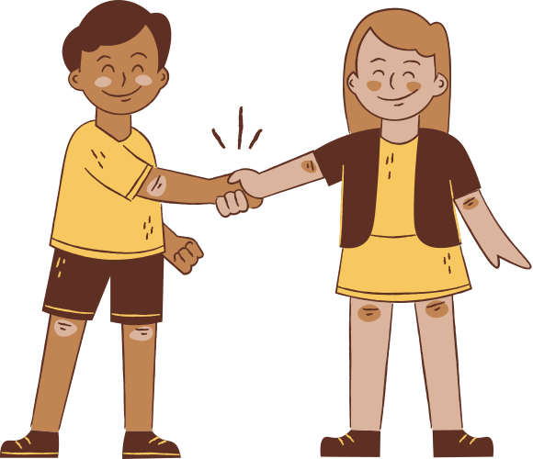

Example
noun is name of an idea
love
friendship
Freedom

Slide 10
ACTIVITY TIME!

Slide 11
Finding Nouns!
Box all the nouns you discover in the sentences.
1. My grandpa bought a pizza for the family.
2. Two elephants crossed the road.
3. I have three pencils and two ballpens.
4. The countries achieved peace without war.
5. Annika has three cats and four dogs.

Slide 12
Thank you!

