Slide 1
Introduction to HTTP2

Slide 2
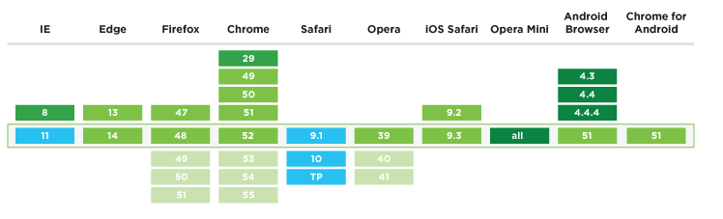
Introduction
In 2015, Internet Engineering Task Force (IETF) release HTTP/2, the second major version of the most useful internet protocol, HTTP. It was derived from the earlier experimental SPDY protocol
Use in client: supported by most modern browsers
Use in server: enable in Apache, WordPress

Slide 3
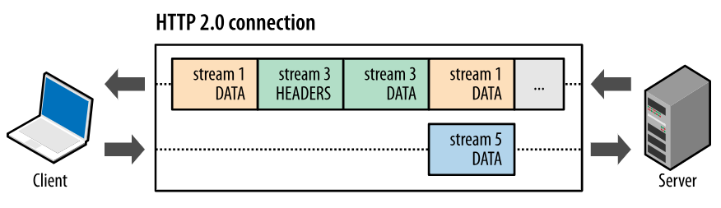
Feature 1: Requst multiplexing
With HTTP/1.x, if the client wants to make multiple parallel requests to improve performance, then multiple TCP connections must be used
HTTP/2 can send multiple requests for data in parallel over a single TCP connection. This is the most advanced feature of the HTTP/2 protocol

Slide 4
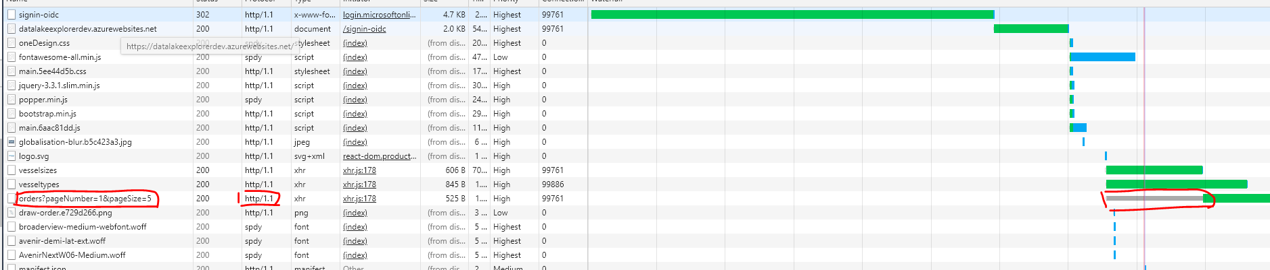
Feature 1: Requst multiplexing
Every browser has a specific limit to open parallel TCP connections, usually 6 – 8 connections
In HTTP/2, doesn’t rely on TCP connections
1. All the conversations under one origin can be done within one connection
2. One connection can support any number of streams

Slide 5
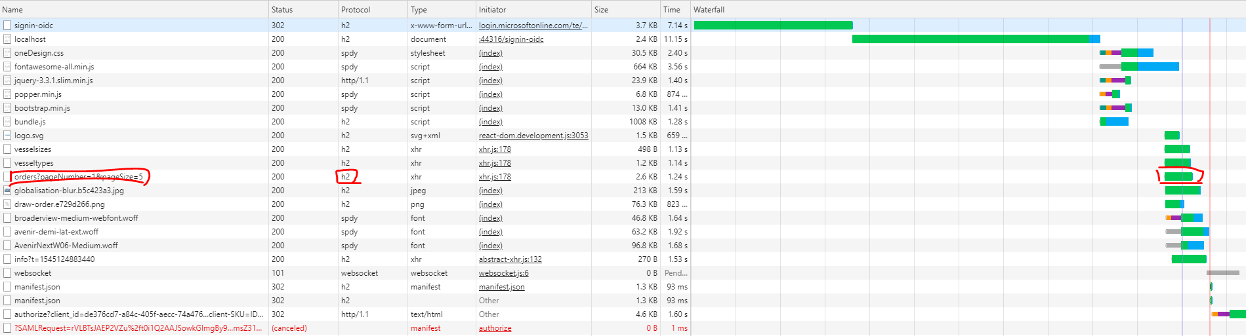
Feature 1: Requst multiplexing

Slide 6
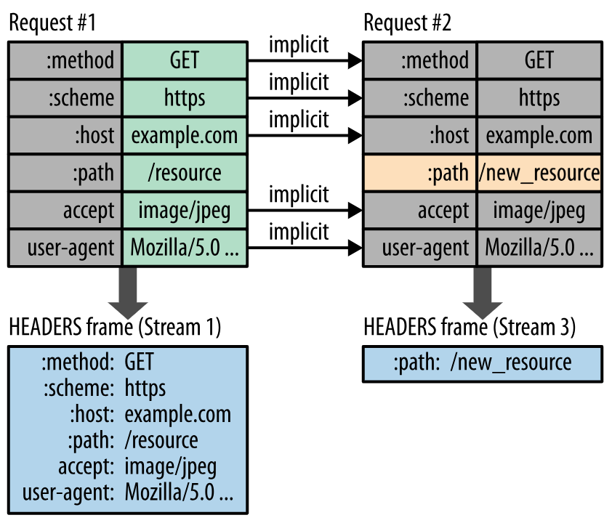
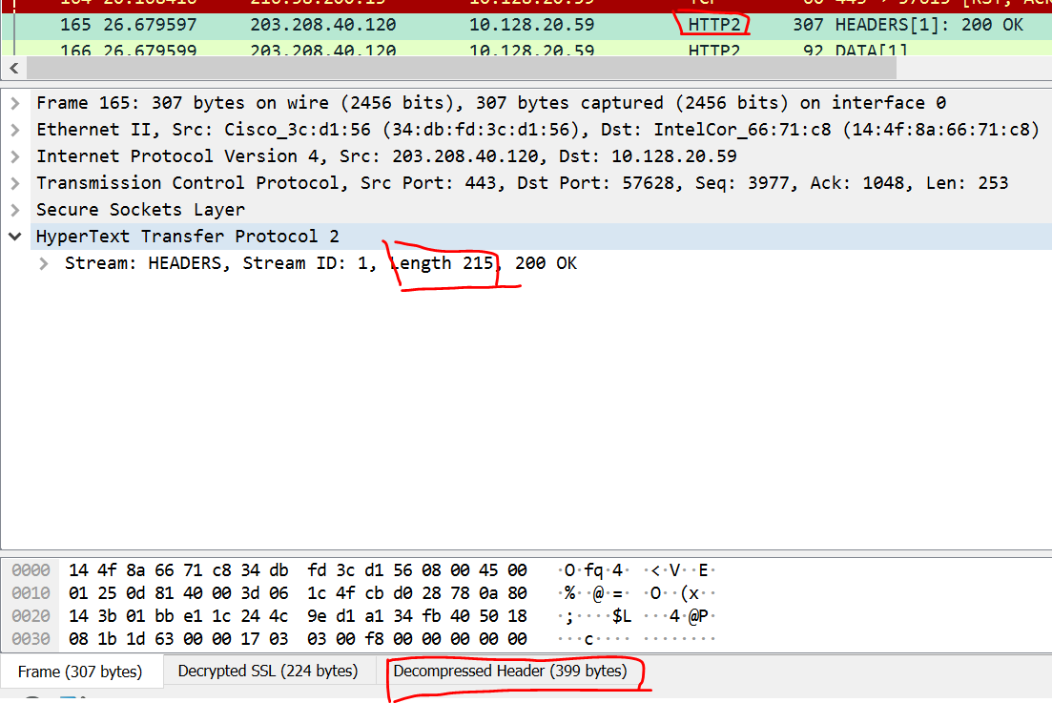
Feature 2: Header Compression
It uses the HPACK specification to compress a large number of redundant header frames
1. It allows the transmitted header fields to be encoded via a static Huffman code, which reduces their individual transfer size.
2. It requires that both the client and server maintain and update an indexed list of previously seen header fields (in other words, it establishes a shared compression context), which is then used as a reference to efficiently encode previously transmitted values.

Slide 7
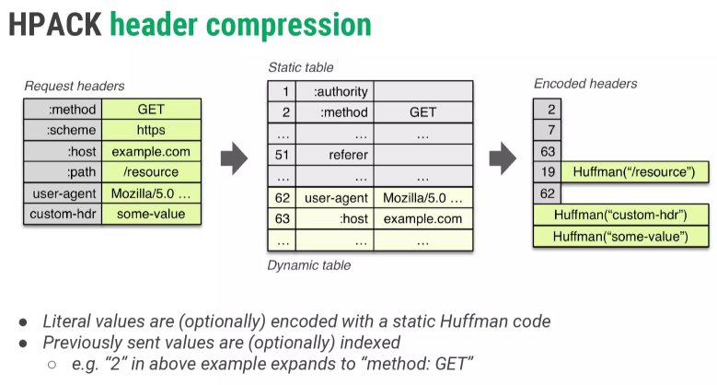
Feature 2: Header Compression
As one further optimization, the HPACK compression
context consists of a static and dynamic table: the static
table is defined in the specification and provides a list of
common HTTP header fields that all connections are likely
to use (e.g., valid header names); the dynamic table is
initially empty and is updated based on exchanged values
within a particular connection. As a result, the size of
each request is reduced by using static Huffman coding
for values that haven’t been seen before, and substitution
of indexes for values that are already present in the static
or dynamic tables on each side.

Slide 8
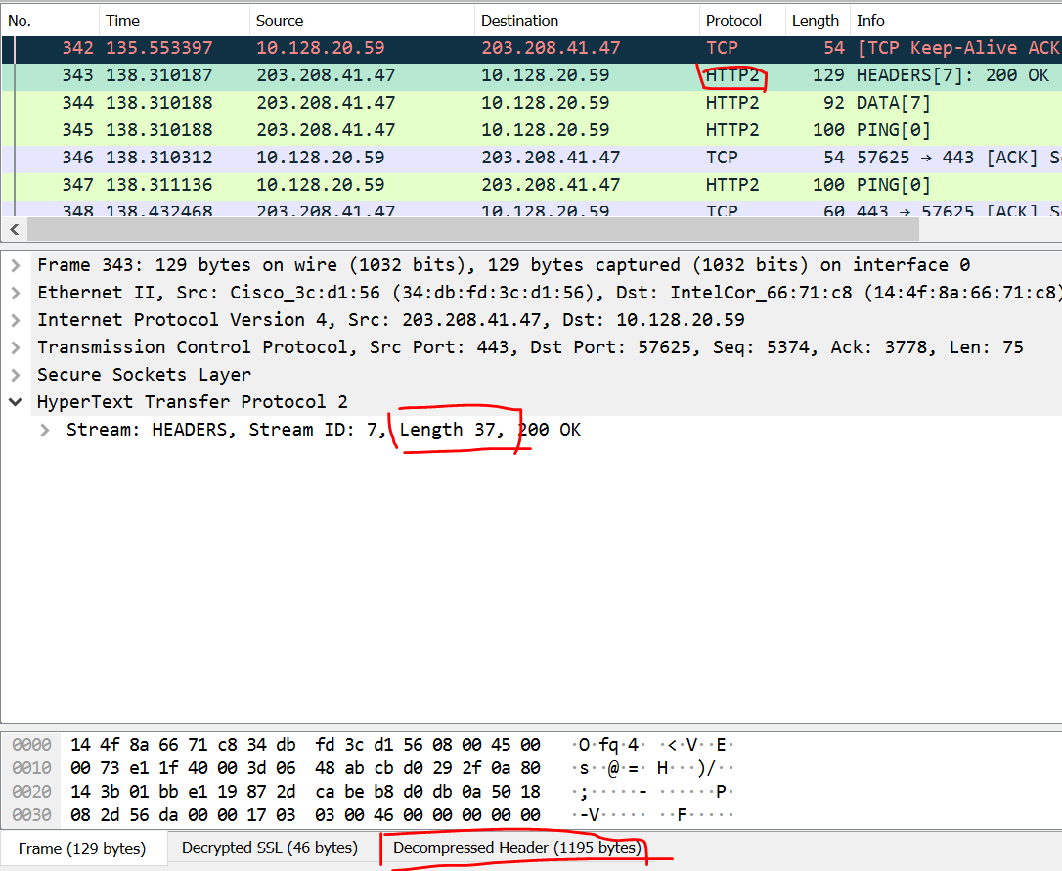
Feature 2: Header Compression

Slide 9
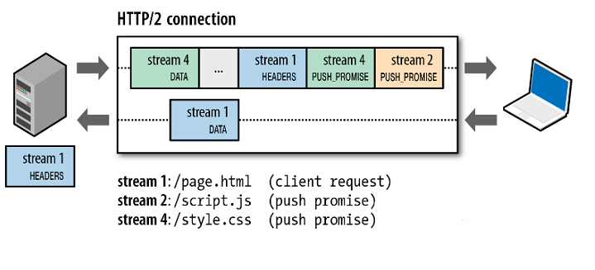
Feature 3: Server Push
Server Push refers to the HTTP/2 ability for the server to actively push resources to clients without a request. For example, a server can actively push images, JS and CSS files to browsers, without waiting for the browser to resolve the HTML before sending the request. When the browser has resolved the HTML, the required resources are already in the browser, which makes web pages load significantly faster. This is demonstrated in the figure below (from High Performance Browser Networking):

Slide 10
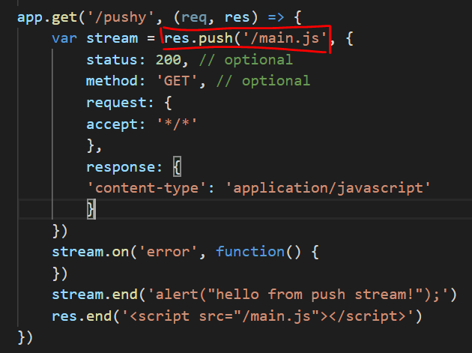
Feature 3: Server Push
Developers should configure this features by themselves, other features are implemented by servers and browsers
Traditional improvement: 1. combine resources into one file. 2. resource preload, <link rel=“preload” href=“/styles.css” as=“style”>
Supported by Nginx, Apache, nodejs

Slide 11
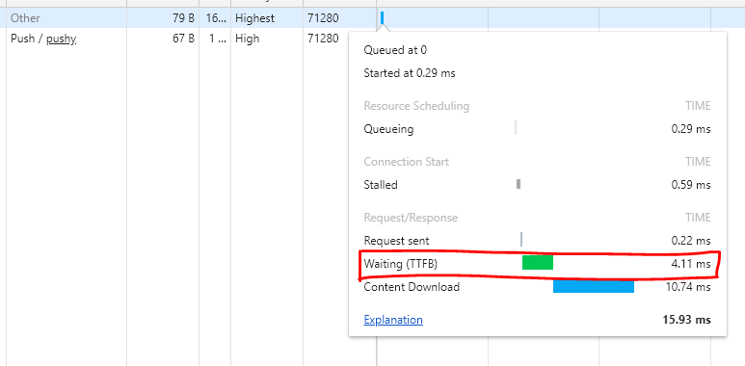
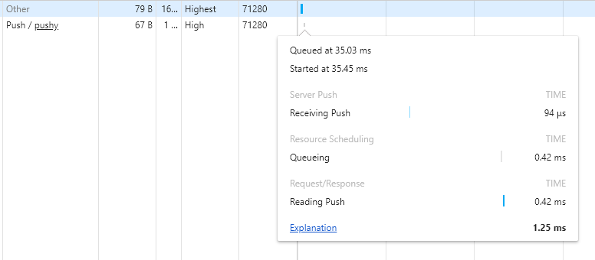
Feature 3: Server Push
TTFB: from sending request until receiving response
No TTFB when using server push

Slide 12
Feature 3: Server Push
Cache problem
Waste of bandwidth if it is already cached in browser. even if a higher version is pushed, browser prefers to use local cache
Allow push service to the user for the first time
About the performance
Slower if too many resources are pushed

Slide 13
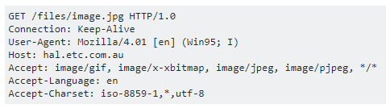
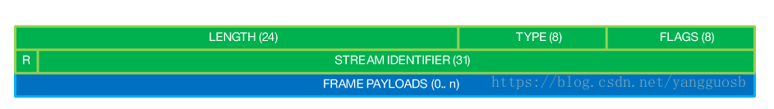
Feature 4: Binary protocol
HTTP is a text protocol: oriented around text strings.
It still sends data in raw bytes, what makes HTTP a text protocol is that the exchange to get resource looks like this:
HTTP transfers data in binary format. Both header and body are in binary format and collectively called the "Frame". Basic binary format of the Frame is as follows

Slide 14
Feature 4: Binary protocol
Streams, messages, and frames
1. Stream: A bidirectional flow of bytes within an established connection, which may carry one or more messages.
2. Message: A complete sequence of frames that map to a logical request or response message.
3. Frame: The smallest unit of communication in HTTP/2, each containing a frame header, which at a minimum identifies the stream to which the frame belongs.
All the features are implemented based on binary framing
Why use binary protocol?
are more efficient to parse – low cost of analyzing protocol
less error-prone, because they often have a number of affordances to “help” with things like whitespace handling, capitalization, line endings, blank lines and so on

Slide 15
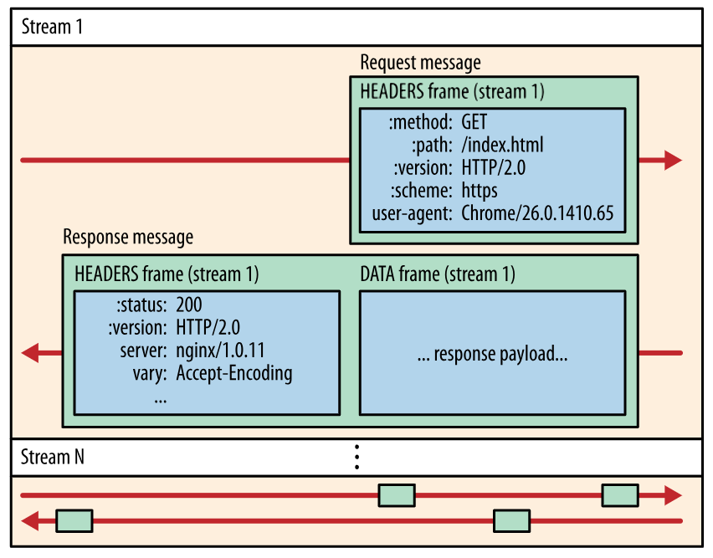
Feature 4: Binary protocol

Slide 16
Feature 5: Stream prioritization
Once an HTTP message can be split into many individual frames, and we allow for frames from multiple streams to be multiplexed, the order in which the frames are interleaved and delivered both by the client and server becomes a critical performance consideration. To facilitate this, the HTTP/2 standard allows each stream to have an associated weight and dependency:
1. Each stream may be assigned an integer weight between 1 and 256.
2. Each stream may be given an explicit dependency on another stream.
The combination of stream dependencies and weights allows the client to construct and communicate a "prioritization tree" that expresses how it would prefer to receive responses. In turn, the server can use this information to prioritize stream processing by controlling the allocation of CPU, memory, and other resources, and once the response data is available, allocation of bandwidth to ensure optimal delivery of high-priority responses to the client.

Slide 17
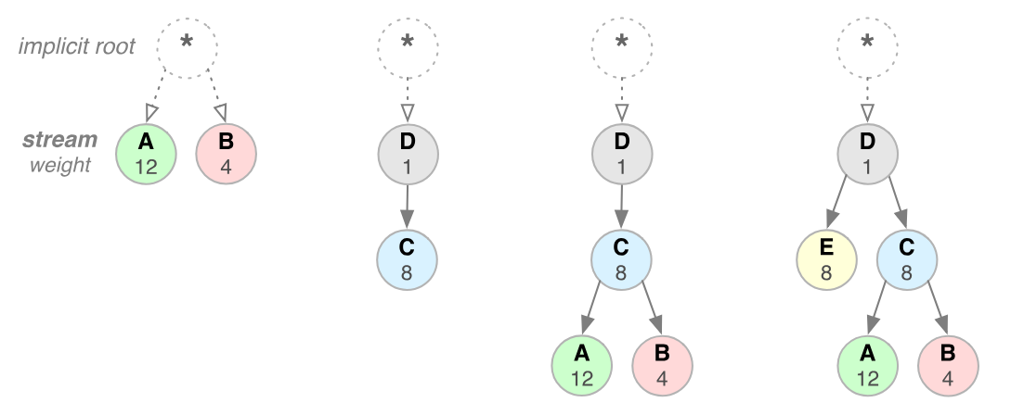
Feature 5: Stream prioritization

Slide 18
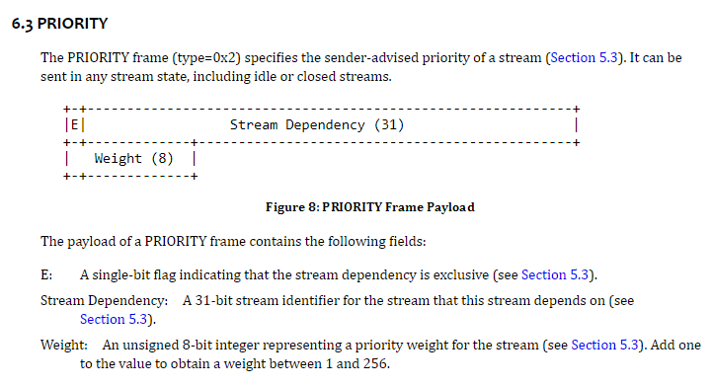
Feature 5: Stream prioritization

Slide 19
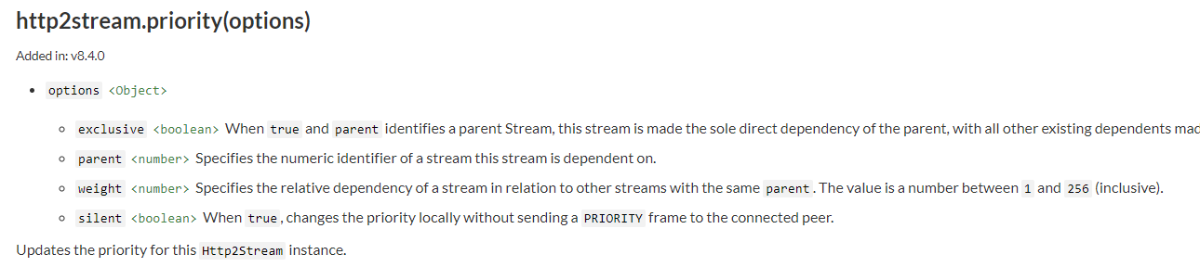
Feature 5: Stream prioritization
Node.js HTTP/2 module

Slide 20
Feature 6: Flow control
Flow control is a mechanism to prevent the sender from overwhelming the receiver with data it may not want or be able to process: the receiver may be busy, under heavy load, or may only be willing to allocate a fixed amount of resources for a particular stream. For example, the client may have requested a large video stream with high priority, but the user has paused the video and the client now wants to pause or throttle its delivery from the server to avoid fetching and buffering unnecessary data. Alternatively, a proxy server may have fast downstream and slow upstream connections and similarly wants to regulate how quickly the downstream delivers data to match the speed of upstream to control its resource usage; and so on.
Request multiplexing may cause race condition, flow control resolves the conflictions

Slide 21
Feature 6: Flow control
Flow control is directional. Each receiver may choose to set any window size that it desires for each stream and the entire connection.
Flow control is credit-based. Each receiver advertises its initial connection and stream flow control window (in bytes), which is reduced whenever the sender emits a DATA frame and incremented via a WINDOW_UPDATE frame sent by the receiver.
Flow control cannot be disabled. When the HTTP/2 connection is established the client and server exchange SETTINGS frames, which set the flow control window sizes in both directions. The default value of the flow control window is set to 65,535 bytes, but the receiver can set a large maximum window size (2^31-1 bytes) and maintain it by sending a WINDOW_UPDATE frame whenever any data is received.
Flow control is hop-by-hop, not end-to-end. That is, an intermediary can use it to control resource use and implement resource allocation mechanisms based on own criteria and heuristics.

Slide 22
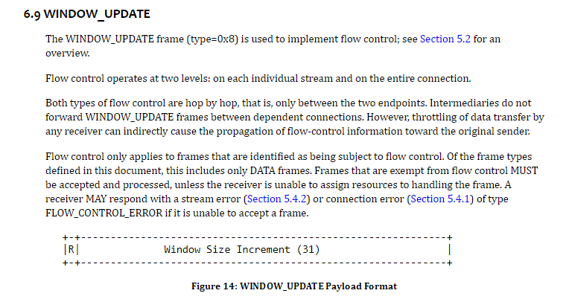
Feature 6: Flow control

Slide 23
Other features
1. Reset – RST_STREAM frame
2. Connection reuse
3. Use of TLS features
4. Security considerations
5. IANA Considerations
6. APLN: Application Layer Protocol Negotiation

Slide 24
Thank you

