Slide 1
Ignite 2018

Slide 2







.NET Overview and Roadmap
Your platform for building anything
DESKTOP
WEB
CLOUD
MOBILE
GAMING
IoT
AI
.NET

Slide 3
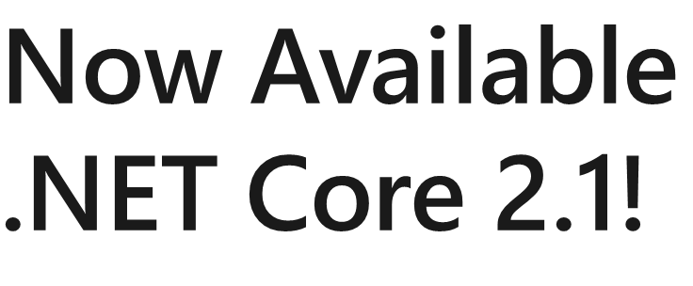
.NET Growth Continues
Visual Studio
+1 million new monthly active .NET developers in last year
.NET Core
Over half a million .NET Core 2.0 developers

Slide 4
.NET Core 2.1 on TechEmpower
REQUESTS / SECOND
+15%
+18%
+147%

Slide 5
.NET Core 2.1 Major Features
.NET Core
Lazy Loading
Value conversions
Query types
Data seeding
ASP.NET Core
Global Tools
Span<T>
Sockets
HttpClient Performance
Windows Compatibility Pack
EF Core
HTTPS
Razor UI as a library
HttpClientFactory
ASP.NET Core SignalR
Notes:
A .NET Core Global Tool is a special NuGet package that contains a console application. A Global Tool can be installed on your machine on a default location that is included in the PATH environment variable or on a custom location.
Currently, there isn't a Global Tool search feature in the .NET Core Command-line Interface (CLI).
You may also find tool recommendations in blog posts or in the natemcmaster/dotnet-tools GitHub repository.
dotnet tool install -g dotnetsay
spans are only a view into the underlying memory and aren’t a way to instantiate a block of memory
Roughly speaking, you can visualize span as a struct containing two fields: a pointer and a length
Socket is greatly improved
Windows Compatibility Pack: Porting existing code to .NET Core used to be quite hard because the available API set was very small. In .NET Core 2.0, we already made this much easier, thanks to .NET Standard 2.0, we made it even easier with the Windows Compatibility Pack, which provides access to an additional 20,000 APIs via a single NuGet package.
Query types: EF Core model can contain query types, which can be used to carry out database queries against data that isn't mapped to entity types.
Query types are like entity types in that they:
Can be added to the model either in OnModelCreating or via a "set" property on a derived DbContext.
Support many of the same mapping capabilities, like inheritance mapping and navigation properties. On relational stores, they can configure the target database objects and columns via fluent API methods or data annotations.
However, they are different from entity types in that they:
Do not require a key to be defined.
Are never tracked for changes on the DbContext and therefore are never inserted, updated or deleted on the database.
Are never discovered by convention.
Only support a subset of navigation mapping capabilities - Specifically:
They may never act as the principal end of a relationship.
They can only contain reference navigation properties pointing to entities.
Entities cannot contain navigation properties to query types.
Are addressed on the ModelBuilder using the Query method rather than the Entity method.
Are mapped on the DbContext through properties of type DbQuery<T> rather than DbSet<T>
Are mapped to database objects using the ToView method, rather than ToTable.
May be mapped to a defining query - A defining query is a secondary query declared in the model that acts a data source for a query type.
Usage scenarios
Some of the main usage scenarios for query types are:
Serving as the return type for ad hoc FromSql() queries.
Mapping to database views.
Mapping to tables that do not have a primary key defined.
Mapping to queries defined in the model.

Slide 6
Announcing Azure SignalR Service GA!
Add real-time web functionalities easily with Azure and .NET Core
Enable via “services.AddSignalR().AddAzureSignalR()”
Fully managed service
No more worries about capacity provisioning, scaling, or persistent connections
Native SignalR development
</>
Use ASP.NET Core SignalR to build real-time experiences such as chat, stock tickers, live dashboards, and instant broadcasting

Slide 7
.NET Core 2.2 Preview 2 Now Available
https://aka.ms/DotNetCore22

Slide 8
.NET Core 2.2 Themes
Improved Web API Development
Microservices and Azure
Continued Performance Improvements

Slide 9
.NET Core 2.2 Major Features
.NET Core
Cosmos DB provider
Spatial extensions for SQL Server and SQLite providers
Reverse engineering of database views
Collections of owned entities
Query tagging
ASP.NET Core
Multi-tier JIT compilation
SQL Connection token auth
EF Core
Template updates: Bootstrap 4, Angular 6
Web API improvements, including API security
HTTP/2
IIS in-process hosting
Health checks
Endpoint routing
SignalR Java client
Notes:
Tiered compilation is a significant new performance feature, In many scenarios that we have tested, applications start faster and run faster at steady state
Since the beginnings of .NET Framework, every method in your code was typically compiled once. However there are tradeoffs to be made when deciding how to do that compilation that will affect the performance of your application
The Tiered Compilation feature changes the premise by allowing .NET to have multiple compilations for the same method that can be hot-swapped at runtime.
This separates the decision making so that we can pick a technique that is best for startup, pick a second technique that is best for steady-state and then deliver great performance on both
Faster application startup time Faster steady-state performance
adding a health checks service and middleware in 2.2.0 to make it easy to use ASP.NET Core in environments that require health checks – such as Kubernetes

Slide 10





.NET Core 3.0 Update
.NET Core 3 expands supported workloads to include Windows Desktop, IoT & AI
.NET Core is perfectly suited for the requirements of cloud-native, cross-platform workloads
WEB
CLOUD
DESKTOP
IoT
AI
.NET CORE
.NET CORE 3
LIBRARIES
INFRASTRUCTURE
RUNTIME COMPONENTS
COMPILERS
LANGUAGES
Notes:
The highlight of .NET Core 3 is support for Windows desktop applications, specifically Windows Forms, Windows Presentation Framework (WPF), and UWP XAML. You will be able to run new and existing Windows desktop applications on .NET Core and enjoy all the benefits that .NET Core has to offer.
.NET Core 3.0 will be one of the most exciting .NET releases we’ve ever released
Benefits of .NET Core for Desktop
Performance improvements and other runtime updates that will delight your users
Super easy to use or test a new version of .NET Core for just one app on a machine
Enables both machine-global and application-local deployment
Support for the .NET Core CLI tools and SDK-style projects in Visual Studio
We’re also announcing a set of improvements that we’ll be adding to both .NET Core 3.0 and .NET Framework 4.8:
Access to the full Windows 10 (AKA “WinRT”) API.
Ability to host UWP XAML controls in WPF and Windows Forms applications.
Ability to host UWP browser and media controls, enabling modern browser and media content and standards.
App-local Deployment: you can install .NET Core in pretty much any way you want. It comes with a lot of deployment flexibility. Deployment of .NET Core desktop applications can either use a global install of the .NET Core runtime (similar to how .NET Framework is deployed), or side-by-side deployment so that each application uses its own version of the runtime.

Slide 11
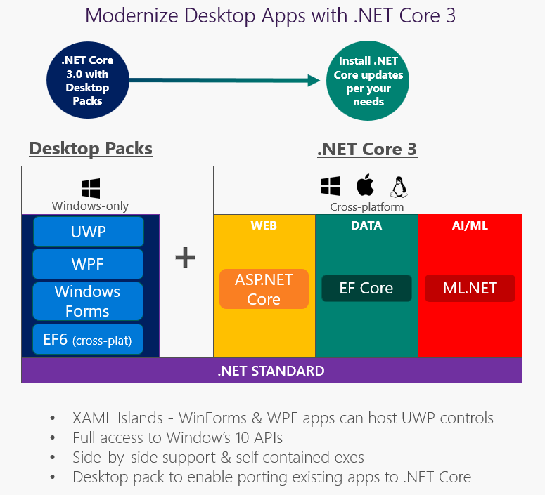
.NET Core 3.0 Update
Notes:
Side-by-side and App-local Deployment
When a new .NET Core version is released, you can update one app on a machine at a time without any concern for affecting other applications. New .NET Core versions are installed in new directories and are not used by existing applications.

Slide 12
.NET Core 3 Desktop Improvements
.NET Core 3 supports WinForms and WPF frameworks
XAML Islands - WinForms & WPF can host UWP
XAML Controls – WinForms & WPF browser and media UWP controls
High DPI fixes for WinForms
Access to all the Windows 10 API’s
NET Core App Bundler
Precompiled, fast startup
Small apps by removing unused dependencies, link away unused IL
Single self-contained .exe

Slide 13
Why Windows Desktop on .NET Core?
Machine global or app local framework
Core runtime and API improvements
SDK based .csproj project system

Slide 14
Experimental Blazor: .NET in the Browser
Build client-side Web UI in .NET
You don’t need to know AngularJS, React, Vue, etc
Take advantage of stability and consistency of .NET
Runs in all browsers
Native performance
Strongly typed on client and server
Requires no plugin or code transpilation
Share C# code with the client and the server
Notes:
Blazor is an experimental .NET web framework using C#/Razor and HTML that runs in the browser with WebAssembly
Blazor uses only the latest web standards. No plugins or transpilation needed. It runs in the browser on a real .NET runtime (Mono) implemented in WebAssembly that executes normal .NET assemblies.

Slide 15
Razor Components (“server-side Blazor”)
Blazor programming model integrated into ASP.NET Core
Runs server-side on .NET Core
Handle client UI interactions using SignalR
Same code can run client-side on WebAssembly with no code changes
WebAssembly support remains experimental while runtime matures
Shipping in .NET Core 3.0

Slide 16
Machine Learning and .NET
Announcing ML.NET 0.5!
https://aka.ms/MLNet05

Slide 17
What’s new with ML.NET?
Shipped four previews of ML.NET 0.1 - 0.5
Additional ML Scenarios
Clustering
Recommendation
Deep Learning (e.g. Image Classification with TensorFlow)
New learners and transforms
Learners: FFM, LightGBM, Ensemble, SymSGD
Transforms: LightLDA, Word Embeddings
ONNX Support
Improved F# support
Additional Train and Test options
Cross-Validation
ML.NET Samples repo
https://github.com/dotnet/machinelearning-samples

Slide 18

Why Serverless?
What are the benefits?
Solve business problems—not technology problems related to undifferentiated heavy lifting
Focus
Shorter time to market
Fixed costs converted to variable costs
Better service stability
Better development and testing management
Less waste
Efficiency
Simplified starting experience
Easier pivoting means more flexibility
Easier experimentation
Scale at your pace—don’t bet the farm on Day 1
Natural fit for microservices
Flexibility

Slide 19
Focus on Code, Not Plumbing
No infrastructure management
Auto-scale based on your workload
No wasted resources, pay only for what you use

Slide 20
Sample scenarios for Functions
Web/Mobile app workloads
IoT-connected backends
Real-time processing
Automation of infrastructure

Slide 21

When we can develop a solution in a week using Azure Functions versus four months using traditional methods, that represents a drastic improvement in our ability to solve business-critical problems.
Hristo Papazov Senior Software Engineer Relativity

Slide 22








Full integration with Azure ecosystem
Development
Platform
IDE support
Event Grid
Functions
Logic Apps
Manage all events that can trigger code or logic
Execute your code based on events you specify
Design workflows and orchestrate processes
Integrated DevOps
Local development
Monitoring
Database
Storage
Analytics
Intelligence
Security
IoT
Visual debug history

Slide 23
Functions 1.0 Challenges
Need for additional language support, e.g. Java, Python, Powershell
Only able to host on Windows
No support for development on Mac and Linux
Assembly probing and binding issues for .NET developers
Performance issues on a range of scenarios / languages
Lack of UX guidance to production success

Slide 24
Functions 2.0 – What in this GA announcement?
New Functions Quickstarts by Language
Updated runtime built on .NET Core 2.1
.NET Functions loading changes
New extensibility model
Decoupled from language providers and bindings
Run code from a package
Tooling updates: CLI, Visual Studio & VS Code
Durable Functions (GA)
Consumption mode SLA

Slide 25
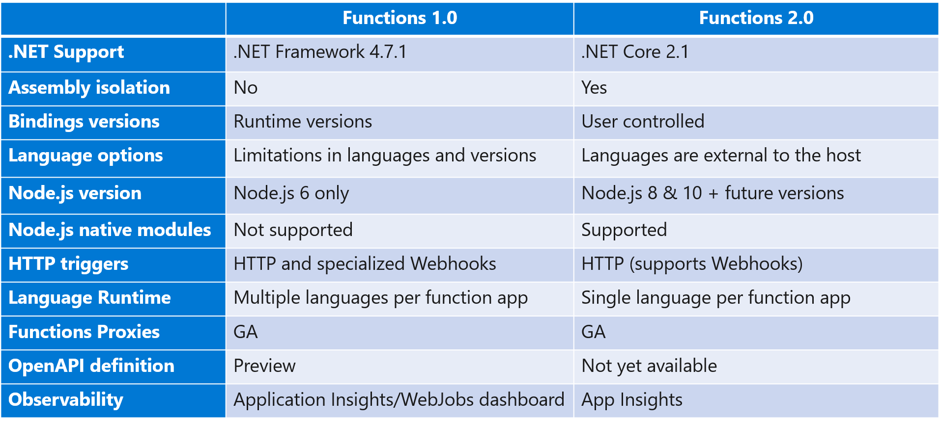
Functions Runtime 1.0 and 2.0 Key Differences

Slide 26
.NET Assembly Probing and Binding Improvements
Runtime assemblies isolation
Function assemblies loaded in a custom Assembly Load Context
Automatic unification (implicit binding redirects)
Improved probing/resolution behavior
Publish artifacts and deps file
Automatic resolution of runtime/platform dependencies and native assets
Consistent with .NET Core
Improved extensibility consolidating on new load behavior
Common dynamic assembly load mechanism for all extensions
Out-of-process .NET language worker (roadmap)
Serialization / Deserialization of triggers and bindings
More flexibility around .NET versions
Dependency injection

Slide 27


Assembly Isolation - Bindings: 1.0 Model
Azure Functions Host – Functions 1.0
Host Assembly Load Context (default)
LoadFrom Context
Job host
Functions Assemblies
Bindings
Functions dependencies
WindowsAzure.Storage 9.3.2
Runtime dependencies
WindowsAzure.Storage 7.2.0
WindowsAzure.Storage 7.2.0
public static Run(…, CloudBlockBlob blob,…))
{
//Function code...;
}

Slide 28
Assembly Isolation - Bindings: 2.0 Model
Azure Functions Host – Functions 2.0
Host Assembly Load Context (default)
Function Assembly Load Context
Job host
Functions Assemblies
Runtime dependencies
Bindings
WindowsAzure.Storage 9.3.1
Functions dependencies
WindowsAzure.Storage 9.5.0
WindowsAzure.Storage 9.3.1
public static Run(…, CloudBlockBlob blob,…))
{
//Function code...;
}

Slide 29















Functions Everywhere
https://github.com/azure/azure-functions-host
(+other repos)
Azure Functions host runtime
Azure Functions Core Tools
Azure Functions base Docker image
Azure Functions .NET Docker image
Azure Functions Node Docker image
●●●
Development
Hosting
Local dev machine
Azure Functions
service
Azure Functions service
IoT devices
Additional Azure hosts
Non-Azure hosts
On-premises
Platform
+
●●●
●●●
●●●
Core Tools + favorite editor
Consumption plan
App Service plan
Azure IoT Edge
AKS, Service Fabric Mesh, …
K8s, raw VMs, & more
App Service on Azure Stack
Application delivery
Code or container
Code
Code or container
Container
Container
Container
Code
Operating system
Windows, macOS, or Linux
Windows or Linux
Windows or Linux
Linux
Linux
Linux
Windows

Slide 30




Language Options
Generally available
Public preview
Private preview
New!

Slide 31
Bindings and Integrations
Functions 1.0
Microsoft.NET.Sdk.Functions (.NET Framework 4.6)
HTTP
Timer
Storage
Service Bus
EventHubs
Cosmos DB
Functions 2.0
Microsoft.NET.Sdk.Functions (.NET Standard 2.0)
HTTP
Timer
Microsoft.Azure.WebJobs.Extensions.Storage 3.0.0
Microsoft.Azure.WebJobs.Extensions.ServiceBus 3.0.0
Microsoft.Azure.Webjobs.Extensions.EventHubs 3.0.0
Microsoft.Azure.WebJobs.Extensions.CosmosDB 3.0.0
Microsoft.Azure.Webjobs.Extensions.EventGrid 2.0.0
Microsoft.Azure.WebJobs.Extensions.DurableTask 1.4.0
Microsoft.Azure.Webjobs.Extensions.MicrosoftGraph 1.0.0-beta

Slide 32
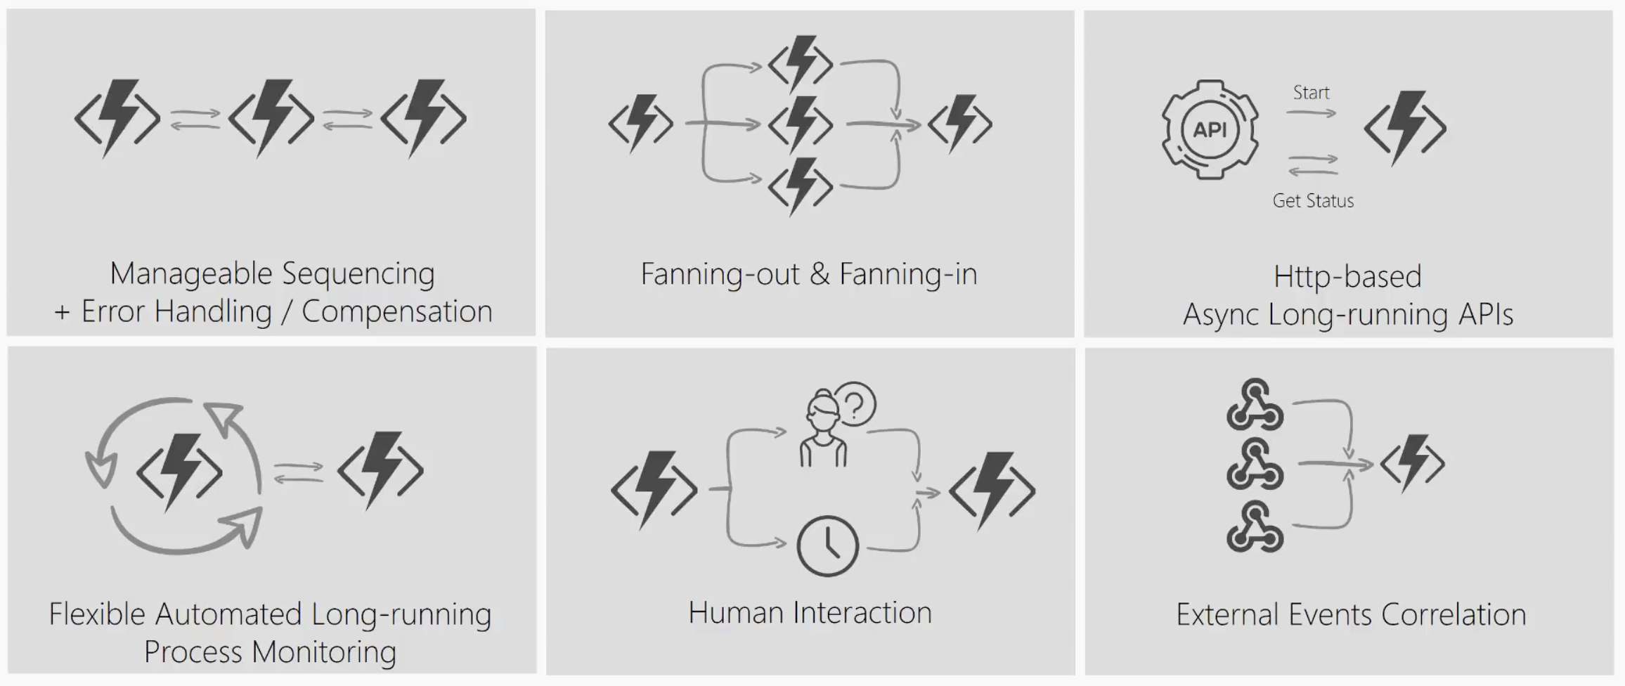
What’s still hard?

Slide 33
Durable Functions
Write long-running orchestrations as a single function while maintaining local state.
Simplify complex transactions and coordination (chaining, etc.) Easily call a Function from another Function, synchronously or asynchronously.
All of the above using code-only. No JSON schemas. No graphical designer.
Announcing: Generally available (v2) - C# and JavaScript

Slide 34
What It Looks Like
Orchestrator Function
// calls functions in sequence
public static async Task<object> Run(DurableOrchestrationContext ctx)
{
try
{
var x = await ctx.CallActivityAsync("F1");
var y = await ctx.CallActivityAsync("F2", x);
return await ctx.CallActivityAsync("F3", y);
}
catch (Exception)
{
// global error handling/compensation goes here
}
}
Activity Functions

Slide 35


Durable Functions
var outputs = new List<string>();
outputs.Add(await context.CallActivityAsync<string>("SayHello", "BRK3348"));
return outputs;
History Table
Orchestrator Function
Orchestrator Function
Activity Function
Orchestrator Started
Activity Function
Execution Started
Task Scheduled, SayHello, "BRK3348"
Orchestrator Completed
["Hello BRK3348!"]
"Hello BRK3348!"
"Hello BRK3348!"
Task Completed, "Hello BRK3348!"
?
Orchestrator Started
Execution Completed, ["Hello BRK3348!"]
Orchestrator Completed
Execution History

Slide 36
Available Tools of Azure Functions
Local Tools
Deployment Center (Kudu)
Azure DevOps
Other CI/CD
Quickly publish to production
Best Suited – Quickly validate code works in the cloud
Watch out – “Friends don’t let friend right-click publish”
Tip – Use the ‘run from package’ feature
App Services powered CI/CD
Best Suited – One-click deploy from GitHub/source
Watch out – Not as customizable as Azure DevOps pipelines
Tip – Use the new “Deployment Center” section
Fully managed CI/CD
Best Suited – Production CI/CD with various environments
Watch out – Web Deploy vs Run from Package
Tip – Can call functions as release gates
Any other CI/CD tool (Jenkins, Octopus, Travis)
Best Suited – Integrated serverless with existing tools and processes
Watch out – Documentation and samples are limited
Tip – Use the ‘run from package’ publish gesture

Slide 37
Coming Soon: Key Vault References
Gets secrets out of App Settings and into secrets management
Leverages the managed identity of your function app
Versions will be required at initial preview (goal of auto-rotation)
Site runtime
Application settings
Environment vars
Foo: mysecret
Foo: mysecret
Code
Site runtime
Application settings
Environment vars
Foo: reference
Foo: mysecret
Key Vault
Code
Foo: mysecret

Slide 38
Thank You

