Slide 1





s
PCIe 应用基础培训
2017.06.07
www.rock-chips.com
TEL: 86-591-83991906 FAX: 86-591-83951833
Rockchip Confidential Proprietary

Slide 2
Agenda
PCIe基础内容介绍
PCIe应用常见分析和限制
PCIe工具分析和应用配置
PCIe 常见异常诊断
问答环节
Rockchip Confidential Proprietary

Slide 3
PCIe基础内容介绍
Protocol Evolution
PCI Express (Peripheral Component Interconnect Express), officially abbreviated as PCIe, is a high-speed serial computer expansion bus standard designed to replace the older PCI, PCI-X, and AGP bus standards .
PCIe 4.0 is released this year!
2002 PCIe Gen1 2.5GT/s
2010 PCIe Gen3 8GT/s
2011 PCIe Gen4 16GT/s announced,
Target is 2017 release
2006 PCIe Gen2 5GT/s
2013 PCIe M-PCIe
Scalable, Flexible
High performance interconnect
Rockchip Confidential Proprietary
Notes:
最初命名为3GIO(第三代通用IO)，AWG组织最初只有intel，后来扩展到其他工业伙伴，最终命名为PCI Express。
While in early development, PCIe underwent a name change to 3GIO (for 3rd Generation I/O) before finally settling on its PCI-SIG name PCI Express. A technical working group named the Arapaho Work Group (AWG) drew up the standard. For initial drafts, the AWG consisted only of Intel engineers; subsequently the AWG expanded to include industry partners

Slide 4
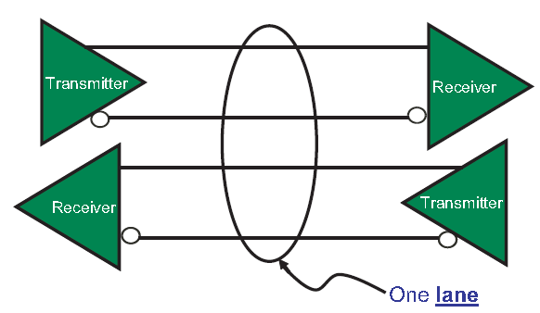
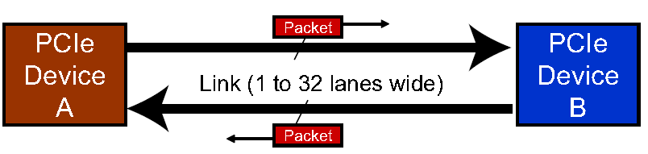
PCIe基础内容介绍
Physical link and lane
One lane consists of a pair of differential TX and a pair of differential RX. It allows a Link to be made up 1, 2, 4, 8, 12, 16, or 32 Lanes，lane counts is link width. But, X32（32*4=128）lanes is Unusual, due to pin cost is intolerability.
Dual-simplex link
Rockchip Confidential Proprietary
Notes:
常用的显卡16X，M.2 PCIe SSD, 2X 4X

Slide 5
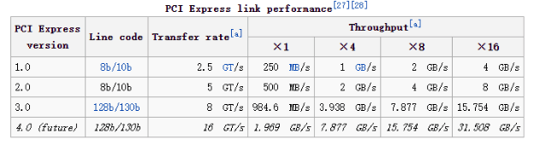
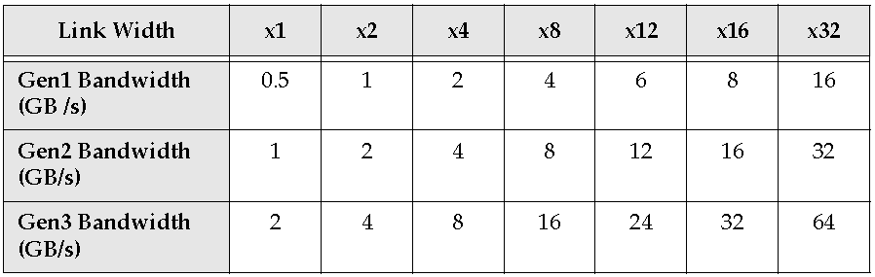
PCIe基础内容介绍
Performance
Gen1/Gen2 :8b/10b
Gen3 : 128b/130b
Gen4 : 128b/130b ?
one lane one direction
M.2(NGFF) SSD
Rockchip Confidential Proprietary

Slide 6
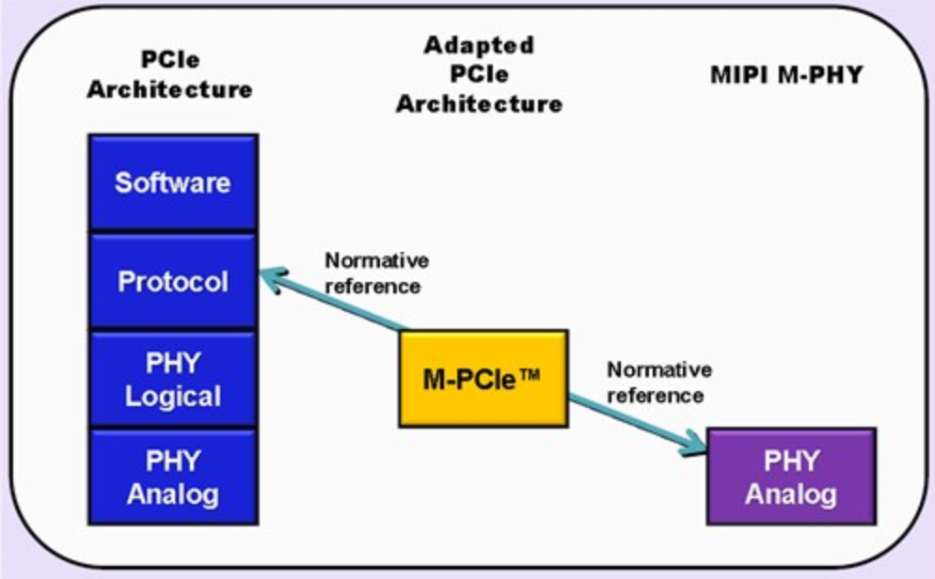
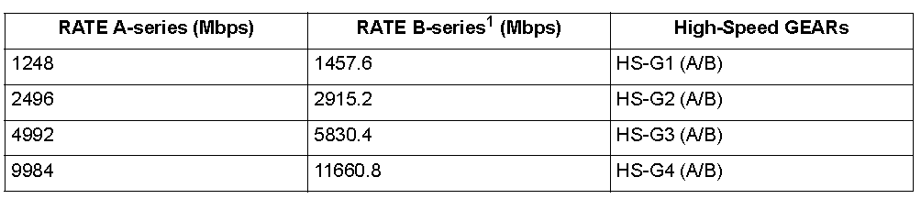
PCIe基础内容介绍
Markets and Applications
Storage
RAID
SSD
High Performance Computing
Super Computing and server
Consumer Computing
Industrial, Medical, Instrumentation, FPGAs
Tester equipment
FPGAs
Ethernet Host Bus Adapter
NVMe
Networking
Network processor
Mobile
WiFi (802.11an, 802.11ac, 802.11ad)
Apps Processors
M-PCIe
Rockchip Confidential Proprietary
Notes:
iPhone 6s A9上的SSD用的不是传统eMMC所用的SDIO接口，而是PCI-E，这个PCI-E也不电脑上的那个，是基于MIPI M-PHY物理层的PCI-E(2个lane)，使用NVMe接口协议，UFS规范走的也是PCI-E物理层同样是MIPI M-PHY，不过接口协议是SCSI。从目前来看，在上层软件中又有专门的协议去做SCSI和NVMe的互转。UFS transfers follow the SCSI model, but with a subset of SCSI commands
磁盘阵列（Redundant Arrays of Independent Disks，RAID)
NVMe: 提高IOPS和降低latency
NVM Express (NVMe) is a register level interface that allows host software to communicate with a non-volatile memory subsystem. This interface is optimized for Enterprise and Client solid state drives, typically attached to the PCI Express interface
AHCI：

Slide 7

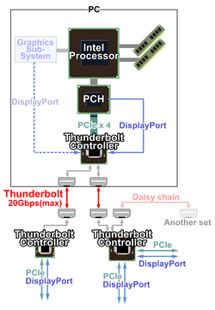
Thunderbolt is the brand name of a hardware interface that allows the connection of external peripherals to a computer. Thunderbolt 1 and 2 use the same connector as Mini DisplayPort (MDP), while Thunderbolt 3 uses USB Type-C. It was initially developed and marketed under the name Light Peak,[1] and first sold as part of a consumer product on February 24, 2011.[2]
Thunderbolt combines PCI Express (PCIe) and DisplayPort (DP) into one serial signal, and additionally provides DC power, all in one cable. Up to six peripherals may be supported by one connector through various topologies.

Slide 8
PCIe基础内容介绍
Storage Application
Rockchip Confidential Proprietary

Slide 9
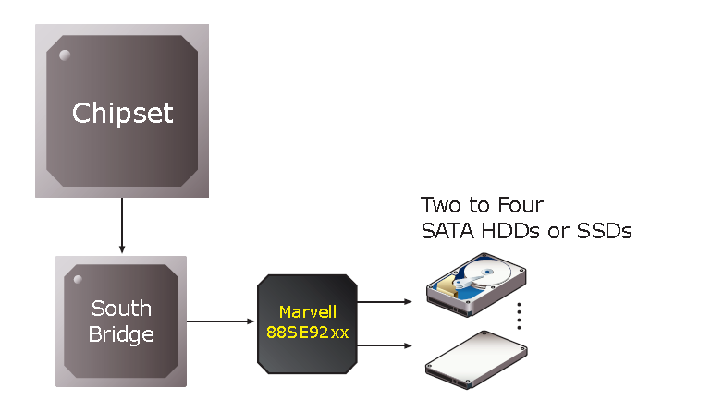
PCIe基础内容介绍
PCIe to SATA
Rockchip Confidential Proprietary

Slide 10
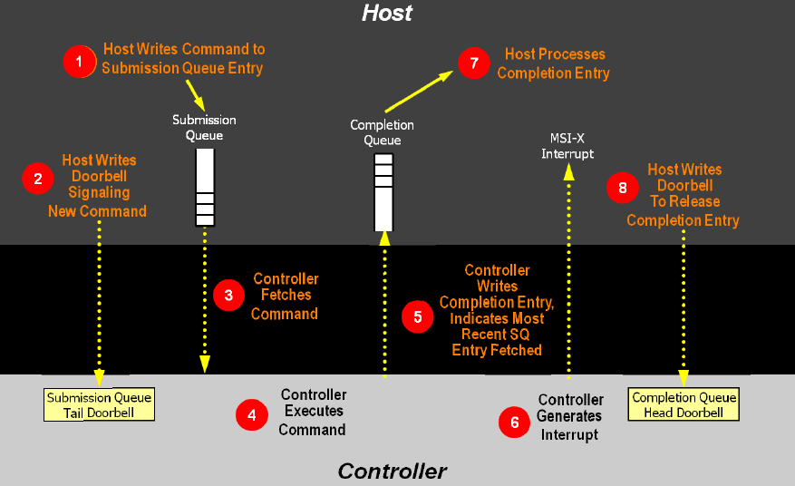
PCIe基础内容介绍
NVMe
LINK
Rockchip Confidential Proprietary

Slide 11
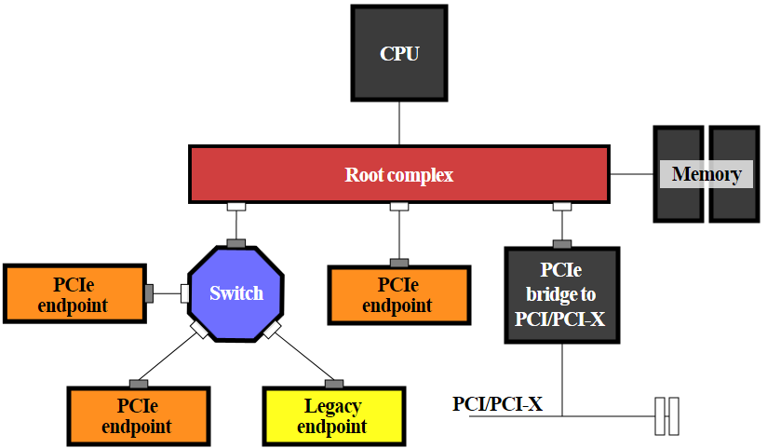
PCIe基础内容介绍
A Simple PCIe Topology
Root Complex: The Root Complex can be understood as the interface between the system CPU and the PCIe topology, with PCIe Ports labeled as "Root Ports” in configuration space
Switch: Fanout or aggregation capability, act as router
Bridge: Interface to other buses, such as PCI/PCI-X or PCIe
Endpoint: Act as initiators and Completers of transactions on the bus. Have legacy EP and native EP
Rockchip Confidential Proprietary
Notes:
RC:可以有多个downstream port
EP:只有一个upstream port
SW:一个upstream port和多个downstream port
BD:一个upstream port和一个downstream port

Slide 12
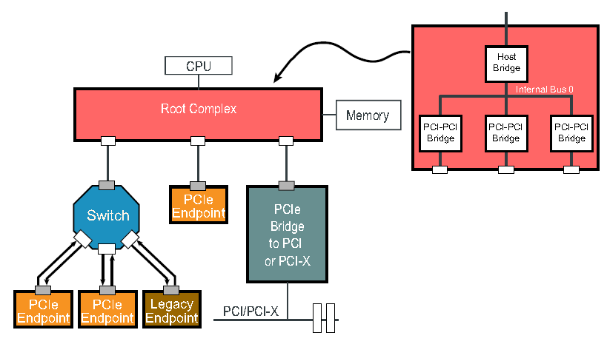
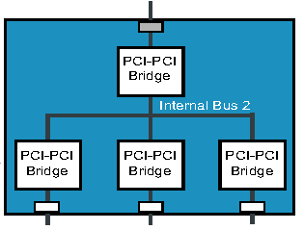
PCIe基础内容介绍
A Simple PCIe Topology
Rockchip Confidential Proprietary

Slide 13
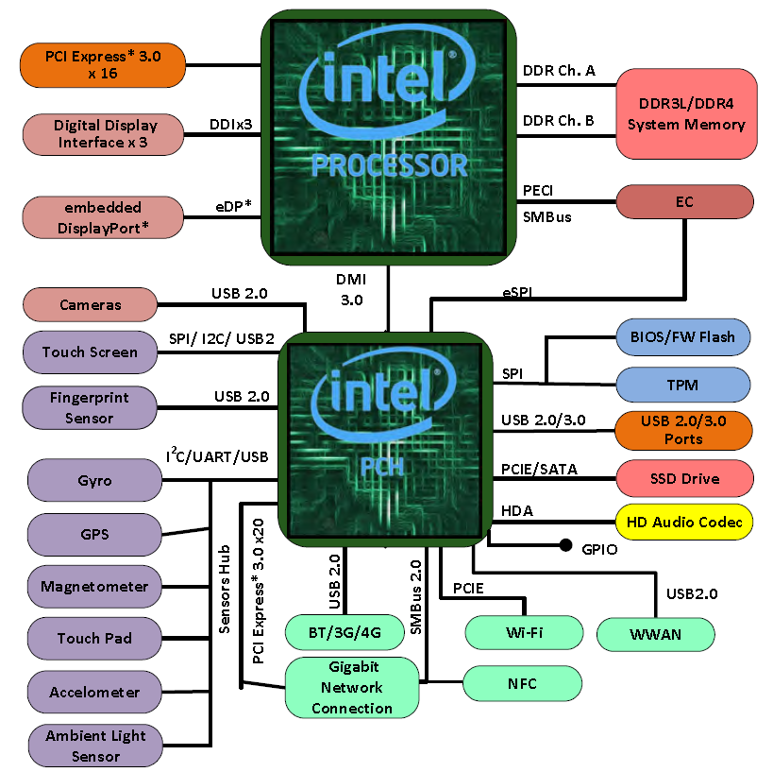
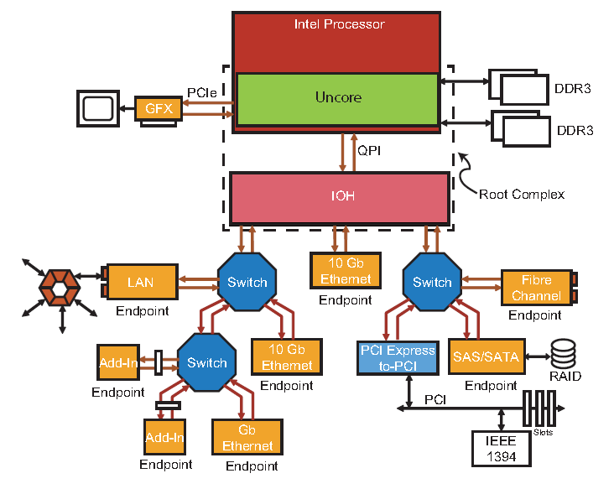
PCIe基础内容介绍
A Complex PCIe Topology
Uncore: Un core
QPI: quick path interconnect
DMI: Direct Media Interface
FDI：Flexible Display Interface
IOH: South Bridge
PCH：platform Controller Hub
Rockchip Confidential Proprietary

Slide 14
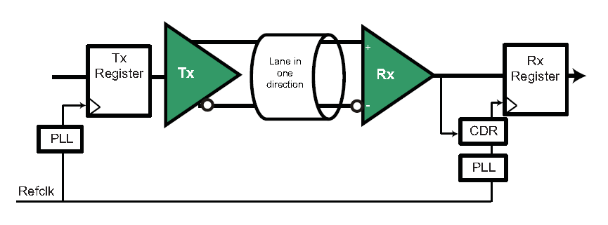
PCIe基础内容介绍
Refclk Architecture overview
Common Refclk Architecture
Data Clocked Rx Architecture
Separate Refclk Architecture
Common Refclk Architecture
Rockchip Confidential Proprietary

Slide 15
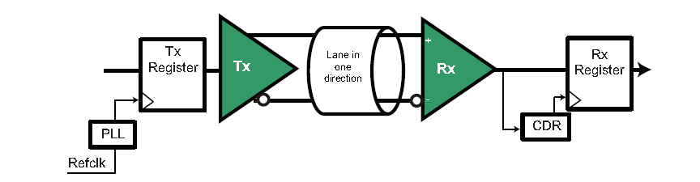
PCIe基础内容介绍
Refclk Architecture overview
Common Refclk Architecture
Data Clocked Rx Architecture
Separate Refclk Architecture
Data Clocked Rx Architecture
Rockchip Confidential Proprietary

Slide 16
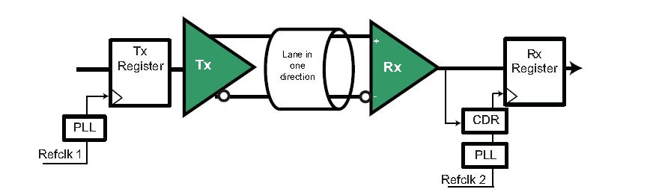
PCIe基础内容介绍
Refclk Architecture overview
Common Refclk Architecture
Data Clocked Rx Architecture
Separate Refclk Architecture
Separate Refclk Architecture
Rockchip Confidential Proprietary

Slide 17
Agenda
PCIe基础内容介绍
PCIe应用常见分析和限制
PCIe工具分析和应用配置
PCIe 常见异常诊断
问答环节
Rockchip Confidential Proprietary

Slide 18
PCIe应用常见分析和限制
Q1: 客户走线的时候不好走，问不同lane之间能否交织？
A1: 可以交织，RC的lane[1-4]与EP/switch的lane[1-4]随意对应。软件不需要改动。
Q2: 同一个lane的差分信号能否交织？比如RC的lane1的RX+ 与EP/Switch的RX-对应，TX+与EP/Switch的TX-对应。或者RX正负对应，TX正负对应等等情况，怎么处理？
A2: 很开心的说：随意接，软件上不需要大家再额外处理。PCIe的探测状态机已经考虑了这些所有情况
Rockchip Confidential Proprietary

Slide 19
PCIe应用常见分析和限制
Q3: RK3399只有一个RC，但是有四个lane, 能不能支持把这四个lane拆分，比如拆分成四个1-1-1-1或者拆分成两个2-2或者其他组合
A3: RK3399不支持。有其他家方案支持。如果客户希望接多个设备，请选用PCIe switch，目前我们调试过Pericom的switch，应该是最便宜的一款。
Q4: RK3399支持SSD吗？
A4：支持。需要大家注意的是，SSD有两种，一种是NVMe, 信号层走的是PCIe总线。另外一种是mSATA，走SATA总线。第二种如果需要支持请客户购买PCIe转SATA或者USB转SATA。
Rockchip Confidential Proprietary

Slide 20
PCIe应用常见分析和限制
Q5：既然支持NVMe，支持最大容量多少，能不能作为启动盘？
A5: 这个问题和当年一直被人追问RK支持的SD卡最大容量多少一样，我的回答是，有多大支持多大。另外，NVMe在RK3399支持从Uboot开始启动，也就是意味需要额外加一个spi-nor用来保存miniloader, 因为maskrom没有NVMe和PCIe驱动。
Rockchip Confidential Proprietary

Slide 21
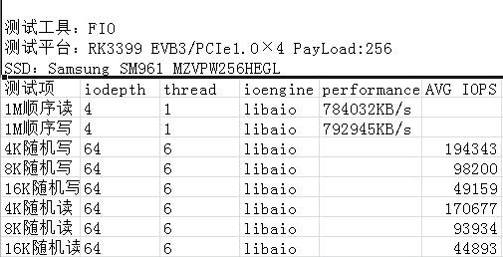
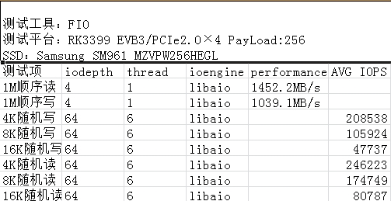
PCIe应用常见分析和限制
Q6：RK3399的PCIe接入NVMe的情况下，带宽如何？
./fio -filename=/dev/block/nvme0n1 -direct=1 -iodepth 4 -thread=1 -rw=write -ioengine=libaio -bs=1M -size=200G -numjobs=30 -runtime=60 -group_reporting -name=my
注意fio需要是带有libaio的，并且内核需要开启AIO支持CONFIG_AIO
Rockchip Confidential Proprietary

Slide 22
PCIe应用常见分析和限制
Q7：RK3399支不支持独立显卡？
A7: 理论上支持，只要能提供ARM版本的驱动。实际支持不了。如果客户问原因，就告诉客户，我们可用于BAR的物理总线内存只有32M，一般独立显卡都超过这个内存的要求。既然转接经过switch，也没有意义，因为switch本身有内存要求，转接之后，对RC的内存要求反而更大。
Q8: PCIe设备需要的电源使用情况 A8: 一般来说提供四类电源，0.9V，3V3, 3V3_AUX, 12V\
0.9V基本是给PCIe wifi设备使用。绝大部分设备都需要3V3这路。
3V3_AUX是辅助电源，要求在suspend情况下不断电，使得设备继续工作，比如wifi需要唤醒主控，这路AUX电源就需要常开。 12V是一些大功率设备使用，比如switch, 显卡等。实际情况按照对方厂家要求。
Rockchip Confidential Proprietary

Slide 23
PCIe应用常见分析和限制
Q9： PCIe支不支持热拔插？
A9： 很少有平台支持，即使是支持热拔插的，也是通知式热拔插，不支持随机热拔插。针对RK3399而言，我们芯片设计上不支持任何一种热拔插。热拔插的后果就是系统死机。
Rockchip Confidential Proprietary

Slide 24
Agenda
PCIe基础内容介绍
PCIe应用常见分析和限制
PCIe工具分析和应用配置
PCIe 常见异常诊断
问答环节
Rockchip Confidential Proprietary

Slide 25
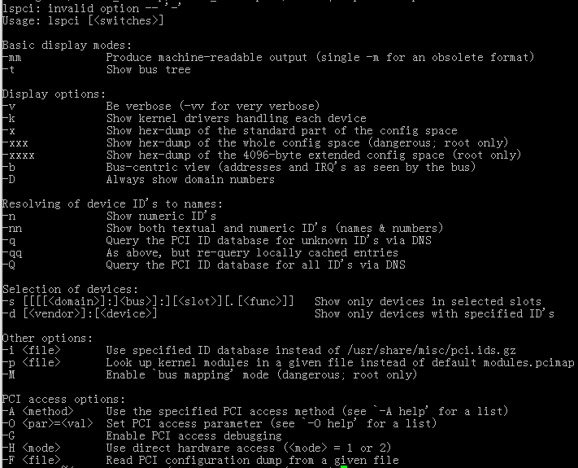
PCIe工具分析和应用配置
Rockchip Confidential Proprietary

Slide 26
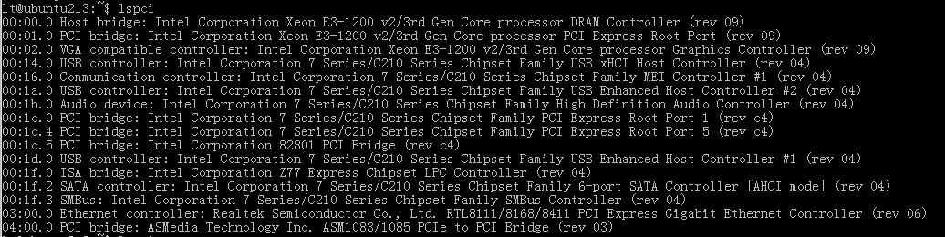
PCIe工具分析和应用配置
Rockchip Confidential Proprietary

Slide 27
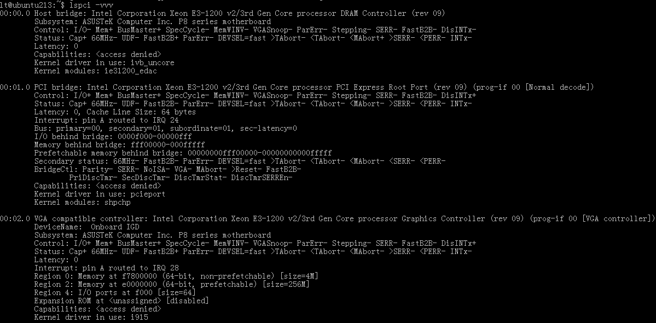
PCIe工具分析和应用配置
Rockchip Confidential Proprietary

Slide 28
PCIe工具分析和应用配置
arch/arm64/boot/dts/rockchip/rk3399.dtsi
pcie0: pcie@f8000000 {
....
max-link-speed = <1>;
};
举例
arch/arm64/boot/dts/rockchip/rk3399-evb.dtsi
&pcie {
ep-gpios = <&gpio3 13 GPIO_ACTIVE_HIGH>;
num-lanes = <4>;
};
Rockchip Confidential Proprietary

Slide 29
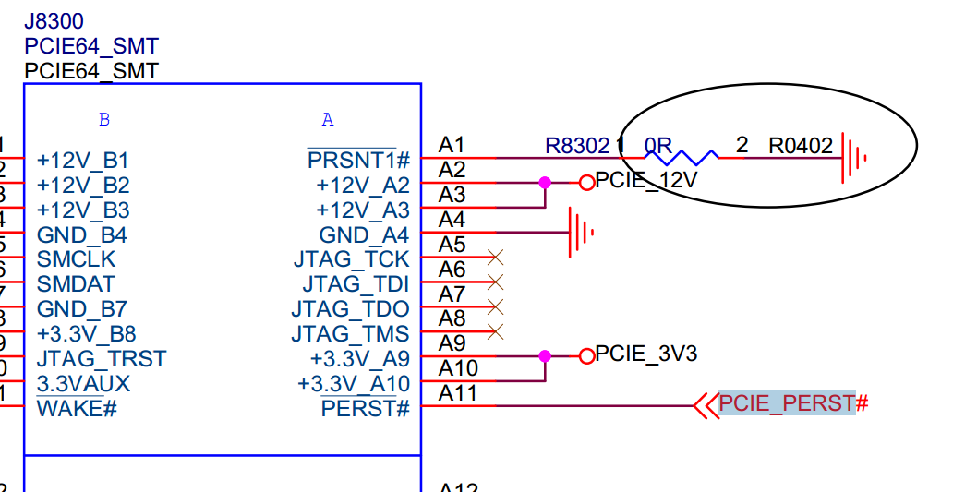
PCIe工具分析和应用配置
Rockchip Confidential Proprietary

Slide 30
Agenda
PCIe基础内容介绍
PCIe应用常见分析和限制
PCIe工具分析和应用配置
PCIe 常见异常诊断
问答环节
Rockchip Confidential Proprietary

Slide 31
PCIe 常见异常诊断
现象1：
rockchip-pcie f8000000.pcie: PCIe link training gen1 timeout!
rockchip-pcie: probe of f8000000.pcie failed with error -1
原因：training失败，外设没有处于工作状态。首先检测下ep-gpios这个是否配置对了。其次，检测下外设的供电是否有，是否足够。3.3V理论上够，但是我们经常发现有写设备需要调整到3.8甚至4V才能工作。最后，即使电压够，也需要排除功率是否够(外接电源进行测试)。
Rockchip Confidential Proprietary

Slide 32
PCIe 常见异常诊断
现象2：
[ 0.459371] pci 0000:00:00.0: bridge configuration invalid ([bus 00-00]), reconfiguring
[ 0.459585] pci 0000:01:00.0: reg 0x10: initial BAR value 0x00000000 invalid
[ 0.460043] pci 0000:01:00.1: reg 0x10: initial BAR value 0x00000000 invalid
[ 0.460503] pci 0000:01:00.2: reg 0x10: initial BAR value 0x00000000 invalid
[ 0.460535] pci 0000:01:00.2: reg 0x14: initial BAR value 0x00000000 invalid
[ 0.460904] Bad mode in Error handler detected, code 0xbf000002 -- SError
[ 0.460919] Internal error: Oops - bad mode: 0 [#1] PREEMPT SMP
[ 0.466658] Modules linked in:
[ 0.466938] CPU: 5 PID: 1 Comm: swapper/0 Not tainted 4.4.55 #41
[ 0.467464] Hardware name: Rockchip RK3399 Excavator Board edp (Android) (DT)
[ 0.468089] task: ffffffc0f2160000 ti: ffffffc0f2168000 task.ti: ffffffc0f2168000
[ 0.468752] PC is at rockchip_pcie_rd_conf+0xb8/0x138
[ 0.469200] LR is at pci_bus_read_config_dword+0x78/0xbc
这种情况设备工作了，完成了枚举，但是通信过程中挂死。绝大部分情况是电源电压不够或者功率不足导致。
Rockchip Confidential Proprietary

Slide 33
PCIe 常见异常诊断
现象3： rk3399 pcie与usb3.0同时使用出错
以下是NVMe使用过程中插入USB设备，系统异常的log
[ 2.801962] Unhandled fault: synchronous external abort (0x96000210) at 0xffffff800936401c
[ 2.801997] Internal error: : 96000210 [#1] PREEMPT SMP
[ 2.803157] Modules linked in:
[ 2.803437] CPU: 2 PID: 146 Comm: nvme Not tainted 4.4.16 #146
[ 2.803949] Hardware name: rockchip,rk3399-firefly-mini (DT)
[ 2.804445] task: ffffffc07187d400 ti: ffffffc071910000 task.ti: ffffffc071910000
[ 2.805108] PC is at nvme_kthread+0x84/0x1f8
[ 2.805484] LR is at nvme_kthread+0x60/0x1f8
结论就是PCIE_AVDD_0V9供电不够或者不稳，加电容或者加大电压试下。
Rockchip Confidential Proprietary

Slide 34
Agenda
PCIe基础内容介绍
PCIe应用常见分析和限制
PCIe工具分析和应用配置
PCIe 常见异常诊断
问答环节
Rockchip Confidential Proprietary

Slide 35
Thank You!
Rockchip Confidential Proprietary

