Slide 1
Backend final project: AI Web Chatbot
蔡譯慶、陳晉祿

Slide 2
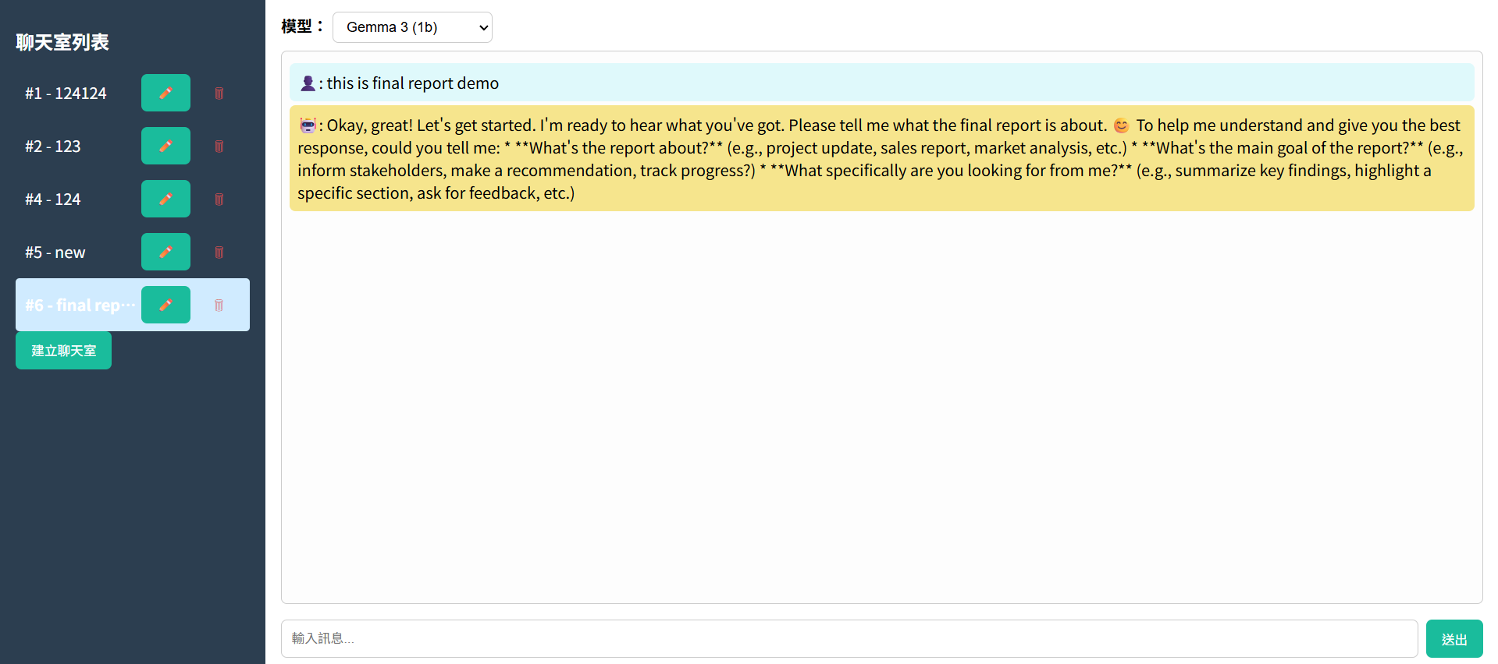
Introduction:
Use a local GPT package Ollama, combine with frontend and backend to implement a chatbot

Slide 3
Functions
Conversation

Slide 4
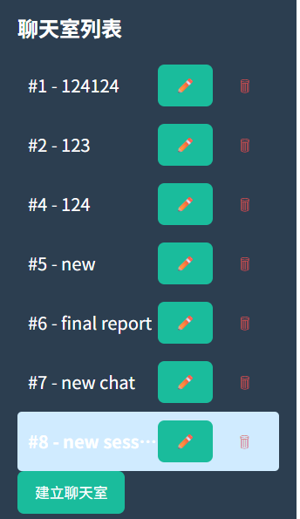
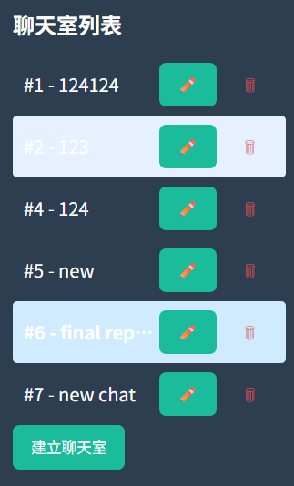
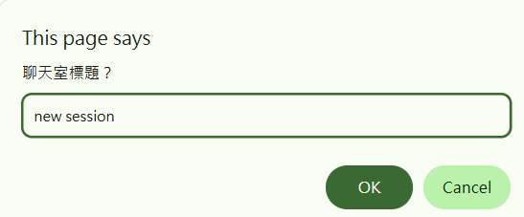
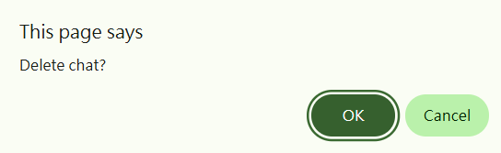

Create session
Delete session

Slide 5
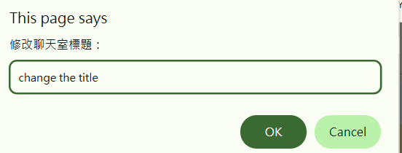


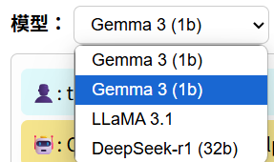
Change the title of session
Change the model of Chatbot

Slide 6
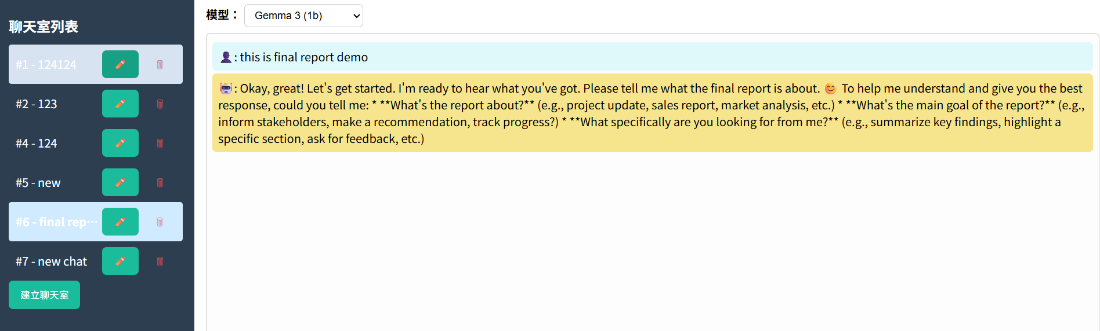
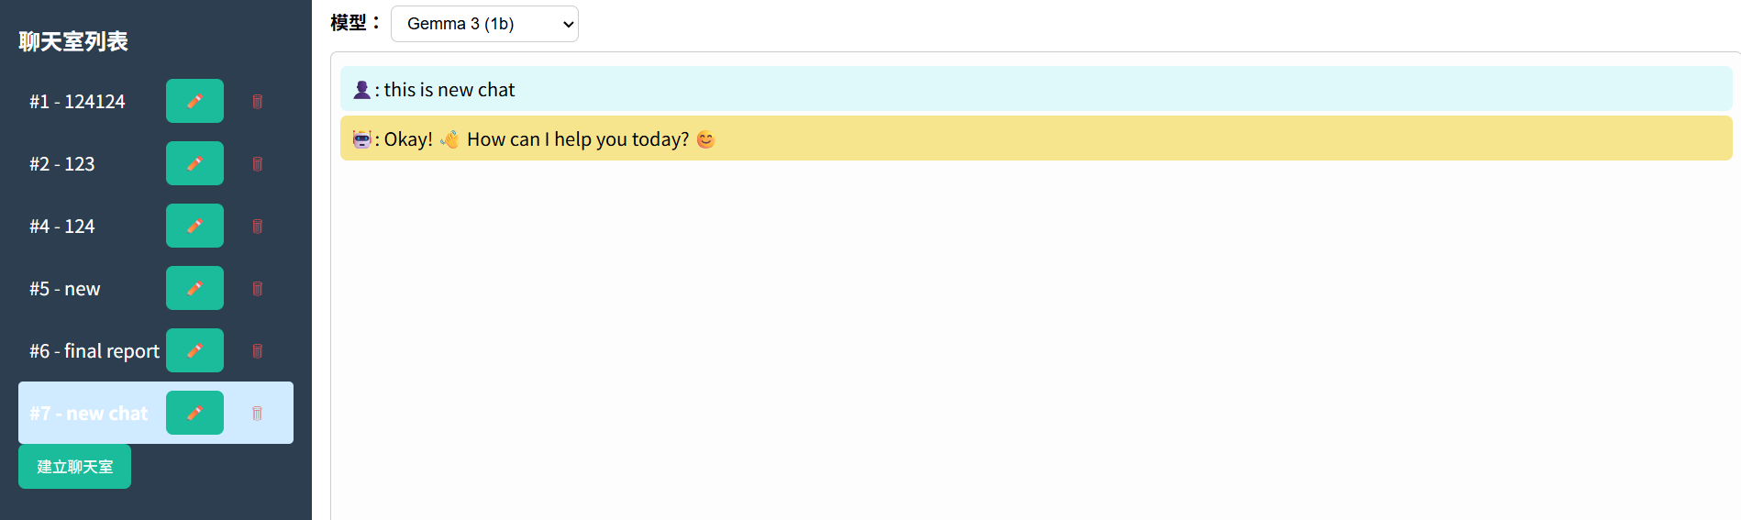
Switch between different session

Slide 7
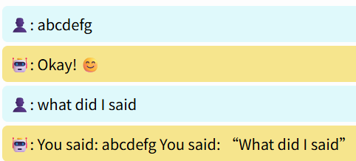
Make the conversation be stateful

Slide 8
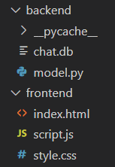
Architecture
Frontend:
HTML
CSS
Javascript
Backend:
python
Ollama
FastAPI
SQLite

Slide 9
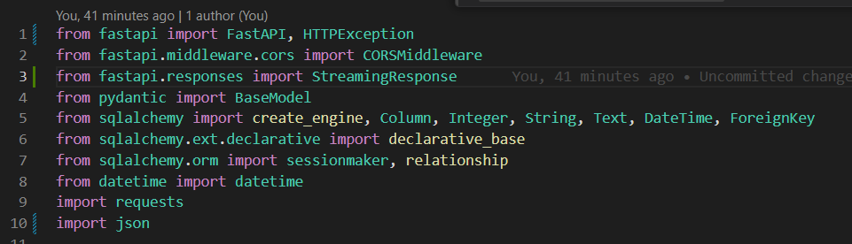
Implementation
packages

Slide 10
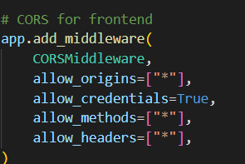
Implementation: CORS setting
When a frontend app (e.g., http://localhost:3000) tries to fetch data from a backend server (e.g., http://127.0.0.1:8000), the browser treats it as a cross-origin request. If the backend doesn't explicitly allow it, the browser will block the request for security reasons.
Allow_origins: Allows requests from any origin (domain, port, protocol).
Allow_credentials: allows the browser to send cookies, authorization headers, or TLS client certificates along with requests to your backend.
Allow_methods: Allows all HTTP methods (GET, POST, PUT, DELETE, etc.).
Allow_headers: Allows any custom headers in requests (e.g., Authorization, Content-Type).

Slide 11
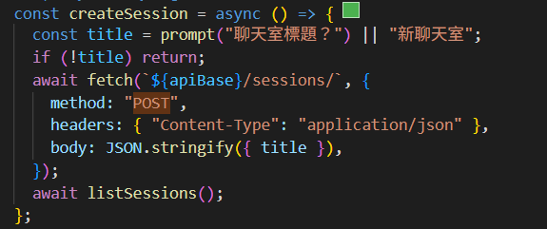
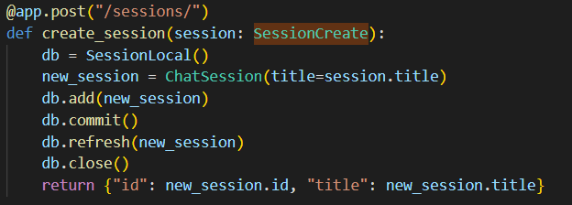
Implementation: Create session (POST)
Frontend
Backend

Slide 12
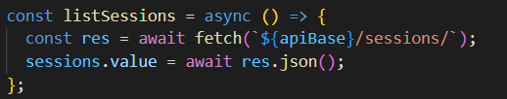
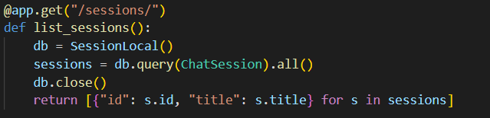
Implementation: List sessions (GET)
Frontend
Backend

Slide 13
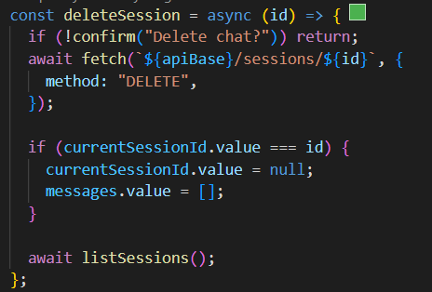
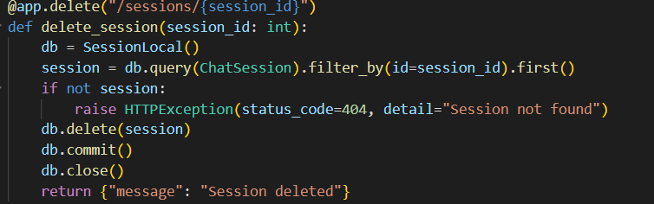
Implementation: delete session (DELETE)
Frontend
Backend

Slide 14
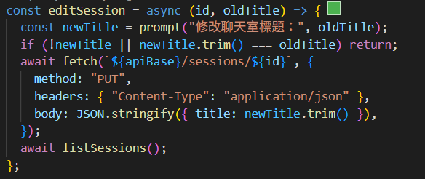
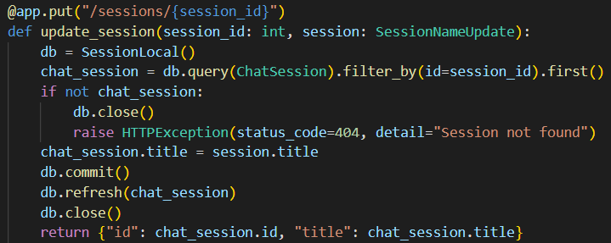
Implementation: edit the title of session(PUT)
Frontend
Backend

Slide 15
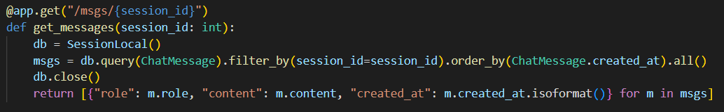
Implementation: (PUT)
Frontend
Backend

Slide 16
Implementation: edit the title of session(PUT)
Frontend
Backend

