Slide 1
Who am I?
My name is Baran BÜYÜK, 38 years old. I’m living in İstanbul. I’m married and have one little princes.
What did I graduate from?
I’m graduate at Gaziantep University
Where do I work?
Introduction
I’m working at Solvia Digital Solutions as Java Unit Manager.
How could you contact me?
Via Linkedin: https://www.linkedin.com/baranbuyuk
Via Gmail : baranbuyuk@gmail.com
Via Mobile Phone: +90 531 336 54 91

Slide 2
First Week
Second Week
Intellij Idea
OOP Concepts with Java
SOLID Principles
Maven Build Tool
Spring IoC, DI
Traditional Spring MVC and Configuration
Spring Bean Lifecycle
Spring Boot and Configuration
Third Week
Fourth Week
Restful Approcahs
Restful HTTP Methods
Spring Restful Services
Relation Database Management Systems ( PostgreSQL & H2DB)
Spring Data Architecture
Spring Data JPA Repositories
Hibernate ( JPA Implementation )
Transactions and Transaction Management
Contents
Fifth Week
Sixth -Seventh Week
Exception Handling via Spring
Spring Security & Json Web Token ( JWT )
Spring Boot Test ( Unit and Integration )
Docker (Basic)
Jenkins
Graduation Project ( Interactive Coding )

Slide 3
Setting up Intellij Idea
If you have already Intellij Idea Editor, you can jump theese steps.
I’m using Mack Book Pro, for that reason, all these steps which are below prepared for Mac OS.
I’m not going to mention about how can you download Java ( JDK ) and set up it. This session not about it. If you don’t have JDK and don’t you know set up,
please google it ☺
Download
Go to https://www.jetbrains.com/idea/download and download it.
Please go to the folder where downladed and in order to install application please click the installation package. The installer will open after that please just click
next buttons. We don’t need to install any extra extension. The default extensions enouhg to us.
First Week
Intellij Idea
We’re going to talk about the features of intellij idea editor in the class.
Topics
Welcome Screen
Plugins / Extensions
Project Section in the editor
Structure Section in the editor
Preferences Screen
Database and Maven Section
Debug Mode
Find / Find and Replace Tool
Short-Cuts

Slide 4
What is OOP? ( Object Oritend Programming )
Object Oriented Programming is programming paradigm based on the concept of “objects, which can contain data and code; data in the form of fields (often known as
attiribute or properties) and code, in the form produces (often known as methods).”
A feature of objects is that an object's own procedures can access and often modify the data fields of itself (objects have a notion of this or self).
In OOP, computer programs are designed by making them out of objects that interact with one another.
OOP languages are diverse, but the most popular ones are class-based, meaning that objects are instances of classes, which also determine their types.
Many of the most widely used programming languages (such as C++, Java, Python, etc.) are multi-paradigm and they support object-oriented programming to a greater or lesser degree, typically in combination with imperative, procedural programming.
Significant object-oriented languages include: Java, C++, C#, Python, R, PHP, Visual Basic.NET, JavaScript, Ruby, Perl, SIMSCRIPT, Object Pascal, Objective C, Dart, Swift, Scala, Kotlin, Common Lisp, MATLAB, and Smalltalk.
First Week
OOP
What is the structure of object-oriented programming?
The structure, or building blocks, of object-oriented programming include following:
Classes are user-defined data types act as the blueprint for individual objects, attributes and methods.
Objects are instance of a class created with specifically defined data. Objects can correspond to real-world objects or an abstract entity. When class is defined initially, the description is the only object that is defined.
Methods are functions that are defined inside a class that describe the behaviors of an object. Each method contained in class definition starts with a reference to an instance object. Additionally, the subroutines contained in an object are called instance methods. Programmers use methods for reusability or keeping functionality encapsulated inside one onject at time.
Attributes are defined in class template are represent at the state of an object. Objects will have data stored in the attributes field. Class attributes belong the class itself.

Slide 5
What are the main principles of OOP?
Object-oriented programming is based on the following principles:
Encapsulation - This principle states that all important information is contained inside an object and only select information is exposed. The implementation and state of each object are privately held inside a defined class. Other objects do not have access to this class or the authority to make changes. They are only able to call a list of public functions or methods. This characteristic of data hiding provides greater program security and avoids unintended data corruption
Abstraction - Objects only reveal internal mechanisms that are relevant for the use of other objects, hiding any unnecessary implementation code. The derived class can have its functionality extended. This concept can help developers more easily make additional changes or additions over time.
Inheritance - Classes can reuse code from other classes. Relationships and subclasses between objects can be assigned, enabling developers to reuse common logic while still maintaining a unique hierarchy. This property of OOP forces a more thorough data analysis, reduces development time and ensures a higher level of accuracy.
Polymorphism - Objects are designed to share behaviors and they can take on more than one form. The program will determine which meaning or usage is necessary for each execution of that object from a parent class, reducing the need to duplicate code. A child class is then created, which extends the functionality of the parent class. Polymorphism allows different types of objects to pass through the same interface.
First Week
OOP
What are the benefits of OOP?
Modularity - Encapsulation enables objects to be self-contained, making troubleshooting and collaborative development easier.
Reusability. Code can be reused through inheritance, meaning a team does not have to write the same code multiple times.
Productivity. Programmers can construct new programs quicker through the use of multiple libraries and reusable code.
Easily upgradable and scalable. Programmers can implement system functionalities independently.
Interface descriptions. Descriptions of external systems are simple, due to message passing techniques that are used for objects communication.
Security. Using encapsulation and abstraction, complex code is hidden, software maintenance is easier and internet protocols are protected.
Flexibility. Polymorphism enables a single function to adapt to the class it is placed in. Different objects can also pass through the same interface.
Let’s look at the good examples for OOP principles.

Slide 6
What is SOLID Principles?
What does the SOLID principles actually mean? Well, it’s just an acronym of the five principles listed as below.
S – Single Responsibility Principle
O – Open / Closed Principle
L – Liskov’s Substitution Principle
I – Interface Segregation Principle
D – Dependency Inversion Principle
Let’s try to understand what all these principles means, one by one with examples.
Single Responsibility Principle
First Week
SOLID Principles
The name itself suggest that the “class should be having one and only one responsibility”. What does it mean? Well, let’s take the class A which does the following operations.
Open a database connection
Fetch data from database
Write the data in an external file
The issue with this class is that it handles lot of operations. Suppose any of the following change happens in future.
New database
Adopt ORM to manage queries on database
Change in the output structure
So, in all the cases the above class would be changed. Which might affect the implementation of the other two operations as well. So ideally according to SRP there should be three classes each having the single responsibility.
Let’s look at the good example in code.

Slide 7
Open / Closed Principle
This principle suggests that “classes should be open for extension but closed for modification”.
What is means is that if the class A is written by the developer AA, and if the developer BB wants some modification on that then developer BB should be easily do that by extending class A, but not by modifying class A.
Let’s look at the good example in code.
Liskov’s Subsitition Principle
First Week
SOLID Principles
This principle suggests that “parent classes should be easily substituted with their child classes without blowing up the application”. Let’s take following example to understand this.
The overridden method shouldn’t remain empty
The overridden method shouldn’t throw an error
Base class or interface behavior should not go for modification (rework) as because of derived class behaviors.
Let’s look at the good example in code.

Slide 8
Interface Segregation Principle
This principle suggests that “many client specific interfaces are better than one general interface”.
This is the first principle which is applied on interface, all the above three principles applies on classes. Let’s take following example to understand this principle.
Let’s look at the good example in code.
Dependency Inversion Principle
First Week
SOLID Principles
This principle suggest that “classes should depend on abstraction but not on concretion”.
What does it mean that we should be having object of interface which helps us to communicate with the concrete classes. What do we gain from this is, we hide the actual implementation of class A from the class B. So, if class A changes the class B doesn’t need to care or know about the changes.
Let’s look at the good example in code.

Slide 9
Singleton Design Pattern
Singleton pattern is one of the simplest design patterns in Java. This type of design pattern comes under creational pattern as this pattern provides one of the best ways to create an object.
This pattern involves a single class which is responsible to create an object while making sure that only single object gets created. This class provides a way to access its only object which can be accessed directly without need to instantiate the object of the class.
There are 3 ways to create Singleton design pattern in the Java.
Lazy initialization, non-thread-safe - This is the classical version, but it's not thread-safe. If more than one thread attempts to access instance at the same time, more than one instance may be created
Non-lazy initialization, thread-safe - This is the simplest thread-safe version, but it does not support lazy initialization.
Lazy initialization, thread-safe - This version supports both properties but has performance problems. Once a thread uses a singleton instance, the others have to wait because of the lock.
Design Pattern of the Week
Singleton
Let’s look how can we create Singleton Design Patterns
There is an issue at all examples, what is that? I’m gonna buy a ice-cream with chocolate to who will able to find the solution ☺

Slide 10
What is Spring Framework?
The Spring Framework is an open-source Java application framework originally developed based on the principles of dependency injection (DI) and inversion of control (IoC).
The Spring Framework has grown over years from just being an Inversion of control container, and currently includes several modules that provide range of services like Aspect-oriented programming, Data access, Transaction management, Model–view–controller, Authentication and authorization, Messaging, and Testing. You can have a look at all of these Spring projects @ spring.io/projects. The core module is the Spring Framework and most other modules are dependent on this module.
Spring provides autowiring capabilities through which you can simply specify the interface type and Spring can find an actual type at runtime, provided there are no conflicts.
Spring has become a popular alternative to the Enterprise JavaBean (EJB) model.
Second Week
Spring Framework
The Spring Framework Container
A container creates and manages your components, and even provides some services to components managed in its environment, such as transaction management, persistence and security etc.
Examples of containers from Java EE are Servlet container (or web container) that manages Servlets, JSPs, Filters etc. and EJB container that manages EJB components like session beans, message driven beans and entity beans.
Spring framework is a also container, as application components can be created and managed, and can be wired together. The spring framework even provides middleware services such as transaction management, dependency injection, persistence, aspect-oriented programming and security.
Spring framework is considered a lightweight container compared to EJBs, as it manages the components and provides services without requiring application code to depend on its own API, and also doesn’t need to be deployed into a full-featured application server, as in the case of EJBs.

Slide 11
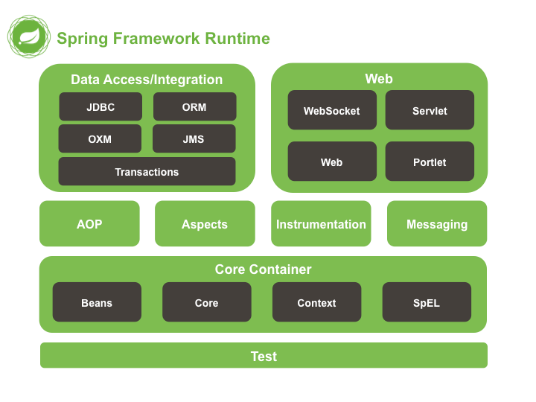
Various Spring modules can be grouped together into the following categories.
Spring Core modules – IoC Container, Events, Resources, i18n, Validation, Data Binding, Type Conversion, SpEL, AOP.
Spring Test modules – Mock Objects, TestContext Framework, Spring MVC Test, WebTestClient.
Data Access Modules – Transactions, DAO Support, JDBC, O/R Mapping, XML Marshalling.
Web Servlet modules – Spring MVC, WebSocket, SockJS, STOMP Messaging.
Reactive Web modules – Spring WebFlux, WebClient, WebSocket.
Integration modules – Remoting, JMS, JCA, JMX, Email, Tasks, Scheduling, Caching.
Second Week
Spring Framework

Slide 12
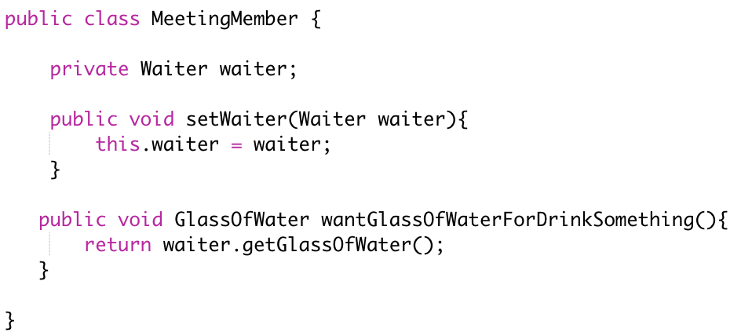
What is IoC (Inversion of Control)
There are differences between IoC and DI. IoC is a paradigm, DI is implementation of IoC by Spring Framework. Let’s take an example to understand what is IoC.
Let's say that we make some meeting in some hotel. Many people, many jugs of water, many plastic cups. When somebody wants to drink, he/she fills a cup, drink, and throw the cup on the floor. After an hour or something, we have a floor covered with plastic cups and water.
Let's invert the control now.
The same meeting in the same place, but instead of plastic cups we have a waiter with one glass cup (Singleton) and she/he all of the time offers to guests drinking.
When somebody wants to drink, she gets it from the waiter, drink, and return it back to the waiter. Leaving aside the question of the hygienic, the last form of drinking process control is much more effective and economic. And this is exactly what the Spring (another IoC container, for example: Guice) does.
Instead of let to application create what it need using new keyword (taking plastic cup), Spring IoC container all of time offer to application the same instance (singleton) of needed object(glass of water).
Think about yourself as an organizer of such meeting. You need the way to message to hotel administration that meeting members will need a glass of water but not a piece of cake.
Second Week
Spring IoC
Let’s write a better example of IoC.

Slide 13
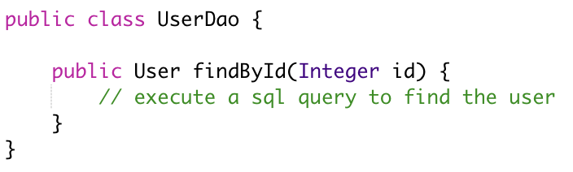
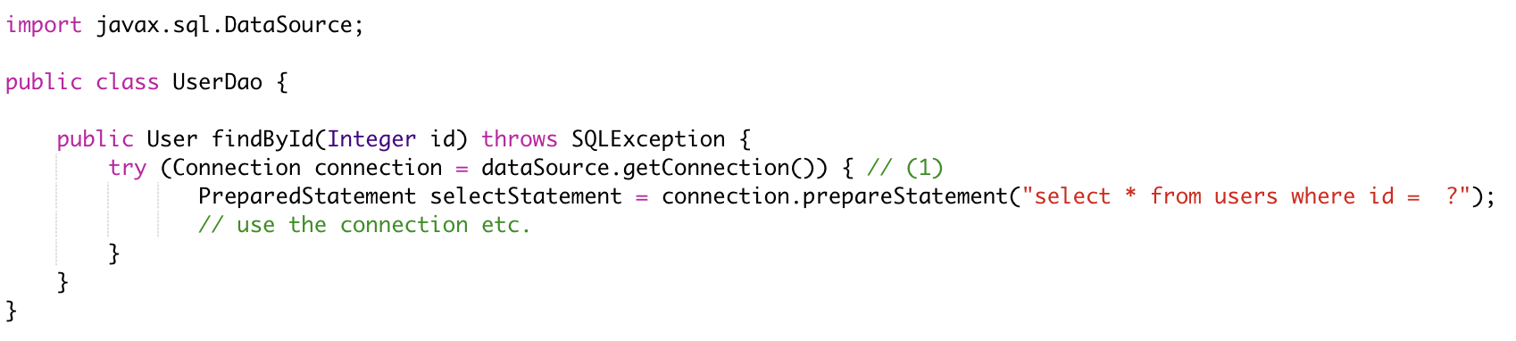
What is IoC (Inversion of Control)
Imagine you are writing a Java class that lets you access a users table in your database. You would call these classes DAOs (data access object) or Repositories. So, you are going to write a User DAO class.
Your User DAO has only one method which lets you find users in your database table by their respective IDs. To execute the appropriate SQL query, your User DAO needs a database connection. And in the Java world, you (usually) get that database connection from another class, called a Data Source. So, your code now would look something like this ;
Second Week
Spring IoC
1 - The question is now where does your User Dao get its Data Source dependency from? The DAO obviously depends on a valid Data Source to fire those SQL queries.

Slide 14
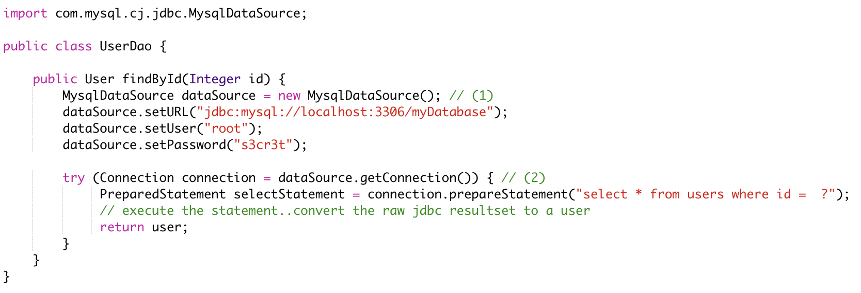
How to insantiate dependencies with new() keyword
The naive approach would be to simply create a new Data Source through a constructor, every time you need one. So, to connect to a MySQL database your User DAO could look like this
Second Week
Spring IoC
We want to connect to a MySQL database; hence we are using a MysqlDataSource and hardcoding URL/Username/Password here for easier reading.
We use our newly created Data Source for the query.

Slide 15
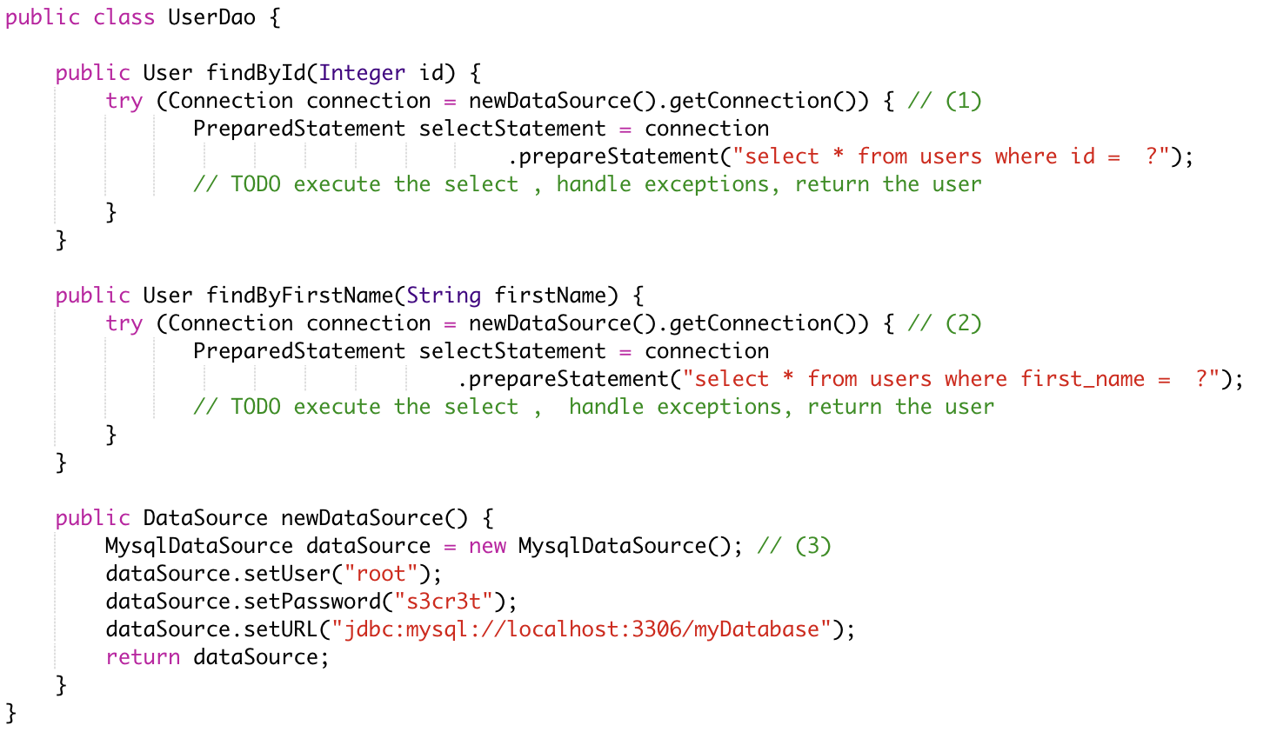
This works, but let’s see what happens when we extend our User Dao class with another method, findByFirstName.
Unfortunately, that method also needs a Data Source to work with. We can add that new method to our Use rDAO and apply some refactorings, by introducing a newDataSource method.
findById has been rewritten to use the new newDataSource() method.
findByFirstName has been added and also uses the new newDataSource() method.
This is our newly extracted method, able to create new DataSources.
This approach works, but has two drawbacks
What happens if we want to create a new ProductDAO class, which also executes SQL statements? Your ProductDAO would then also have a DataSource dependency, which now is only available in your UserDAO class. You would then have another similar method or extract a helper class that contains your DataSource.
We are creating a completely new DataSource for every single SQL query. Consider that a DataSource opens up a real, socket connection from your Java program to your database. This takes time and is rather expensive. It would be much nicer if we opened just one DataSource and re-used it, instead of opening and closing tons of them. One way of doing this could be by saving the DataSource in a private field in our UserDao, so it can be reused between methods - but that does not help with the duplication between multiple DAOs.
Second Week
Spring IoC

Slide 16
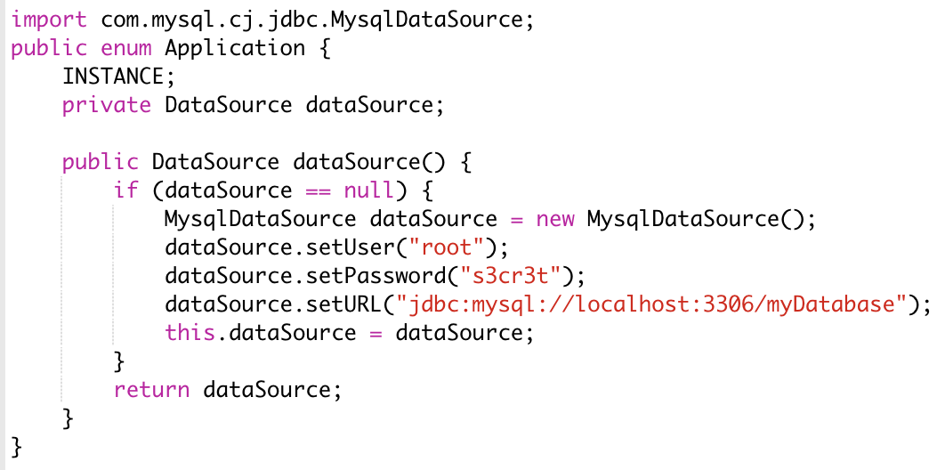
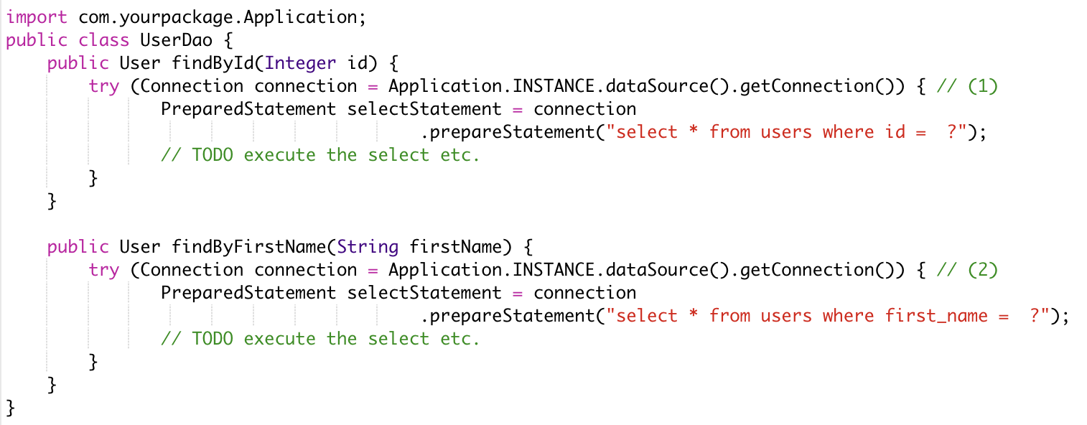
How to 'manage' dependencies in a global Application class
To accommodate these issues, you could think about writing a global Application class, that looks something like this
It is an improvement in two ways
Your UserDAO does not have to construct its own DataSource dependency anymore, instead it can ask the Application class to give it a fully-functioning one. Same for all your other DAOs.
Your application class is a singleton (meaning there will only be one INSTANCE created), and that application singleton holds a reference to a DataSource singleton.
Second Week
Spring IoC
There are however still several drawbacks to this solution
The UserDAO actively has to know where to get its dependencies from, it has to call the application class → Application.INSTANCE.dataSource().
If your program gets bigger, and you get more and more dependencies, you will have one monster Application.java class, which handles all your dependencies. At which point you’ll want to try and split things up into more classes/factories etc.
Your UserDAO could now look like this

Slide 17
What Are RESTful Web Services?
RESTful web services are built to work best on the Web. Representational State Transfer (REST) is an architectural style that specifies constraints, such as the uniform interface, that if applied to a web service induce desirable properties, such as performance, scalability, and modifiability, that enable services to work best on the Web. In the REST architectural style, data and functionality are considered resources and are accessed using Uniform Resource Identifiers (URIs), typically links on the Web. The resources are acted upon by using a set of simple, well-defined operations. The REST architectural style constrains an architecture to a client/server architecture and is designed to use a stateless communication protocol, typically HTTP. In the REST architecture style, clients and servers exchange representations of resources by using a standardized interface and protocol.
The following principles encourage RESTful applications to be simple, lightweight, and fast:
Third Week
Restful Approach
Resource identification through URI: A RESTful web service exposes a set of resources that identify the targets of the interaction with its clients. Resources are identified by URIs, which provide a global addressing space for resource and service discovery.
Uniform interface: Resources are manipulated using a fixed set of four create, read, update, delete operations: PUT, GET, POST, and DELETE. PUT creates a new resource, which can be then deleted by using DELETE. GET retrieves the current state of a resource in some representation. POST transfers a new state onto a resource.
Self-descriptive messages: Resources are decoupled from their representation so that their content can be accessed in a variety of formats, such as HTML, XML, plain text, PDF, JPEG, JSON, and others. Metadata about the resource is available and used, for example, to control caching, detect transmission errors, negotiate the appropriate representation format, and perform authentication or access control.
Stateful interactions through hyperlinks: Every interaction with a resource is stateless; that is, request messages are self-contained. Stateful interactions are based on the concept of explicit state transfer. Several techniques exist to exchange state, such as URI rewriting, cookies, and hidden form fields. State can be embedded in response messages to point to valid future states of the interaction.

Slide 18
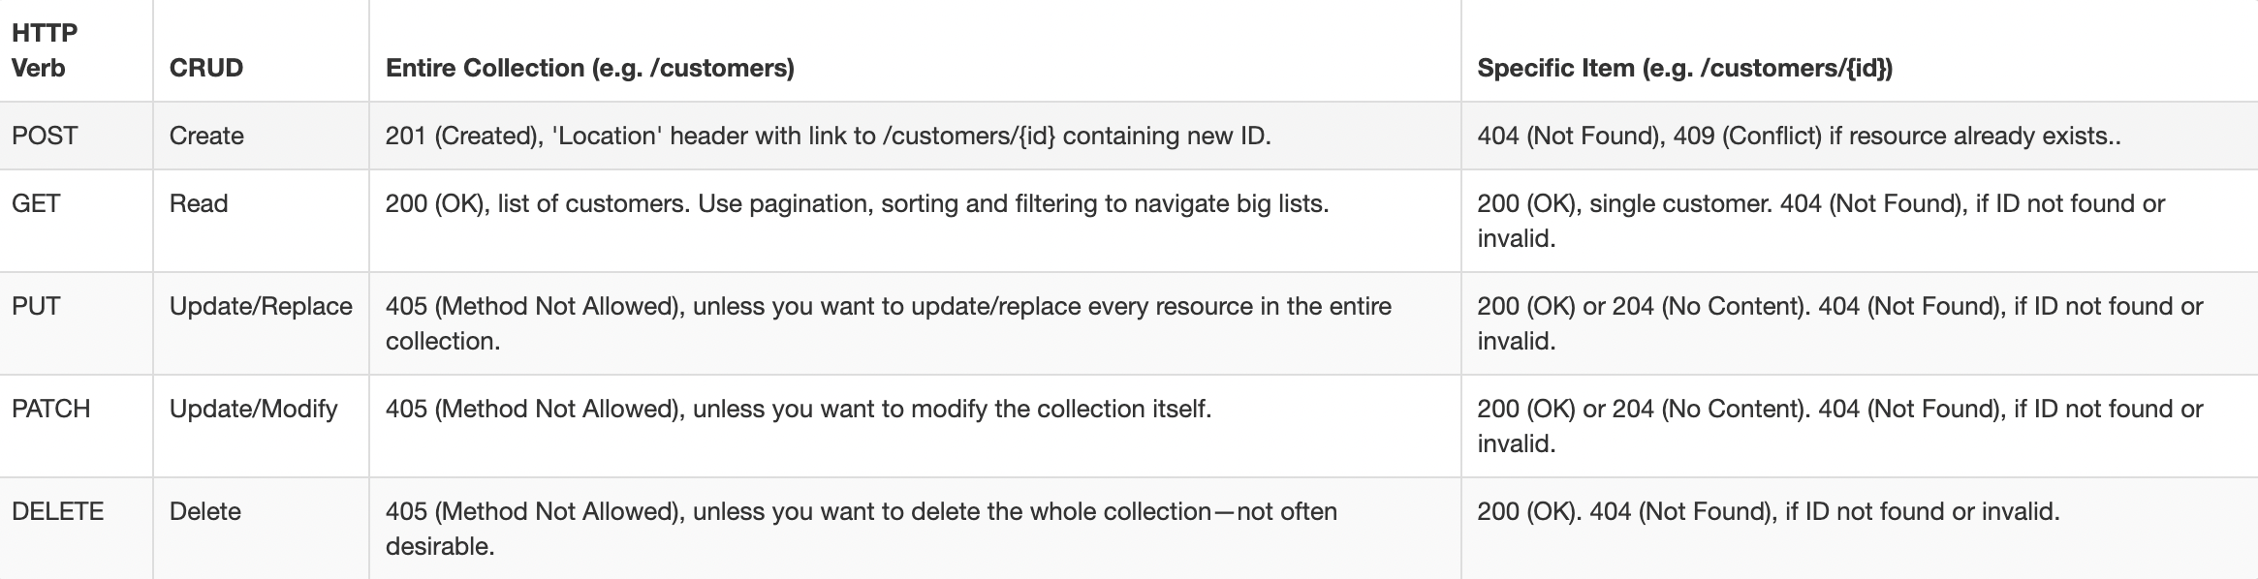
Using HTTP Methods for RESTful Services
The HTTP verbs comprise a major portion of our “uniform interface” constraint and provide us the action counterpart to the noun-based resource. The primary or most-commonly-used HTTP verbs (or methods, as they are properly called) are POST, GET, PUT, PATCH, and DELETE. These correspond to create, read, update, and delete (or CRUD) operations, respectively. There are a number of other verbs, too, but are utilized less frequently. Of those less-frequent methods, OPTIONS and HEAD are used more often than others.
Below is a table summarizing recommended return values of the primary HTTP methods in combination with the resource URIs:
Third Week
Restful HTTP Methods

Slide 19
HTTP Methods
POST
The POST verb is most-often utilized to **create** new resources. In particular, it's used to create subordinate resources. That is, subordinate to some other (e.g. parent) resource. In other words, when creating a new resource, POST to the parent and the service takes care of associating the new resource with the parent, assigning an ID (new resource URI), etc.
On successful creation, return HTTP status 201, returning a Location header with a link to the newly-created resource with the 201 HTTP status.
POST is neither safe nor idempotent. It is therefore recommended for non-idempotent resource requests. Making two identical POST requests will most-likely result in two resources containing the same information.
Examples:
POST http://www.example.com/customers
POST http://www.example.com/customers/12345/orders
Third Week
Restful HTTP Methods
GET
The HTTP GET method is used to **read** (or retrieve) a representation of a resource. In the “happy” (or non-error) path, GET returns a representation in XML or JSON and an HTTP response code of 200 (OK). In an error case, it most often returns a 404 (NOT FOUND) or 400 (BAD REQUEST).
According to the design of the HTTP specification, GET (along with HEAD) requests are used only to read data and not change it. Therefore, when used this way, they are considered safe. That is, they can be called without risk of data modification or corruption—calling it once has the same effect as calling it 10 times, or none at all. Additionally, GET (and HEAD) is idempotent, which means that making multiple identical requests ends up having the same result as a single request.
Do not expose unsafe operations via GET—it should never modify any resources on the server.
Examples:
GET http://www.example.com/customers/12345
GET http://www.example.com/customers/12345/orders
GET http://www.example.com/buckets/sample

Slide 20
PUT
PUT is most-often utilized for **update** capabilities, PUT-ing to a known resource URI with the request body containing the newly-updated representation of the original resource.
However, PUT can also be used to create a resource in the case where the resource ID is chosen by the client instead of by the server. In other words, if the PUT is to a URI that contains the value of a non-existent resource ID. Again, the request body contains a resource representation. Many feel this is convoluted and confusing. Consequently, this method of creation should be used sparingly, if at all.
Alternatively, use POST to create new resources and provide the client-defined ID in the body representation—presumably to a URI that doesn't include the ID of the resource (see POST below).
On successful update, return 200 (or 204 if not returning any content in the body) from a PUT. If using PUT for create, return HTTP status 201 on successful creation. A body in the response is optional—providing one consumes more bandwidth. It is not necessary to return a link via a Location header in the creation case since the client already set the resource ID.
PUT is not a safe operation, in that it modifies (or creates) state on the server, but it is idempotent. In other words, if you create or update a resource using PUT and then make that same call again, the resource is still there and still has the same state as it did with the first call.
If, for instance, calling PUT on a resource increments a counter within the resource, the call is no longer idempotent. Sometimes that happens and it may be enough to document that the call is not idempotent. However, it's recommended to keep PUT requests idempotent. It is strongly recommended to use POST for non-idempotent requests.
Examples:
PUT http://www.example.com/customers/12345
PUT http://www.example.com/customers/12345/orders/98765
PUT http://www.example.com/buckets/secret_stuff
Third Week
Restful HTTP Methods

Slide 21
PATCH
PATCH is used for **modify** capabilities. The PATCH request only needs to contain the changes to the resource, not the complete resource.
This resembles PUT, but the body contains a set of instructions describing how a resource currently residing on the server should be modified to produce a new version. This means that the PATCH body should not just be a modified part of the resource, but in some kind of patch language like JSON Patch or XML Patch.
PATCH is neither safe nor idempotent. However, a PATCH request can be issued in such a way as to be idempotent, which also helps prevent bad outcomes from collisions between two PATCH requests on the same resource in a similar time frame. Collisions from multiple PATCH requests may be more dangerous than PUT collisions because some patch formats need to operate from a known base-point or else they will corrupt the resource. Clients using this kind of patch application should use a conditional request such that the request will fail if the resource has been updated since the client last accessed the resource. For example, the client can use a strong ETag in an If-Match header on the PATCH request.
Examples:
PATCH http://www.example.com/customers/12345
PATCH http://www.example.com/customers/12345/orders/98765
PATCH http://www.example.com/buckets/secret_stuff
Third Week
Restful HTTP Methods
DELETE
DELETE is pretty easy to understand. It is used to **delete** a resource identified by a URI.
On successful deletion, return HTTP status 200 (OK) along with a response body, perhaps the representation of the deleted item (often demands too much bandwidth), or a wrapped response (see Return Values below). Either that or return HTTP status 204 (NO CONTENT) with no response body. In other words, a 204 status with no body, or the JSEND-style response and HTTP status 200 are the recommended responses.
HTTP-spec-wise, DELETE operations are idempotent. If you DELETE a resource, it's removed. Repeatedly calling DELETE on that resource ends up the same: the resource is gone. If calling DELETE say, decrements a counter (within the resource), the DELETE call is no longer idempotent. As mentioned previously, usage statistics and measurements may be updated while still considering the service idempotent as long as no resource data is changed. Using POST for non-idempotent resource requests is recommended.
There is a caveat about DELETE idempotence, however. Calling DELETE on a resource a second time will often return a 404 (NOT FOUND) since it was already removed and therefore is no longer findable. This, by some opinions, makes DELETE operations no longer idempotent, however, the end-state of the resource is the same. Returning a 404 is acceptable and communicates accurately the status of the call.
Examples:
DELETE http://www.example.com/customers/12345
DELETE http://www.example.com/customers/12345/orders
DELETE http://www.example.com/bucket/sample

Slide 22
REST with Spring Boot
@RequestMapping
In Spring MVC applications, the RequestDispatcher (Front Controller Below) servlet is responsible for routing incoming HTTP requests to handler methods of controllers.
When configuring Spring MVC, you need to specify the mappings between the requests and handler methods.
To configure the mapping of web requests, you use the @RequestMapping annotation.
The @RequestMapping annotation can be applied to class-level and/or method-level in a controller.
The class-level annotation maps a specific request path or pattern onto a controller. You can then apply additional method-level annotations to make mappings more specific to handler methods.
@RequestMapping With Multiple URIs
You can have multiple request mappings for a method. For that add one @RequestMapping annotation with a list of values.
Third Week
RESTful Spring Boot
@RequestMapping With @RequestParam
The @RequestParam annotation is used with @RequestMapping to bind a web request parameter to the parameter of the handler method.
Using @RequestMapping With HTTP Methods
The Spring MVC @RequestMapping annotation is capable of handling HTTP request methods, such as GET, PUT, POST, DELETE, and PATCH. By default, all requests are assumed to be of HTTP GET type.
Using @RequestMapping With Producible and Consumable
The request mapping types can be narrowed down using the produces and consumes elements of the@RequestMapping annotation.
In order to produce the object in the requested media type, you use the produces element of @RequestMapping in combination with the @ResponseBody annotation.
You can also consume the object with the requested media type using the consumes element of@RequestMapping in combination with the @RequestBody annotation.

Slide 23
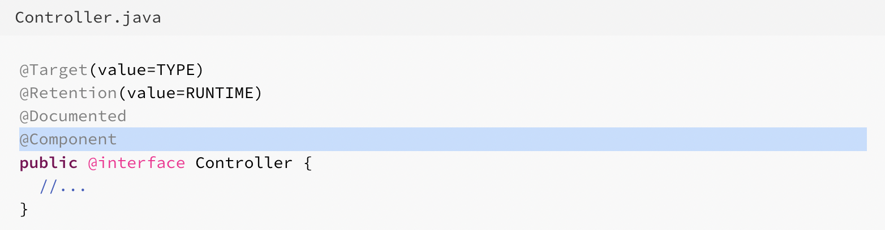
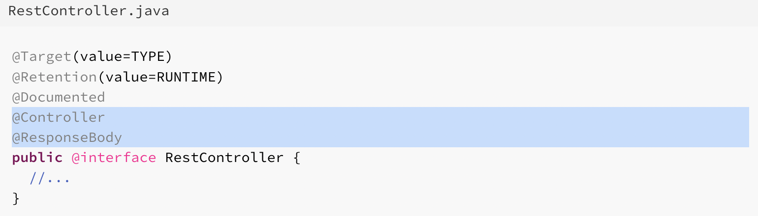
@Controller Annotation
In Spring, incoming requests are always handled by some controller. Usually, dispatcher servlet is responsible for identifying the controller and appropriate request handler method inside controller by URL matching.
In typical spring mvc application, controller is indicated by annotation @Controller. This annotation serves as a specialization of @Component, allowing for implementation classes to be auto-detected through classpath scanning. It is typically used in combination with annotated handler methods based on the @RequestMapping annotation.
@RestController Annotation
As name suggest, it shall be used in case of REST style controllers i.e. handler methods shall return the JSON/XML response directly to client rather using view resolvers. It is a convenience annotation that is itself annotated with @Controller and @ResponseBody.
Third Week
RESTful Spring Boot
Let’s look at the good example in code.

Slide 24
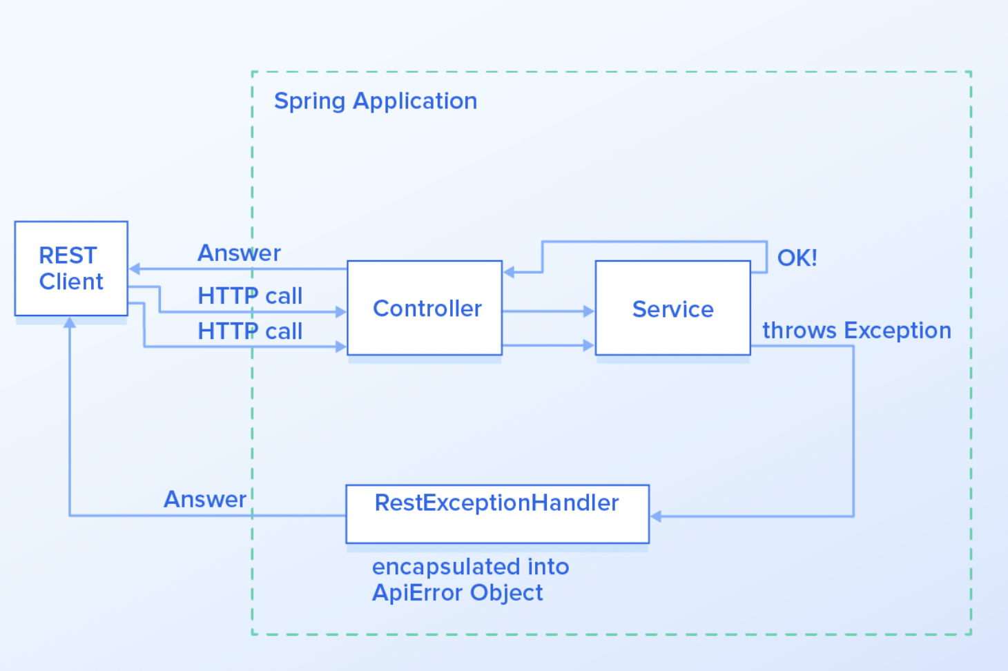
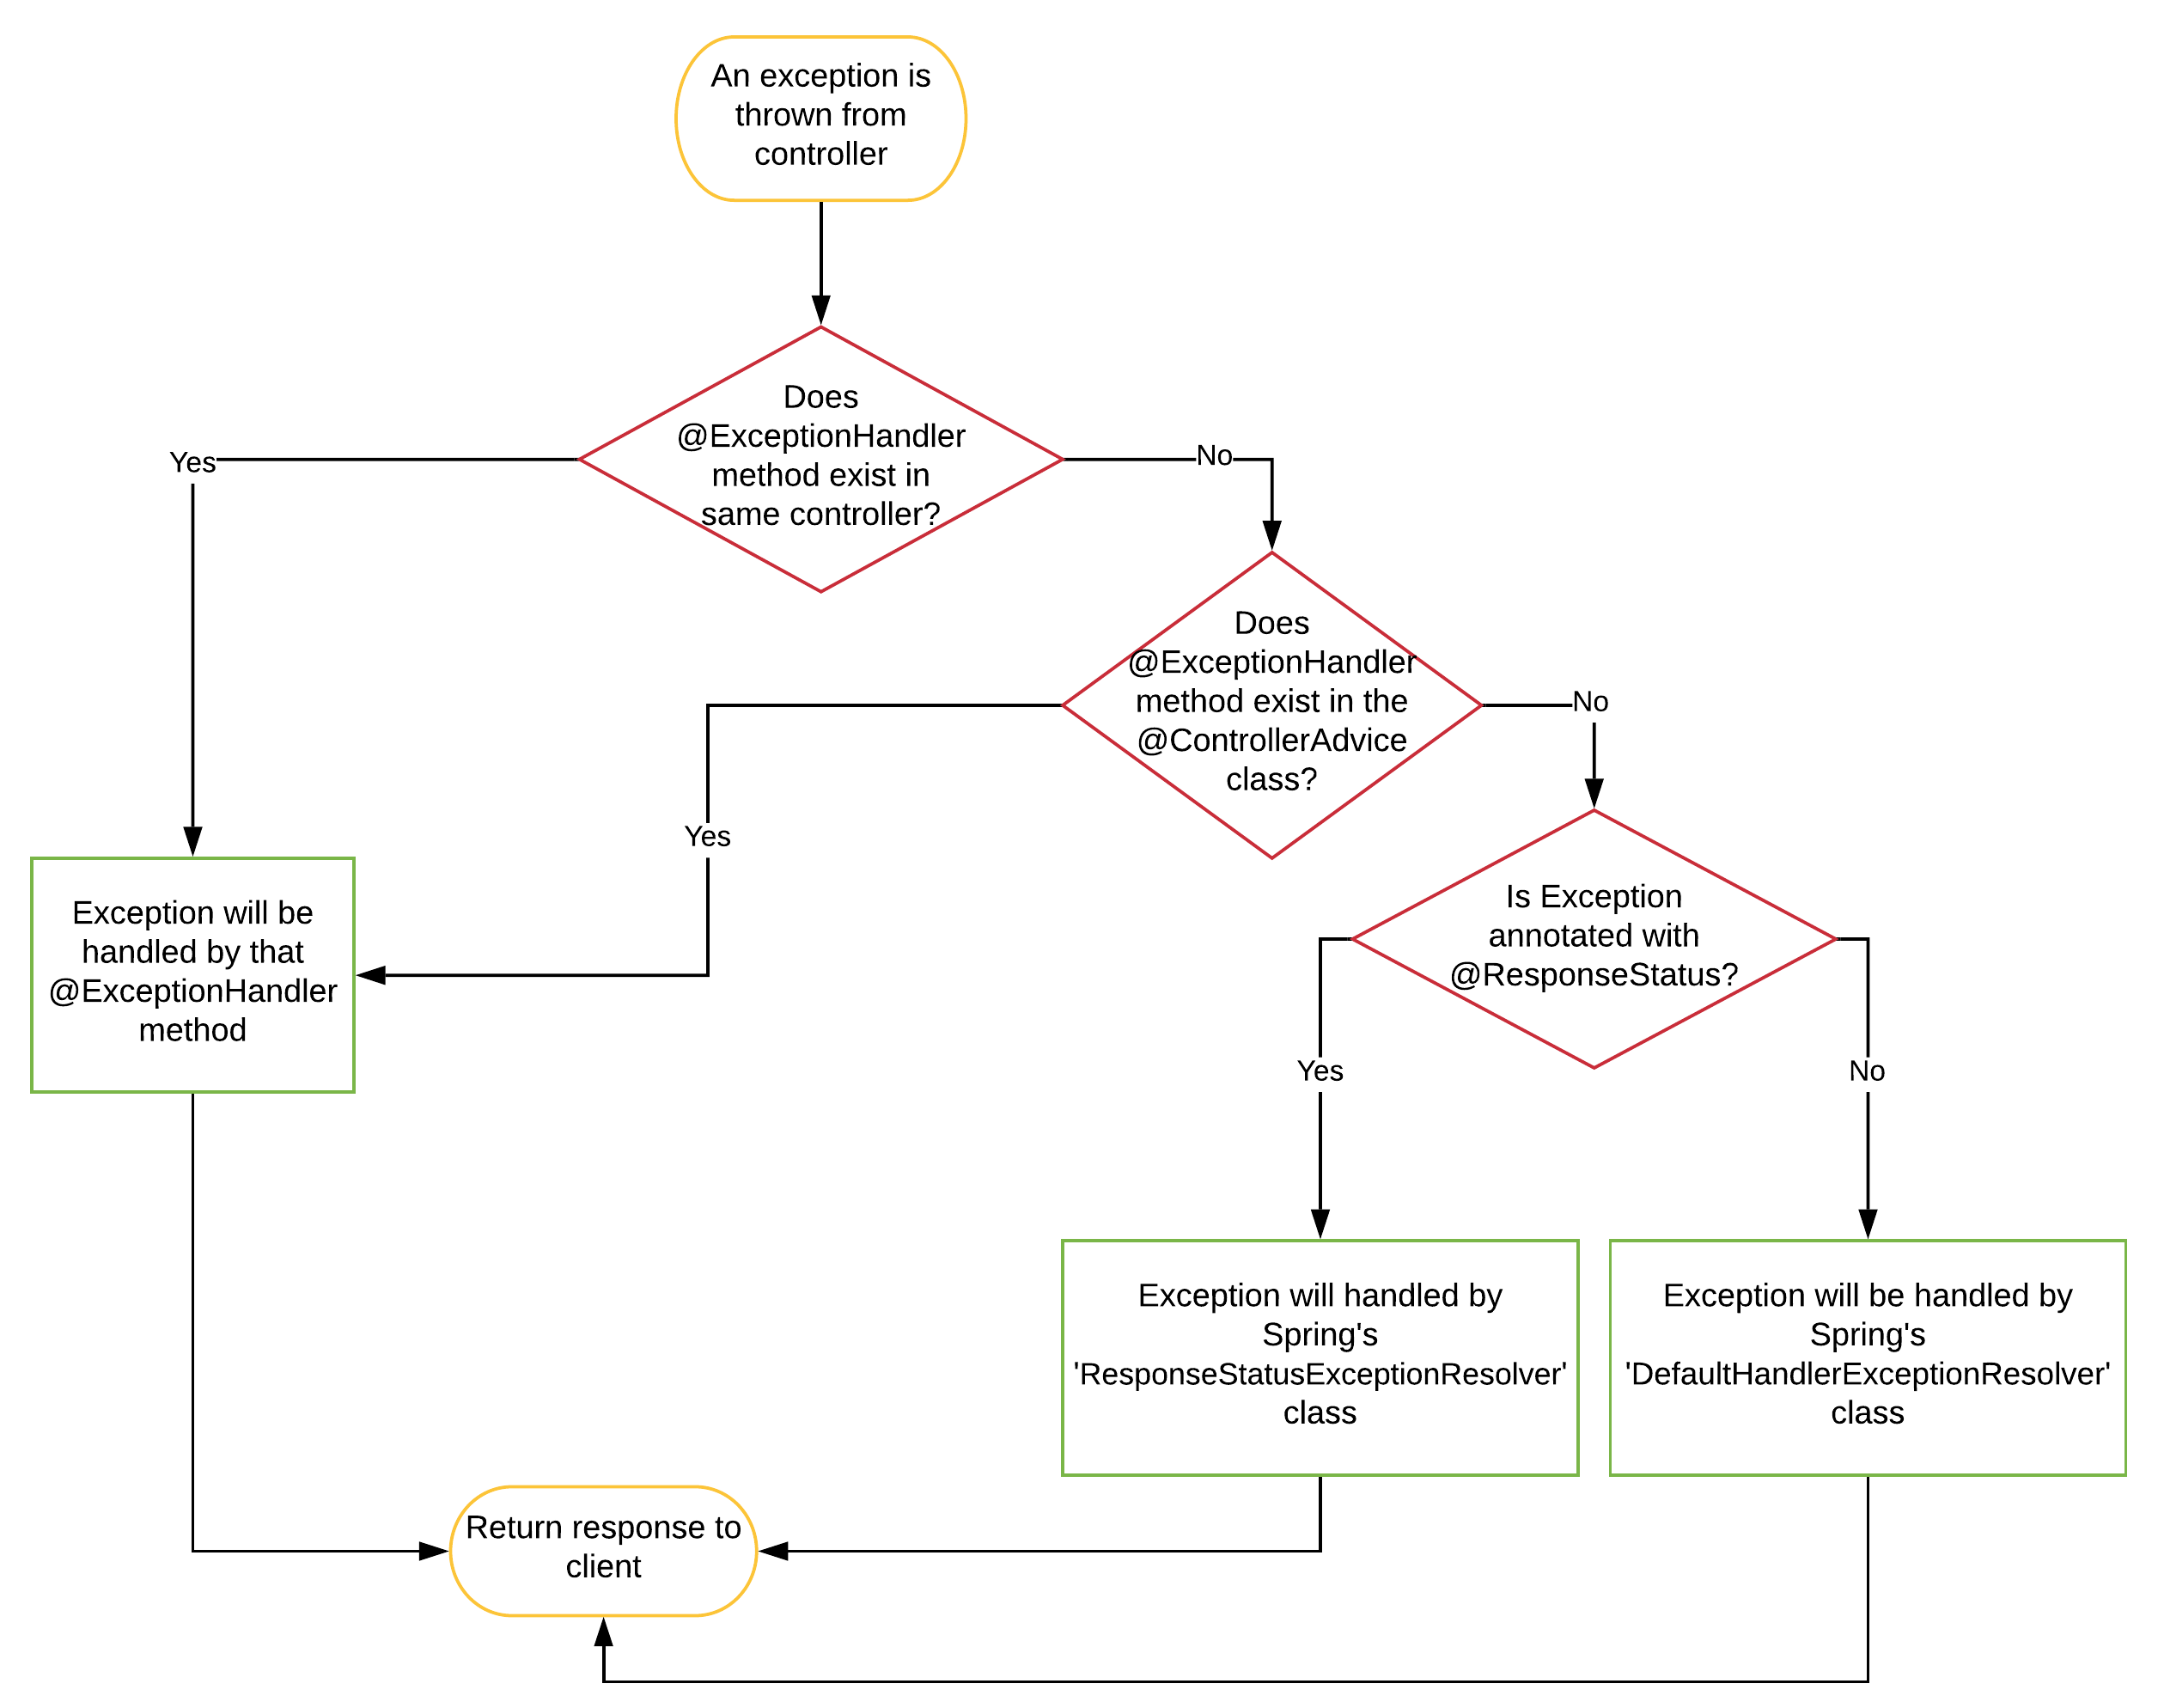
@ControllerAdvice
@ControllerAdvice is a specialization of the @Component annotation which allows to handle exceptions across the whole application in one global handling component. It can be viewed as an interceptor of exceptions thrown by methods annotated with @RequestMapping and similar.
@ExceptionHandler
ExceptionHandler is a Spring annotation that provides a mechanism to treat exceptions that are thrown during execution of handlers (Controller operations). This annotation, if used on methods of controller classes, will serve as the entry point for handling exceptions thrown within this controller only.
Third Week
RESTful Spring Boot

Slide 25
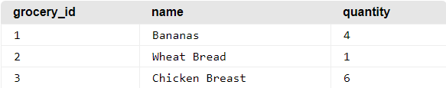

What is RDBMS?
A relational database is defined as a database structured to recognize relations among stored items of information according to Google search. You can represent data of all sorts through a relational database, such as a grocery store’s inventory to a realtor company and their houses. The way a relational database works is by storing information in tables, where each table has its own rows and columns. A row represents a record (or tuple), while a column represents a field (or attribute). I will provide an example of a basic table.
In this example of a grocery list, a row represents a grocery item and how many of each item, while a column represents an attribute of a grocery item in the list. This table is shown by selecting all elements in the table.
Fourth Week
RDBMS
Now, after seeing this example, you might think a database looks like a spreadsheet. However, what makes a database relational is the fact that there are relationships between the tables. This enables a relational database to efficiently store large amounts of data, while retrieving selected data.
What is SQL?
SQL (pronounced either as “sequel” or “ess que el”) stands for Structured Query Language. This language was developed to work with relational databases. There are many popular adaptations of SQL that are specific to certain relational database management systems (RDBMS), such as PostgreSQL, MySQL or mSQL.

Slide 26
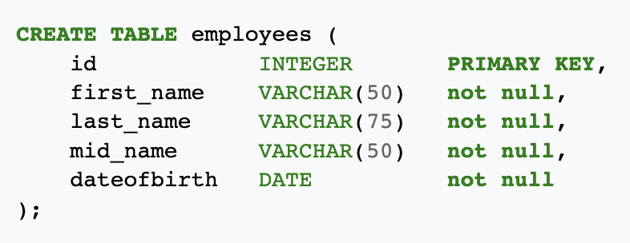

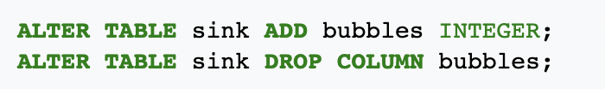

SQL Commands
Data Definition Language (DDL)
This includes CREATE (tables, views, objects, etc.), ALTER and DROP (delete).
Data Manipulation Language (DML)
SELECT, INSERT, UPDATE, DELETE of records within tables.
Data Control Language (DCL)
GRANT and/or REVOKE user privileges, etc.
Fourth Week
RDBMS
Database Indexing
CREATE INDEX and DROP INDEX statements are used to create and delete indexes in tables.
DDL Examples

Slide 27
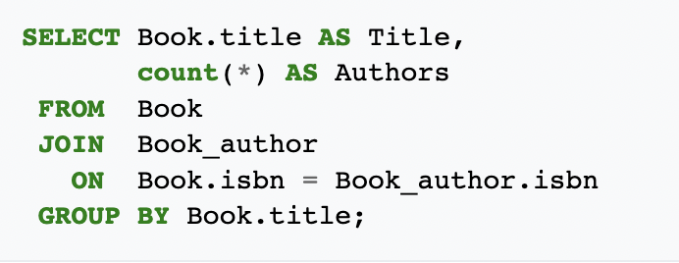
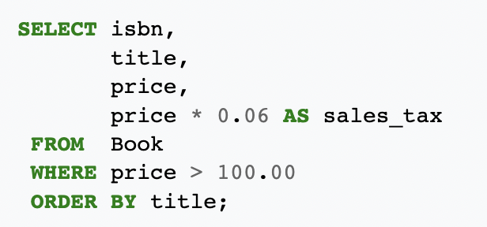
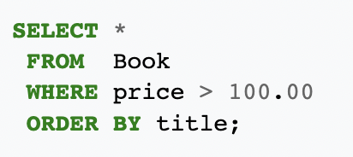
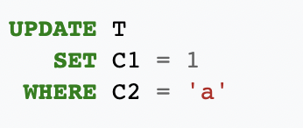
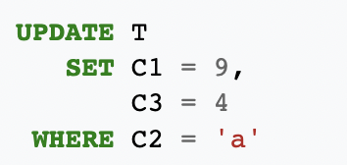
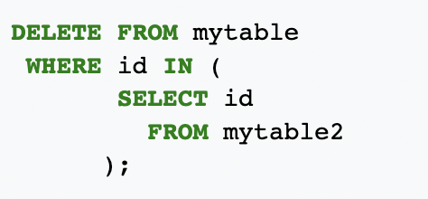
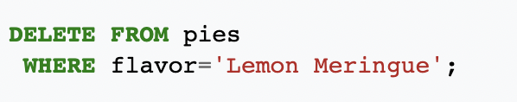
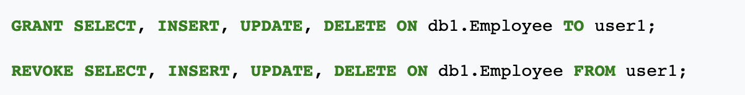
DML Examples
Fourth Week
RDBMS
DCL Examples

Slide 28
What’s JPA (Java Persistence API)?
Spring Boot JPA is a Java specification for managing relational data in Java applications. It allows us to access and persist data between Java object/ class and relational database. JPA follows Object-Relation Mapping (ORM). It is a set of interfaces. It also provides a runtime EntityManager API for processing queries and transactions on the objects against the database. It uses a platform-independent object-oriented query language JPQL (Java Persistent Query Language).
In the context of persistence, it covers three areas:
The Java Persistence API
Object-Relational metadata
The API itself, defined in the persistence package
JPA is not a framework. It defines a concept that can be implemented by any framework.
Why should we use JPA?
Fourth Week
JPA
JPA is simpler, cleaner, and less labor-intensive than JDBC, SQL, and hand-written mapping. JPA is suitable for non-performance oriented complex applications. The main advantage of JPA over JDBC is that, in JPA, data is represented by objects and classes while in JDBC data is represented by tables and records. It uses POJO to represent persistent data that simplifies database programming. There are some other advantages of JPA:
JPA avoids writing DDL in a database-specific dialect of SQL. Instead of this, it allows mapping in XML or using Java annotations.
JPA allows us to avoid writing DML in the database-specific dialect of SQL.
JPA allows us to save and load Java objects and graphs without any DML language at all.
When we need to perform queries JPQL, it allows us to express the queries in terms of Java entities rather than the (native) SQL table and columns.
JPA Features
There are following features of JPA:
It is a powerful repository and custom object-mapping abstraction.
It supports for cross-store persistence. It means an entity can be partially stored in MySQL and Neo4j (Graph Database Management System).
It dynamically generates queries from queries methods name.
The domain base classes provide basic properties.
It supports transparent auditing.
Possibility to integrate custom repository code.
It is easy to integrate with Spring Framework with the custom namespace.

Slide 29
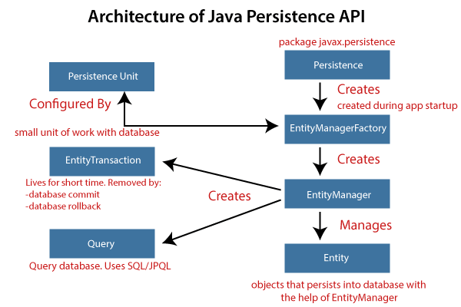
JPA Architecture
JPA is a source to store business entities as relational entities. It shows how to define a POJO as an entity and how to manage entities with relation.
The following figure describes the class-level architecture of JPA that describes the core classes and interfaces of JPA that is defined in the javax persistence package. The JPA architecture contains the following units:
Persistence: It is a class that contains static methods to obtain an EntityManagerFactory instance.
EntityManagerFactory: It is a factory class of EntityManager. It creates and manages multiple instances of EntityManager.
EntityManager: It is an interface. It controls the persistence operations on objects. It works for the Query instance.
Entity: The entities are the persistence objects stores as a record in the database.
Persistence Unit: It defines a set of all entity classes. In an application, EntityManager instances manage it. The set of entity classes represents the data contained within a single data store.
EntityTransaction: It has a one-to-one relationship with the EntityManager class. For each EntityManager, operations are maintained by EntityTransaction class.
Query: It is an interface that is implemented by each JPA vendor to obtain relation objects that meet the criteria.
Fourth Week
JPA
JPA Class Relationship
The relationship between EntityManager and EntiyTransaction is one-to-one. There is an EntityTransaction instance for each EntityManager operation.
The relationship between EntityManageFactory and EntiyManager is one-to-many. It is a factory class to EntityManager instance.
The relationship between EntityManager and Query is one-to-many. We can execute any number of queries by using an instance of EntityManager class.
The relationship between EntityManager and Entity is one-to-many. An EntityManager instance can manage multiple Entities.

Slide 30
JPA Implementations
JPA is an open-source API. There is various enterprises vendor such as Eclipse, RedHat, Oracle, etc. that provides new products by adding the JPA in them. There are some popular JPA implementations frameworks such as Hibernate, EclipseLink, DataNucleus, etc. It is also known as Object-Relation Mapping (ORM) tool.
Object-Relation Mapping (ORM)
In ORM, the mapping of Java objects to database tables, and vice-versa is called Object-Relational Mapping. The ORM mapping works as a bridge between a relational database (tables and records) and Java application (classes and objects).
In the following figure, the ORM layer is an adapter layer. It adapts the language of object graphs to the language of SQL and relation tables
Differences between JPA and Hibernate
JPA: JPA is a Java specification that is used to access, manage, and persist data between Java object and relational database. It is a standard approach for ORM.
Hibernate: It is a lightweight, open-source ORM tool that is used to store Java objects in the relational database system. It is a provider of JPA. It follows a common approach provided by JPA.
The following table describes the differences between JPA and Hibernate.
Fourth Week
JPA
JPA | Hibernate
JPA is a Java specification for mapping relation data in Java application. | Hibernate is an ORM framework that deals with data persistence.
JPA does not provide any implementation classes. | It provides implementation classes.
It uses platform-independent query language called JPQL (Java Persistence Query Language). | It uses its own query language called HQL (Hibernate Query Language).
It is defined in javax.persistence package. | It is defined in org.hibernate package.
It is implemented in various ORM tools like Hibernate, EclipseLink, etc. | Hibernate is the provider of JPA.
JPA uses EntityManager for handling the persistence of data. | In Hibernate uses Session for handling the persistence of data.

Slide 31
JPA Annotations
@Entity
@Column
Annotate all your entity beans with @Entity.
Specify the column mapping using @Column annotation.
@Table
Specify the database table this Entity maps to using the name attribute of @Table annotation. In the example below, the data will be stored in 'company' table in the database.
@OneToOne
@OneToMany
@ManyToOne
@ManyToMany
Fourth Week
JPA
@Id
Annotate the id column using @Id.
@GeneratedValue
Let’s try to understand via good example
Let database generate (auto-increment) the id column.
@Transient
Annotate your transient properties with @Transient.
@Temporal
Annotate for date/time properties.
@Enumerated
Annotate for enum properties.

