Slide 1
NaviPath
曲廷锌
211250183

Slide 2
Why do we need it ?
/01
To support pathologists in navigating high-resolution tumor images to search for pathology patterns of interest

Slide 3
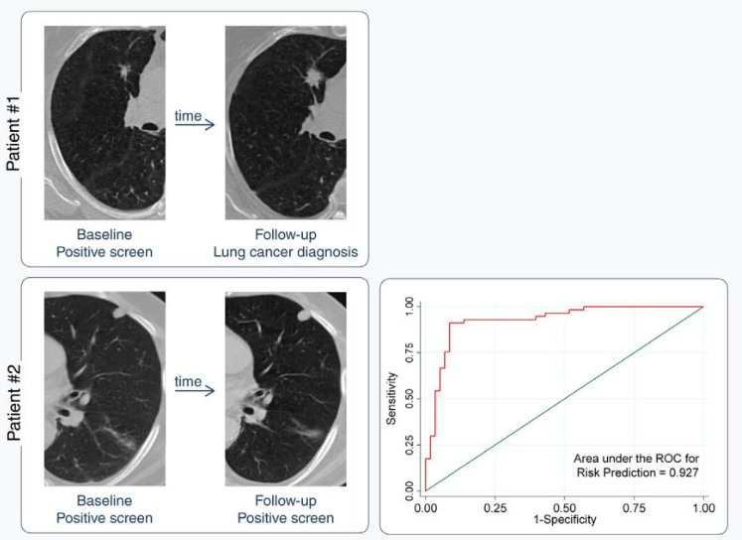
Background
Notes:
虽然传统的生物统计学和机器学习方法已被用于解决肺癌筛查中的许多局限性，但AI有可能取代这些方法来识别减少成像假阳性结果并更准确地区分良性和恶性结节。这可以导致对肺癌风险和发病率的更定量预测，从而产生稳健，更好定义的临床决策指南。
癌症诊断的一个关键步骤是病理学家通过光学显微镜对肿瘤进行检查。随着数字病理学的发展，肿瘤标本可以被扫描成高分辨率的数字扫描，使医疗专业人员能够通过数字接口访问、分析和共享这些扫描。然而，病理学家检查数字扫描可能比使用显微镜需要更长的时间。罪魁祸首是导航困难——病理扫描通常有极高的分辨率比计算机显示屏高很多
为什么需要改进来促进对病理扫描
病理诊断很难而且很多都是发病率很低
病理学家需要领域知识和AI知识（这在以往的系统中很少考虑）
对将Ai整合到诊断过程会阻碍病理学家的工作

Slide 4
What problem do we face ?
/02
Research has long realized the difficulty in navigating high-resolution images and proposed various interface designs to assist users with general navigation tasks

Slide 5
Problem to be solved
Complicated and low-incidence
consideration of integrating
Pathologists’ navigation is usually substantially complicated because some pathology patterns have a low prevalence rate
Domain knowledge
The lack of consideration towards integrating AI into pathologists’ workflows might discourage them from using human-AI systems
Pathologists require specific domain knowledge and navigation strategies ,which current navigation systems for general use rarely consider;

Slide 6
How to design the experiment ?
/03
a formative study with six medical professionals in pathology from two medical centers to study how pathologists examine digital scans for mitosis evaluation

Slide 7
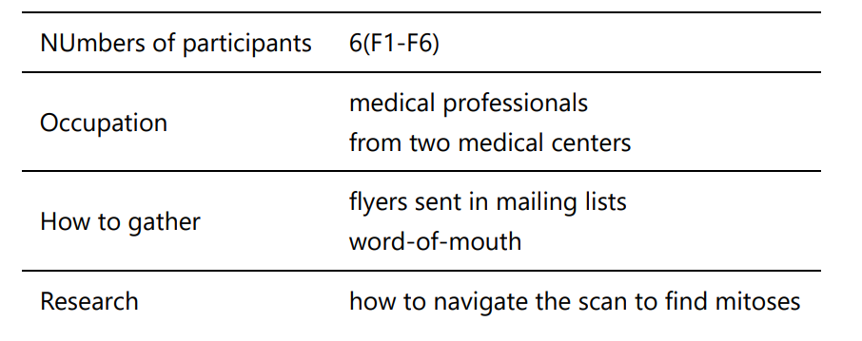
Formative Study

Slide 8
Obversions and System Requirements
Overview first,
then detail
Covering multiple magnification levels
Using macroscopic patterns to locate ROIs in the low magnification
System
Requirements
Incorporating pathologists’ domain knowledge
Obversion
Low throughput in higher magnifications
Accelerating navigation in high magnifications

Slide 9
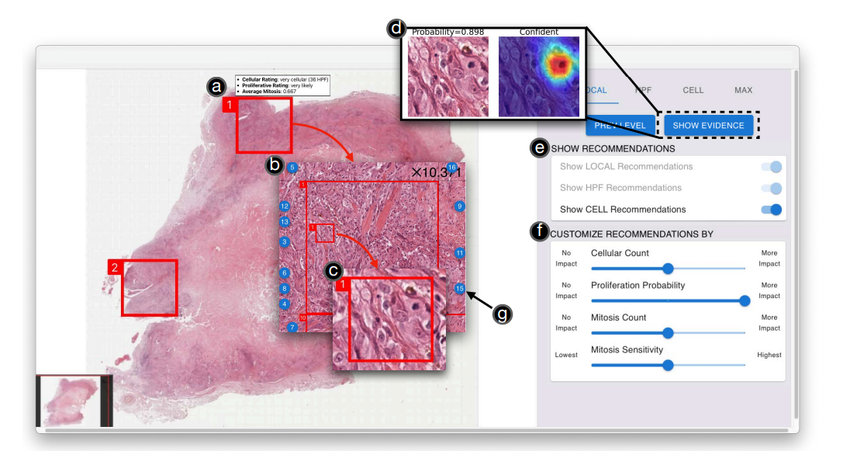
NaviPath Design
Notes:
Hierarchical AI Recommendations 分为三层
Customizable Recommendations by Multiple Criteria 三个判断标准：（可以改变这三个权重来个性化)细胞数量 扩散概率 有丝分裂数量
5e -> 5a(local recommend) -> b(HPF) -> c(有丝分裂cell recommend) -> d（解释卡） -> g （跳转到其他HPF）-> f（个性化设置）

Slide 10
Work sessions with pathologists
/04
work sessions with medical professionals in pathology to validate NaviPath

Slide 11
Research Questions
• RQ1：Can NaviPath (as a human + AI approach) increase pathologists’ precision
and recall in identifying the pathological features (in this case, mitosis)?
• RQ2：Can NaviPath save pathologists time and effort?
• RQ3：Compared to manual navigation, what is the benefit of using NaviPath？

Slide 12
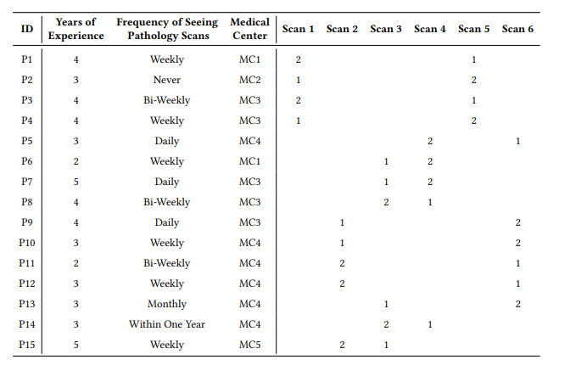
Work Sessions
Participants
Experimental group and control group

Slide 13
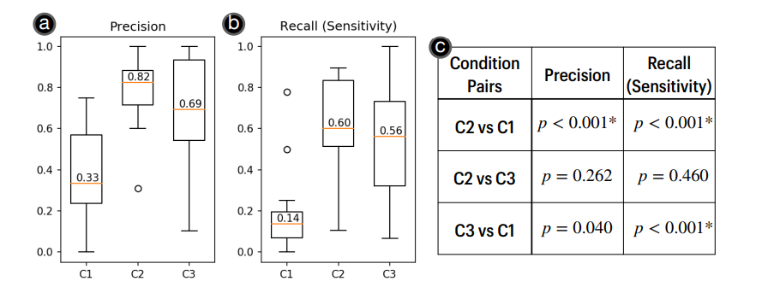
Result and Findings of RQ1
Notes:
与手动导航相比，NAvIPATH在识别有丝分裂方面取得了更高的精度和召回率。此外，作为一种人工+人工智能的方法，相比于只使用人工智能的情况，NAvIPATH可能会带来改进:NAvIPATH实现了更高的平均精度和召回率。然而，我们没有观察到这种改善在统计学上是显著的。

Slide 14
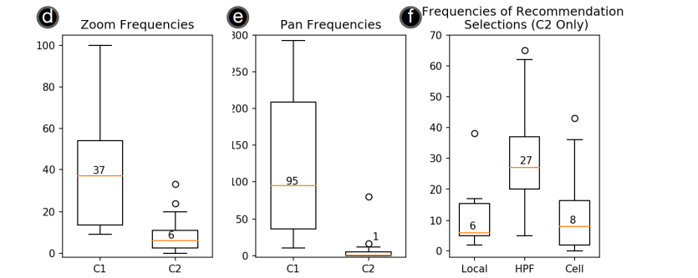
Result and Findings of RQ2

Slide 15
Thank you

