Slide 1
“Natural” User Interfaces
曲廷锌
211250183

Slide 2
What’s the Natural User Interface?
/01
NUI is really natural？

Slide 3
Development
Timeline
2010
Gesture
2030年1月
VR
AR
Multi-touch
2007
iPhone
ipad
1980s
GUI
Apple Macintosh
Microsoft Windows

Slide 4
“I believe we will look back on 2010 as the year we expanded beyond the mouse and keyboard and started incorporating more natural forms of interaction such as touch, speech, gestures, handwriting, and vision— what computer scientists call the ‘NUI’ or natural user interface.”
—Steve Ballmer, CEO Microsoft
Marketing rhetoric is ahead of reality！

Slide 5
Disadvantages
/02
Not easy to remember and learn
Cultural intermix

Slide 6




Disadvantage
NUI
Gestures are temporary and
untraceable
Sometimes it's just convention
Cultural intermix
Damage
The gestures are constant
Some gestures are too natural

Slide 7
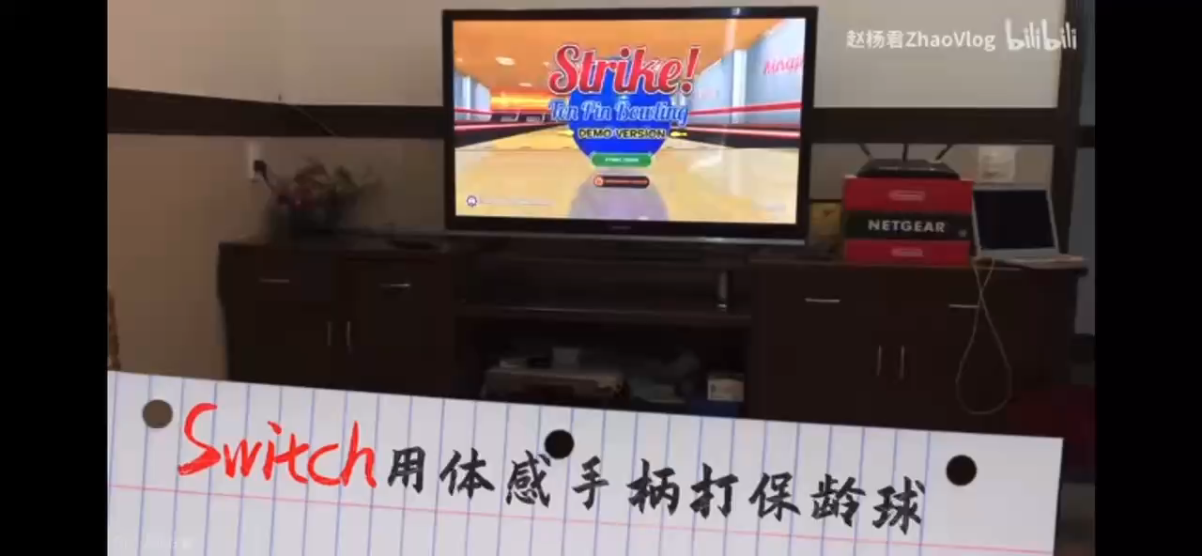

Slide 8
Available?
/03
They will be useful !

Slide 9
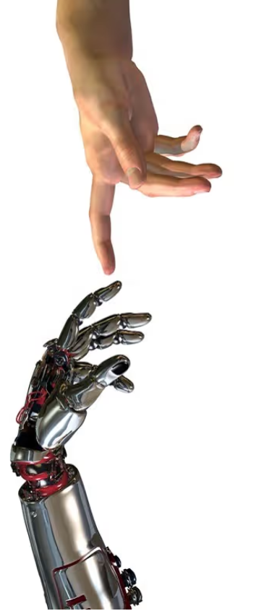
They will be useful
.
Design dictum
Proper behavior comes about through careful design, not through instrument manuals and warnings.
Notes:
d47470a7-320f-49d5-a245-317518f97e82.source.1.zh-Hans

Slide 10
Thank you

