Slide 1

ANGELUS
LAYOUT 12 SEP. 2005

Slide 2
Changes
Date | Rev. | Page | Changes
02 AUG. 2005 | Sample |  |  | KITAMURA（P）
29 AUG. 2005 | 1.0 |  |  | KITAMURA (P)
30 AUG. 2005 | 1.1 | Text & Color | Added colors. | KITAMURA (P)
 |  | Home | Added descriptions of text-color.
05 SEP. 2005 | 2.0 | (New) | Single Image, Select, Print Order, Setup | KITAMURA (P)
12 SEP. 2005 | 3.0 | Select, Setup, Dialogue | Simplified the coordinates of buttons. | KITAMURA (P)
 |  | (New) | Scroll Bar, Setup - 4 Items (Information) , Select -HDD check, Setup-3 Items (Display setup), Setup-4 Items (view), Setup-Sub menu, Audio-List

Slide 3


Explanatory notes
About the marks in this document.
Parts
Sample
A
A = (0,0) 640*50
Parts
Coordinate
(x,y)
Size
(Width x Height)
Text
A text-coordinate shows a position of an English capital letter E, not an actual text box.
All text boxes in all languages,
Vertical align = “middle”.
(15,418)
Sample
Text
Capital letter E = (15,418)
2 lines, pitch = Y28 dots

Slide 4
- Common -

Slide 5
Text & Color
Font (Resolution = 96dpi ) | English: Swiss 721 condensed, L-24pt, S-18pt Japanese: Kaku-Gothic Ca-M, L-20pt, S-16pt
Color (R,G,B) | White (255,255,255) Blue (0,52,113) Dark Gray (13,13,13) Light Gray (217,217,217) Orange (255,202,92) Green (0,200,0)
Text Color (Usual) | Default = White Focus = Blue Selected = Dark Gray Execute = White

Slide 6

Background
\common\background
A = (0,0) 640*480
A

Slide 7
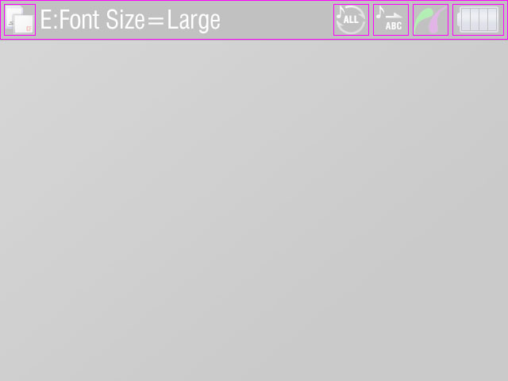
Header
\common\header
F : Pict Bridge Icon
A: Header Base
G : Battery Icon
Screen Title Text
C: Repeat Status Icon
D:
Display Mode Icon
Player Mode Icon
Color variations
Default (Playback)
Backup
Screen of sub-functions
Setup
A = (0,0) 640*50
B = (5,5) 40*40
C = (420,5) 45*40
D = (470,5) 45*40
E = (520,5) 45*40
F = (570,5) 65*40
Screen Title Text
Capital letter E = (52,12)
B : Screen Title Icon

Slide 8
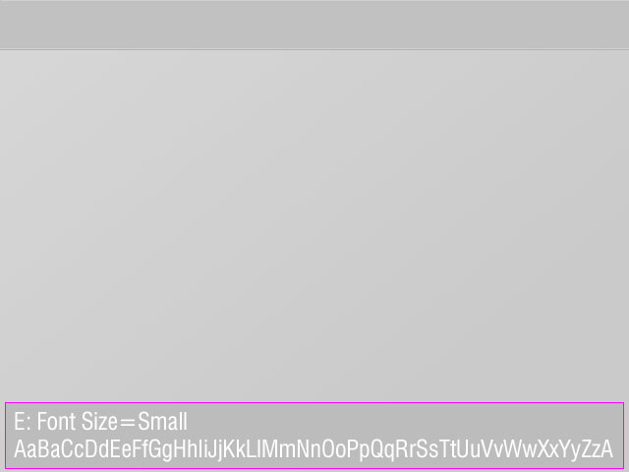
Information
A:
2-Line Base = (5,409) 630*68
1-Line Base = (5,437) 630*40
A: Information Base
Information Text
Capital letter E = (15,419)
2 lines, pitch = Y28 dots
Information Text

Slide 9
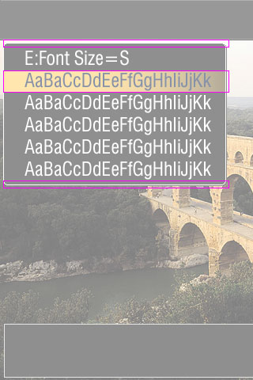
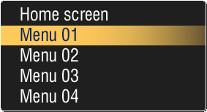
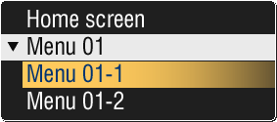
Menu Unit
\common\menu
(0,0)
Menu Text
A
Menu Text
Capital letter E = (28,4) *Relative
Pitch = Y28 dots
Menu Base - Top
A = (4,50) 286*10
Default
Menu Base – Middle
Pitch = Y28 dots
Focus-1
Menu Base - Bottom
Focus-2
Focs-2nd
1st Menu
2nd Menu
Execute

Slide 10
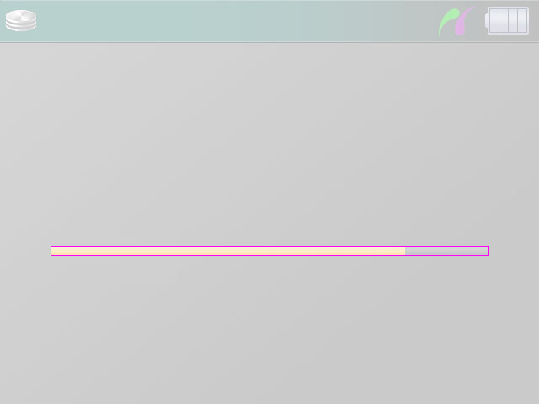

Scroll Bar
\common\bar
Base
Left = 20*12
Middle = 50*12 (Adjust the width)
Right = 20*12
Bar = 10*10 (Adjust the width)
Base(0,0)
Bar(1,1)
Left
Middle
Right
20dots
Adjust the width
20dots
Color variations
Orange
Red
Green
Base
Bar
Adjust the width

Slide 11
- Screens -

Slide 12

Splash
Background : Splash

Slide 13
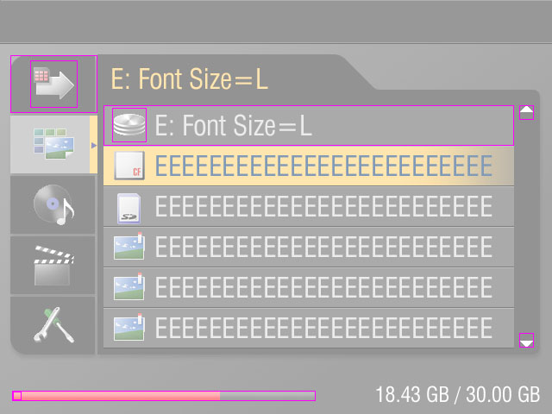
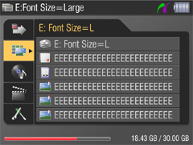
Home
\screens\home
A : 1st Base
B : 1st Icon
1st Item
Pitch = Y70 dots
A = (12,64) 101*67
B = (35,70) 55*55
2nd Item
Max. 6 Lines, pitch = Y47 dots
C = (120,122) 476*47
D = (130,125) 40*40
E = (602,122) 17*17 ← \common\scroll
F = (602,386) 17*17 ← \common\scroll
*Display if necessary
G = (14,453) 352,12 ← \common\bar
1st Text
E : Scroll-Up
2nd Text
D : 2nd Icon
C : 2nd Base
F : Scroll-Down
G : Bar Base
1st Text
Capital letter E = (130,79)
Color = “Orange”
2nd Text
Capital letter E = (181,133)
H : Bar ( * Adjust the width)
Background : Home
Header Color : Default
2nd Focus: Usual Text Color
Information Text
ALIGN = “Right”
1st Focus:
Text Color = “Light Gray”

Slide 14
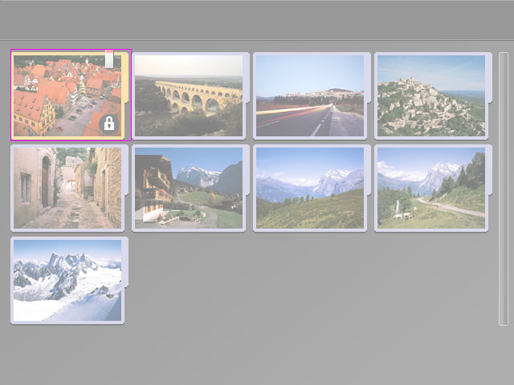
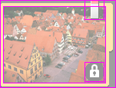
Album Index
\screens\index
A : Album Thumbnail Unit
A = (13,61) 151*115
Pitch = X151, Y115 dots
D:
Bookmark Icon
B:
Album Base
C:
Thumbnail
E:
Protect Icon
Album Thumbnail Unit
B = (0,0) 151*115
C = (4,8) 134*101
D = (110,0) 26*26
E = (110,81) 26*26
Background : Common
Header Color : Default

Slide 15
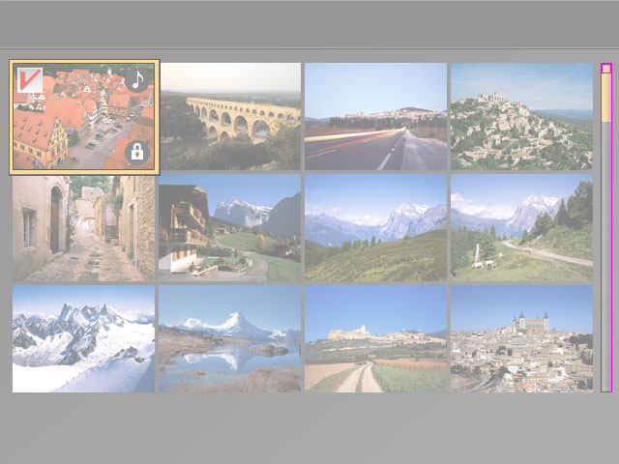
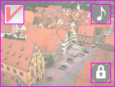
Image Index
\screens\index
A : Focus
C : Bar Base
A = (9,61) 157*121
Pitch = X151, Y115 dots
B = (13,65) 147*111
Pitch = X151, Y115 dots
C = (621,65) 12*341 ← \common\bar
D = (622,66) 10*10 ← \common\bar
Variations
Jump Mode Focus
B : Thumbnail Unit
D : Bar ( * Adjust the height)
F:
Bookmark Icon
G:
File Icon
E:
Thumbnail
H:
Protect Icon
Background : Common
Header Color : Default
Image Thumbnail Unit
E = (0,0) 147*111
F = (5,5) 26*26
G = (116,5) 26*26
H = (116,80) 26*26

Slide 16
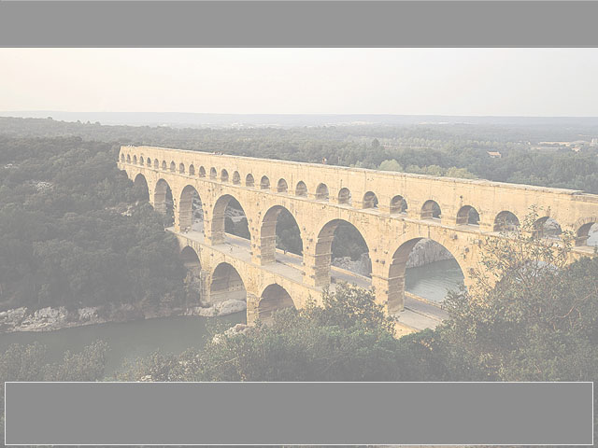
Image Screen
Header Color : Default

Slide 17
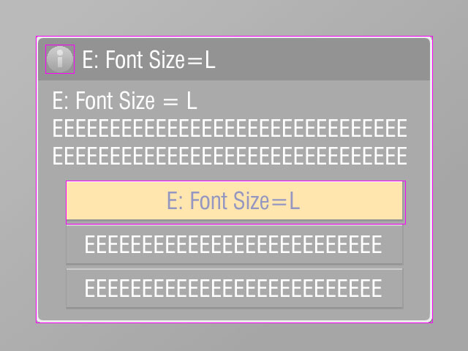
Dialogue
C: Dialogue Base
A: Title Icon
C = (49,49) 543*393
A = (62,61) 40*40
Title Text
Title Text
Capital letter E = (114,69)
3 Lines, pitch = Y38 dots
Dialogue Text
Capital letter E = (73,125)
3 Lines, pitch = Y38 dots
Dialogue Text
B: Button Base
Button Base
B = (90,247) 465*60
Max. 3 Buttons, pitch = Y60 dots
1 button
2 buttons
3 buttons

Slide 18
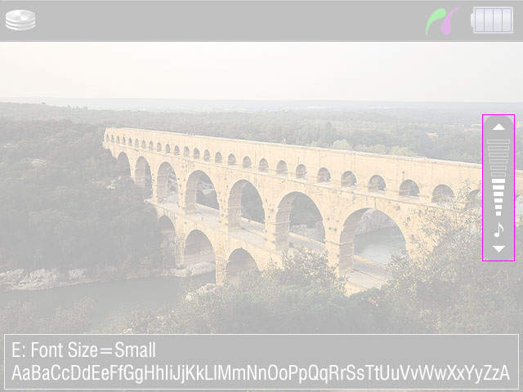
Single Image - Volume
\screens\singleimage
A = (590,140) 40*180
A: Sound Volume Indicator

Slide 19
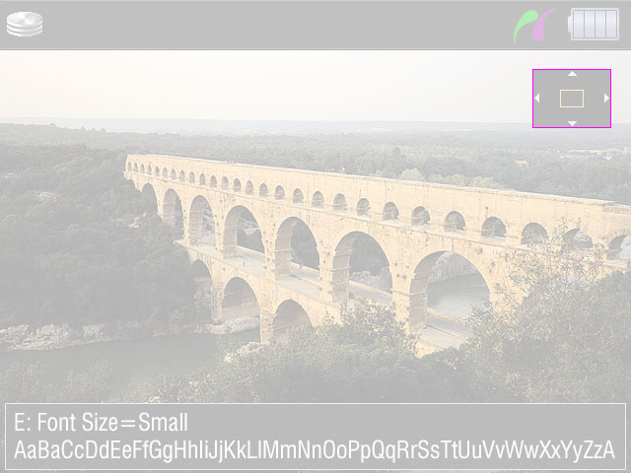
Single Image - Zoom
\screens\singleimage
A = (540,70) 80*60
B
1 dot Line, “Orange” color
Adjust the position
Adjust the size
A: Zoom Indicator Base
B: Display Area

Slide 20
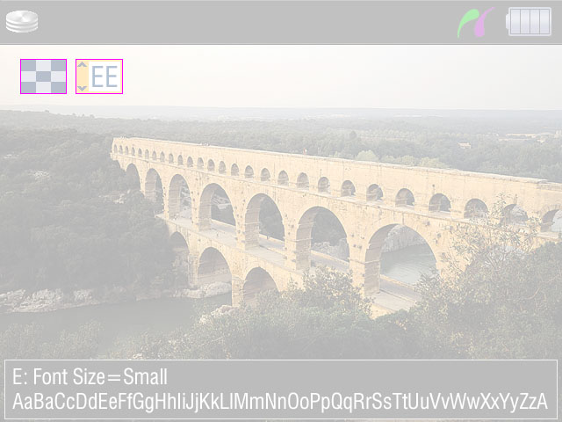
Single Image - Print
\screens\singleimage
A: Index Print Icon
A = (23,67) 53*40
B = (86,67) 54*40
B: Number Base
Number of Copies
Number of Copies
Font Size = L,
Capital letter E = (121,75)

Slide 21
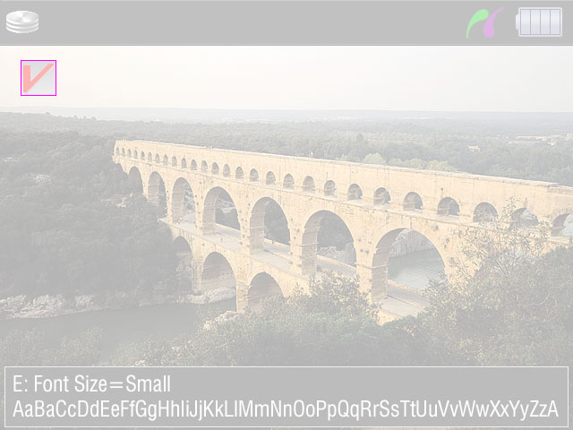
Single Image - Check
\screens\singleimage
A = (23,67) 40*40
A: Check Mark

Slide 22
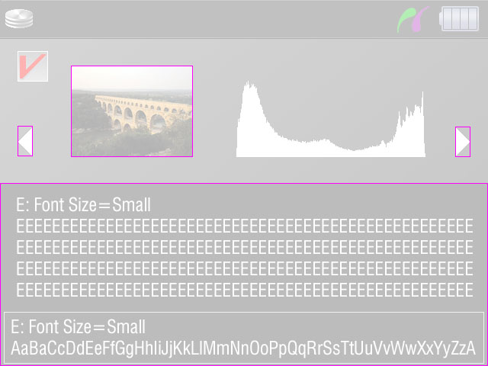
Single Image - File Information
\screens\singleimage
A = (93,86) 160*120
B: Height = 120
C1 = (23,166) 20*40
C2 = (597,166) 20*40
D = (0,240) 640*240
A: Thumbnail
B: Histogram
C1: Scroll-Back
C2: Scroll-Next
D: Information Base
Information Text
Font Size L or S
*According to the amount of the text.
22dots
22dots

Slide 23
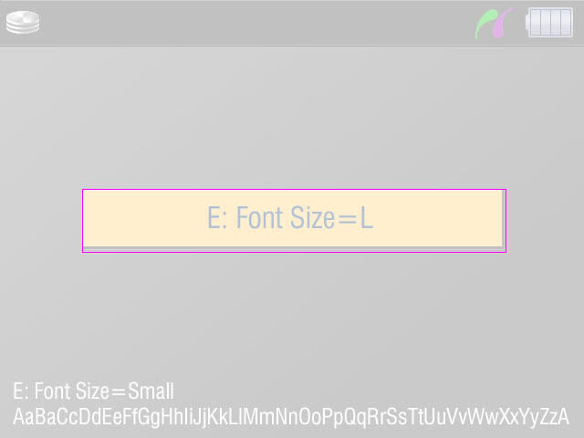

Select - 1 Button
\screens\select
A = (90,207) 465*70
A: Button Base 1
Button Text:
center

Slide 24
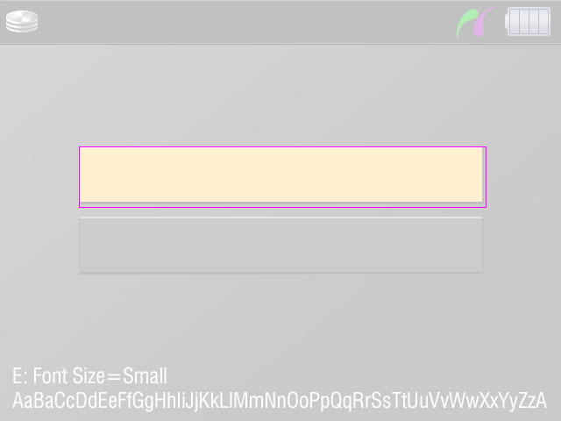
Select - 2 Buttons
\screens\select
A = (90,167) 465*70
Pitch = Y80
A: Button Base 1

Slide 25
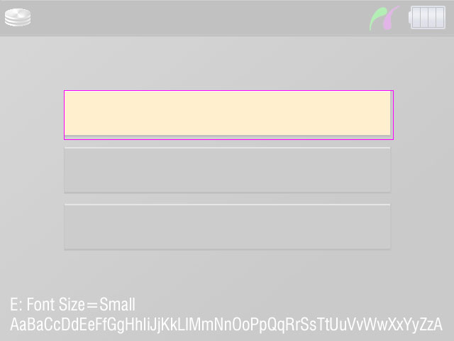
Select - 3 Buttons
\screens\select
A = (90,127) 465*70
Pitch = Y80
A: Button Base 1

Slide 26
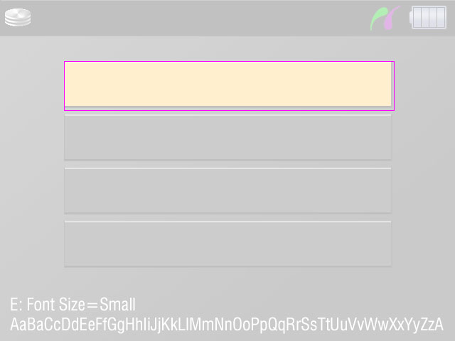
Select - 4 Buttons
\screens\select
A = (90,86) 465*70
Pitch = Y75
A: Button Base 1

Slide 27
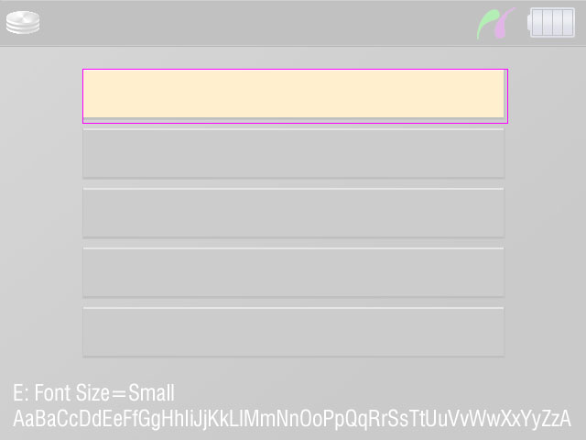
Select - 5 Buttons
\screens\select
A = (90,75) 465*60
Pitch = Y65
A: Button Base 5

Slide 28
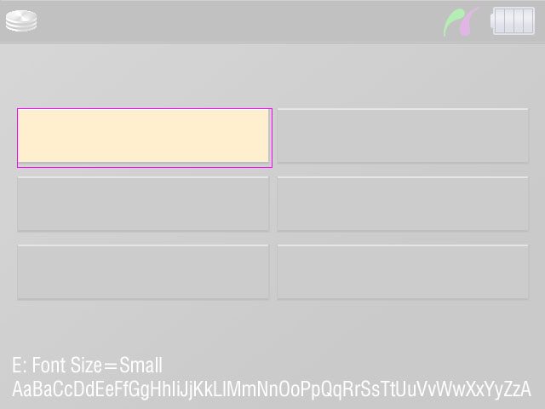
Select - 6 Buttons
\screens\select
A = (20,127) 300*70
Pitch = X305, Y80
A: Button Base 6

Slide 29
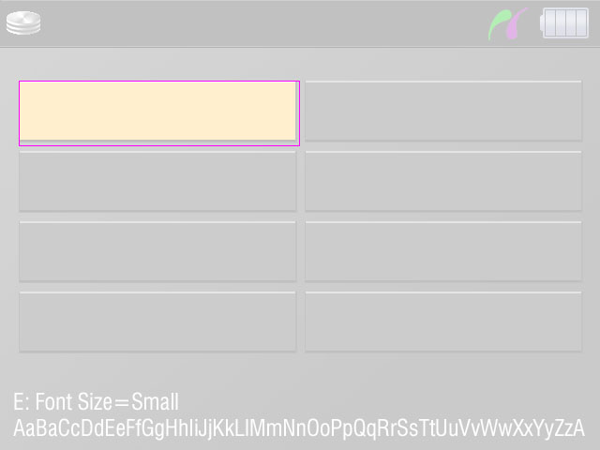
Select - 7&8 Buttons
\screens\select
A = (20,86) 300*70
Pitch = X305, Y75
A: Button Base 8

Slide 30
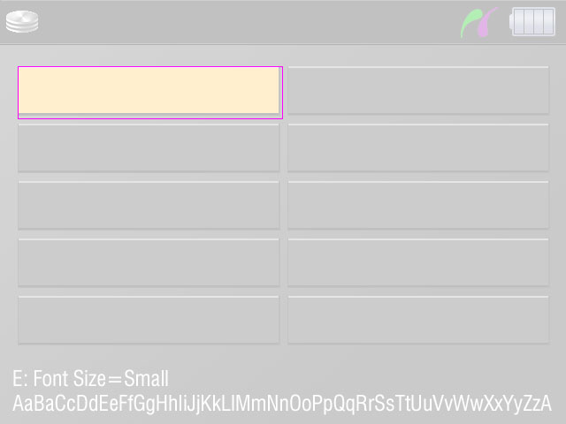
Select - 9&10 Buttons
\screens\select
A = (20,75) 300*60
Pitch = X305, Y65
A: Button Base 10

Slide 31
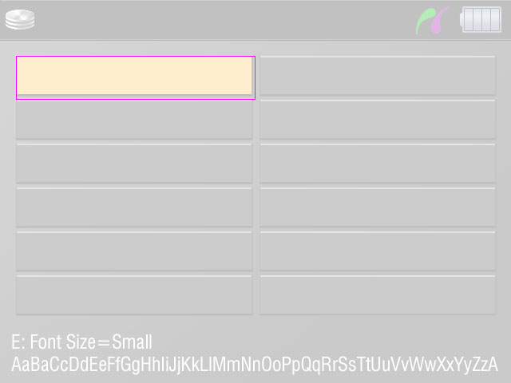
Select - 11&12 Buttons
\screens\select
A = (20,70) 300*55
Pitch = X305, Y55
A: Button Base 12

Slide 32
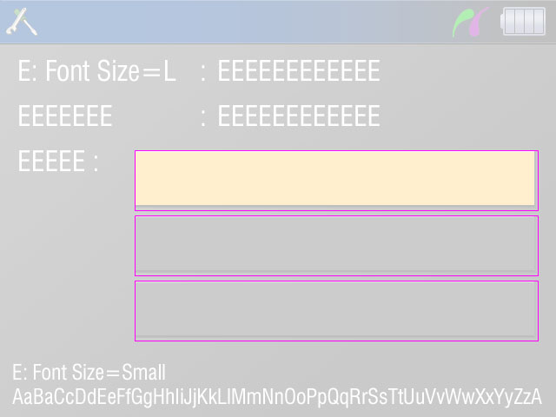
Select - HDD Check
\screens\select
A = (155,173) 465*70
Pitch = Y75
Text
Align
A: Button Base 1
Text
Capital Letter E = (22,69)
Pitch = Y52

Slide 33
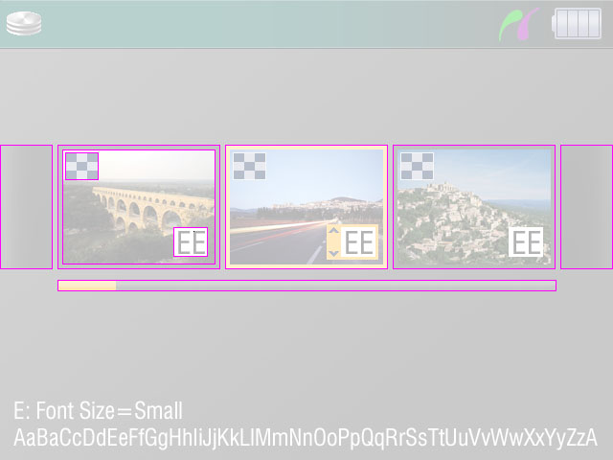
Print Order
\screens\print
A = (0,151) 55*130
Print Order Thumbnail Unit
Pitch = X175
B1 = (60,151) 170*130
B2 = (65,156) 160*120
B3 = (68,159) 35*29
B4 = (181,237) 36*31
B5 = (202,241) (Capital Letter E)
D = (60,292) 521*12
A: Base-L
B1: Thumbnail Base
C: Base-R
B2: Thumbnail
B3: Index Print Icon
B5: Number of Copies
B4: Number Base
D: Scroll Bar

Slide 34
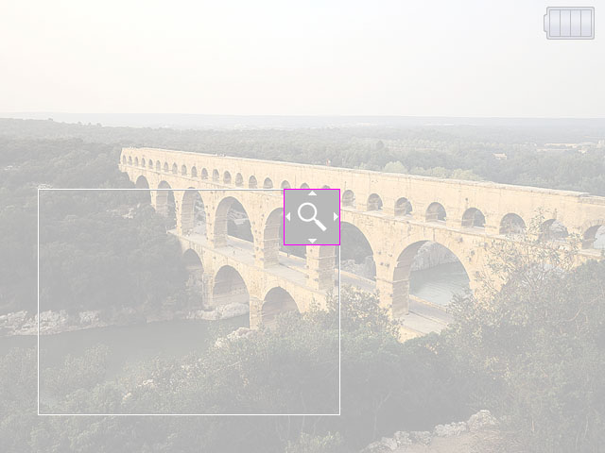
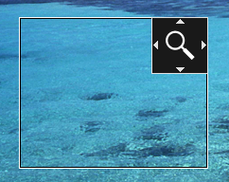
Trimming Print
\screens\print
A = 60*60
*Align to the top-right of “Trimming area”.
Trimming Area
System drawing:
Outside line = 1dot White line
Inside line = 1 dot Black line
Trimming Area
A: Operation Mark

Slide 35




Setup - Text on Buttons
\screens\setup
12 dots
12 dots
Item Base L
580*47
12 dots
12 dots
Item Base S
410*47
Button Base 2
Button Base 3
287*47
190*47
center
center
Button Base S
160*47
center

Slide 36
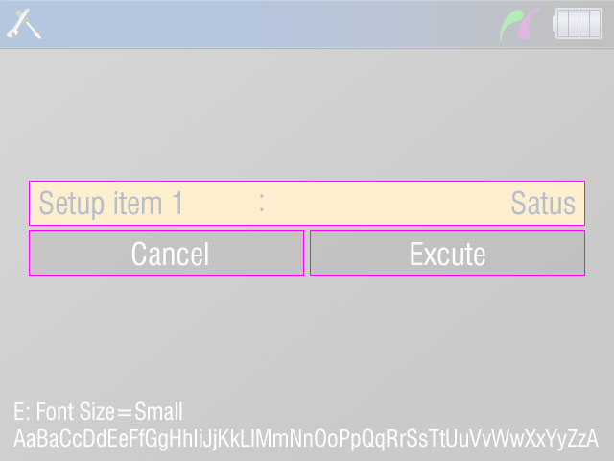
Setup - 1 Item
\screens\setup
A = (30,188)
B1 = (30,240)
B2 = (323,240)
A: Item Base L
B1: Button Base 2
B2: Button Base 2

Slide 37
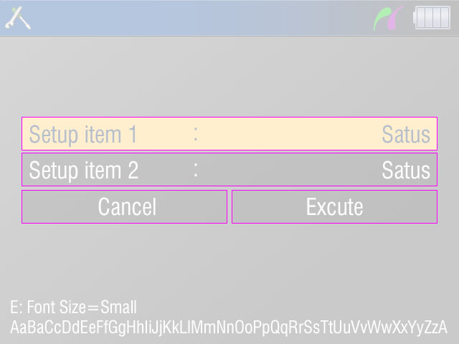
Setup - 2 Items
\screens\setup
A1 = (30,163)
A2 = (30,213)
B1 = (30,265)
B2 = (323,265)
Align
A1: Item Base L
A2: Item Base L
B1: Button Base 2
B2: Button Base 2

Slide 38
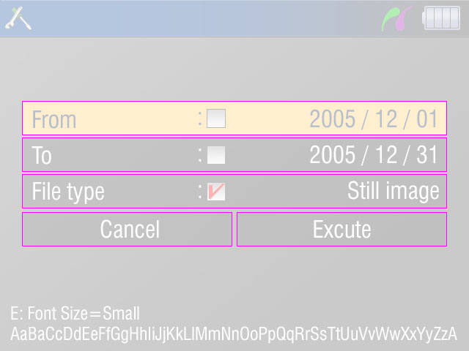
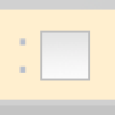
Setup - 3 Items
\screens\setup
A = (30,138)
Pitch = Y50
B1 = (30,290)
B2 = (323,290)
A: Item Base L
Align
7 dots
11 dots
B1: Button Base 2
B2: Button Base 2
Check box

Slide 39
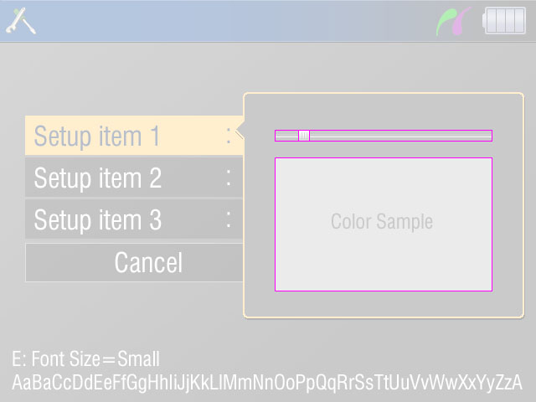
Setup - 3 Items (Display Setup)
\screens\setup
A1 = (328,155) 260*14
A2 = 14*14 *Adjust the position
A1: Slider Bar
A2: Slider Head
A3: Color Sample
Sub Menu 6

Slide 40
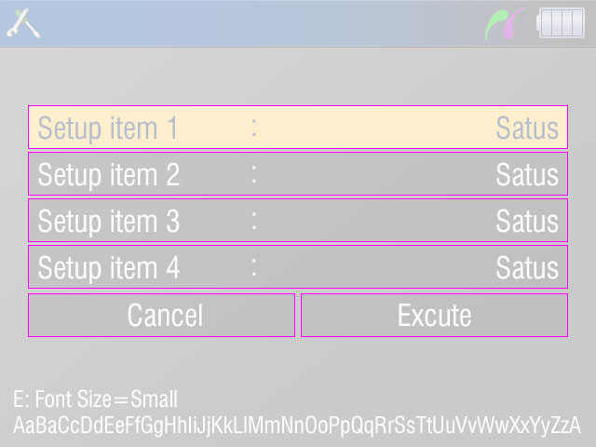
Setup - 4 Items
\screens\setup
A = (30,113)
Pitch = Y50
B1 = (30,315)
B2 = (323,315)
A: Item Base L
Align
B1: Button Base 2
B2: Button Base 2

Slide 41
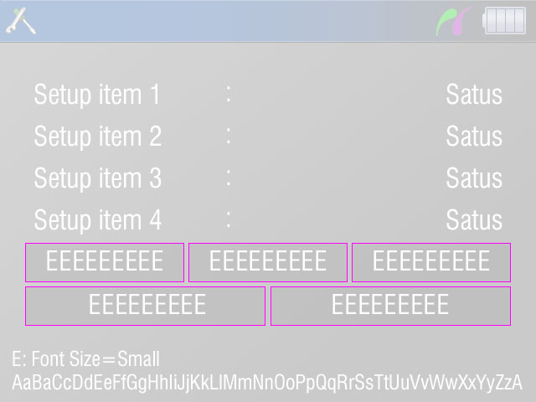
Setup - 4 Items (View)
\screens\setup
A1 = (30,290)
A2 = (225,290)
A3 = (420,290)
B1 = (30,342)
B2 = (323,342)
A1: Button Base 3
A2: Button Base 3
A3: Button Base 3
B1: Button Base 2
B2: Button Base 2

Slide 42
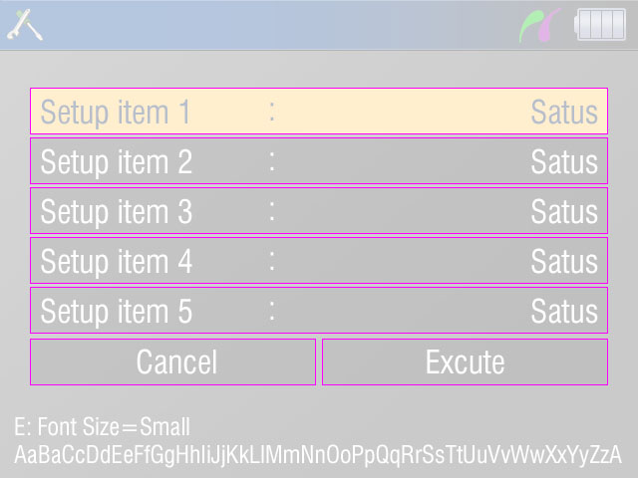
Setup - 5 Items
\screens\setup
A = (30,88)
Pitch = Y50
B1 = (30,340)
B2 = (323,340)
A: Item Base L
Align
B1: Button Base 2
B2: Button Base 2

Slide 43
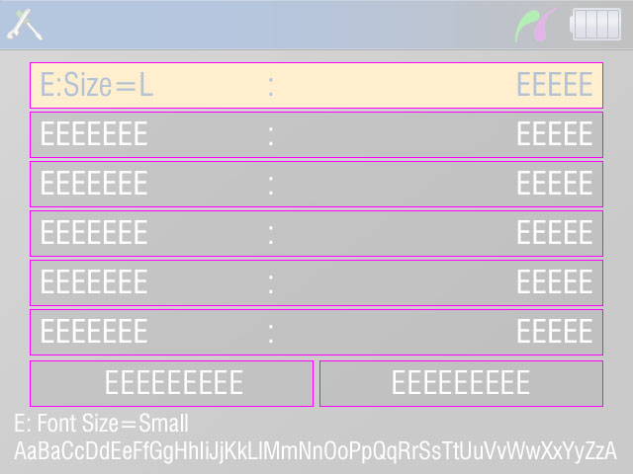
Setup - 6 Items
\screens\setup
A = (30,63)
Pitch = Y50
B1 = (30,365)
B2 = (323,365)
A1: Item Base L
Align
B1: Button Base 2
B2: Button Base 2

Slide 44
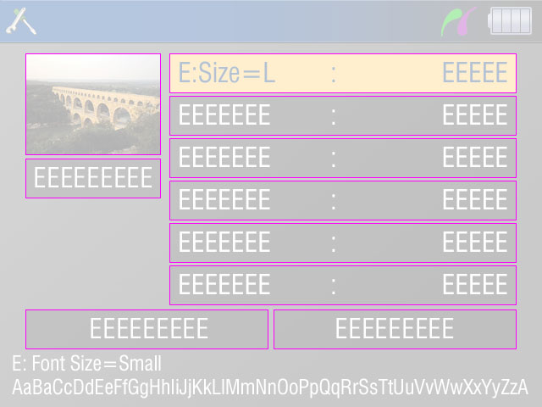
Setup - 6 Items with Thumbnail
\screens\setup
A = (200,63)
Pitch = Y50
B1 = (30,365)
B2 = (323,365)
C = (30,63) 160*120
D = (30,187)
C: Thumbnail
A: Item Base S
Align
D: Button Base S
B1: Button Base 2
B2: Button Base 2

Slide 45
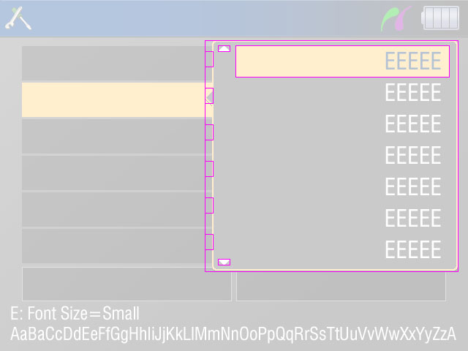
Setup - Sub Menu
\screens\setup
A: Scroll Up
Variations
1 item to 7 items
Sub Menu Base (0,0)
Sub Menu Base
*Adjust the position case by case.
Sub Menu Pointer
VALIGN = “middle” of its item-base
Pitch = Y50
A = (18,7) 17*9
B = (18,299) 17*9
C = (42,7) 293*43
Pitch = Y43
Sub Menu Pointer
C: Sub Menu Focus
B: Scroll Down

Slide 46
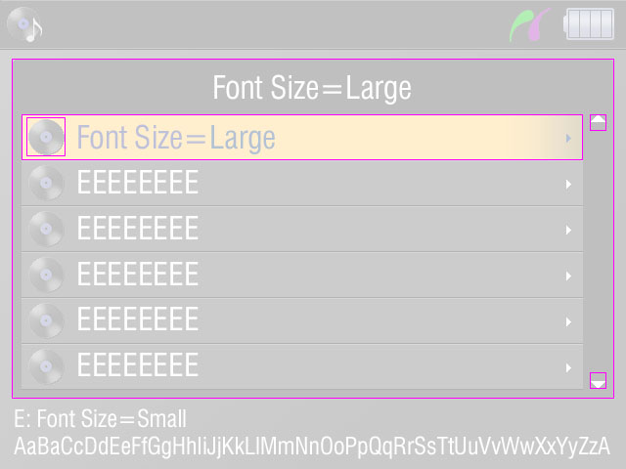
Audio - List
A: List Base
A = (12,60) 616*348
B = (22,117) 574*47
Pitch = Y47
C = (27,120) 40*40
Pitch = Y47
D1 = (603,117) 17*17 ← \common\scroll
D2 = (603,381) 17*17 ← \common\scroll
B: Item Base
Center
D1: Scroll-Up
C: Item Icon
D2: Scroll-Down
12 dots

