Slide 1


Online News Articles Popularity Prediction
Machine Learning
CSCI 6364_81
TEAM
DHEERAJ MAKINEEDI
MANISHA THERUPALLI

Slide 2
Problem Definition:
To predict the number of shares of a news article based on its textual content, category, publication date, and other attributes. How article features effects the popularity of the article
Motivation:
In the online news industry, content providers or advertisers benefit greatly from the ability to accurately predict the popularity of content before it is published. Thus, it is interesting and meaningful to use machine learning techniques to predict the popularity of these articles. Popularity of news depends upon various features like usage of different keywords, relevance to a trending topic, perhaps even the day the article is published. It is necessary to know what makes one online news article more popular than another. As a preemptive approach, articles predicted to be unpopular can be enhanced to promote popularity by tweaking identified key features
Hypothesis:
This problem falls under the domain of predictive analytics and can be tackled using machine learning algorithms such as regression, decision trees and Random Forest

Slide 3
ASSUMPTIONS:
1.The dataset is representative of news articles published by the Mashable website during the period from January 7, 2013, to December 31, 2015.
2.The dataset contains no missing values, as it has already been preprocessed and cleaned.
3.The features in the dataset can be categorized into three groups: textual content features (such as number of words and average word length), keyword-based features (such as the number of keywords in the title), and metadata features (such as the article's category, author, and publication date).
4.There may be correlations between some of the features, which may need to be considered when performing further analysis or building predictive models.

Slide 4
Approach :
Using machine learning algorithms such as regression, decision trees, KNN, SVM and Random Forest.
Why above Approach:
The approach of using machine learning algorithms such as regression, decision trees, SVM, and Random Forest is selected for the UCI Online News Popularity dataset as it is a predictive analytics problem where the goal is to predict the number of shares of a news article based on its features. Machine learning algorithms are particularly useful for this type of problem as they can learn patterns and relationships between the input features and the target variable from the data. Additionally, these algorithms can help to create a predictive model that can estimate the number of shares of an article and identify the most important features that drive the popularity of the article. This information can provide valuable insights to content creators and publishers for optimizing their content to increase engagement on social media.

Slide 5






CONTENTS
01 Data Background
02 Exploratory Data Analysis
03 Data Pre-processing
01 Model
Prediction
01 Conclusion and Future Scope

Slide 6
Data Background
https://www.kaggle.com/datasets/thehapyone/uci-online-news-popularity-data-set The dataset was originally published by Mashable, a popular blogs site in the world. A copy of this dataset is taken from Kaggle instead, due to difficulties in downloading from the original source.
ABOUT THE DATA:
What – ​News Articles data from Mashable Blog site
How Many – 39,000+ Articles & 61 features​
When – January 7, 2013 – January 7, 2015
Where – Obtained from UCI Machine Learning Repository
Why – To classify an article as popular or unpopular prior to publication

Slide 7
Understanding the Data
Extracted features
NLP features
Encodings and decoding
Mashable dependent features
Target variable
Shares convergence

Slide 8
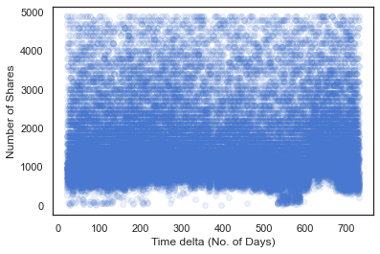
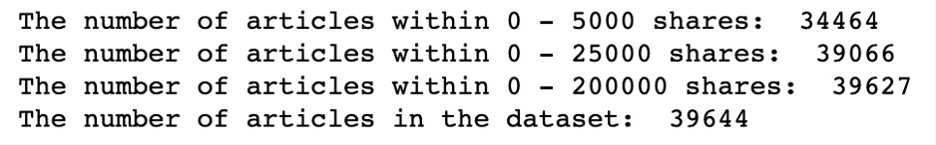
Scatter plot
Notes:
So we plotted this scatter plot to see if there is any relationship. And as we assumed, there is none. The majority of the number of shares lie within the range 0-5000 (87% of the data) which is why we have filtered it till here.
And for the classification problem, we went ahead and calculated the median of our dataset – which was 1400 and engineered another variable called target to classify each article as popular vs unpopular. This became our response variable. Why not mean? Because of class imbalance.

Slide 9
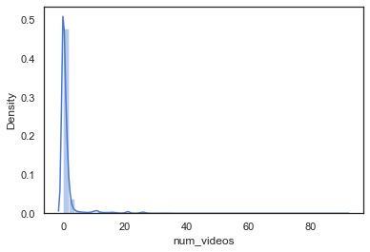

Exploratory Data Analysis
1. Effect of Digital content on popularity
2 Digital Content features – Number of Videos and Number of Images
Distributions

Slide 10
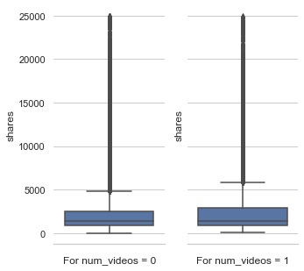
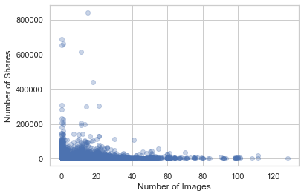

Slide 11
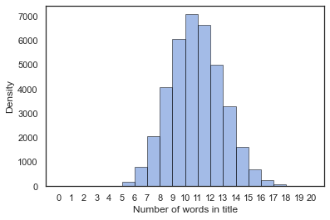
2. No. Of Words to Popularity
2 features – Number of words in Content and Number of words in Title
Distributions
Notes:
n_token_titles seems to have a perfect normal distribution in the dataset with average value at around 10

Slide 12
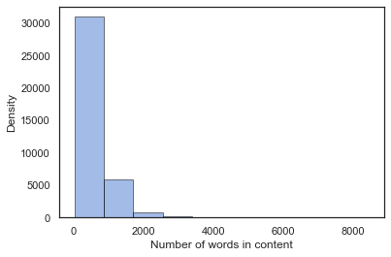
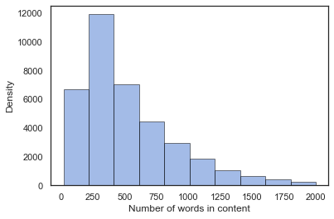
Notes:
Majority of the number of words tend to be concentrated < 2000. Subsetting and plotting this.
When I looked at the value_counts of this, I could see around 1180 articles with 0 in number of contents. This EDA was important in removing this erroneous rows. When I checked the actual links of the articles, there were words in them so these rows were incorrect. We used this in preprocessing

Slide 13
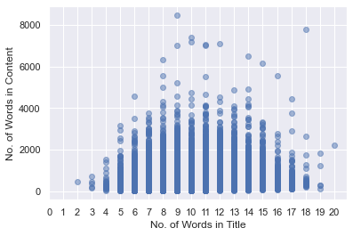
Notes:
Before plotting the relationship of these 2 features with number of shares, we wanted to see if there was a relationship between these 2 itself. So we plotted a scatter plot. It seems like, except for a few outliers, Number of words in the content peak when the Number of words in the title are between 8-14 and they fall off gradually as it increases or decreases from this range

Slide 14
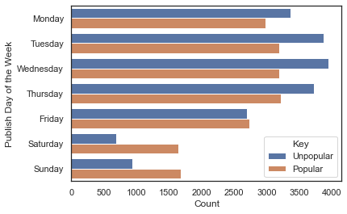
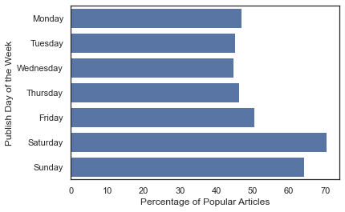
3. Day of Week effect on Popularity
Engineered feature that combines all Days of Week
Notes:
This plot gives us highly useful insight. An article published over the weekend is more likely to be popular as opposed to an article that is published over the weekday. This makes intuitive sense since people have more time to read articles over the weekend as opposed to weekday. To showcase this, i'll plot the percentage chance of popularity on all weekdays according to our data.
We observe a trend. Near the weekends, the percentage of popular articles increases and peaks on Saturday, however, it gradually decreases then and is the lowest during mid-week on Wednesday.

Slide 15
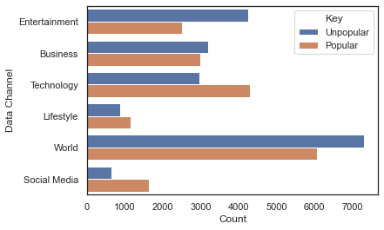
4. Data Channel effect on Popularity
Engineered feature that combines all Data channels
Notes:
We can observe that in category of technology and social media, the proportion of popular news is much larger than unpopular ones, and in category of world and entertainment, the proportion of unpopular news is larger than popular ones. This reflects that the readers of "Mashable.com" prefer the channel of technology and social media over the channel of world and entertainment.
We can plot the percentage of this like before to see comparison between popular and unpopular

Slide 16
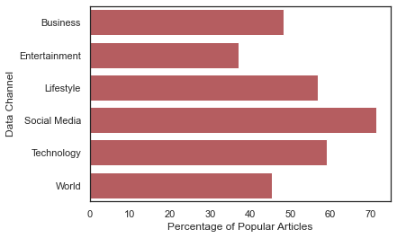
Notes:
Reinforces the previous observation

Slide 17
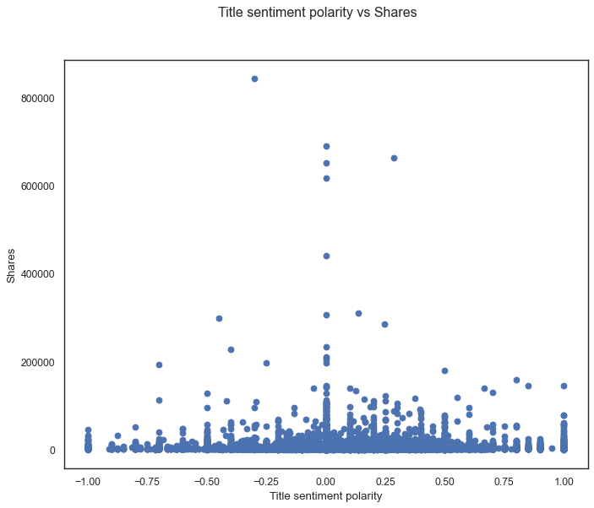
5. Title Sentiment effect on Popularity
Ranges from –1 to 1
Defines the orientation of expressed sentiment
Notes:
Mostly the articles have titles which are not too positive or negative. It lies with in the range of -0.5 to 0.5. However highest concentration can be seen in the 0 axis i.e. high no. of articles are neutral in nature with higher number of shares.

Slide 18
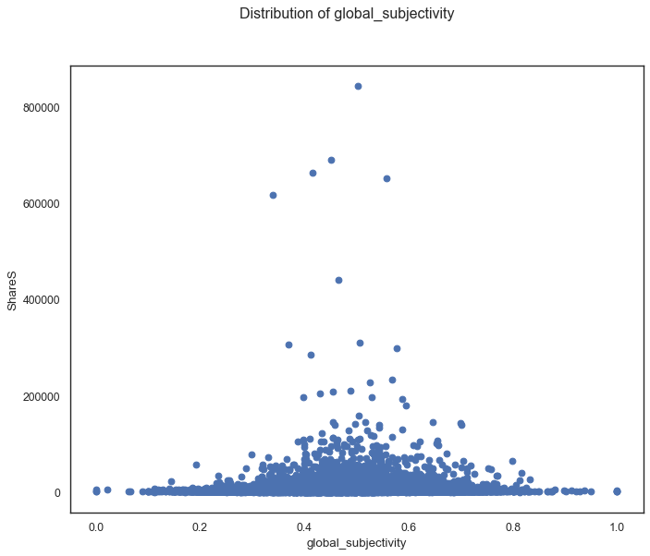
6. Global subjectivity effect on Popularity
Ranges from 0 to 1
Defines the ratio of subjectivity to objectivity in the text
Notes:
Maximum of global_subjectivity lies between 0.3 to 0.7. Hence, we conclude that most of the articles with medium global_subjectivity have maximum shares, that is popular articles contain a good blend of personal opinions and factual information.

Slide 19
EDA Conclusions
Publishing article on Weekend – Higher shares
Publishing in Social Media and technology – Higher Shares
Balancing personal opinions with facts – Higher Shares
Remaining neutral towards Content – Higher Shares
Number of Words in title to be between 10 – 18, not too long;
not too short.
Number of Words in content less than 0-2000. Short and catchy.

Slide 20
PREPROCESSING FOR MODELING
Dropping duplicates
Dropping missing values
Subset – time_delta and words in content
Dropping irrelevant columns
Correlation heatmap – feature elimination
Outlier Treatment: Outliers clipped at
Q1 – 1.5 IQR and Q3 + 1.5 IQR
Imbalanced scale of features – Log or Standard Scaler?
Standard scaler adopted
Notes:
Irrelevant columns like URL, timedelta
For the correlation heat map, we picked our threshold as 0.7 which seemed reasonable to remove variables that crossed this threshold. This helped avoid the problem of multicollinearity in the dataset.
We picked Standard Scaler over Log scaling because we had a few features with negative values. We also wanted to preserve the distribution of the features and none of the remaining features had right skewness that needed treatment

Slide 21
Feature Engineering
Logistic Regression model is built initially using all available features, and then feature selection is performed based on p-values to build another model without insignificant features. While there is no improvement in the R-squared or adjusted R-squared value after removing the insignificant features, the process demonstrates that the same variability in the response can be explained using fewer features. Furthermore, the pre-processing step includes removing correlated features, standard scaling, and using several classification algorithms with a 7:3 train-test split ratio.
• Datatype of the time_delta column is changed to DateTime datatype
• By using all data channel-related columns in dataset new column Data channel is
created
• By using all weekdays related columns in dataset new column publish_DOW (Day of week) is
created
• The values which have more than 0.7 correlation are deleted.

Slide 22
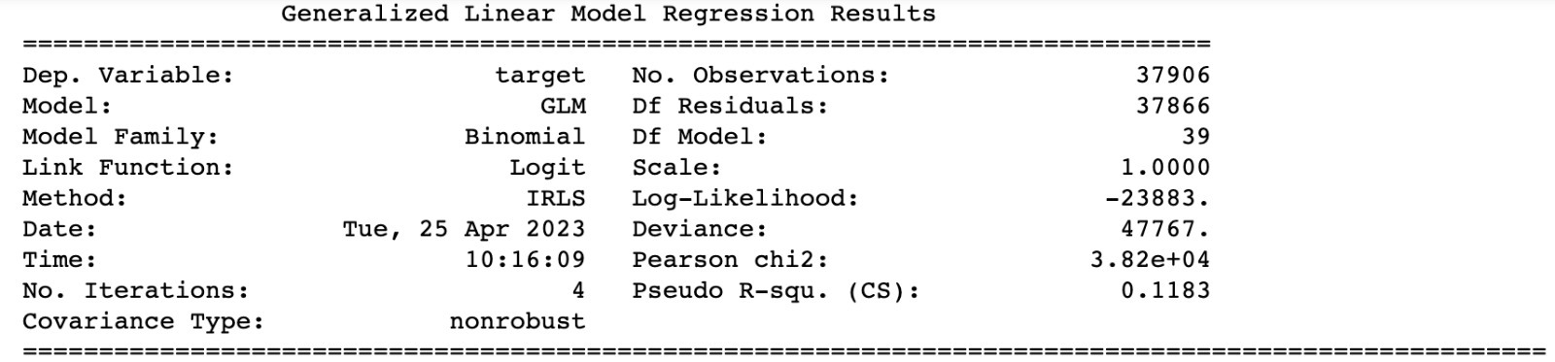
MODELLING
Stats library – Logit regression with all features
Notes:
Target variable ni all colms 11% explain chesthunai, p value <0.05

Slide 23
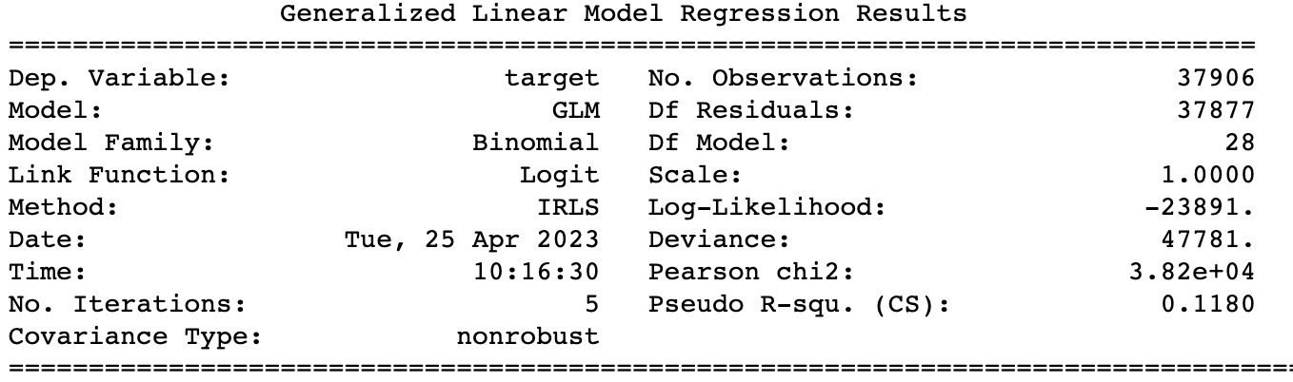
Stats library – Logit regression with only significant features
Notes:
P<0.05 col deletd and agan peformed log reg

Slide 24
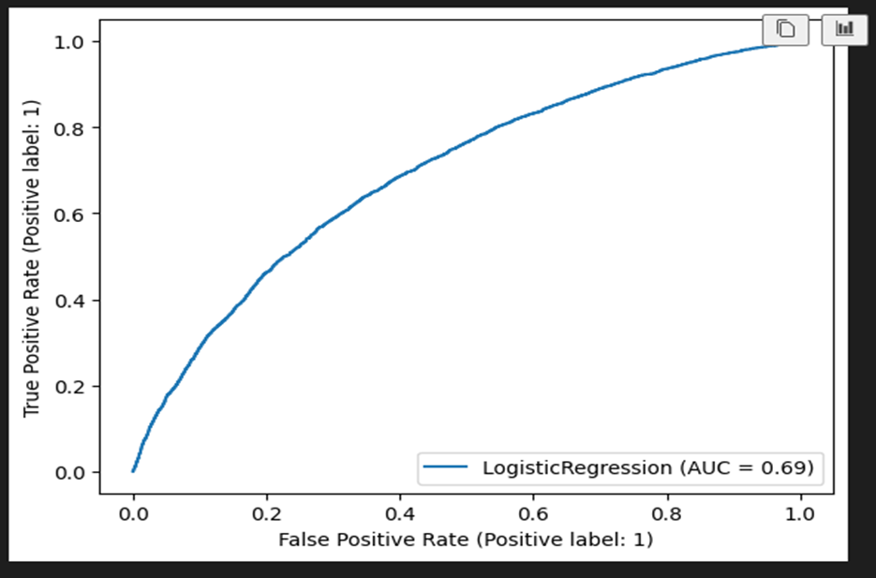
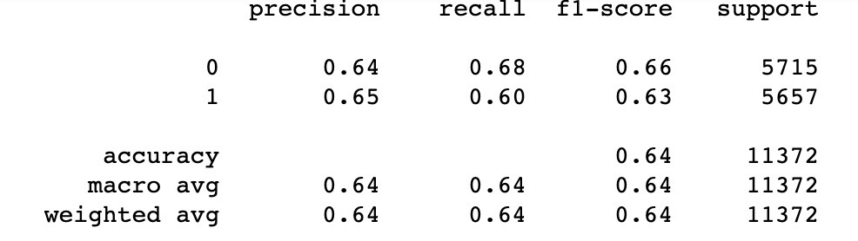
Logit Regression with Sklearn Library

Slide 25
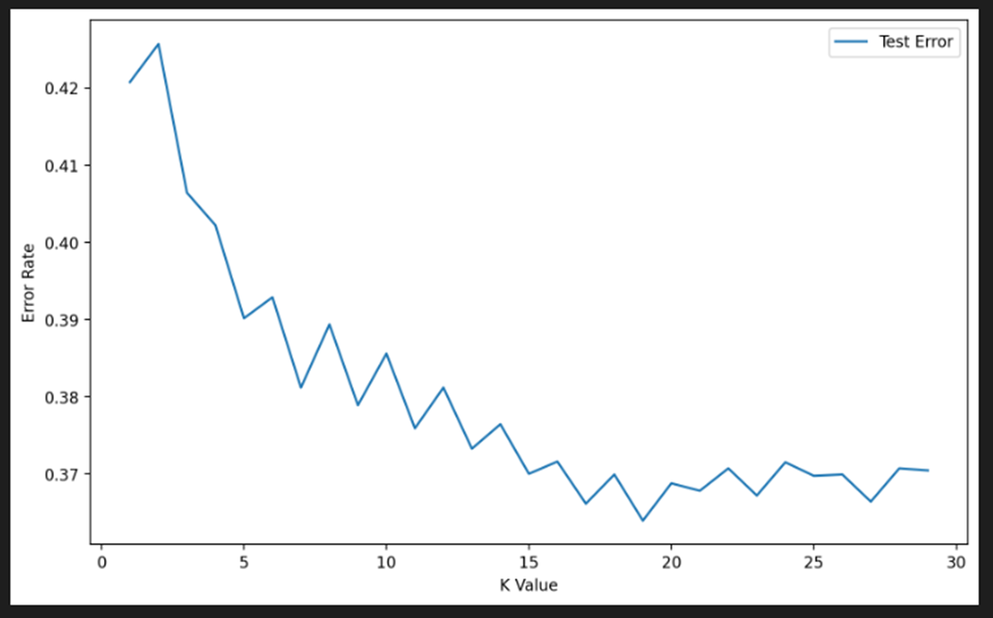
KNN
Choosing K value

Slide 26
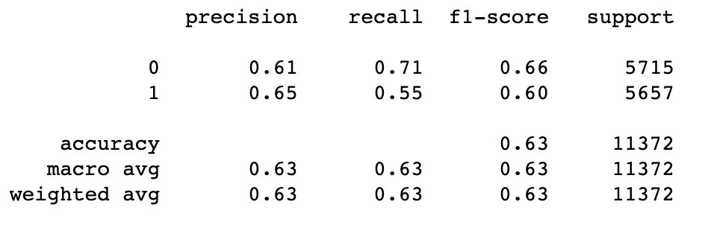
KNN
K = 17

Slide 27
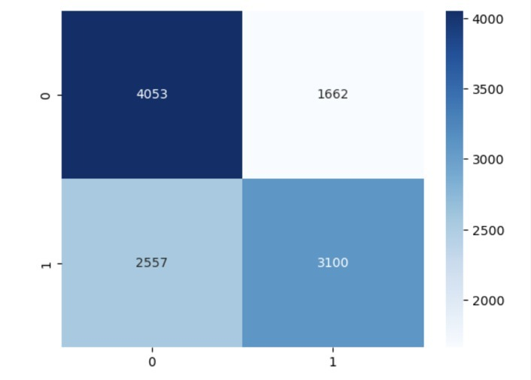
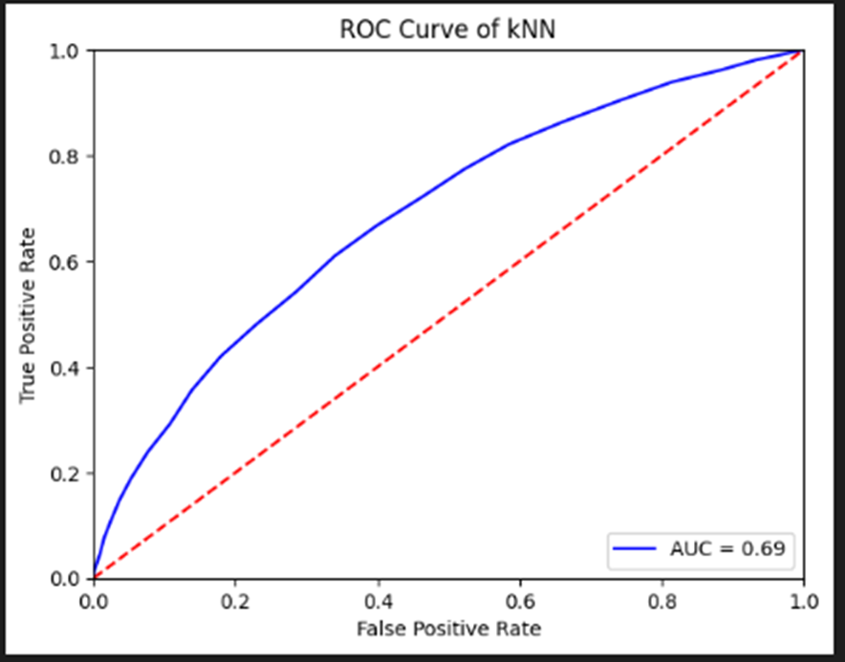
KNN- Confusion Matrix and ROC Curve

Slide 28
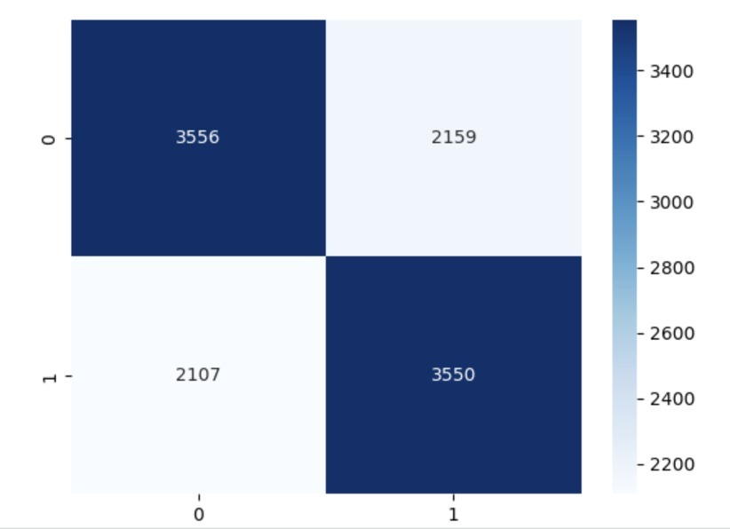
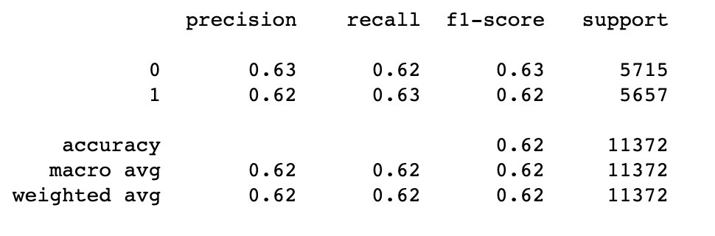
DECISION TREE

Slide 29
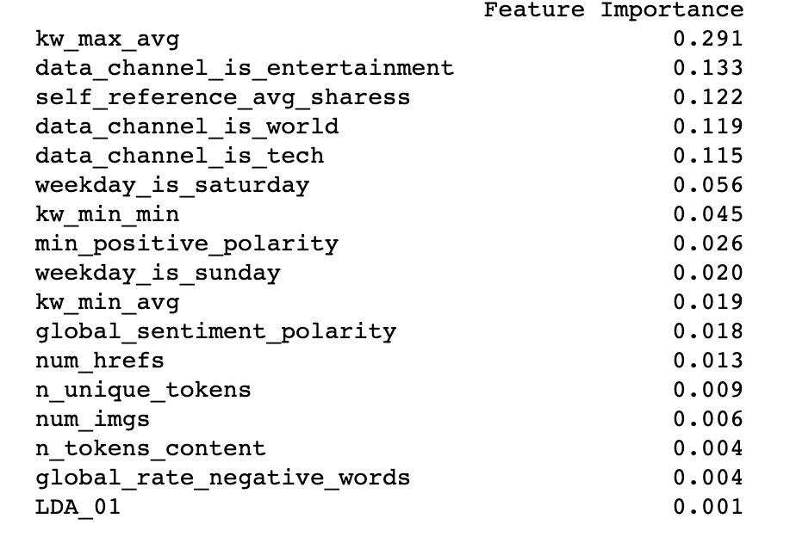
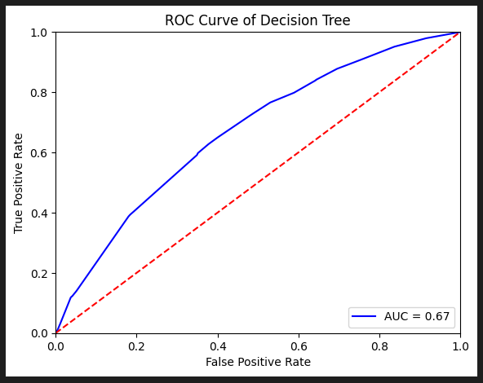
Feature Selection and ROC Curve

Slide 30
Pruning Decision Tree with features selection

Slide 31
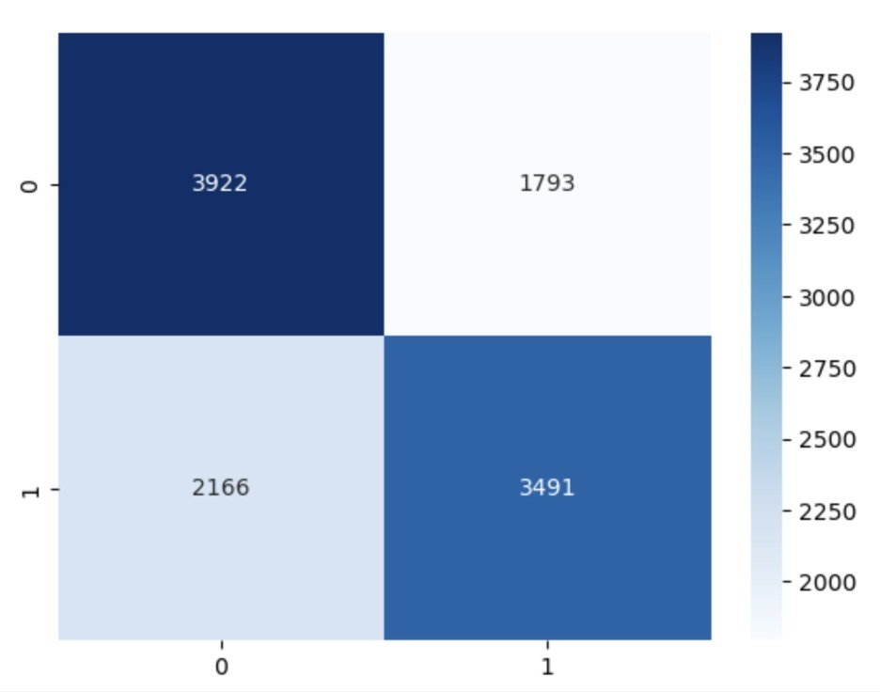
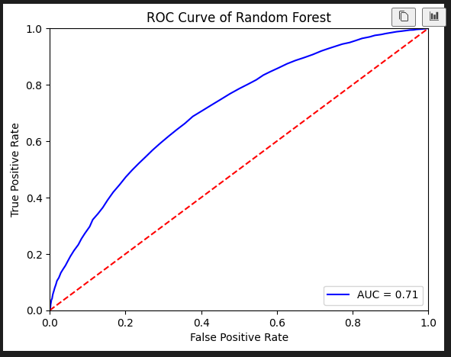
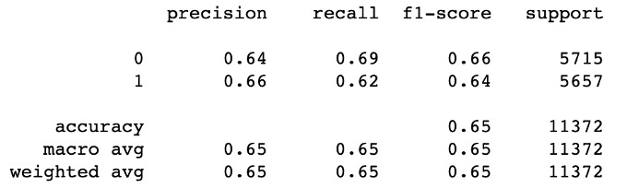
RANDOM FORREST

Slide 32
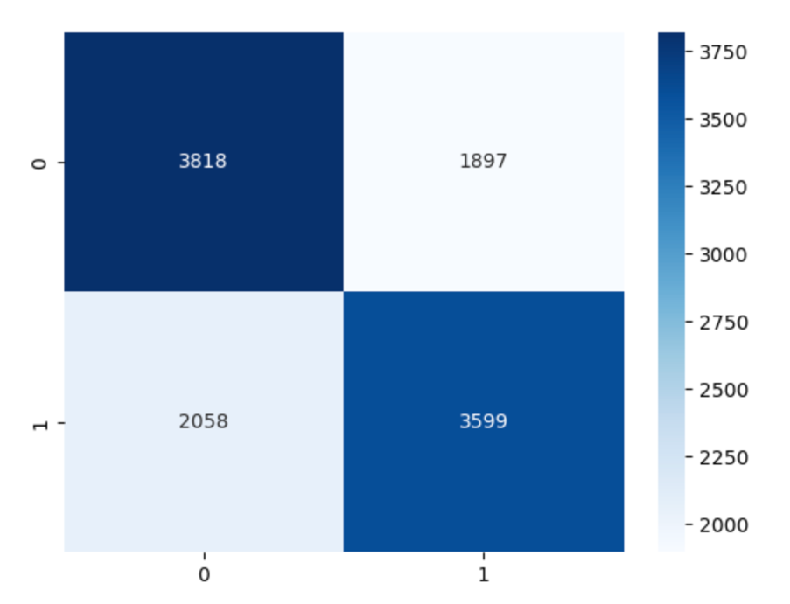
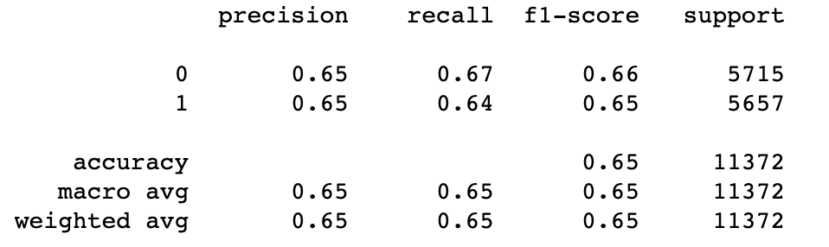
SVC

Slide 33
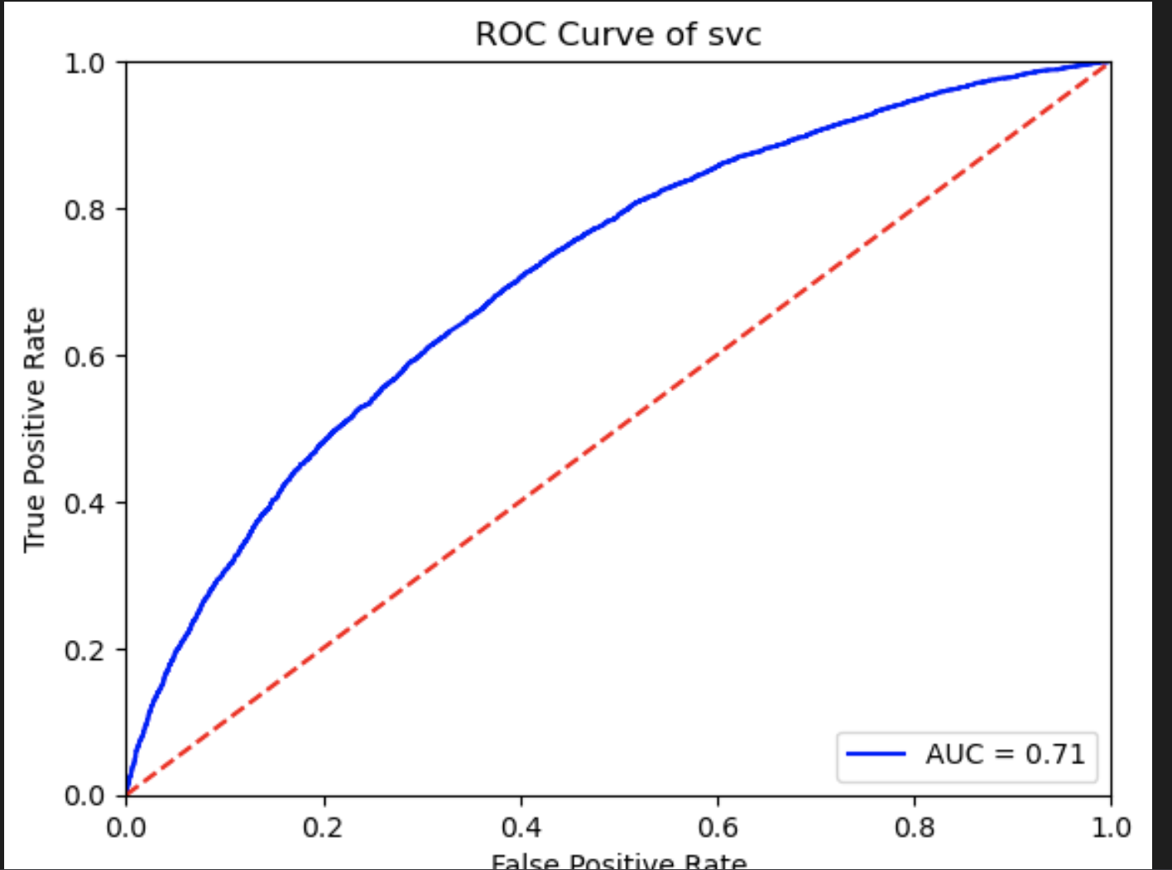
ROC curve for SVC

Slide 34
Model Conclusions
Random Forest and SVC gave the best results out of all the models in terms of accuracy.
The AUC for Random Forest and SVC was also the highest – 0.71, 21% greater than chance.

Slide 35
Future directions
Exploring deep learning models: Deep learning models, such as convolutional neural networks (CNNs) or recurrent neural networks (RNNs), can be used to extract more complex features from the data and capture the nonlinear relationships between the features and the target variable.
Incorporating external data sources: External data sources, such as social media or sentiment analysis data, can be incorporated into the analysis to improve the predictive accuracy of the models and capture additional contextual information..

Slide 36
THANK YOU

