Slide 1
Zen and the Art of Network Architecture
Larry Peterson

Slide 2
Zen and the Art of Motorcycle Maintenance
by
Robert Pirsig
Rejected by 121 publishers (World Record)
Classic v Romantic Perspectives
Rational vs Mystic
Analytical vs Intuitive
Science vs Art
Notes:
Western v Eastern

Slide 3
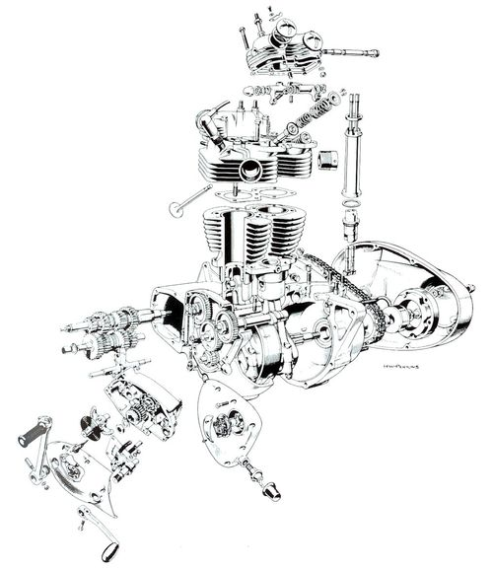
Classic View

Slide 4
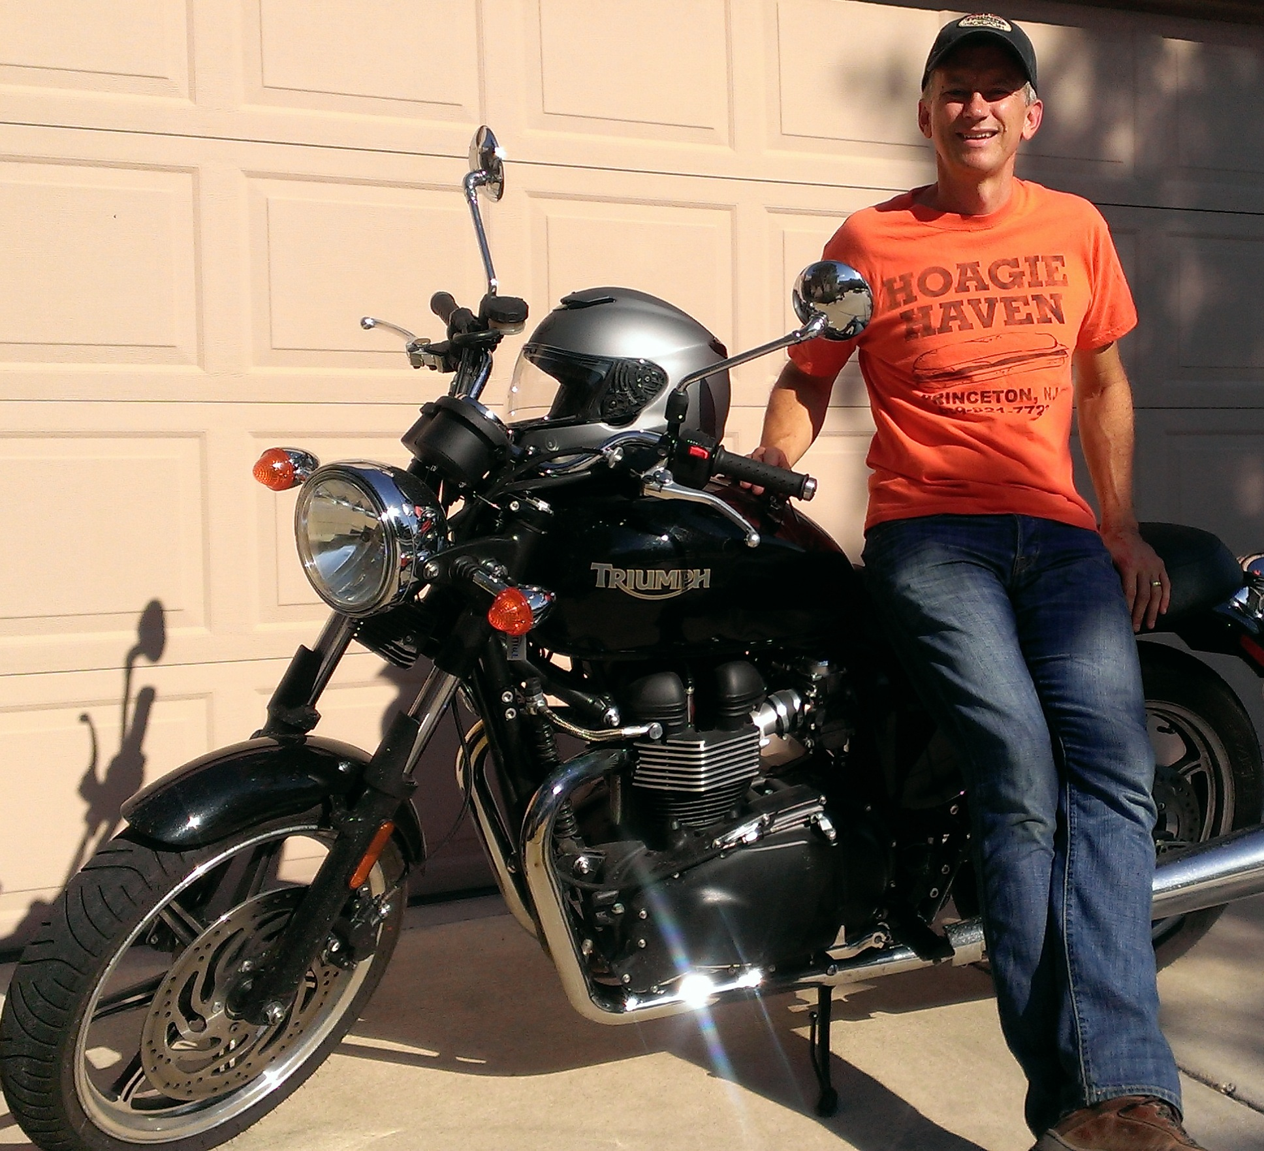
Romantic View

Slide 5
Quality
Unifies Classic and Romantic Perspectives
Whole is greater than the sum of the parts
More about potential than measurable value
Notes:
Unifies is my word… Gestalt
Quality is a “higher level” concept; can’t define quality in strictly Classic or Romantic terms.
It’s a hypothesis that can only be tested with time (Prisig – Hypothesis from Intuition)
Realize that’s a bit vague, so let me try to go deeper (but we’ll need to go deeper into Zen).

Slide 6
Buddhism’s First Noble Truth
Life is Suffering
Notes:
Suffering = Dissatisfaction, Anxiety; striving

Slide 7

Duality – Networking vs Distributed Systems
Notes:
Suffering = Dissatisfaction (if PL is good, then 100xPL must be better… it’s the American way)
Compute-Centric vs Communication-Centric

Slide 8
The Middle Way
Involves Both Analysis and Intuition
Balances Requirements*
Not about optimizing any one dimension
Seeks Unifying Abstractions
Accommodates both this and that
*GENI Design Principles. GDD-06-08. August 2006.
Identifies 11 requirements (dimensions) and offers
“rules” on resolving 7 inter-requirement tensions.
Notes:
Document you’ve never read, but you should. On my home page.

Slide 9

Path to Enlightenment
Notes:
Delusion. 8-way (principles, not steps)

Slide 10
Path to Enlightenment
Change the Market
Commercial Adoption
Market
Reality
Pilot Demonstrations
Customer
Reality
Ideas
Maturity
Deployment Studies
Traffic & User
Reality
Controlled Lab Experiments
Implementation
Reality
Analysis
Time
Notes:
Delusion.

Slide 11
PlanetLab & CoBlitz
Change the Market
?
Commercial Adoption
Sold to
Telcos
Pilot Demonstrations
Deployed in Telco
(served real events)
Ideas
Maturity
Deployment Studies
Ran on PlanetLab
(many iterations)
Controlled Lab Experiments
Micro Benchmarks
Analysis
Simulated
Algorithms
2002
Time
2014
Notes:
Both Platform and Service (Synergistic)

Slide 12
Change the Market
Operator CDNs…
Now incentives for CDN Interconnection (CDNI)
Virtualized Commodity Servers at the Edge…
Enables Network Function Virtualization (NFV)
Dovetails with (but distinct from) SDN
Notes:
And the cycle continues…

Slide 13
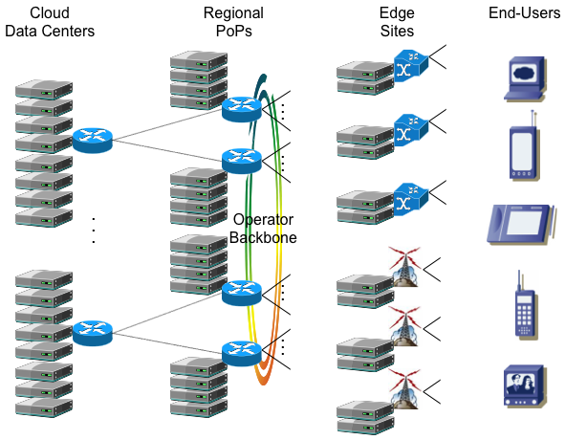
Commodity Servers in the Net

Slide 14
NFV Proof-of-Concept – with BT, Intel & HP –
Mgmt
VM
B-RAS
VM
B-RAS
VM
B-RAS
VM
B-RAS
VM
CDN
VM
...
Hypervisor
Core
0
Core
1
Core
2
Core
3
…
Core
8
Cores
9-11
10GE
4x10GE
Niantic NIC
10GE
Storage
Notes:
Now doing a second PoC focused on IPTV and another on enterprise services (middle boxes).
Each of the above are really the composition of multiple “functions” (HPC, RR) and (PPPoE & Radius)

Slide 15
Path to Enlightenment
See Reality Clearly – Assumptions hide the truth
Experience-Based – Users reveal hidden assumptions
Operationalize – The New Bar!
Deploy & Operate > Implement > Thought Experiment
Notes:
With the availability of IaaS, there’s no excuse…

Slide 16
Entropy
A Measure of Engineering’s Effect on Architecture
Natural part of the process
Design Principles*
Acknowledge the dynamic nature of systems
How Architecture Manifests
Represents the “fixed point” of an architecture
*Peterson and Roscoe. PlanetLab Design Principles. Operating Systems Review, 40(1):11-16, January 2006.
Identifies 13 design invariants to guide evolution.
Notes:
Joke about 2nd law of thermodynamics and 4 noble truths of Buddhism (impermanence).
2nd noble truth – the origin of suffering can be known
But engineers don’t read design documents!

Slide 17
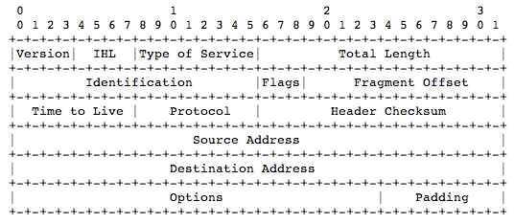
Manifestation of an Architecture
Circa 1981 (ASCII renderings of protocol headers)

Slide 18
Manifestation of an Architecture
Circa 2013 (Django Object Class Definition)
class Slice(PlCoreBase):
tenant_id = models.CharField(max_length=200, help_text="Keystone tenant id")
name = models.CharField(unique=True, help_text="The Name of the Slice", max_length=80)
enabled = models.BooleanField(default=True, help_text="Status for this Slice")
omf_friendly = models.BooleanField()
description=models.TextField(blank=True,help_text="High level description of the slice and expected activities", max_length=1024)
slice_url = models.URLField(blank=True, max_length=512)
site = models.ForeignKey(Site, related_name='slices', help_text="The Site this Node belongs too”)
tags = generic.GenericRelation(Tag)
serviceClass = models.ForeignKey(ServiceClass, related_name = "slices", null=True, default=ServiceClass.get_default)
creator = models.ForeignKey(User, related_name='slices', blank=True, null=True)

Slide 19
Lessons
Part Analysis, Part Intuition
Whole is greater than the sum of its parts
Unifying Abstractions
Duality is an opportunity
Balance Requirements
Not about optimizing a single dimension
Experience (Reality) Driven
Deploy It, Operationalize It, Use It
Dynamicity (Evolution) is the Norm
Define Principles and Invariants
Notes:
Speak to SIGCOMM community… Heard the “architecture” story before, worth repeating. But also the “operationalize” story.

Slide 20
This slide intentionally left blank
Notes:
This slide intentionally left blank. Clear your mind.

Slide 21
Putting Lessons to Action
Software Defined Networking (SDN)
Separating the Control and Data Planes
Network Function Virtualization (NFV)
Data plane functions running in VMs on commodity servers
Scalable Cloud Applications and Services (Apps)
Applications running on top of the network
Or… Finding the middle way for Open Networking Lab (ON.Lab) and the PlanetLab Consortium (PLC)

Slide 22
Distinctions without a Difference
Three implementation points for “network functions”
SDN, NFV, Apps
Blurring the SDN/Application Line
Is a proxy that cuts-through uninteresting flows a Controller?
Is a scalable Controller that uses a NoSQL DB an App?
Is a CDN that manages a caching hierarchy a Controller?
Blurring the NFV/Application Line
Is a proxy an example of NFV or is it an application?
Blurring the NFV/SDN Line
Is a firewall in the data plane or the control plane?
Notes:
Four observations… Culminating with a refactoring

Slide 23
Topology
Virtual Toplogy
(Big Switch)
Network Virtualization Layer
– Topology Isolation
– Address Space Isolation
– Semantic Isolation
Physical Topology
Notes:
Show a Big Switch virtual network

Slide 24
Topology Optimizations
F
F
Cut-Through
In-Line
F
Notes:
Start – Models an App.
Cut-Through – Behaves like a Controller
In-Line – Behaves like NFV

Slide 25
Scaling Functions
F
F
F
F
F
F
F
=
F
F
F
F
F
F
F
F
F
F
F
F
F
F
Interesting question: How to partition functions into DC and edge “subroutines”?
Notes:
Latency matters
Shared state matters
Sufficient resources matters

Slide 26
Refactoring the Space
Model all “network functions” as scalable services
Application vs Controller vs NFV distinction is arbitrary
Use SDN to bootstrap a virtualization layer that…
Isolates virtual networks from each other
Maps virtual topology to physical topology
Maintains this mapping in the presence of failures, etc.
Tunnels vs OpenFlow is an implementation choice
Supports a cut-through optimization (service hint)
NFV reduces to an implementation choice
Put function “in line” at the edge when appropriate

Slide 27
XaaS – Everything-as-a-Service
Service as a Unifying Abstraction
Unifies across resources (Compute, Network, Storage)
Unifies across the network (DC, WAN, Access)
Unifies across service levels (IaaS, PaaS, SaaS)
XOS – XaaS Operating System
Defines service as a first class object
Supports managing services, not servers
Supports seamless service extensions to XOS
Integrates service orchestration with resource provisioning
Supports both service isolation and service composition
Notes:
Talk about experiences, especially in top half

Slide 28
Service Abstraction
Provides a well-defined function
Exports a programmatic (REST) interface
Available network-wide (location independent)
Scalable, elastic, and resilient
Scales with the number of users (self-balancing)
Seamlessly grows/shrinks based on demand
Built out of unreliable components (self-healing)
Runs in a set of VMs connected by one or more VNs
Build new services by composing with existing services
Some are building blocks (NoSQL DB), some are user-facing (Facebook), and some are both (DropBox)
Notes:
Talk about experiences, especially in top half

Slide 29
Examples of Service Composition
CoBlitz: Operator CDN (Now Akamai Aura)
HyperCache (HPC)
Request Router (RR)
Intercept Service (IS)
Syndicate: Scalable Storage Service
Durability of Cloud Storage (S3, DropBox, Google Drive, Box)
Scalability of a CDN (HPC, RR)
Coherence of a Local FS (NoSQL DB – Google App Eng)
Third: Scalable Monitoring & Analytics Service
Distributed data collection, analysis, and archiving
Leverages Storm, Cassandra, RabbitMQ and ZooKeeper

Slide 30



Syndicate
Shared
Volume
UG
UG
Metadata
Service
(NoSQL DB)
UG
AG
Caches + Request Routers
(CDN)
Data Sets
RG
RG
RG
DropBox
S3
Local
NFS
Notes:
Emphasize value – but limitations – of existing resources: (1) R/W performance of local disk, (2) Scalable Read Bandwidth, (3) Persistent Storage, (4) popular data sets. Then introduce UG, RG, and AG, plus tied all together with (1) HTTP data plane and (2) MS. Results in shared/global volume.

Slide 31
Service Isolation/Composition
R
C
Internet
O
Clients
S
e.g., “Content Acquisition”
Network
M
Big Switch (Virtual Net)
F
Scalable Service “F”
Notes:
Not a linear path (arbitrary “calls”)
May also be “NFV annotations” on edge (switches)
SDN also gives me benefit within a service (e.g., migration, etc.)
“Internet” is redundant (it’s just a big switch)
May be internal-only switches (e.g., on left)
Topology (big switch) versus “power of set operations”

Slide 32
XOS
Cloud Management System (CMS)
XOS
(REST API + Data Model + Controller)
OSaaS
(Syndicate)
CaaS
(Nova)
NaaS
(Quantum)
IMaaS
(Keystone)
AaaS
(Third)
MaaS
MaaS
MaaS
MaaS
MaaS
MaaS
Node
Node
OvS
Libvirt
OvS
Libvirt
Notes:
Talk about IaaS and PaaS as convenient packages.

Slide 33
XOS Data Model
Service runs in one or more Slices
Extend data model with service-specific objects
Define “shim” so programs can access service from VMs
Slice is a resource container
Set of VMs + Set of VNs
Constraint-based VM placement
VMs added and deleted over time
VNs provide service isolation and composition
Each VN is…
A big switch that fully connects all VMs in Slice
Private or Public (routable)
Closed or Open (available for multiple slices to join)
Notes:
Eg, mount syndicate volume in a VM

Slide 34
Operationalizing OpenStack
Policies, Configurations and Workflows
that Codify Operational Practices* and Usage Models
OpenStack Components and Mechanisms
(Nova, Quantum, Keystone, Glance…)
*Understanding and Resolving Conflicts on PlanetLab. November 2008. Unpublished Note.

Slide 35
OpenCloud Pilot – Hardware
ViCCI
(5 SDN-Capable
Data Centers)
Internet2
(SDN-Capable
Backbone + ViNI)
PlanetLab
(500+ Sites, many
with campus SDN)

Slide 36
OpenCloud Pilot – Software
OpenCloud CMS
Dashboard
REST API
Effectively Defines XOS
– Codifies Operational Experience
– Explicit Support for XaaS
Data Model
Quantum
Keystone
Nova
OpenVirteX
Node
Node
OvS
Libvirt
OvS
Libvirt

Slide 37
Status
Near-term Development
Initial prototype of OpenCloud (XOS) running in the lab
Will deploy on operational system this fall
Deployment will include exemplar services
Integrating generalized Network Virtualization is next
Longer term research questions
What are the right abstractions to support XaaS?
How do XaaS and Software Routers “meet in the middle”?
How is functionality best split between DC and the edge?
What is the performance impact of service composition?
Notes:
Talk about experiences, especially in top half

Slide 38

Conclusions
I am indebted to many people, including…
Tom Anderson
Scott Baker
Andy Bavier
Sapan Bhatia
Mic Bowman
Brent Chun
David Culler
Bruce Davie
Jim Dolce
Serge Fdida
Marc Fuiczyski
John Hartman
Mike Hluchyj
Santosh Krishnan
David Lowenthal
Tony Mack
Rick McGeer
Nick McKeown
Steve Muir
Aki Nakao
Jude Nelson
Vivek Pai
KyoungSoo Park
Thierry Parmentelat
Guru Parulkar
Marcin Pilarski
Patrick Richardson
Timothy Roscoe
Scott Shenker
Stephen Soltesz
David Tennenhouse
Siobhan Tully
Michal Wawrzoniak

