Slide 1


SIMPLE-fying Middlebox Policy Enforcement Using SDN
Zafar Ayyub Qazi
Cheng-Chun Tu
Luis Chiang
Vyas Sekar
Rui Miao
Minlan Yu
Notes:
Hello everyone, I am Zafar, Today I will be talking about how we can simplify middlebox management using Software Defined networking. This is a joint work with collaborators from Stony Brook university and university of southern California.

Slide 2
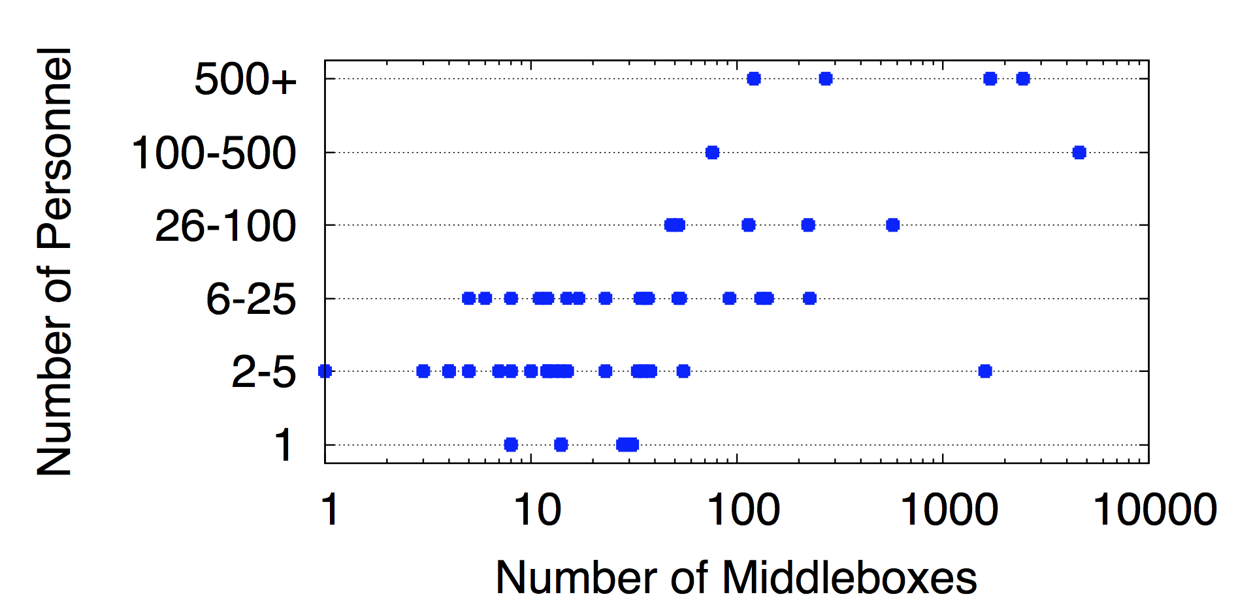
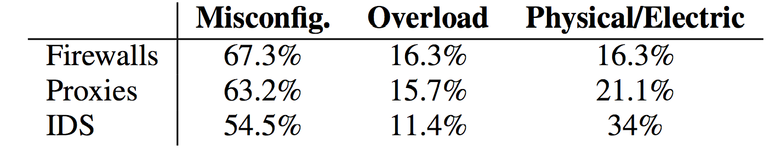
Middleboxes management is hard!
Survey across 57 network operators (J. Sherry et al. SIGCOMM 2012)
e.g., a network with ~2000 middleboxes required 500+ operators
Critical for security, performance, compliance
But expensive, complex and difficult to manage
Notes:
Middleboxes are widely used today to meet security, performance and compliance requirements. Even though they are a critical piece of the network infrastructure, there are expensive, complex and difficult to manage. A survey across 57 network operators showed that middlebox management is complex as significant manual effort is required for configuring them, as a result middleboxes are prone to failures due to misconfiguration and overload.

Slide 3
Can SDN simplify middlebox management?
Centralized Controller
Web
Firewall
IDS
Proxy
OpenFlow
“Flow” | FwdAction
… | …
“Flow” | FwdAction
… | …
Proxy
IDS
Scope: Enforce middlebox-specific steering policies
Necessity + Opportunity:
Incorporate functions markets views as important
Notes:
SDN on the other hand offers a promising alternative by using logically centralized management, decoupling of the data and control planes, and providing the ability to programmatically configure forwarding rules. In the scope of this work, we specifically consider the question that can we simplify middlebox-specific policy enforcement using SDN.
This problem is also interesting because it provides both a necessity and an opportunity for SDN. It’s a necessity for SDN because in order to justify deployment into production networks it needs to incorporate functionalities that are viewed as important by the market. Its an opportunity because SDN has focused on L2/L3 tasks and middlebox requires higher layer functionalities.

Slide 4
What makes this problem challenging?
Centralized Controller
Web
Firewall
IDS
Proxy
OpenFlow
“Flow” | FwdAction
… | …
“Flow” | FwdAction
… | …
Proxy
IDS
Middleboxes introduce new dimensions beyond L2/L3 tasks.
Achieve this with unmodified middleboxes and existing SDN APIs
Notes:
There are two key aspects which makes this problem challenging.
One middleboxes introduce new dimensions that fall outside the scope of L2/L3 has traditionally focused on.
One traditionally SDN has focused on L2/L3 tasks, however middleboxes require higher layer functionalities which introduce new dimensions
Second, we already have a large number of middlebox deployments and middlebox implementations are proprietary in nature which makes it difficult to change middleboxes. We also want to use existing SDN APIs, whose minimalism has been a key driver for the adoption of SDN.

Slide 5

Our Work: SIMPLE
Web
Firewall
IDS
Proxy
Policy enforcement layer for
middlebox-specific “traffic steering”
Flow | Action
… | …
Flow | Action
… | …
Legacy
Middleboxes
OpenFlow
capable
Notes:
In order to address these challenges, we present a policy enforcement layer called SIMPLE. SIMPLE translates middlebox-specific policies into rules that can be installed on SDN switches while ensuring that load across middleboxes is balanced.

Slide 6
Outline
Motivation
Challenges
SIMPLE Design
Evaluation
Conclusions
6
Notes:
Next we discuss in-detail the challenges in the management of middleboxes in SDN.

Slide 7
Challenge: Policy Composition
*
Firewall
IDS
Proxy
Policy Chain:
Firewall
Proxy
IDS
Oops! Forward Pkt to IDS or Dst?
S1
S2
Dst
“Loops” Traditional flow rules may not suffice!
Notes:
Typically middlebox policies require packets to traverse through a sequence of middleboxes. For instance, consider this example, where given this network of two switches and 3 middleboxes, we want to route all traffic through the policy chain Firewall-IDS-Proxy. To enforce this policy chain, the path that the packet should traverse has a loop. This is because switch S2 sees multiple instances of the same packet on the same interface.
As a result when the packet reaches switch S2, it cannot determine whether to forward the packet to an IDS or the destination.
As result traditional flow rules may not suffice to ensure correct forwarding in such scenarios.

Slide 8
Challenge: Resource Constraints
Firewall
Proxy
Space for
traffic split?
S2
S4
S1
S3
IDS1 = 50%
IDS2 = 50%
Can we set up “feasible” forwarding rules?
Notes:
There are two key resource constraints here: middlebox processing constraint and limited TCAM space in SDN switches. Middleboxes involve complex processing to capture application level semantics or use deep packet inspection. In order to avoid scenarios of middlebox overload its important to balance the load across middleboxes. For instance in this network, we may want to spilt the load evenly across the two IDs. However when we split the traffic, each split needs to have forwarding rules to route the traffic to the correct physical middleboxes.
In summary, besides the middlebox resource constraints, we also have to with switch TCAM space constraints.

Slide 9
Challenge: Dynamic Modifications
User1: Proxy → Firewall
User2: Proxy
Proxy may modify flows
User 1
Proxy
S1
S2
User 2
Firewall
Are forwarding rules at S2 correct?
Notes:
Many middleboxes actively modify traffic headers and packet contents. To ensure that correct policies are enforced, we need to handle these transformations. Lets consider this example scenario, where we have a proxy receiving requests for the same content from two users. The proxy may combine these two requests and send it out as one packet. As the proxy modifies the flow, we need ensure that correct forwarding rules are installed in S2 to handle these transformations.

Slide 10
New dimensions beyond Layer 2-3 tasks
1) Policy Composition → Potential loops
2) Resource Constraints → Switch + Middlebox
3) Dynamic Modifications → Correctness?
Can we address these with unmodified middleboxes and existing SDN APIs?
Notes:
We have discussed three challenges in using SDN to simply middlebox management:
Policy composition: enforce a policy that dictates that middleboxes route through a sequence of middleboxes.
Resource constraints: while doing middlebox load balancing we need to take into account TCAM space in SDN switches.
Many middleboxes dynamically modify flows, for correct routing of packets, these transformations should be taken into account.
In summary, we observe that middleboxes introduce new challenges that fall outside the scope of L2/L3 tasks.

Slide 11
Outline
Motivation + Context for the Work
Challenges
SIMPLE Design
Evaluation
Conclusion
Notes:
To address these challenges we have designed a SIMPLE, a SDN-based policy enforcement layer for efficient middlebox-specific “traffic steering”. SIMPLE addresses these challenges without modifying the existing SDN APIs and without modifying middleboxes and without requiring an visibility into the internal state of middleboxes.

Slide 12
SIMPLE System Overview
Web
Firewall
IDS
Proxy
Resource Manager
Modifications Handler
Rule Generator
Flow | Action
… | …
Flow | Action
… | …
Legacy
Middleboxes
OpenFlow
capable
Notes:
SIMPLE takes as input the middlebox specific policies corresponding to different traffic classes given a network of legacy middleboxes and SDN switches.
Simple consists of a resource manger for load balancing across middleboxes subject to the middlebox and forwarding table capacity constraints, a modifications handler to account for dynamic middlebox induced transformations and the rule generator which enforces policy composition and outputs rules that can be installed in SDN switches using OpenFlow protocol.

Slide 13
Composition → Tag Processing State
*
Firewall
IDS
Proxy
Policy Chain:
Firewall
Proxy
IDS
Fwd to Dst
S1
S2
Post-Firewall
Dst
Post-Proxy
ORIGINAL
Post-IDS
Insight: Distinguish different instances of the same packet
Notes:
In order to address the first challenge of policy composition, we introduce processing tags, which keep track of the processing state of the packet and help to disambiguate different instances of the same packet on the same switch interface. For instance in this example, S2 could not determine whether to forward packets to the IDS or destination using simple flow rules. However, now as the packet traverses a middlebox, the connected switch adds a tag to encode this information. The corresponding rules in the switches now take into account the state information encoded by the tag to take a forwarding decision. We can use an spare bits in IP header to encode this information.

Slide 14
SIMPLE System Overview
Web
Firewall
IDS
Proxy
Resource Manager
Modifications Handler
Rule Generator
Flow | Action
… | …
Flow | Action
… | …
Legacy
Middleboxes
OpenFlow
capable
Notes:
Next we discuss the Resource manager which balances the load across middleboxes while ensuring that TCAM space constraints in SDN switches are not exceeded.
Drop the details of physical sequences discussion slide 19.

Slide 15
Resource Constraints→ Joint Optimization
Topology & Traffic
Middlebox
Capacity + Footprints
Switch
TCAM
Policy
Spec
Resource Manager
Optimal & Feasible
load balancing
Theoretically hard!
Not obvious if some configuration is feasible!
Notes:
The goal of the resource manager is to do optimal and feasible load balancing.
The key challenge in the resource manager is the need to account for both the middlebox constraints and the flow table capacity of SDN switches. This makes the problem significantly more challenging compared to prior optimization models for middlebox load balancing. Unfortunately, this optimization problem is theoretically hard and is practically inefficient to solve for realistic scenarios

Slide 16
Offline + Online Decomposition
Policy
Spec
Network
Topology
Switch
TCAM
Mbox Capacity
+ Footprints
Traffic
Matrix
Resource Manager
Offline Stage
Online Step
Deals with Switch constraints
Deals with only load balancing
Notes:
We handle this challenge by decomposing the optimization into two parts: (1) a slow offline stage where we tackle the switch constraints and (2) an online linear program formulation that only deals with load balancing. The offline pruning stage only needs to run when the network topology, switches, middlebox placements, or the network policy changes. The online load balancing stage runs more frequently when traffic patterns change on shorter timescales.

Slide 17
Offline Stage: ILP based pruning
Feasible
Sufficient freedom
Set of all possible middlebox load distributions
Pruned Set
Balance the middlebox load
Notes:
In the offline stage, we prune the set of all physical sequences of middleboxes given all the policy chain, ensuring that the pruned set of physical sequences are feasible i.e., all policy chains will have at least one physical sequence and secondly there is sufficient freedom to ensure that there arre ample load balancing opportunities.

Slide 18
SIMPLE System Overview
Web
FW
IDS
Proxy
Resource Manager
Modifications Handler
Rule Generator
Flow | Action
… | …
Flow | Action
… | …
Legacy
Middleboxes
OpenFlow
capable
Notes:
Next, we discuss how we handle dynamic packet transformations induced by certain middleboxes.

Slide 19
Modifications → Infer flow correlations
Correlate
flows
Install rules
Payload Similarity
User 1
Proxy
S1
S2
User 2
Firewall
User1: Proxy → Firewall
User2: Proxy
Notes:
In order to handle the dynamic transformations we correlate the incoming and outgoing flows from a middlebox.
For example, in this network, we collect the first few packet of the incoming and outgoing flow from the proxy, then using payload similarity based algorithm to correlate these flows. Then we can install correct forwarding rules in the downstream switches which enforce the desired policy.

Slide 20
SIMPLE Implementation
Web
FW
IDS
Proxy
Resource Manager
(Resource Constraint)
CPLEX
Modifications Handler
(Dynamic modifications)
Rule Generator
(Policy Composition)
POX extensions
OpenFlow 1.0
Flow | Tag/Tunnel | Action
… |  | …
Flow | Tag/Tunnel | Action
… |  | …
Notes:
We implement SIMPLE as an extension to the POX controller. And we use openflow 1.0 protocol for talking to the controller.
Note: Although we use OpenFlow 1.0, SIMPLE can use any other versions.
Tunneling, we do other optimizations

Slide 21
Outline
Motivation + Context for the Work
Challenges
SIMPLE Design
Evaluation
Conclusion
Notes:
Next, we describe how we evaluate the performance of SIMPLE and the evaluation results.

Slide 22
Evaluation and Methodology
What benefits SIMPLE offers? load balancing?
How scalable is the SIMPLE optimizer?
How close is the SIMPLE optimizer to the optimal?
How accurate is the dynamic inference?
Methodology
Small-scale real test bed experiments (Emulab)
Evaluation over Mininet (with up to 60 nodes)
Large-scale trace driven simulations (for convergence times)
Notes:
There are a diverse set of measures that we use to evaluate SIMPLE’s performance.
We evaluate the benefits that SIMPLE offers in terms of flexibility in middlebox placement by improving middlebox load balancing. We compare these with today’s ingress based middlebox deployments, where middleboxes closed to the ingress are selected as well as the optimal. How quickly it reacts to middlebox failure and traffic overload. We measure the time in configuring a network using SIMPLE and how close it is to the optimal. The accuracy in handling dynamic transformations.
To evaluate these measures, we use a combination of evaluation in Emulab and Mininet (for large topologies) and trace driven simulations (for running optimizations on large network traces). Due to the lack of publicly available information on network topologies and middlebox-related policy, we use network topologies from past work.
Given the time constraints, I am going to focus on SIMPLE’s Scalability and optimality

Slide 23
Benefits: Load balancing
Optimal
4-7X better load balancing and near optimal
Notes:
We compare SIMPLE with today’s ingress-based middlebox deployments, where for each ingress-egress pair, the middleboxes closest to the ingress are selected. The y-axis shows the maximum middlebox load compared to the optimal. A load close to 1 is equal to the optimal. We see that besides 4-7X better load balancing as compared to the ingress based solution, we also see that SIMPLE is very close to the optimal.
Public available educational backbones
Rocket Fuel and enterprise, consolidate mB
How middleboxes are dsitrbuted? Randomly, arbitrarily?

Slide 24
Overhead: Reconfiguration Time
33 node topology including 11 switches
Around 125 ms to reconfigure, most time spent in pushing rules
Notes:
The time that it takes to reconfigure rules using SIMPLE is given here for a topology consisting of 33 nodes including 11 switches. (Internet2).
It takes around 125ms to reconfigure and most of that time is consumed in updating the rules at the switches.
This is 4-5 orders of magnitude faster than naïve optimization solution, where we simply run an ILP to find an optimal load balancing solution.
For some large topologies it takes a day.

Slide 25
Other Key Results
LP solving takes 1s for a 252 node topology
4-5 orders of magnitude faster than strawman
95 % accuracy in inferring flow correlations
Scalability of pruning: 1800s → 110s

Slide 26
Conclusions
Middleboxes: Necessity and opportunity for SDN
Goal: Simplify middlebox-specific policy enforcement
Challenges: Composition, resource constraints, modifications
SIMPLE: policy enforcement layer
Does not modify middleboxes
No changes to SDN APIs
No visibility required into the internal of middleboxes
Scalable and offers 4-7X improvement in load balancing
Notes:
The goal of this work was to determine whether we can use SDN to simplify the management of middleboxes.
We observed that there are three main challenges in using SDN for middleboxes. These are policy composition, middlebox and TCM constraint in SDN switches, dynamic modifications induced by many middleboxes.
Somewhat surprisingly we show that these challenges can be addressed using existing SDN APIs and without modifying middleboxes. We design SIMPLE, a policy enforcement layer for middlebox specific traffic steering. We show that it provides4-7X improvement over today’s middlebox deployments.
This work is an initial attempt to integrate middleboxes in SDN. There are interesting future directions. For instance, in our ongoing work, we are investigating how the our dynamic handler we can deal with encrypted traffic
Practical and offers benefits.
We find that

Slide 28
Decompose Optimization: Slow Offline + Fast Online Steps
Rule
Model
Traffic
Matrix
Mbox
Capacity
Policy
Spec
Enumerate
Physical
Sequences
Prune for
Feasible
Configs
LP with PrunedSet
PrunedSet
Network
Topology
Offline Pruning
Online Load Balancing
Notes:
In order to efficiently solve the optimization problem, we decompose the problem into a slow offline stage and fast online step.
Offline stage that tackles the switch constraints
An online step runs a linear program that only deals with load balancing.
In the offline stage given a set of logical chains, we select a subset of the available physical sequences that will not violate the switch capacity constraints. The offline pruning stage only needs to run when the network topology, switches, middlebox placements, or the network policy changes. The online load balancing stage runs more frequently when traffic patterns change on shorter timescales.

Slide 29
Enumerating Physical Sequences
Proxy1
Policy Chains
Firewall
IDS
Proxy
FW1
10.1/16, HTTP → *
S2
S4
S1
S5
S3
S6
FW2
IDS1
 | Physical Sequence
FW1-IDS1-Proxy1 | S1 S2 FW1 S2 S4 S5 IDS1 S5 S4 S2 Proxy1 S2 S4 S5 S6
FW2-IDS1-Proxy1 | S1 S3 FW2 S3 S5 IDS1 S5 S4 S2 Proxy1 S2 S4 S5 S6
29

