Slide 1
Linux 操作说明
为完全没有接触过 Linux 的同学准备的简易说明

Slide 2
命令提示符
user@ubuntu:~$
~：当前工作目录

Slide 3
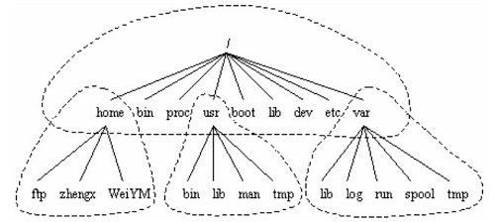
Linux 目录结构
/：根目录（root）
~：主目录（home）
一般等价于 /home/<your_user_name>

Slide 4

ls - list directory contents
Usage:
ls [option]...
Options:
-a do not hide entries starting with .
-l use a long listing format
显示颜色：
蓝色-目录；绿色-可执行文件；红色-压缩文件

Slide 5
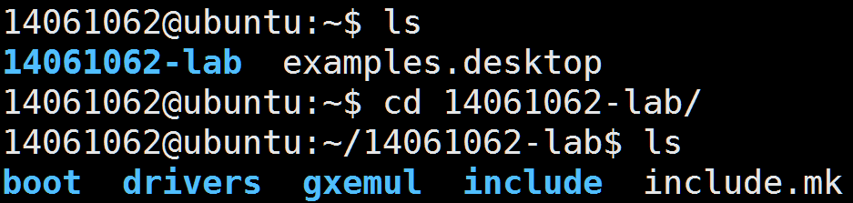
cd - change working directory
Usage:
cd [path]
e.g.
cd . Change to current working directory
cd .. Change to parent directory

Slide 6
cat - concatenate files and print
Usage:
cat [option]... [file]...
Options:
-n show line number

Slide 7
source - execute commands in file
Usage:
source filename
. filename
If filename does not contain a slash, files in PATH would be searched first.
The file need not be executable.

Slide 8
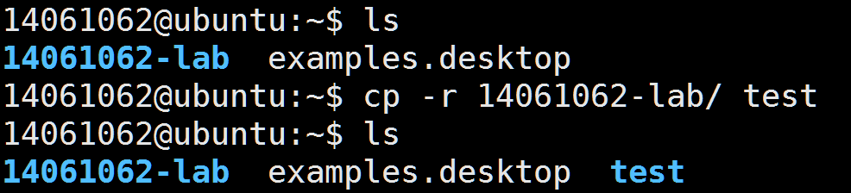
cp - copy files and directories
Usage:
cp [option]... source... directory
Options:
-r copy recursively

Slide 9
mv - move / rename files
Usage:
mv source... directory

Slide 10
rm - remove files or directories
Usage:
rm [option]... file...
Options:
-r remove directories and their contents recursively
-f ignore nonexistent files, never prompt
e.g.
rm -rf testdir

Slide 11
mkdir - make directories
Usage:
mkdir directory...

Slide 12
rmdir - remove empty directories
Usage:
rmdir directory...

Slide 13
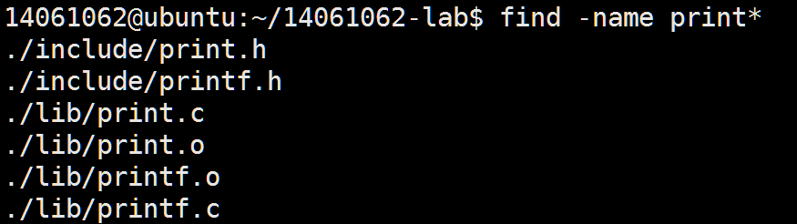
find - search for files in a directory hierarchy
Usage:
find -name filename

Slide 14
grep - print lines matching a pattern
Usage:
grep pattern file...
e.g.
grep print lib/*

Slide 15
passwd - change user password
Usage:
passwd

Slide 16
man - manual
Usage:
man page
e.g.
man ls

Slide 17
常用快捷键
Ctrl+C 终止当前程序的执行
Ctrl+Z 挂起当前程序

