Slide 1

IP子网规划

Slide 2
本章目标
通过本章学习，您应该掌握以下内容：
十、二、十六进制之间的相互转换
掌握IP地址分类，子网掩码的作用，识别网络号、子网的数目、可用的主机数目
掌握VLSM和CIDR的概念
Notes:
Purpose: This figure states the chapter objectives.
Emphasize: Read or state each objective so each student has a clear understanding of the chapter objectives.

Slide 3
十进制和二进制的转换
128 64 32 16 8 4 2 1
1 0 0 0 0 0 0 0 = 128
1 1 0 0 0 0 0 0 = 192
1 1 1 0 0 0 0 0 = 224
1 1 1 1 0 0 0 0 = 240
1 1 1 1 1 0 0 0 = 248
1 1 1 1 1 1 0 0 = 252
1 1 1 1 1 1 1 0 = 254
1 1 1 1 1 1 1 1 = 255
Notes:
Purpose: This figure explains how subnet masks are converted to decimal addresses.
Emphasize: Review binary-to-decimal conversion, bit weighting, and conversion.
Explain logical AND.
One possible explanation of logical AND follows: We will need to be able to perform a logical AND on the binary numbers. Just take two binary numbers and place one above the other. The ones in the bottom are like a pipe—the number above it just drops through. The zeros are like a clogged pipe, so nothing comes out in the answer.
Presenting a truth table will help some students understand. You might need to give more than one explanation.
Note: You might want to hand out a binary-to-decimal conversion sheet if you have not already done so. We have not included one in the lab section. It is more useful to have one that is on a separate page from the labs.

Slide 4
IP 地 址
32 bits
Dotted
Decimal
Network
Host
255
255
255
255
Maximum
Notes:
Layer 1 of 3:
Purpose: This figure show the general format of an IP address.
In layer 1, the address is 32 bits with a network and host portion.

Slide 5
IP 地 址
32 bits
Dotted
Decimal
Network
Host
255
255
255
255
Maximum
1
8
9
16
17
24
25
32
11111111
11111111
11111111
11111111
Binary
128
64
32
16
8
4
2
1
128
64
32
16
8
4
2
1
128
64
32
16
8
4
2
1
128
64
32
16
8
4
2
1
Notes:
Layer 3 of 3:
In layer 2, one can convert the address to binary.

Slide 6
IP 地 址
32 bits
Dotted
Decimal
Network
Host
255
255
255
255
Maximum
1
8
9
16
17
24
25
32
11111111
11111111
11111111
11111111
Binary
128
64
32
16
8
4
2
1
128
64
32
16
8
4
2
1
128
64
32
16
8
4
2
1
128
64
32
16
8
4
2
1
Example
Decimal
172
16
122
204
10101100
00010000
01111010
11001100
Example
Binary
Notes:
Layer 3 of 3:
In layer 3, an example of dotted-decimal format and binary are displayed.
Emphasize: IP address format is dotted-decimal. Dotted-decimal makes it easy to work with IP addresses. However, in this course we will work with the addresses on the bit level, so we will convert these addresses into binary, make changes to them, and convert them back.
The central authority for addresses is the Internet Assigned Numbers Authority.
Note: This most common form of addressing reflects the widely used IP version 4. Faced with the problem of depleting available addresses, Internet Engineering Task Force (IETF) work is under way for a backward-compatible next generation of IP (IPng, also called IP 6).
IP 6 will offer expanded routing and addressing capabilities with 128-bit addresses rather than the 32-bit addressing shown on the graphic. Addresses from both IP versions will coexist. Initial occurrences will probably be at locations with address translator software and firewalls.

Slide 7



IP 地址分类
8 bits
8 bits
8 bits
8 bits
Class A:
Class B:
Class C:
Class D: 多播地址
Class E: 科研用
Notes:
Purpose: This graphic describes the three most common classes of IP address.
Emphasize: Discuss classes of addresses. Each address contains information about the network number and the host number of the device. Class A addresses are for very large organizations. Class B addresses are for smaller organizations, and Class C addresses for even smaller ones.
As the number of networks grows, classes may eventually be replaced by another addressing mechanism, such as classless interdomain routing (CIDR). RFC 1467, Status of CIDR Deployment in the Internet, presents information about CIDR. RFC 1817, CIDR and Classful Routing, also presents CIDR information.

Slide 8
IP 地址分类
1
8
9
16
17
24
25
32
Bits:
0NNNNNNN
Host
Host
Host
Class A:
范围 (1-126)
1
8
9
16
17
24
25
32
Bits:
10NNNNNN
Network
Host
Host
Class B:
范围 (128-191)
1
8
9
16
17
24
25
32
Bits:
110NNNNN
Network
Network
Host
Class C:
范围 (192-223)
1
8
9
16
17
24
25
32
Bits:
1110MMMM
Multicast Group
Multicast Group
Multicast Group
Class D:
范围 (224-239)
Notes:
Emphasize: Highlight the fixed values that start each class address.
The first octet rule states that when an address falls into a specified range, it belongs to a certain class. Students should soon be able to recognize the address class of any IP address on sight.
Note: If time or interest permits, you can use the initial bit patterns in the first octet and show how a class of IP network derives the range of network numbers for that IP address class.

Slide 9
特殊IP地址
一些特殊的IP 地址:
1.IP 地址127.0.0.1:本地回环(loopback)测试地址
2.广播地址:255.255.255.255
3.IP 地址0.0.0.0:代表任何网络
4.节点号全为1:代表该网段的所有主机
广播地址TCP/IP 协议规定：主机号部分各位全为1 的IP 地址用于广播.所谓广播地址指同时向网上所有的主机发送报文。
如136.78.255.255 就是B 类地址中的一个广播地址,你将信息送到此地址,就是将信息送给网络号为136.78 的所有主机.

Slide 10
私有IP地址
私有IP地址:
1.A 类地址中:10.0.0.0 到10.255.255.255
2.B 类地址中:172.16.0.0 到172.31.255.255
3.C 类地址中:192.168.0.0 到192.168.255.255

Slide 11
计算一个网络号中
可用的主机地址
网络
主机
172 16 0 0
N
10101100
00010000
00000000
00000000
1
16
15
14
13
12
11
10
9
8
7
6
5
4
3
2
1
00000000
00000001
2
00000000
00000011
3
...
...
...
11111111
11111101
65534
11111111
11111110
65535
11111111
11111111
65536
-
2
2^{N}-2 = 2¹⁶-2 = 65534
65534
Notes:
Purpose: This figure explains how to calculate the number of available hosts in a network.
Emphasize: 2^{N}-2 is the calculation to determine available hosts. N is the number of binary digits in the host field. Subtract 2 because a host cannot be all 0s or 1s.
The same principal applies when determining the number of available networks.

Slide 12
IP地址分类练习
地址
类别
网络
主机
10.2.1.1
128.63.2.100
201.222.5.64
192.6.141.2
130.113.64.16
256.241.201.10
Notes:
Layer 1 of 2:
Purpose: This exercise verifies that the students understand IP address classes, network numbers, and host numbers.
Give the students time to list the address class, network, and host number for each IP address in the table. Review the correct answers interactively.
The answers are given in the following figure.

Slide 13
IP地址分类练习（答案）
地址
类别
网络
主机
10.2.1.1
A
10.0.0.0
0.2.1.1
128.63.2.100
B
128.63.0.0
0.0.2.100
201.222.5.64
C
201.222.5.0
0.0.0.64
192.6.141.2
C
192.6.141.0
0.0.0.2
130.113.64.16
B
130.113.0.0
0.0.64.16
256.241.201.10
Nonexistent
Notes:
Layer 2 of 2:
Purpose: This answers to the exercise are given in the figure.
Note: Students can also find the answers to this exercise in the “Answers” appendix.

Slide 14
子网划分的好处
1.缩减网络流量
2.优化网络性能
3.简化管理
4.更为灵活地形成大覆盖范围的网络

Slide 15


不设子网的地址
172.16.0.1
172.16.0.2
172.16.0.3
172.16.255.253
172.16.255.254
…...
172.16.0.0
网络 172.16.0.0
Notes:
Purpose: This figure explains what networks look like without subnets.
Without subnets, use of network addressing space is inefficient.
The Class B network is like a highway with no exits—there is no place to exit, so all of the traffic is in one line.

Slide 16

设置子网的地址
172.16.3.0
172.16.4.0
172.16.1.0
172.16.2.0
网络 172.16.0.0
Notes:
Purpose: This figure describes network structure when subnets are used.
Emphasize: The host bits of an IP address can be subdivided into a subnetwork section and a host section. The subnetwork section in this example is the full third octet.
Point out the difference in the addressing between the previous slide and this slide.
A subnetted address space is like a highway with exits.
A network device uses a subnet mask to determine what part of the IP address is used for the network, the subnet, and the device ID.
A subnet mask is a 32-bit value containing a number of one bits for the network and subnet ID and a number of zero bits for the host ID.
Given its own IP address and subnet mask, a device can determine if an IP packet is destined for 1) a device on its own subnet, 2) a device on a different subnet on its own network, or 3) a device on a different network.
A device can determine what class of address the device has been assigned from its own IP address. The subnet mask then tells the device where the boundary is between the subnet ID and the host ID.

Slide 17
缺省情况下的子网掩码
网络
主机
172.16.2.160
10101100
00010000
00000010
10100000
255.255.0.0
11111111
11111111
00000000
00000000
10101100
00010000
00000000
00000000
网络号
172
16
0
0
缺省情况下子网未划分
Notes:
Purpose: This graphic explains how routers use addresses that have no subnet mask.
Emphasize: Explain how masking works at the bit level. Zero bits mask host information.
Note: This is an easy place to lose students. At this point, they need to learn several abstract mathematical concepts before we can show them how to lay out an IP-addressed network. To the novice these techniques may seem unrelated, making the presentation confusing. To a more experienced audience, these techniques will be familiar.

Slide 18
子网地址
172.16.2.200
172.16.3.5
172.16.3.1
E1
172.16.2.2
E0
172.16.3.100
172.16.2.1
172.16.2.160
172.16.3.150
新路由表
172.16
网络
端口
.
2
.
160
网络
主机
172.16.0.0
172.16.0.0
E0
E1
Notes:
Layer 1 of 2:
Purpose: This figure shows what would happen if there were no subnetting.
Emphasize: If networks could not be broken down into more granular, subnetworks few networks could exist, each with a capacity for many hosts.

Slide 19
子网地址
172.16.2.200
172.16.3.5
172.16.3.1
E1
172.16.2.2
E0
172.16.3.100
172.16.2.1
172.16.2.160
172.16.3.150
新路由表
172.16
网络
端口
.
2
.
160
网络
子网
主机
172.16.2.0
172.16.3.0
E0
E1
Notes:
Layer 1 of 2:
Emphasize: By turning on more bits in the mask, we reserve some bits as network information and can use these bits to describe subnetworks.
Describe how the router makes use of this technique. Point out that there is more information in the routing table now.
Note: As you enter the discussion about subnet masks, a question might arise about whether it is legal to define a discontiguous subnet mask. A discontiguous subnet mask consists of intervening zeros, as in 101111011000, rather than all ones followed by zeros, as in 1111111100000000. The question has two answers. According to RFC 950 that describes IP, a discontiguous subnet mask is legal. However, the hardware expense to produce an interface that supports discontiguous masking is cost-prohibitive. Thus in practice it is not supported on most vendors’ equipment, including Cisco. Also, discontiguous masking has no benefit, and it is much more difficult to maintain a network based on this design. Later RFCs make noncontiguous subnet masks illegal because they are incompatible with future addressing schemes such as CIDR.

Slide 20
子网划分的核心思想
“借用”主机位来“制造”新的“网络”

Slide 21
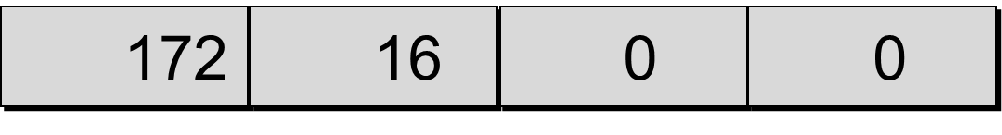
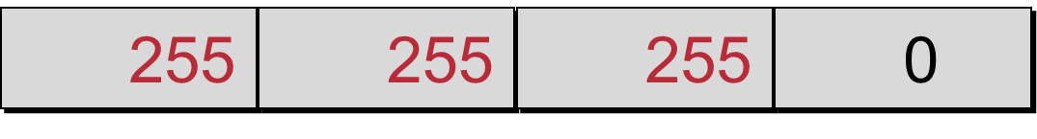
子网掩码
Network
Host
IP
Address
Network
Host
Default
Subnet
Mask
255
255
0
0
11111111
11111111
00000000
00000000
“/16” 表示子网掩码有16位.
Network
Subnet
Host
8-bit
Subnet
Mask
“/24”表示子网掩码有24位.
Notes:
A:/8
10.0.0.0 255.0.0.0>10.0.0.0/8
172.16.0.0 255.255.0.0>172.16.0.0/16

Slide 22
利用子网掩码划分子网
网络
子网
主机
172.16.2.160
10101100
00010000
00000010
10100000
255.255.255.0
11111111
11111111
11111111
00000000
10101100
00010000
00000010
00000000
128
192
224
240
248
252
254
255
网络号
172
16
2
0
扩展了8位地址的网络
Notes:
Purpose: This figure shows how the router determines an address when subnetting is used.
Emphasize: This example makes a Class B address space look like a collection of Class C address spaces.
Now the logical AND allows us to extract the subnet number as well as the assigned network number.
An exercise follows that tests the students’ understanding of subnet masks.

Slide 23
利用子网掩码划分子网
网络
子网
主机
172.16.2.160
10101100
00010000
00000010
10100000
255.255.255.192
11111111
11111111
11111111
11000000
10101100
00010000
00000010
10000000
128
192
224
240
248
252
254
255
128
192
224
240
248
252
254
255
网络号
172
16
2
128
扩展了10位地址的网络
Notes:
Purpose: This figure shows how the router determines an address when subnetting is used.
Emphasize: This example is different from the previous example in that the the subnet and host are divided within an octet.
Transition: An exercise follows that tests the students’ understanding of subnet masks.

Slide 24
划分子网方法
划分子网方法:
1.你所选择的子网掩码将会产生多少个子网?:2 的x次方(x 代表掩码位数)
2.每个子网能有多少主机?: 2 的y 次方-2(y 代表主机位数)
3.有效子网是?:有效子网号=256-10 进制的子网掩码(结果叫做block size 或base number)
4.每个子网的广播地址是?:广播地址=下个子网号-1
5.每个子网的有效主机分别是?:忽略子网内全为0 和全为1 的地址剩下的就是有效主机地址.

Slide 25
C类地址子网划分例子
网络地址192.168.10.0;子网掩码255.255.255.192(/26)
1.子网数=2*2=4
2.每个子网中的可用主机数=2 的6 次方-2=62
3. 有效子网?:block size=256-192=64，所以：
第一个子网为192.168.10.0
第二个子网为192.168.10.64
最后一个子网为192.168.10.192
4.广播地址:下个子网-1，所以：
第一个子网的广播地址是192.168.10.63
第二个子网的广播地址是192.168.10.127
最后一个子网的广播地址是192.168.10.255
5.有效主机范围是：第一个子网的主机地址是192.168.10.1 到192.168.10.62;第二个是192.168.10.65 到192.168.10.126;最后一个是192.168.10.193到192.168.10.254

Slide 26
B类地址子网划分例子1
例子1:网络地址:172.16.0.0;子网掩码255.255.192.0(/18)
1.子网数=？
2.主机数=？ （2 的14 次方=16384）
3.有效子网号？
4.广播地址？
5.有效主机范围是？

Slide 27
B类地址子网划分答案1
例子1:网络地址:172.16.0.0;子网掩码255.255.192.0(/18)
1.子网数：2的2次方=4
2.主机数：2 的14 次方=16384-2=16382
3.有效子网号？ 网络号增量为：256-192=64
4.广播地址？
5.有效主机范围是？
网络号 广播地址
172.16.0.0 172.16.63.255
172.16.64.0 172.16.127.255
172.16.128.0 172.16.191.255
172.16.192.0 172.16.255.255

Slide 28
B类地址子网划分例子2
B 类地址例子2:网络地址:172.16.0.0;子网掩码255.255.255.224(/27)
1.子网数=? (2 的11 次方=2048)
2.主机数=?
3.有效子网号?
4.广播地址?
5.有效主机范围是?

Slide 29
B类地址子网划分答案2
B 类地址例子2:网络地址:172.16.0.0;子网掩码255.255.255.224(/27)
1.子网数：2 的11 次方=2048
2.主机数： 2 的5 次方-2=30
3.有效子网号? 网络号增量为：256-224=32
4.广播地址?
5.有效主机范围是?
网络号
172.16.0.0 172.16.1.0
172.16.0.32 172.16.1.32
172.16.0.64 172.16.1.64
。。。。。。 。。。。。
172.16.0.224 172.16.1.224

Slide 30
变长子网掩码（VLSM）
变长子网掩码(Variable-Length Subnet Masks,VLSM)的出现是打破传统的以类(class)为标准的地址划分方法,是为了缓解IP 地址紧缺而产生的
作用:节约IP 地址空间;减少路由表大小.
注意事项：使用VLSM 时,所采用的路
由协议必须能够支持它,这些路由协议包括RIPv2,OSPF,EIGRP 和BGP.

Slide 31
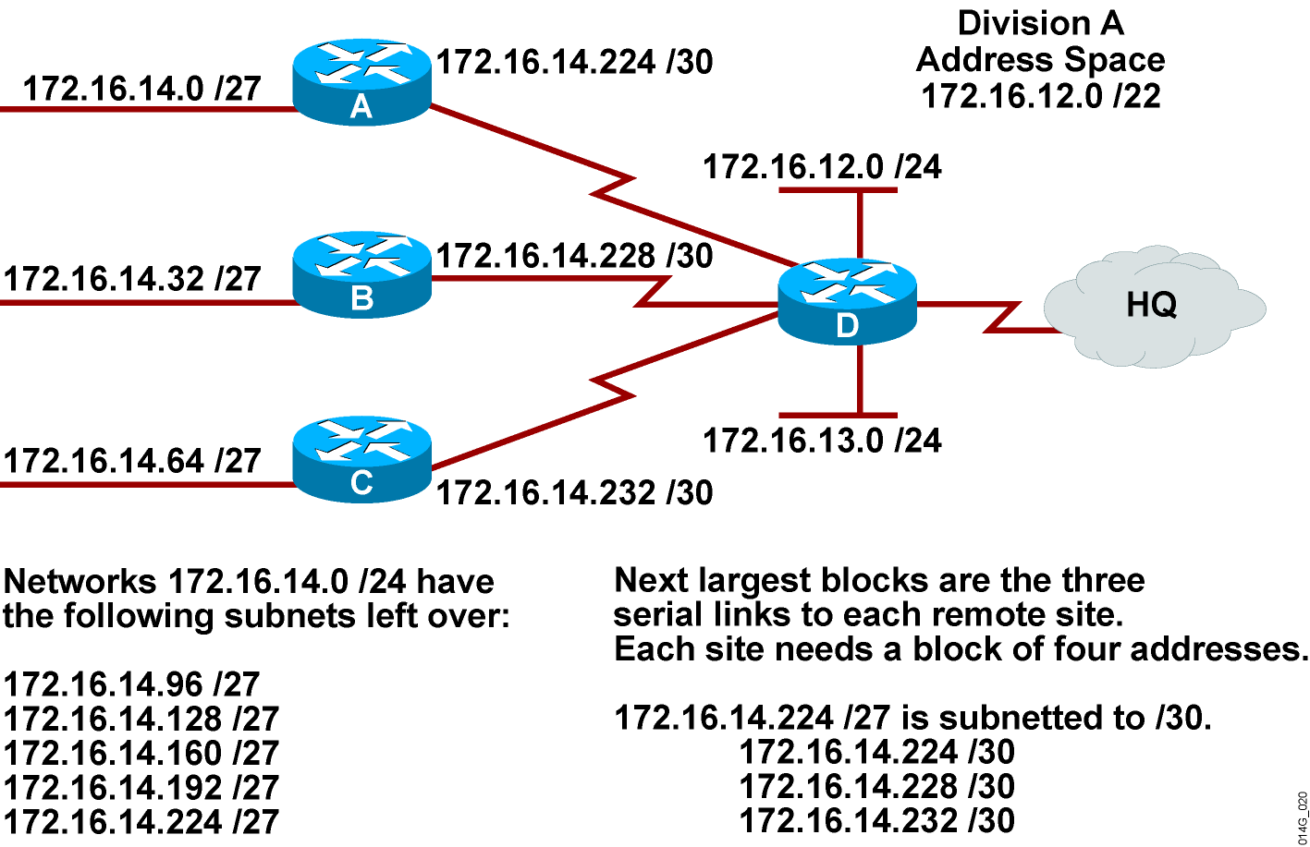
VLSM的实现(5)

Slide 32
无类域间路由 (CIDR)
CIDR的概念：忽略A、B、C类网络的规则，定义前缀相同的一组网络为一个块，即一条路由条目。（如：199.0.0.0/8）

Slide 33
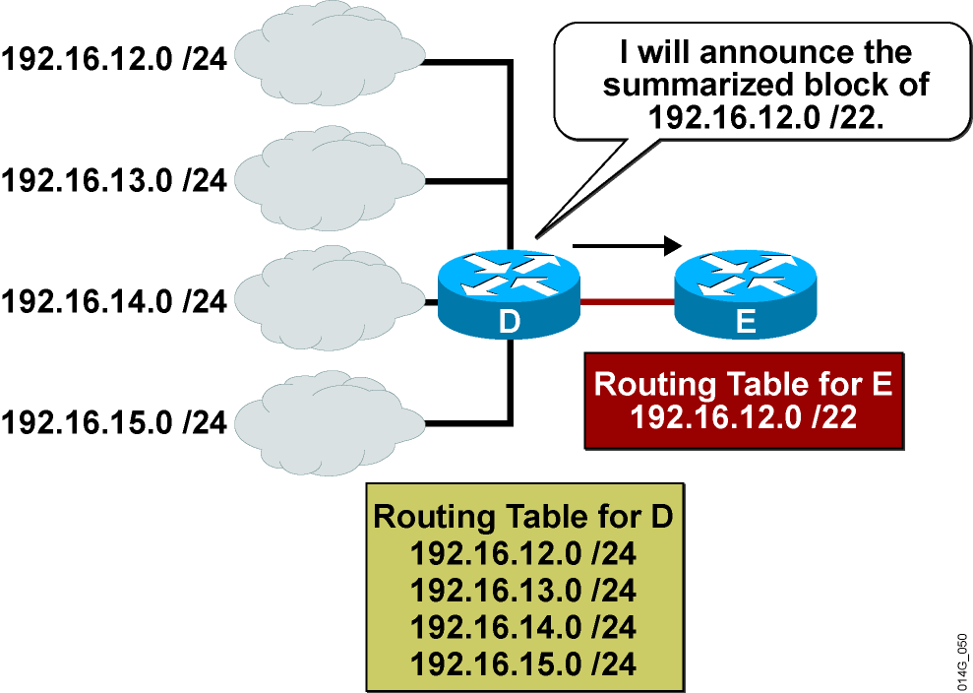
CIDR例子

Slide 34
CIDR的优点
减少了网络数目，缩小了路由选择表
从网络流量、CPU和内存方面说，开销更低
对网络进行编址时，灵活性更大

Slide 35
练习
192.168.8.0/24
192.168.9.0/24
192.168.10.0/24
192.168.11.0/24
192.168.12.0/24
192.168.13.0/24
192.168.14.0/24
192.168.15.0/24
172.16.32.0/24
。。。。。。
172.16.63.0/24

Slide 36
答案
192.168.8.0/24
192.168.9.0/24
192.168.10.0/24
192.168.11.0/24
192.168.12.0/24
192.168.13.0/24
192.168.14.0/24
192.168.15.0/24
192.168.8.0/21 255.255.248.0
（超网）
172.16.32.0/24
。。。。。。
172.16.63.0/24
172.16.32.0/19 255.255.224.0

